Slide 1
The highs and lows of building an adtech data pipeline
Dan Goldin
@dangoldin

Slide 2
Agenda
Data in adtech
The evolution
Lessons learned

Slide 3
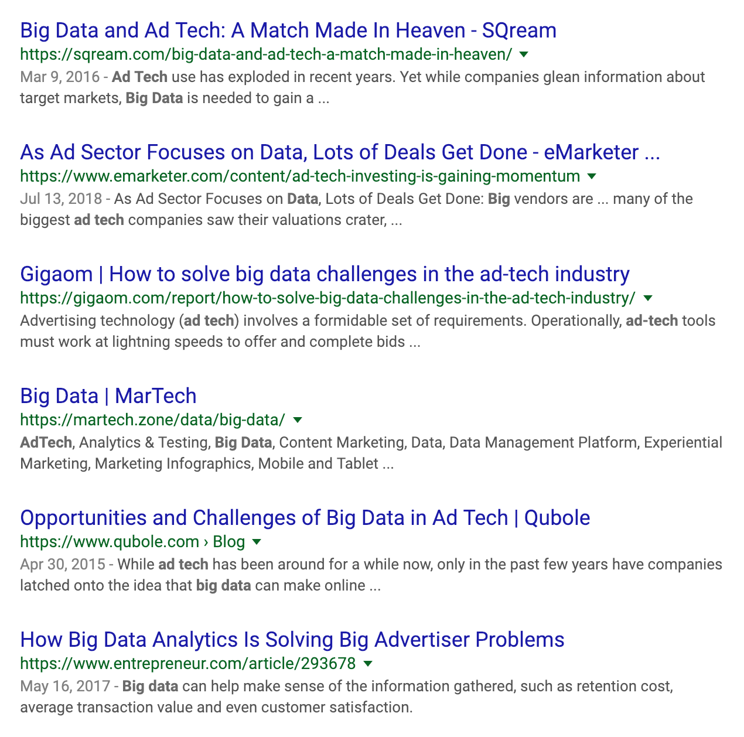
Data in adtech

Slide 4
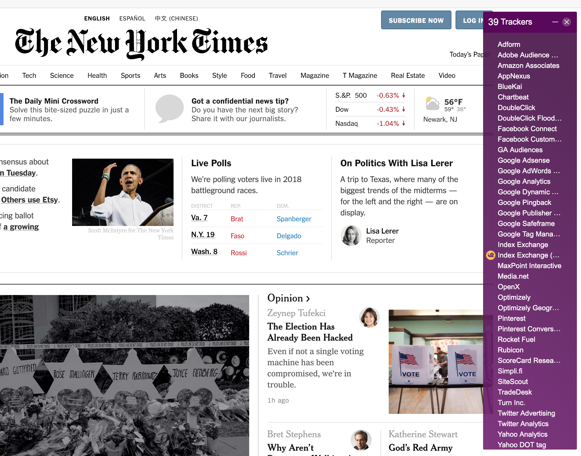
Data in adtech

Slide 5
Why all this data? Where does it go?

Slide 6

Photo courtesy of Sotheby’s

Slide 7


Real time bidding
2
1
4
3
Browser send an ad request to an exchange
Exchange sends unique ad requests to Demand-Side Platforms (DSPs)
DSPs respond with ads and bids
Exchange determines winner and sends that to the browser
And all this happens within 200 hundred ms - literally faster than a blink of an eye.

Slide 8
Data at each step
2
1
5
4
3
Ad request: Geography, device, time
Bid request: DSP augmented requests
Bid response: Bid amount, ad information, brand
Creative response: Winner, price
Engagement metrics: Render, click, mouseover, video events

Slide 9
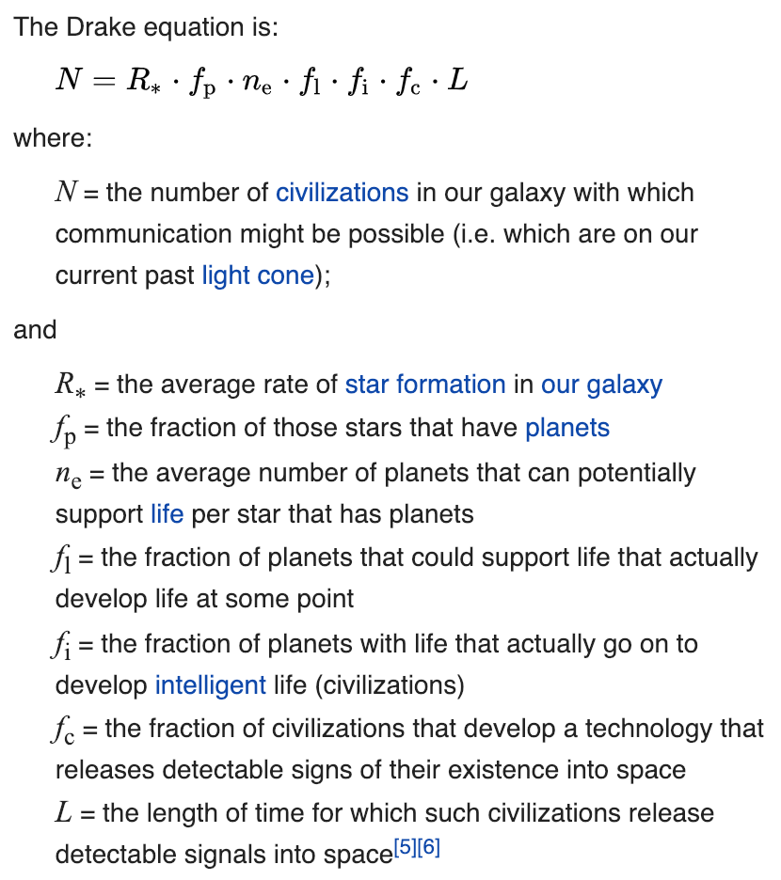
Why does any of this matter?
High cardinality: ~50 dimensions
High volume: ~4B ad requests/day
Low value: Average request revenue is tiny - less than a thousandth of a penny
Notes:
Key point is that it’s high scale but needs to be cheap

Slide 10
4B Ad Requests/Day
300k Kafka messages/sec
13M unique aggregate rows/hour
140B Bid Requests/Day
50MB/sec into Kafka
30 min data processing delay
43 Kafka topics
270MB/sec out of Kafka
36GB stored in Druid/day

Slide 11
The evolution

Slide 12



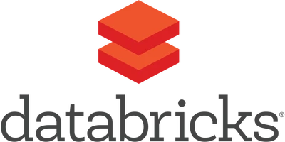





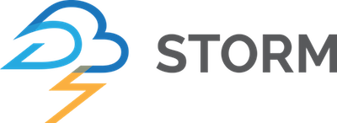
Before we begin: What is a data pipeline?
Events
Processing
Storage
Access
Individual event stream
Apply business rules and combine the events
Store the results of the process to optimize access
Allow customers to access and interact with the data
Notes:
We’ll use this framework going forward but keep in mind it’s not as black and white. There’s overlap between them.

Slide 13
v0: Can’t believe we did this
Implementation “Highlights”
Reduce volume via client side sampling
  if (Math.random() < 0.1) { … }
Have a node.js application that does mini aggs in memory and writes the results to MySQL every few minutes
Separate daily job to do rollup within MySQL
Sample browser events
Simple node.js application
MySQL
API/UI
Events
Processing
Storage
Access
Notes:
Purposefully v0 since it doesn’t deserve a real version.

Slide 14
v0: Can’t believe we did this
Simple to get something up and running
Cheap and functional
Gave us what we needed when we needed it
Why did we do this?
Investigations incredibly difficult
Frequent event loss
Non scalable
What challenges did we run into?
One can get pretty far with a simple system
What did we learn?

Slide 15
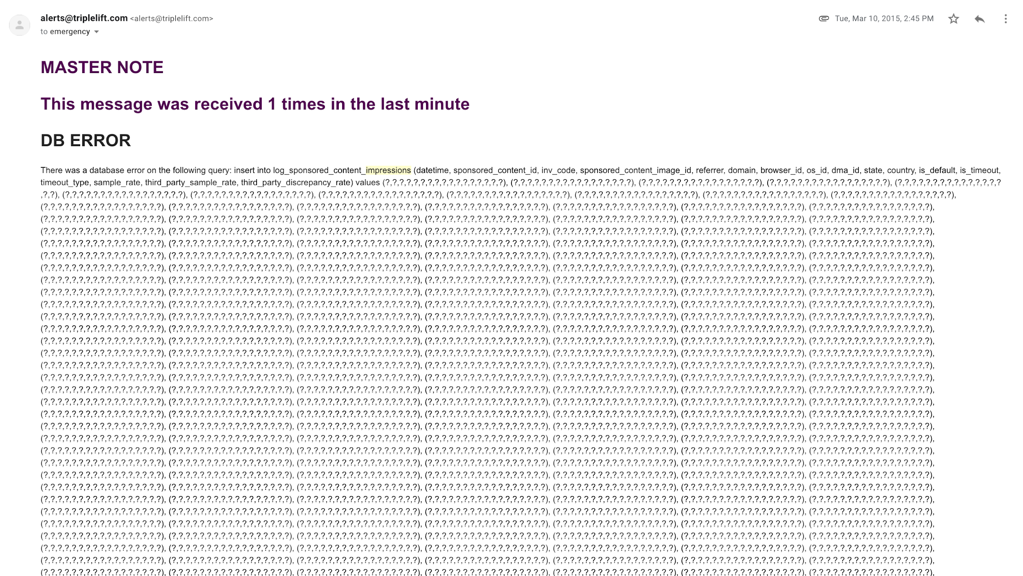

Slide 16



v1: Redshift all the things
Browser Events
Server Events
Kafka
Storm
Implementation Highlights
Capture every event
Leverage Redshift for both storage and processing
Hack Secor to talk to RabbitMQ
Homebuilt scheduler in Java
Custom Secor
S3
RabbitMQ
Java Loader
Kafka - High performance message queue
Redshift - AWS columnar database designed for analytics
Redshift
Redshift
RabbitMQ - General purpose message queue
Java Scheduler and Aggs
MySQL
Secor - Kafka to S3 persistence
API/UI
Events
Processing
Storage
Access
Notes:
Secor: Persist Kafka messages to S3/Google storage

Slide 17
v1: Redshift all the things
Needed ability to explore event level data
Stop dropping events
MySQL was just not able to handle the load
Why did we do this?
Not all logic can be expressed using SQL
Aggregate tables per use case
Job scheduling and dependencies
What challenges did we run into?
Redshift is expensive
Avoid forking open source code
What did we learn?
Notes:
Not all logic can be expressed as SQL
We had some statistical logic inside the code, making sure reserves were hit based on

Slide 18

v2: Spark and Druid
Browser Events
Server Events
Kafka
Storm
Implementation Highlights
Spark
  Replace Redshift processing
Druid
  Replace Redshift agg tables
Still use the homebuilt scheduler
Standard Secor
S3 (event level)
Databricks
S3 (aggs)
Spark - Distributed big data computing framework
Redshift
Druid - Large scale analytics database for time-series data
Druid
MySQL
Events
Processing
Storage
Access
API/UI
BI tools
Notes:
Druid: “Apache Druid (incubating) is a high performance analytics data store for event-driven data.”

Slide 19
v2: Spark and Druid
Redshift became prohibitively expensive
We needed logic beyond SQL
Why did we do this?
Lots of effort spent migrating and supporting both systems simultaneously
Handling historical data was a challenge
Spark became yet another thing to learn
What challenges did we run into?
S3 is extremely versatile
SQL is wonderful
Big data is big money
What did we learn?
Notes:
Log retention days
Hourly to daily

Slide 20

v3: Lambda, the ultimate?
Browser Events
Server Events
Implementation Highlights
Introduce VoltDB for real time stream processing
Leverage Druid’s Lambda architecture to combine the batch and real time processing
Kafka
Storm
Batch
System
VoltDB
Kafka
Partitioned in memory database leveraging Java stored procedures
Druid
API/UI
BI tools
Events
Processing
Storage
Access
Notes:
VoltDB - all in memory designed with finance and high speed in mind
Lambda - combination of batch and streaming

Slide 21
v3: Lambda, the ultimate?
Needed to reduce data delay from the 3+ hours
Proof of concept worked well
Why did we do this?
Introduced yet another technology to maintain with its own language and configuration
Kafka version differences between 0.8 and 0.10
What challenges did we run into?
Tuning production systems is tough
The Lambda architecture is elegant
What did we learn?

Slide 22

v4: Less is more
Browser Events
Server Events
Kafka
Storm
Implementation Highlights
Replace VoltDB with mini Spark batches
Introduce Airflow for job scheduling and monitoring
Standard Secor
S3 (event level)
Spark (hourly + mini batches)
Airflow
S3 (aggs)
Job scheduler and dependency management system
Druid
Redshift
Events
Processing
Storage
Access
API/UI
BI tools
Notes:
We tried Spark streaming (and want to go back) but ran into difficulties and needed something quick

Slide 23
v4: Less is more
Scaling issues with VoltDB
Paying for functionality we didn’t need
Why did we do this?
Went from close to real time reporting to 30 minutes
What challenges did we run into?
Why did we spend time building our own scheduler? Airflow is great
All things to all people is not a scalable strategy
What did we learn?

Slide 24
To summarize
Start of 2015
Mid 2016
End of 2017
Mid 2018
Can’t believe we did this
Redshift all the things
Spark and Druid
Lambda, the ultimate?
Less is more
Not very “big data”
Introduced event level data and used Redshift for storage and processing
Spark for processing and Druid for storage.
Leverage VoltDB to get real time data
Replace VoltDB with mini batches and introduce Airflow

Slide 25
Lessons learned

Slide 26
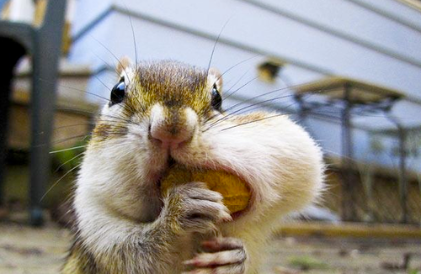
Scale the team with the technology
Notes:
Don’t bite off more than you can chew.
There is a ton of tech and while exciting focus on what you need to get done.
Leverage open source.
Offload work to vendors.
Build system to be vendor agnostic.

Slide 27

Data DevOps is difficult
Notes:
So many configuration options. You get it working but as you scale you run into these limits.
Which team owns this? Data engineering? DevOps?
Handling different versions and upgrades poses another challenge.
Many problems only happen at scale. Spark upgrade worked on sand environment but failed in production. Testing and development at high scale is difficult!

Slide 28

Big data is limited by money, not technology
Notes:
Ton of open source tools and technologies for nearly any data use case
Unless you’re huge the limit is cost, not technology

Slide 29
Thank you!
Questions?

