Slide 1

Engineering Lessons Learned by Data Scientists in Growing MalwareScore from Kaggle Competition to Trusted Antivirus Solution
Phil Roth, PhD
@mrphilroth
Data Scientist, Endgame

Slide 2
Where We Screwed Up
Phil Roth, PhD
@mrphilroth
Data Scientist, Endgame

Slide 3


Institution:
PhD in Physics from UMD working for IceCube
Consultant to defense contractors at User Systems
Data Scientist at Endgame
Data Source:
Photomultiplier tubes at the South Pole
Space/airborne radar systems
Script kiddies
About Me
Notes:
In putting together this slide, I realized I might be moving in the wrong direction on how cool my data sources are. And also that I need to do more posters with Endgame.

Slide 4

Notes:
This talk is more of a story. A tale from the trenches. Hopefully, it’ll contain something useful for you.

Slide 5

Speed of Development
Maintainability
Notes:
The main subject of the story is our small team of data scientists tried to balance speed of development and maintainability. And where we failed and succeeded along the way.

Slide 6

Data Science in Security
(from a Kool-Aid drinker)
Benefits:
Notes:
But first! An advertisement!

Slide 7
Data Science in Security
Benefits:
Mission
“The best minds of my generation are thinking about how to make people click ads. That sucks.”
- Jeff Hammerbacher

Slide 8
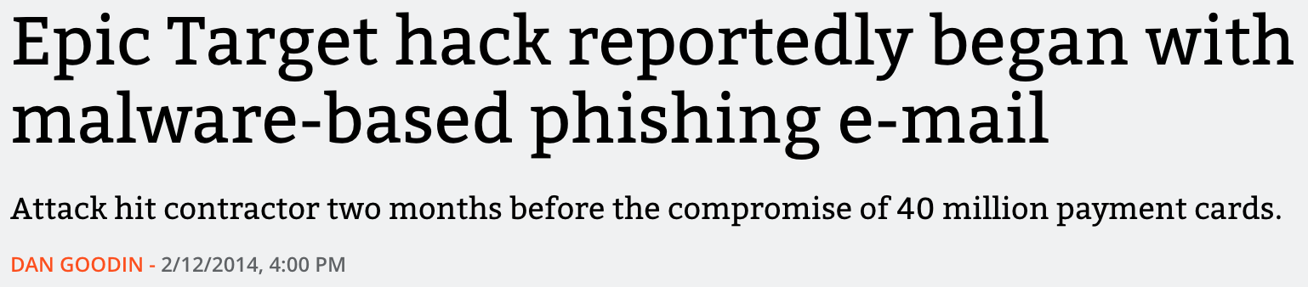
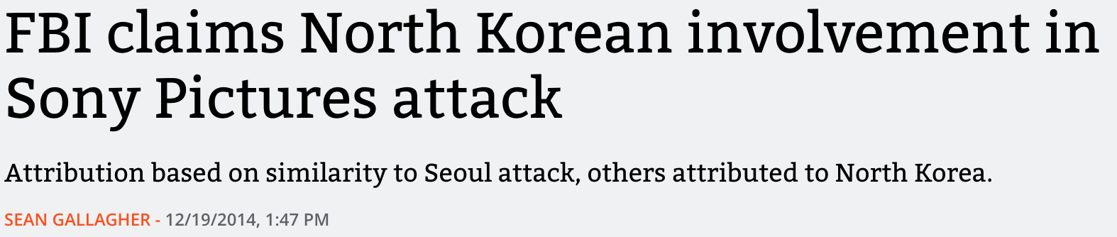
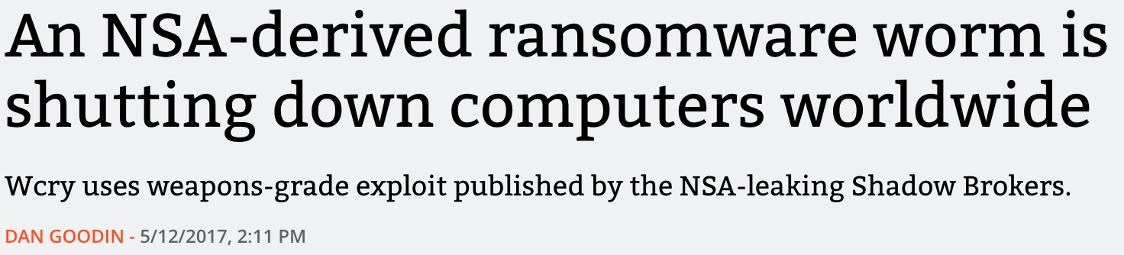
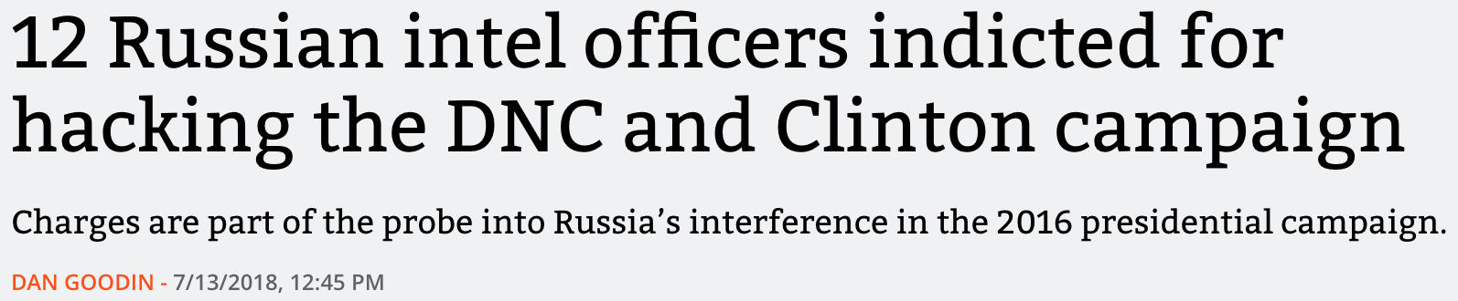
Data Science in Security
Benefits:
Mission
Relevant

Slide 9
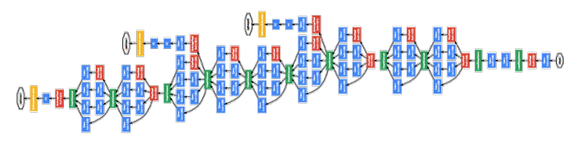
Data Science in Security
Benefits:
Mission
Relevant
Opportunity
This does not yet exist for common security machine learning applications:

Slide 10

Data Science in Security
Common application areas:
doable
Domain Generation Algorithm protection
Malicious File Classification
Anomaly Detection
Insider Threat Detection
Network Intrusion Detection System
hardly doable
etc...

Slide 11
MalwareScore
A machine-learning-first antivirus solution
Lightweight
Static features
Fast prediction time
Deployed to customer machines
Expanding to more and more file types

Slide 12

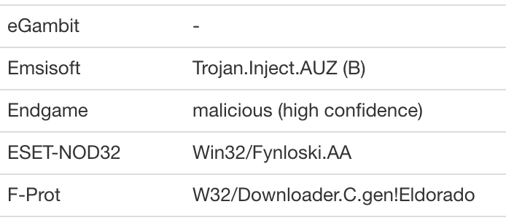
MalwareScore
Decisions are public:

Slide 13
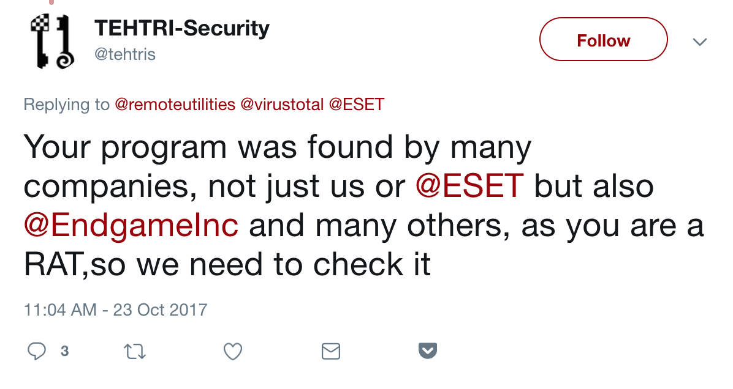
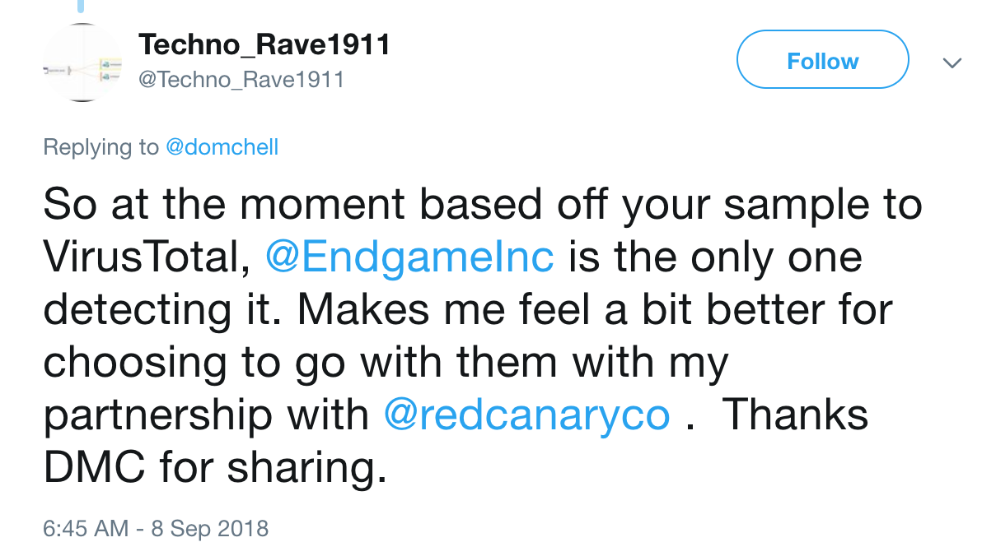
MalwareScore
Decisions are public:
Success and failures are out there for all to see!
Notes:
Stressful

Slide 14

MalwareScore Features
A simplified version of our static features is described in EMBER, Endgame’s publicly released dataset:
https://github.com/endgameinc/ember
Raw Bytes:
Byte Histogram
Byte Entropy Histogram
Strings
Requires PE Format:
Section Information
General
Header
Imports
Exports

Slide 15
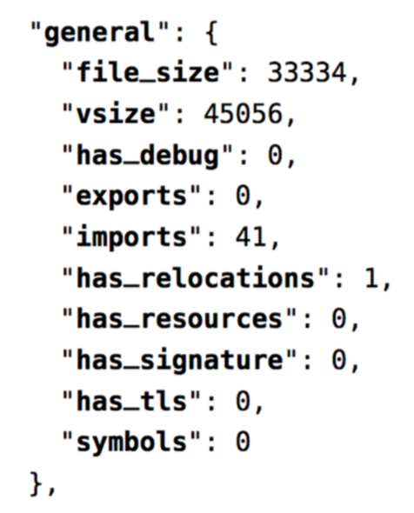
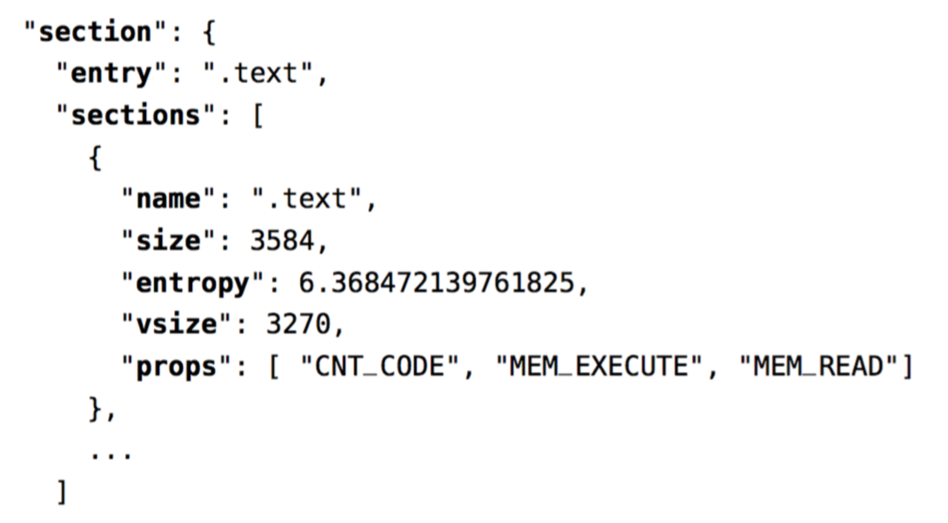
MalwareScore Features
Examples:

Slide 16

MalwareScore Model
We’ve described our process in choosing a model on Endgame’s technical blog:
https://www.endgame.com/blog/technical-blog/its-bake-navigating-evolving-world-machine-learning-models
Result:
Gradient Boosted Decision Trees
Tried to balance:
Accuracy
Prediction time
Cost to retrain
Size of the model

Slide 17
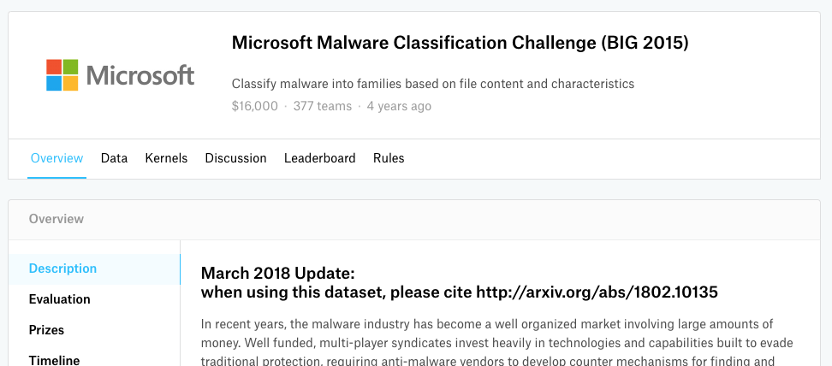
Humble beginnings

Slide 18

Early experimentation
[proth@datasci ~]$ printdb
features
byteentropy 2555
endpointexports 2559
peasciihasher 2560
endpointfeatures 39294059
bytehistogram 2555
endpointsection 2555
dispatch 1955
endpointversion 2557
endpointresources 2556
endpointbasic 2550
endpointimports 2557
endpointpeextractor 41759825
filesize 34098543
pefilesection 2553
peascii 2557
Separating feature sets into different collections allowed multiple team members to experiment independently

Slide 19
Early experimentation
Gathering the features from the database was always awkward. Then it grew to be impossible.
client = pymongo.MongoClient()
for chunk in chunks:
for featname in all_features:
for doc in client.features[featname].find({"sha256": {"$in": chunk}}):
# Line up features in the correct rows and columns
cursors = client.features.endpointfeatures.parallel_scan(32)

Slide 20

Lesson: Don’t rely on proof of concept framework too long

Slide 21

Transition to SQL
Once the features we’d decided on were frozen, we could calculate them and store them in a SQL table.
The labeling process became a large SQL table that was more easily trackable.

Slide 22

A Talk Recommendation
Dan: “Experiment early and often on new designs/products and abandon those that don’t add value.”
My Corollary: “After you decide to continue on a design/product, use that moment to rethink the architecture supporting it.”
https://www.slideshare.net/danmckinley/design-for-continuous-experimentation
https://www.youtube.com/watch?v=qCKj_K5RNfY

Slide 23
Training Costs
As the data size grew, we used whatever tricks we could find to be able to train on our single machine.

Slide 24
Training Costs
Through experimentation, we found that memmap’ing features from disk saved in maximum RAM required.
import xgboost
import numpy as np
import pandas as pd
labeldf = pd.read_csv(label_path, index_col=0)
y = np.array(labeldf["y"], dtype=np.int16)
X = np.memmap(X_path, dtype=np.float32, mode="r")
X = X.reshape((len(y), -1))
training_dmatrix = xgboost.DMatrix(X, label=y, missing=0.0)
model = xgboost.train(parameters, training_dmatrix, n_estimators)
model.save_model(model_path)

Slide 25
Training Costs
This worked for awhile, but eventually we went distributed. We ported this memory mapping technique to a hacked dask (https://dask.org/) setup.
S3
features labels
EBS
raw float data
EC2 RAM
xgboost DMatrix

Slide 26
Training Costs
But our training code fell over as hidden package dependencies creeped forward.
S3
features labels
EBS
raw float data
EC2 RAM
xgboost DMatrix

Slide 27
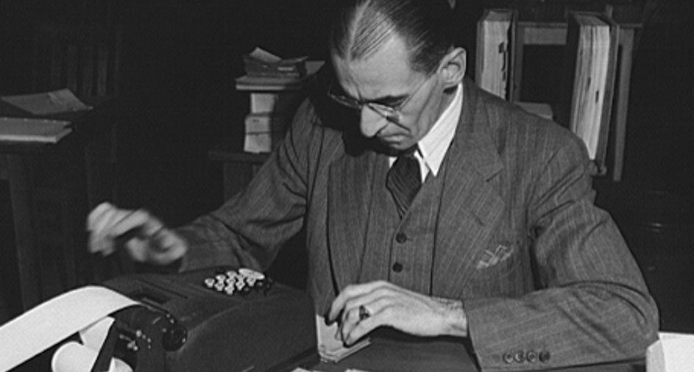
Lesson: Don't focus on small cost savings early

Slide 28
Training Costs
Through a lot of work, we were able to train again by freezing all dependency versions, but it probably cost more in developer time than it saved in AWS costs.
Set yourself up with a framework, and then modify from there if/when cost savings are required.

Slide 29
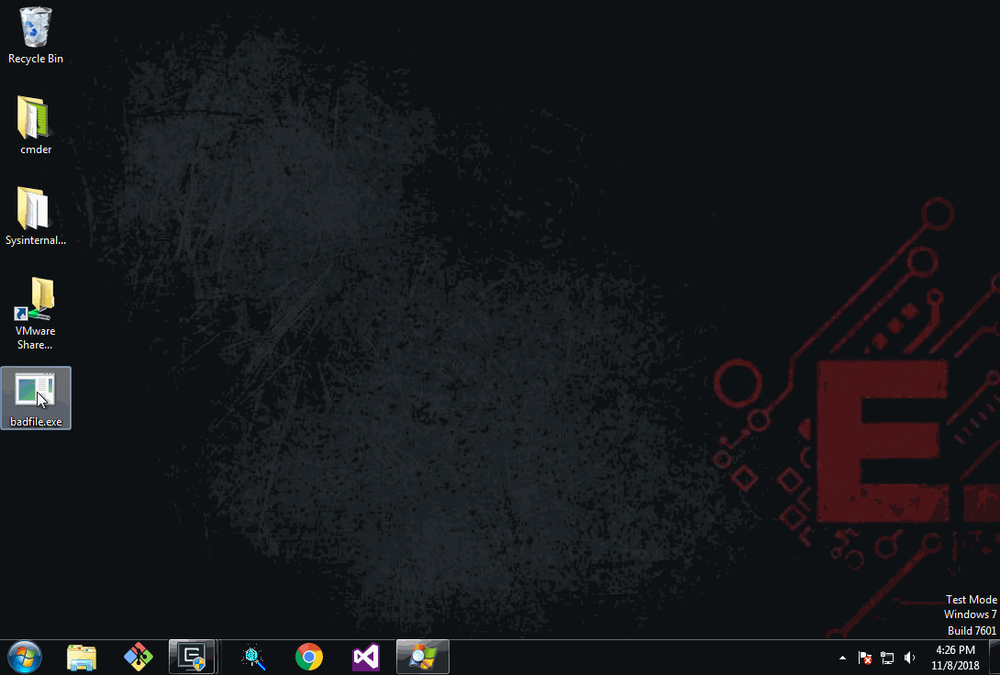
Model Deployment
Deploying the model and making predictions on customer workstations requires safe, robust code that is FAST.

Slide 30
Model Deployment
Data Scientists (me) wrote janky code and data structures with extensive tests and handed it off.
float score(ClassifierModel *model, float *features) {
float psum = 0.0f;
for(unsigned int itree = 0; itree < model->model_params.num_trees; itree++) {
unsigned int leaf_index = get_leaf_index(features, model->trees[itree].nodes);
psum += model->trees[itree].nodes[leaf_index].leaf_value;
}
psum = logistic(psum);
return psum;
}
The professionals took it from there….

Slide 31


Model Deployment
Workstations
Tests
Customer appliance
Model
Training Process
Customer appliance
Customer appliance
Customer appliance
Customer appliance
well defined interface

Slide 32

Lesson: Define a format for smooth handoffs to engineering for deployment

Slide 33
Efficacy Checks
Bit Inspector is an internal tool for communicating progress, soliciting feedback, and identifying errors related to MalwareScore.
Built with
Flask (http://flask.pocoo.org/)
D3.js (https://d3js.org/)
matplotlib (https://matplotlib.org/)
seaborn (https://seaborn.pydata.org/)
Connects to multiple internal data and processing resources

Slide 34
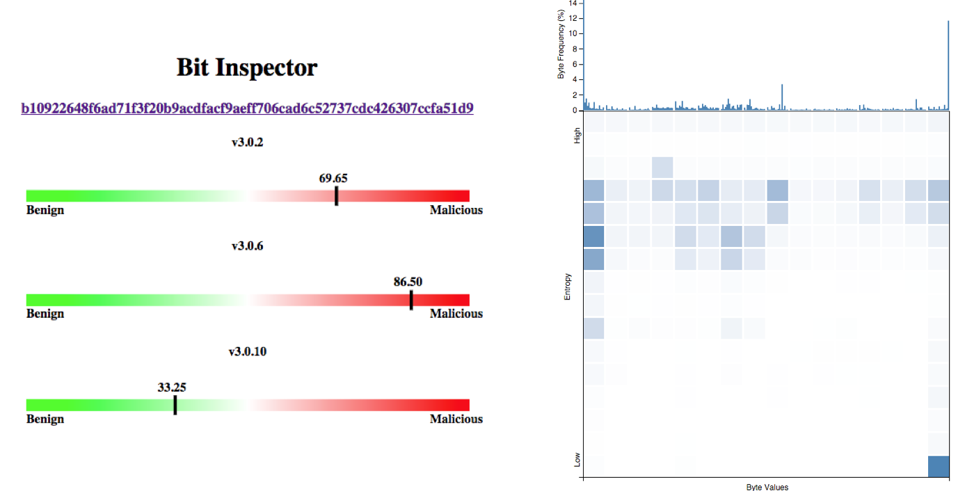
Efficacy Checks
Sample Page

Slide 35
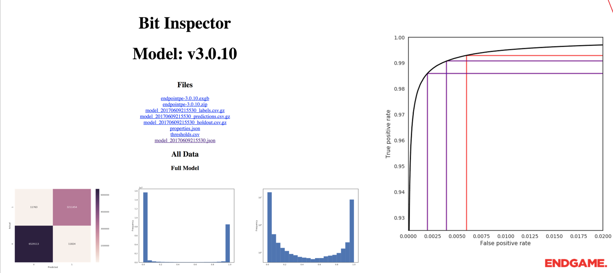
Efficacy Checks
Model Page

Slide 36

Efficacy Checks
Missed a data ingest problem over three weeks

Slide 37

Efficacy Checks
data scientists
data ingest efficacy
model efficacy

Slide 38

Lesson: Efficacy checks on the pipeline as well as the model

Slide 39
Don’t rely on proof of concept framework too long
Don't focus on small cost savings early
Define a handoff format to engineering
Efficacy checks on the pipeline as well as the model
Phil Roth
Endgame
@mrphilroth
proth@endgame.com
Thanks!

