Slide 1
Accelerating
Single-cell Bioinformatics
with N-dimensional Arrays
in the Cloud
Ryan Williams
DataEngConf NYC
11/9/2018
bit.ly/dataengconf-rw

Slide 2
Accelerating
Single-cell Bioinformatics
with N-dimensional Arrays
in the Cloud
Ryan Williams
DataEngConf NYC
11/9/2018
bit.ly/dataengconf-rw

Slide 3


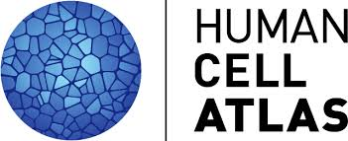
Intro
Laserson Lab at Mount Sinai School of Medicine
Chan Zuckerberg Initiative / Human Cell Atlas
@laserson @tomwhite @ryan-williams

Slide 4
Overview
sequencing breakthrough!
  bulk → single-cell
storing the data:
  HDF5 → Zarr
parallelizing analysis
  Dask and Zappy (Apache Spark, Apache Beam, Pywren)
ndarray.scala:
  Zarr implementation for the JVM and Javascript
bit.ly/dataengconf-rw

Slide 5
Central Dogma of Biology
… for Computer People

Slide 6
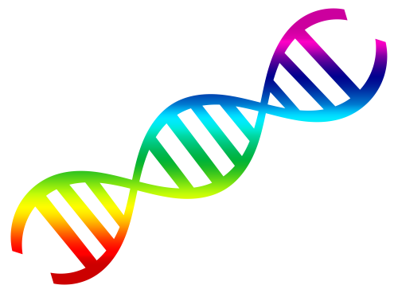
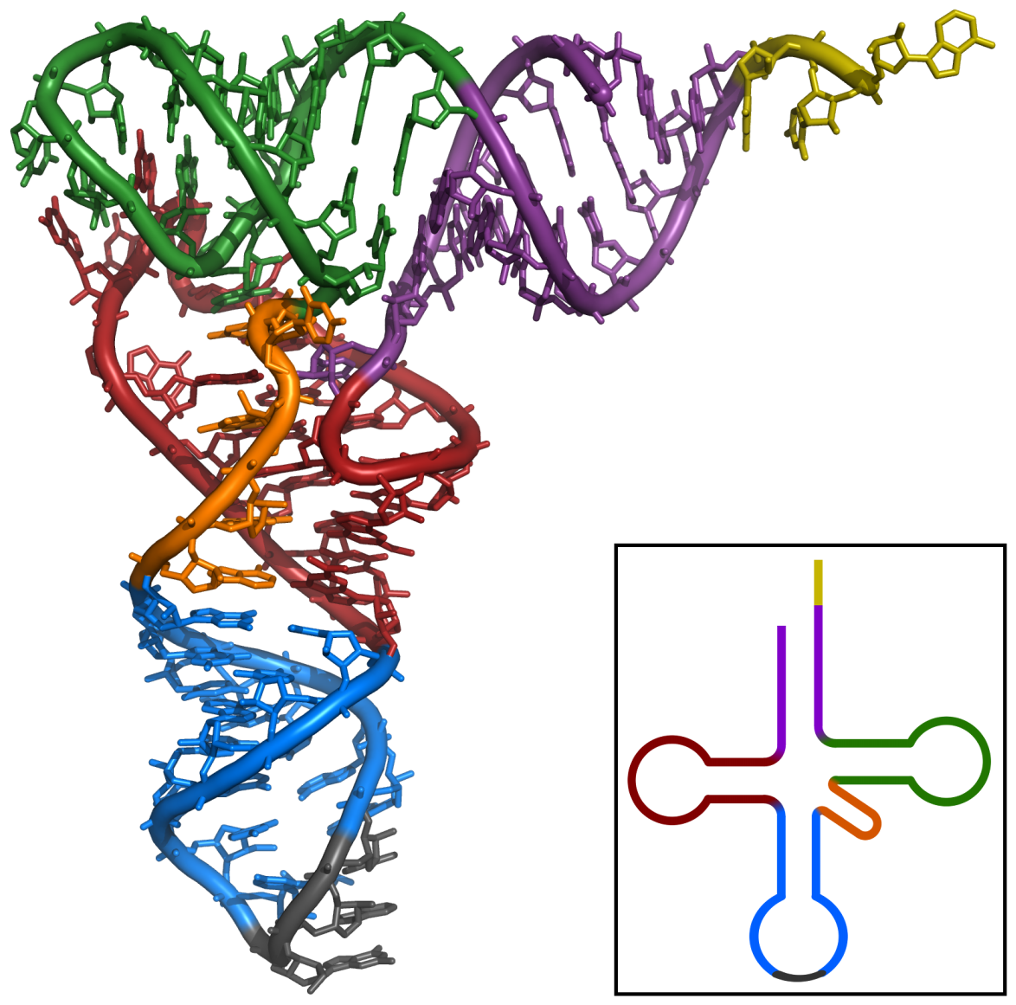
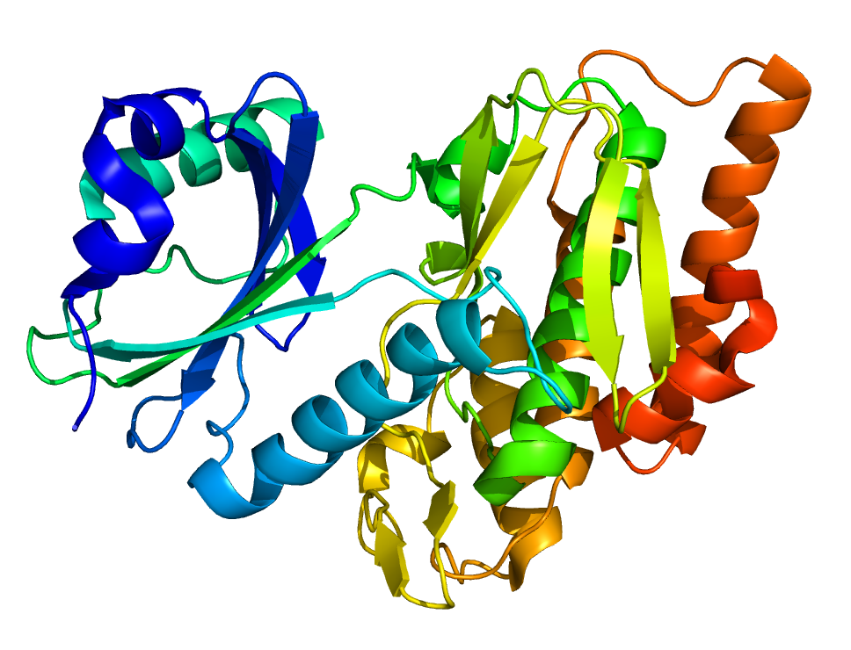

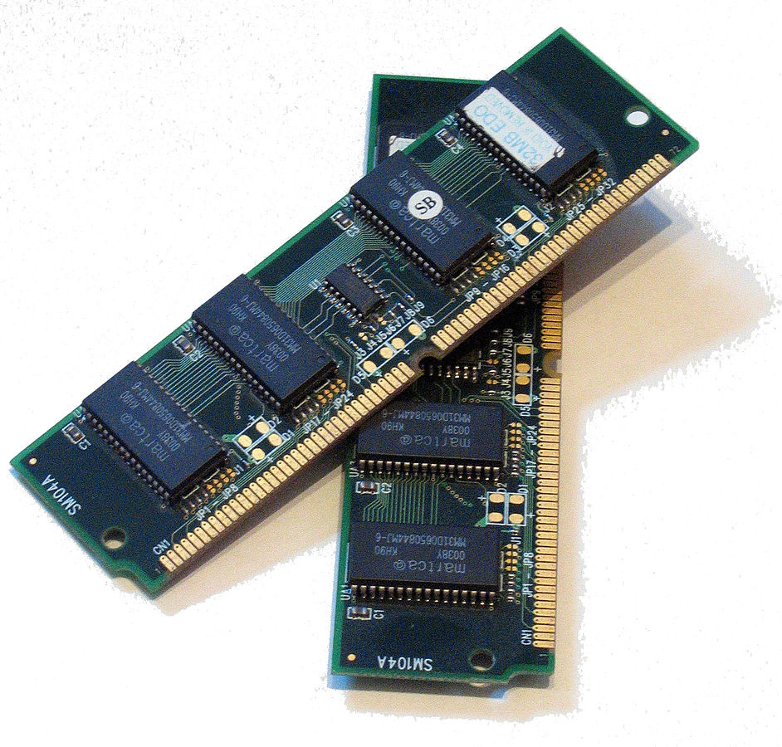
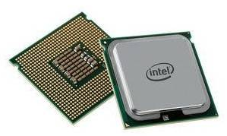
DNA
RNA
Protein
transcription
translation
paging
running
Disk
Memory
CPU

Slide 7

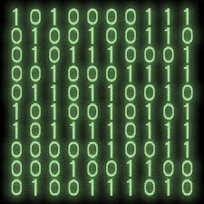

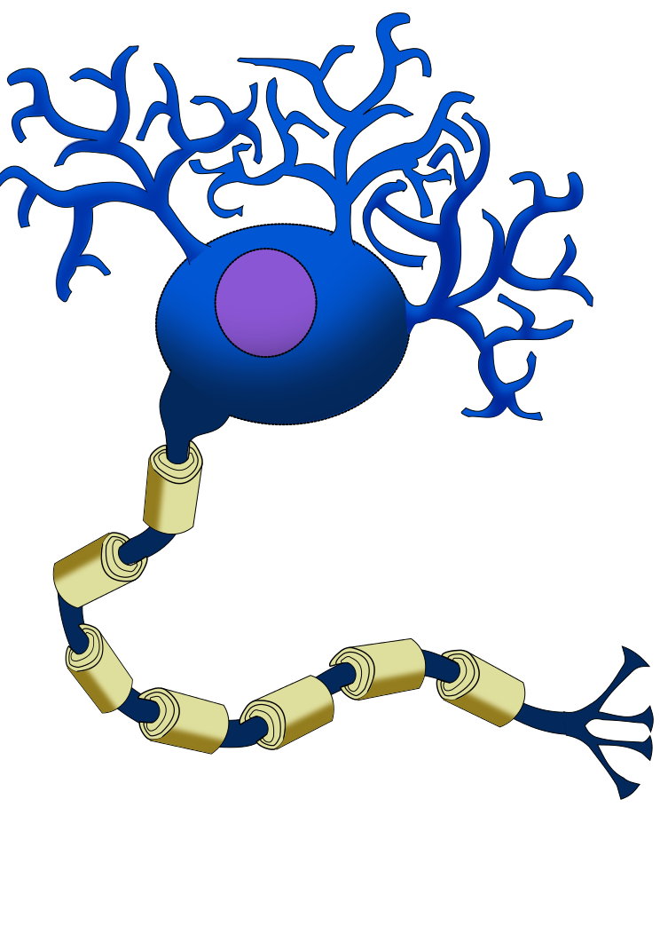



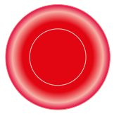













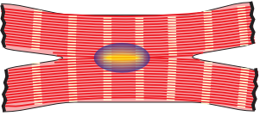
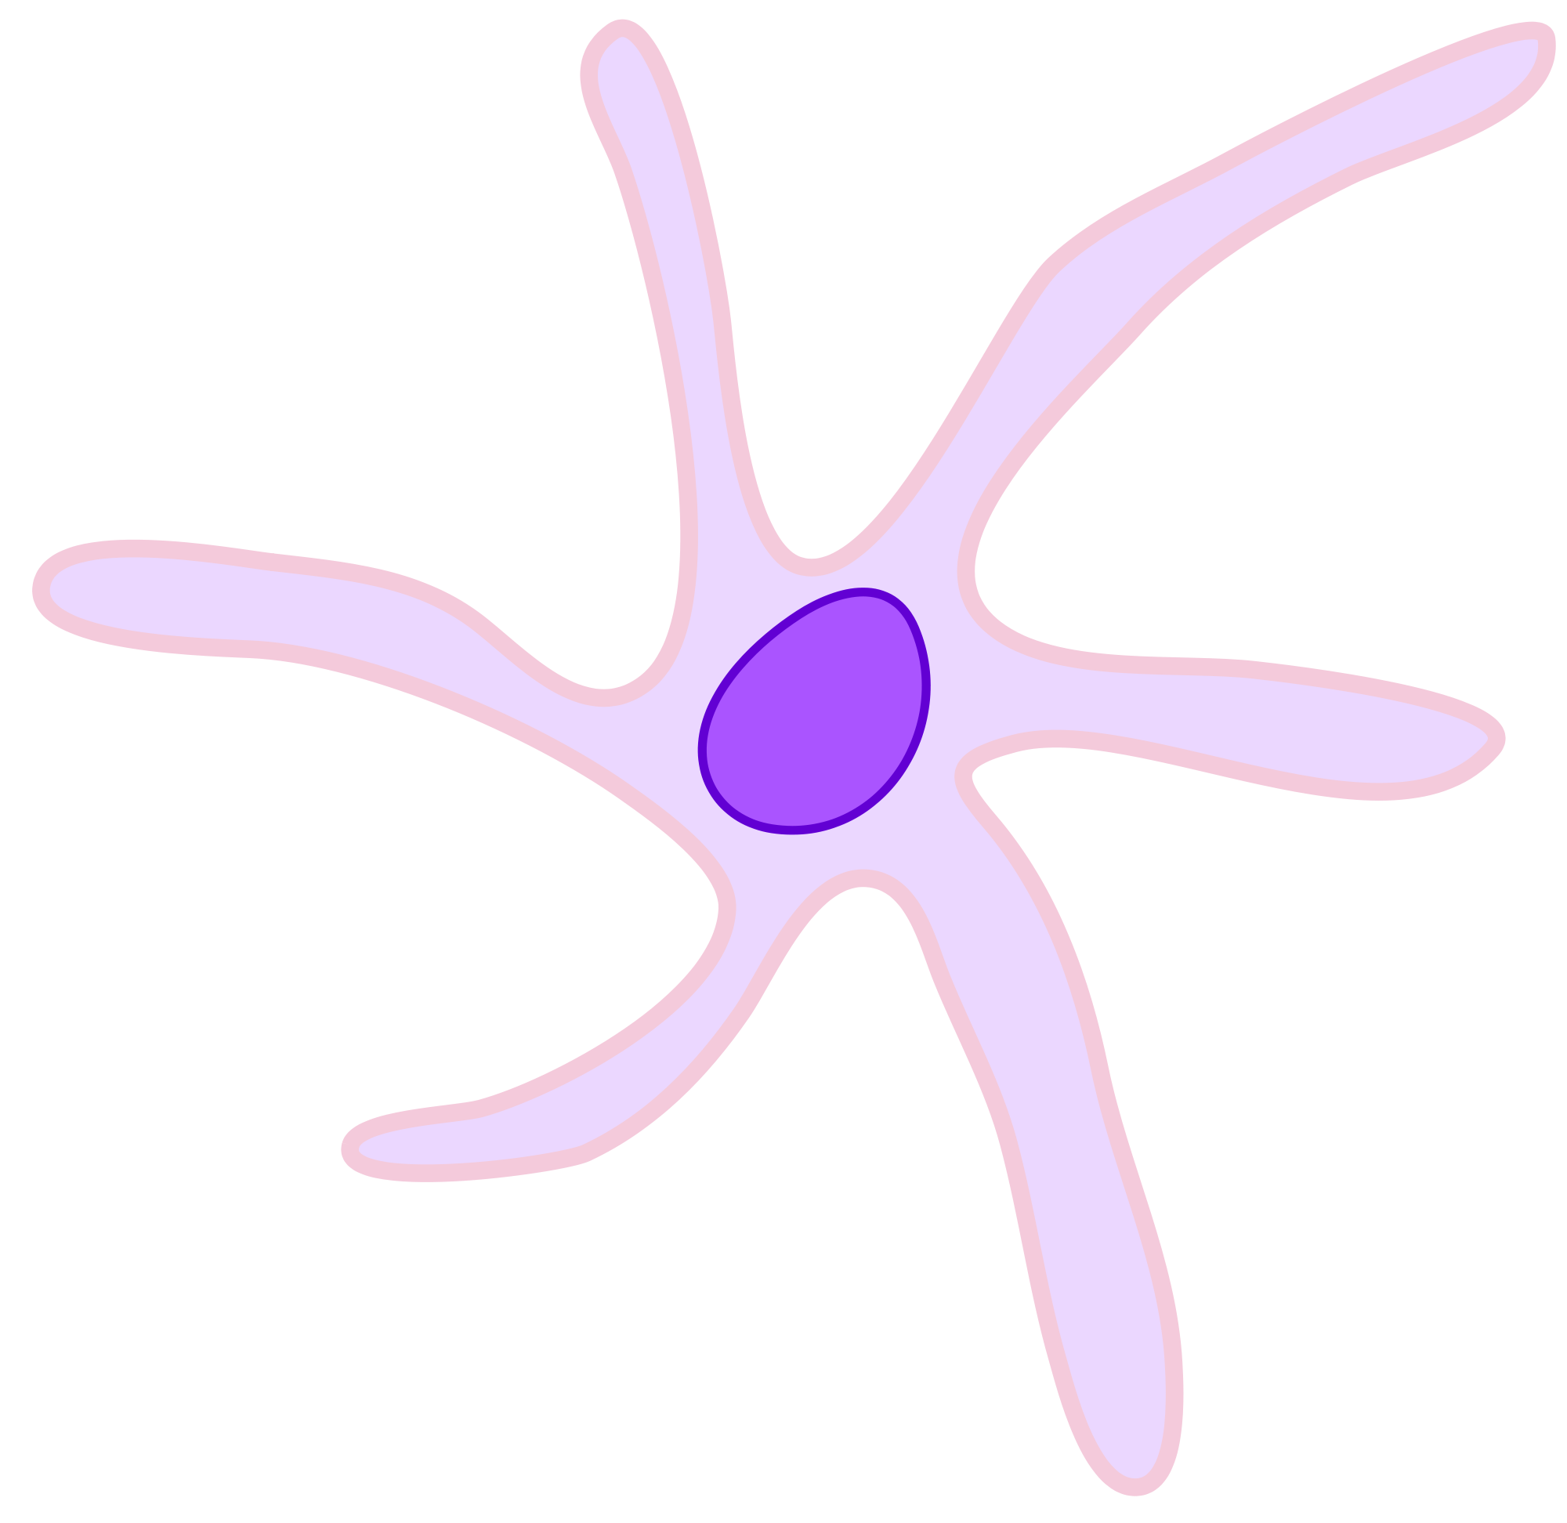




Protein:
actual interactions w/ world
RNA:
apps running on machine
DNA:
apps installed on machine
Notes:
DNA: apps installed on a machine
RNA: apps actually running at any time
protein: actual work / interactions with the world
two machines w same apps installed can behave very differently based on which apps they are running (web server, graphic design work, email/VC, development/compilation)
a snapshot of what apps are installed can tell us some things about a machine, but we'd usually rather know what apps it's running, which tells us more about what it's actually doing

Slide 8
Bulk Sequencing →
Single-cell Sequencing

Slide 9
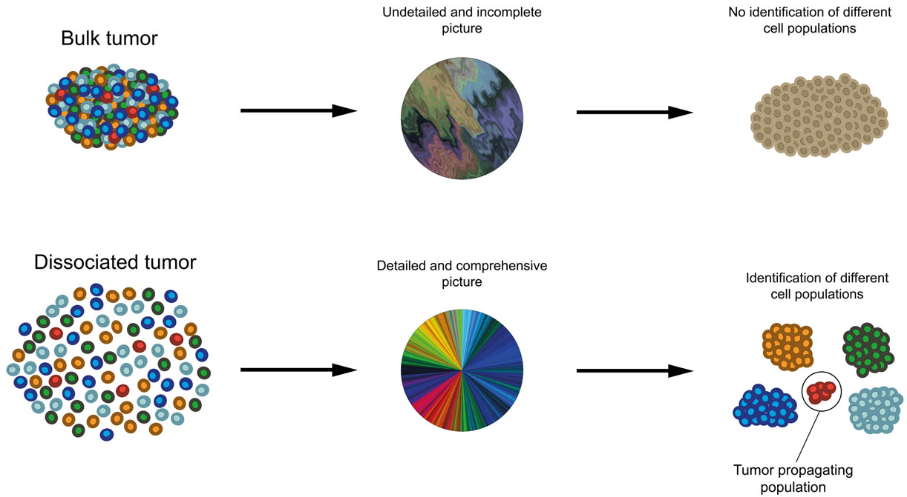
Bulk Sequencing
Population averages
Cell populations not resolved
Single-cell Sequencing
Detailed, comprehensive picture
Identification of different cell populations
http://fightdipg.org/research/
Notes:
a

Slide 10
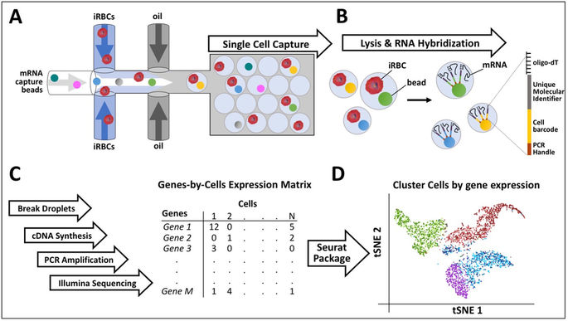

Slide 11
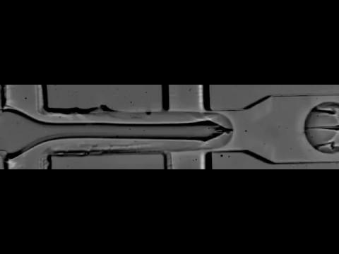
http://mccarrolllab.com/wp-content/uploads/2015/05/Substack-4455-4504.gif

Slide 12
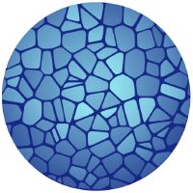
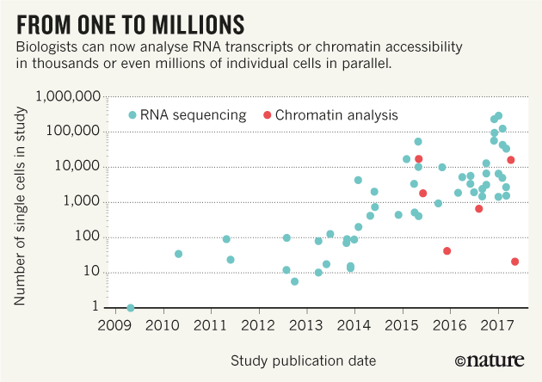
Human Cell Atlas
"a unique ID card for each cell type, a three-dimensional map of how cell types work together to form tissues, knowledge of how all body systems are connected, and insights into how changes in the map underlie health and disease"

Slide 13
Single-cell data analysis

Slide 14
Expression Matrices
how much of each gene did each cell "express"?
  cells x genes
    20-30k genes in humans
    largest public dataset: 1.3MM cells
  sparse: 2% non-zero
workflows:
  preprocessing / QC
  clustering
popular tools:
  scanpy (python)
  seurat (R)
  bioconductor (R)
persisted formats (all HDF5):
  10x
  loom
  anndata

Slide 15
Want:
out-of-core processing
parallel processing
operate directly on cloud-resident data
Hard to do these with HDF5…

Slide 16
Multidimensional-Array
Container Formats

Slide 17
HDF5
"container" / "meta"-format
embed a virtual filesystem in a single (large) file:
  datasets (≈files): multidimensional arrays of a homogenous type
  groups (≈directories): contain datasets and other groups
popular in many scientific domains for 20 years!
structure inside HDF5 file varies by application domain
  expect datasets with certain names and types
  roughly a "schema"
ubiquitous for data-persistence in single-cell analysis tools, to date

Slide 18
HDF5 – rough edges
complicated
  150pg spec
  official C implementation (300k LoC) is wrapped in many languages
cloud IO: 🚫
  can only read/write local files
  FUSE adapters should help, but are brittle in practice
parallel IO: 🚫
  parallel-writing single large files doesn't work well in general (≈by design)
  parallel-reading is limited by local-files-only requirement above
emerging consensus:
need something simpler
friendlier to remote storage and parallel processing

Slide 19
Zarr
Example 2-D Array
simple, chunked multi-dimensional arrays
each chunk is a separate file on a filesystem
  (or: key in a key-value store)
  plays nicely with Hadoop-ecosystem conventions around parallel IO of sharded datasets
  pluggable compression
simple spec
reference implementation in Python
multiple independent implementations
  z5 (C++)
  ndarray.scala (JVM+Javascript via Scala)
very new (tooling and community)
being adopted by the Human Cell Atlas after extensive benchmarking of candidate formats
Metadata (.zarray):
{
"shape": [ 20, 20 ],
"chunks": [ 10, 10 ],
"compressor": {
"id": "zlib",
"level": 1
},
"dtype": "<i4",
"fill_value": 42,
"filters": null,
"order": "C",
"zarr_format": 2
}
Filesystem footprint:
├── .zarray
├── 0.0
├── 0.1
├── 1.0
├── 1.1

Slide 20
Common Data Model (CDM)
"merges the netCDF, OPeNDAP, and HDF5 data models to create a common API for many types of scientific data"
subset of HDF5*
independent Java implementation: unidata/thredds
* almost

Slide 21
Progress Report

Slide 22
Container-format improvements
Use Zarr in single-cell tools:
  Zarr support in scanpy: anndata#38
    reading+writing cloud storage ✅
    can be slow due to cloud-store seeks
  other tools: Zarr support in R TBD
Improve HDF5 tooling:
  Generic HDF5 support in cloud stores
    inject JSR203 / NIO interface underneath CDM/NetCDF Java library
  Read HDF5 in parallel with Spark, including from cloud stores

Slide 23
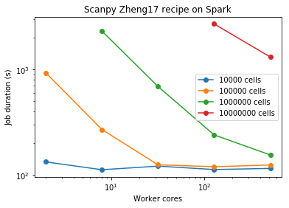
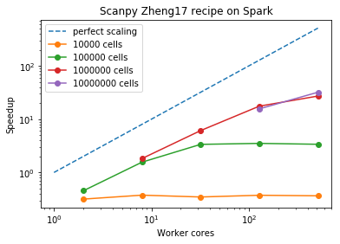
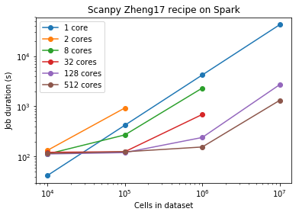
Parallelize Single-Cell Analyses
zappy: distributed numpy arrays
  configurable parallelization backends: Pywren, Apache Spark, Apache Beam, "direct" (eager / in-memory)
  live in scanpy: #283
  Spark benchmarks:

Slide 24
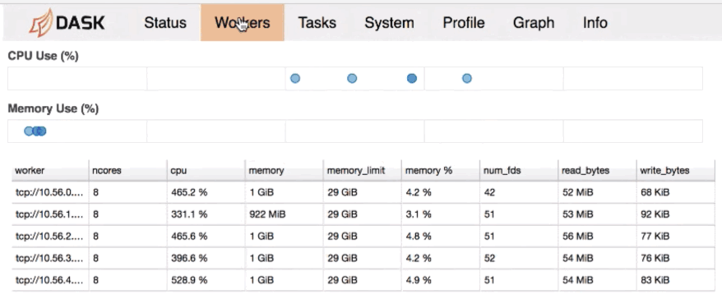
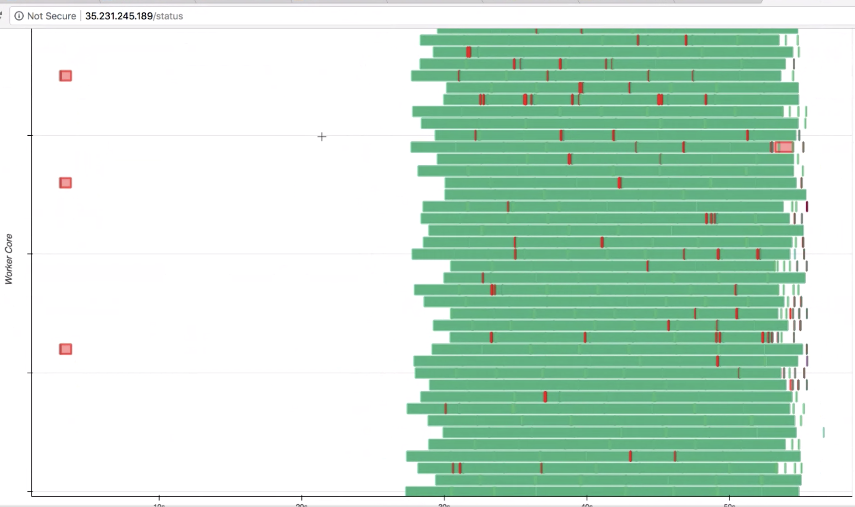
Scanpy + Dask
“Dask natively scales Python”
implements numpy array interface (with distributed engine)
merged in scanpy: #283

Slide 25
ndarray.scala
pure Scala implementation of Zarr spec
also wraps NetCDF-java HDF5 bindings, supports HDF5→Zarr conversions
cross-compiles to JVM and Javascript
cloud-store friendly
webapp can read/display Zarr files in e.g. GCS directly in browser, or proxy to server
heavy use of type-level and functional programming:
  higher-kinded types: pluggable array-implementations, distribution-engines
  type-system tracks number of array dimensions, verifies correct indexing
  implicit-derivations as proofs

Slide 26
(Near-)Future Work

Slide 27
Next Steps
synthetic 10MM, 100MM cell datasets for benchmarking
parallel+cloud, further into standard single-cell pipelines
  clustering
  indexing+search
ndarray.scala:
  flesh out Java API (#7), array DSLs (#8, #9)
  pluggable parallelization, similar to zappy (#10)
  browser-based {HDF5, Zarr} viewers, converters (#11)
  compile to native (#12)
parallel+cloud for R-based tools (Seurat, Bioconductor)
  via SparkR
  or: shell out to python/Java
  or: native code, callable from R

Slide 28
Summary
{cloud-friendly, parallel} x {storage, processing} of single-cell data
  multiple existing tools
  multiple parallelization engines
  multiple languages
simple stages scaling well!
  more complex stages next
zappy: parallelize numpy arrays with Spark, Pywren, etc.
ndarray.scala: typesafe multidimensional arrays, HDF5 and Zarr support

Slide 29
Thank you!
Questions?

