Slide 1
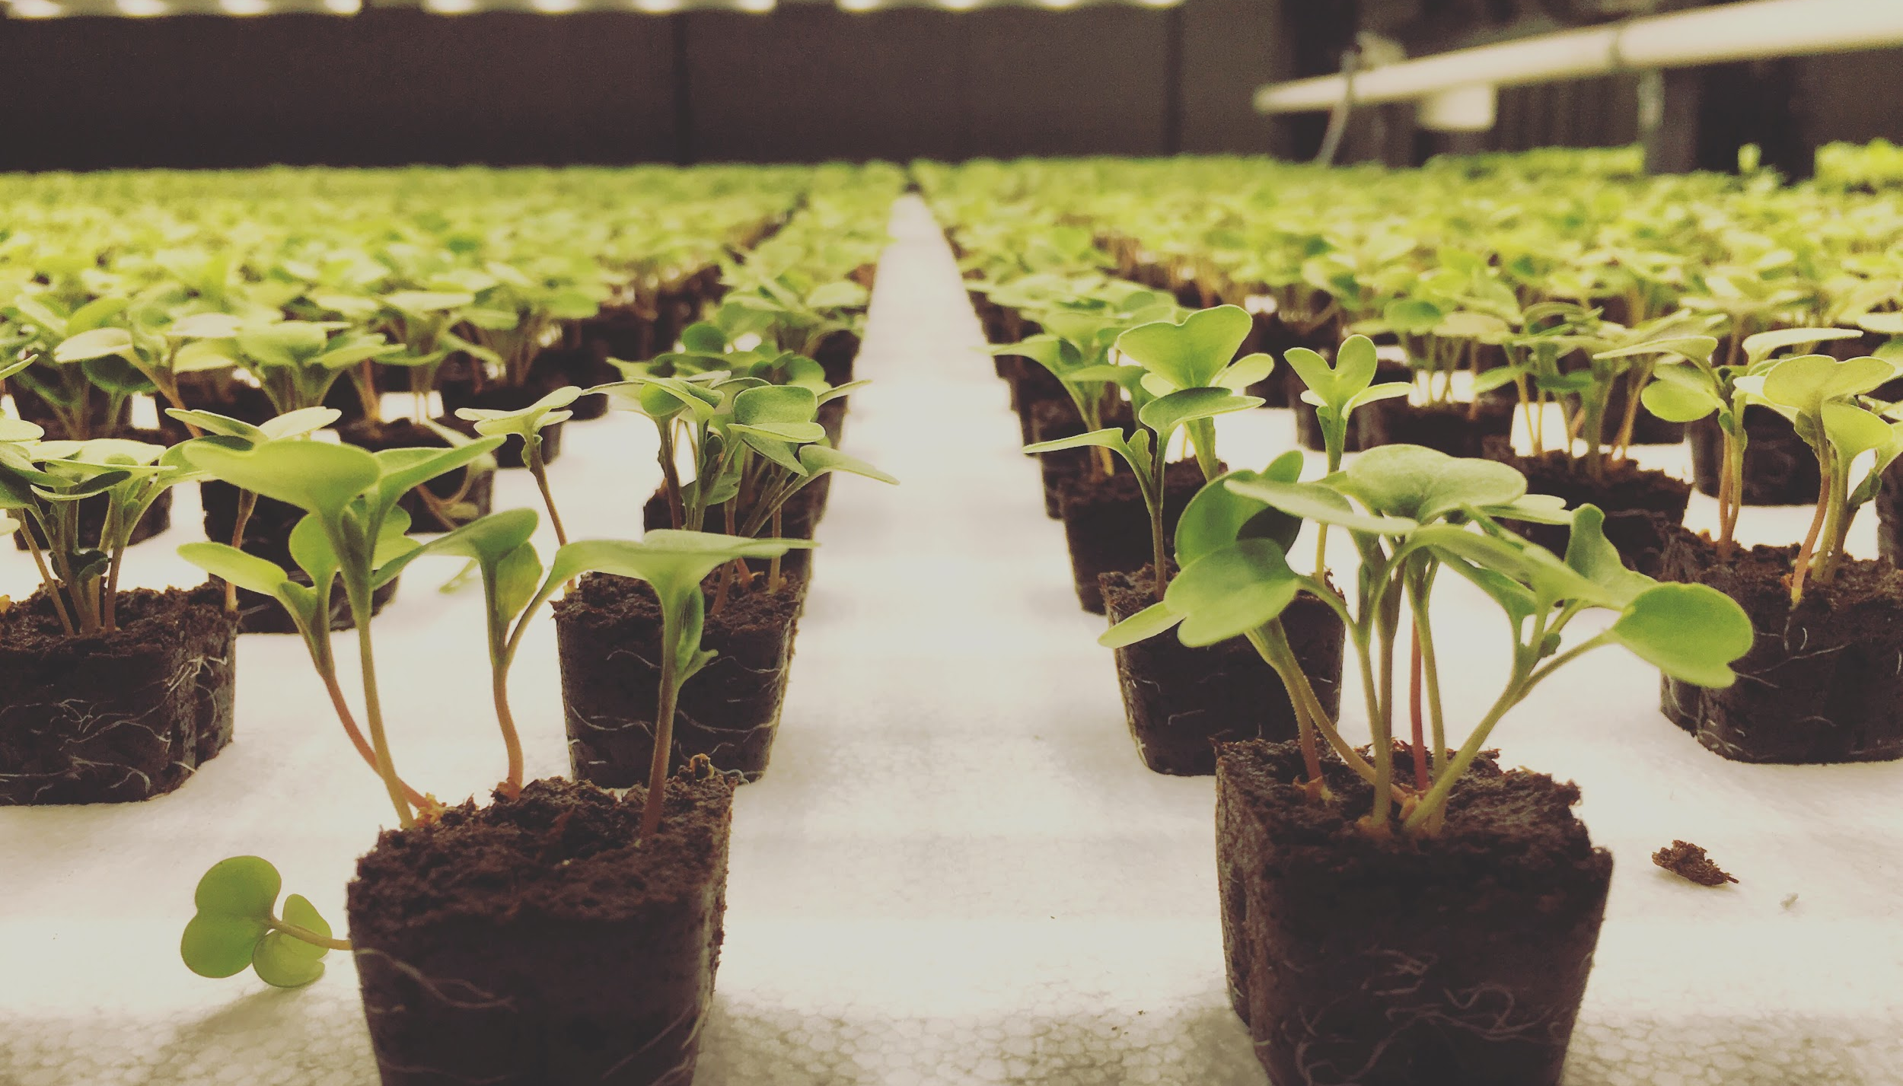


AI FARMING
100x the yield with a data team of . . . 1
Sam Swift
Head of Data & AI
DataEngConf NYC
Nov 9, 2018

Slide 2
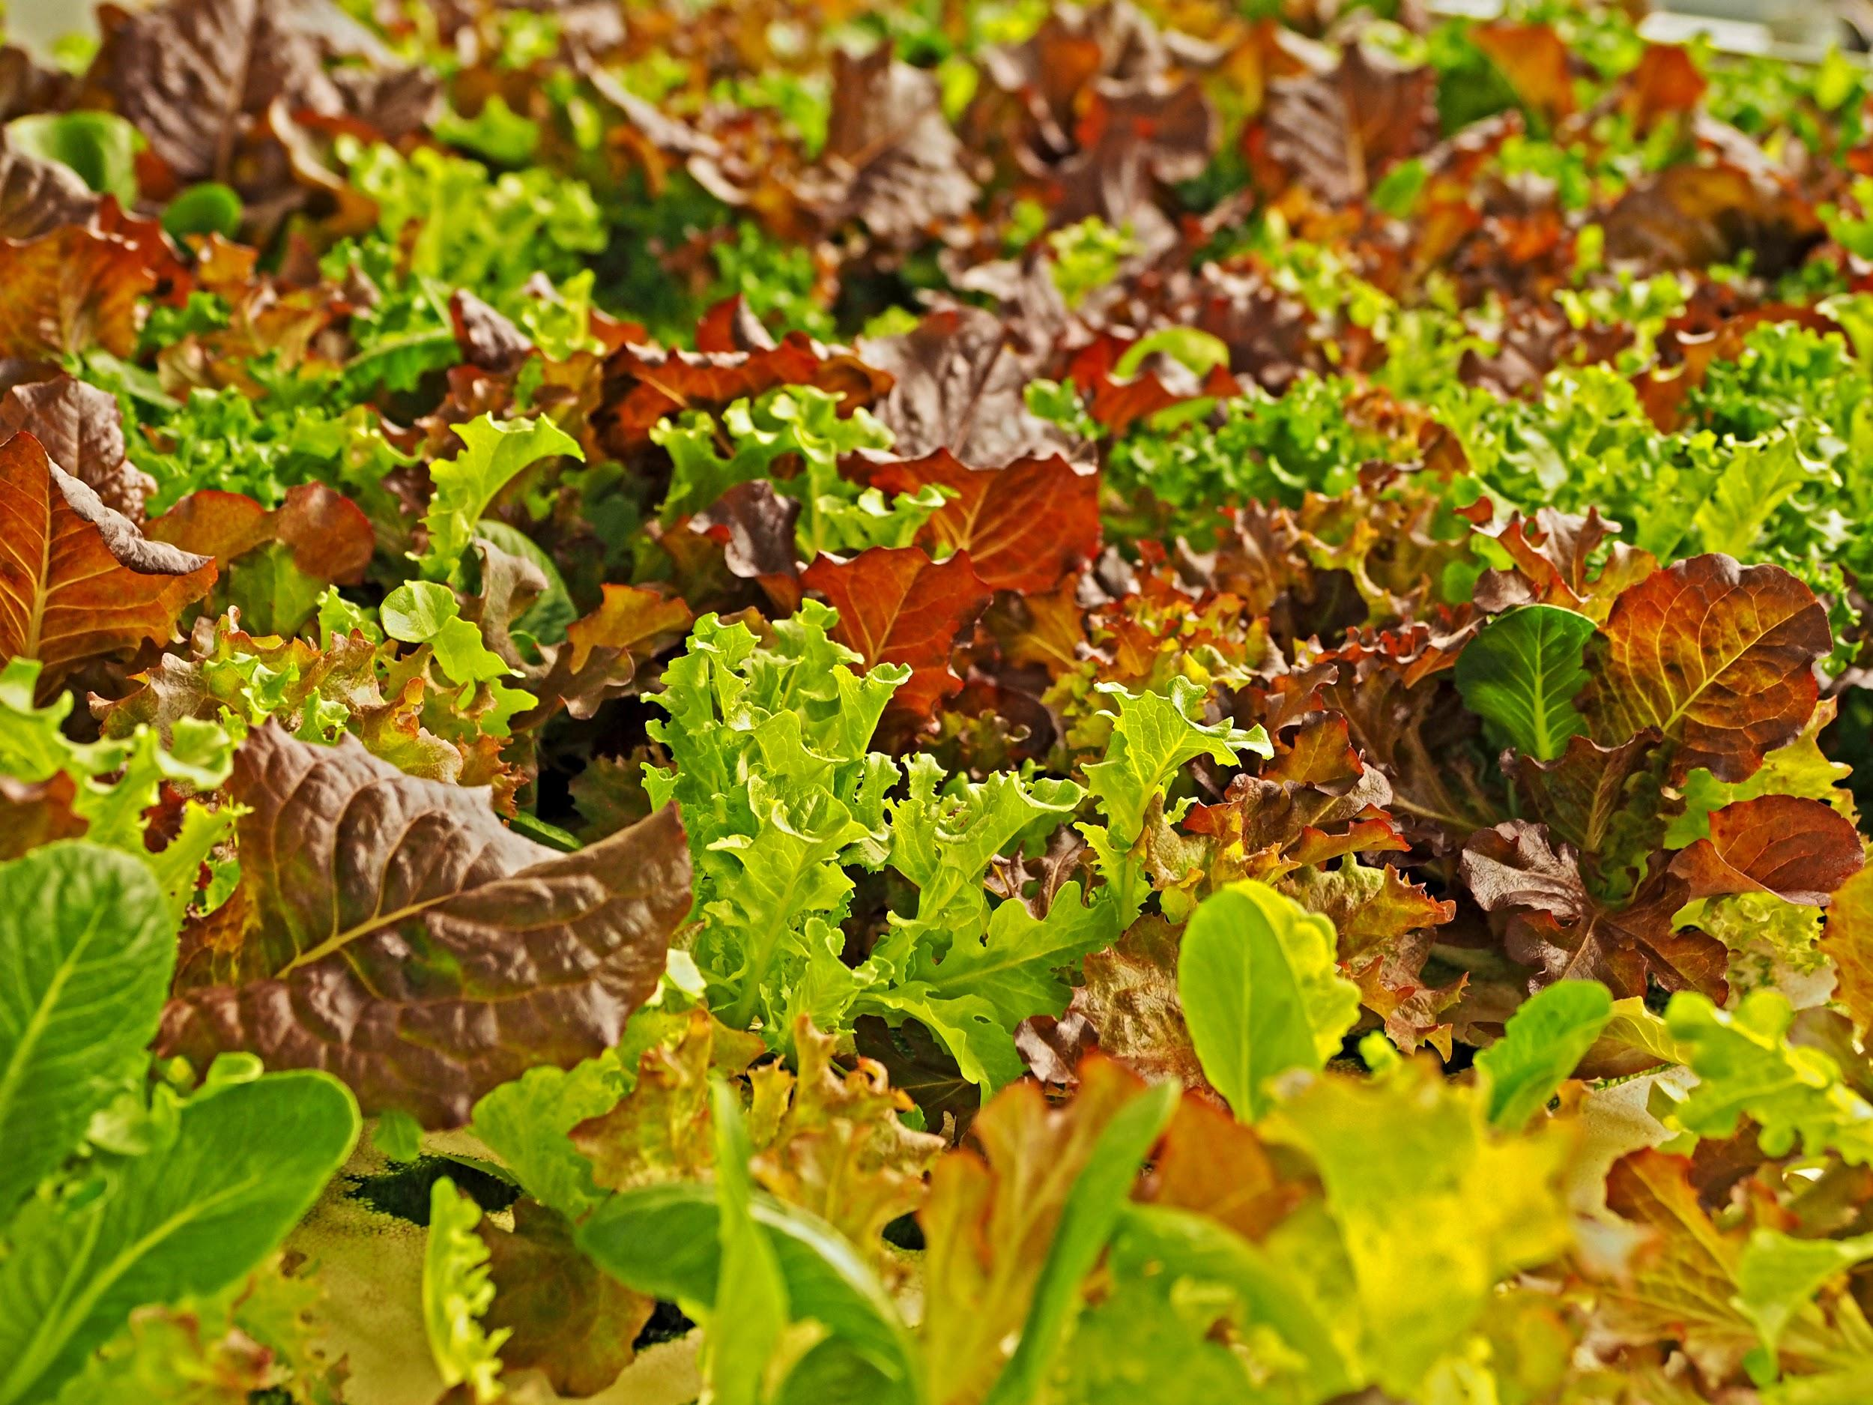




Modern Farming?
Indoor
Hydroponic
LED lit
Vertical
Automated
Notes:
Over 100x more productive per acre of land
Requires absolutely no pesticides
Uses 95% less water than outdoor crops
Always grown locally to minimize impact of transportation

Slide 3





3 years old, Series A,
60 employees
Product is available at
… more coming soon!

Slide 4

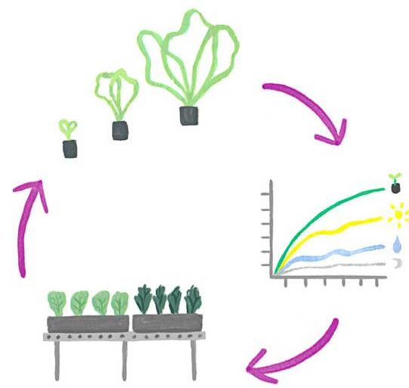
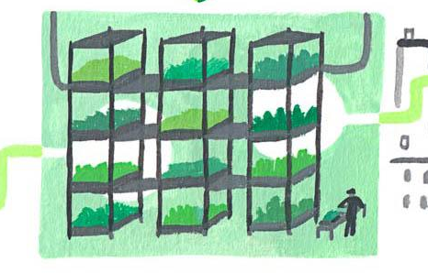
But what about the “AI”?
Operational
Constrained
optimization
Informational
Scaling the
green thumb
Agricultural
Finding the
perfect recipe
Notes:
Constrained optimization
Crop positioning within the farm to maximize utilization
Task ordering to maximize labor efficiency
Informational
Computer vision to measure crop growth promote early warning of any problems
Automatically allocate human grower attention to crops that need it
Agricultural
High-dimensional search of recipe parameters
Specific to cultivar and use

Slide 5
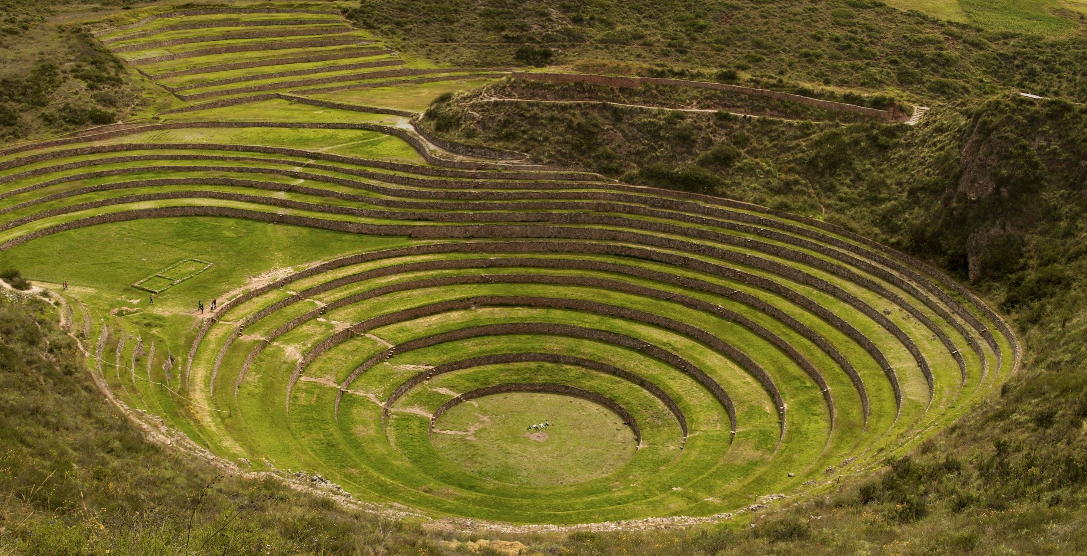
Notes:
The Inca developed terracing to improve yield in the 15th century

Slide 6
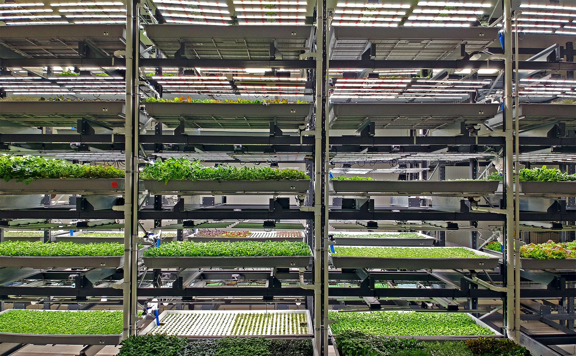
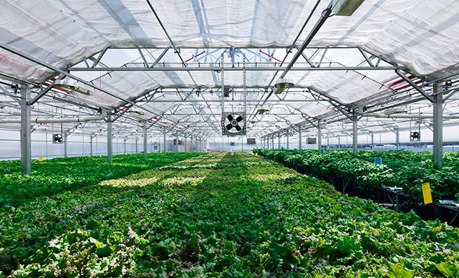
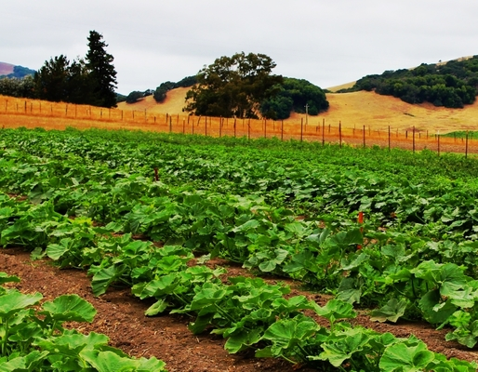
What’s different? Control and time to iterate
1000’s
Indoor Vertical
100’s
Greenhouse
Trials per year
10’s
Open Field
a few
1
0
Proportion of factors controlled
1
Notes:
Our rate of learning scales with the number and size of our farms, not with the size of our AgSci R&D staff

Slide 7




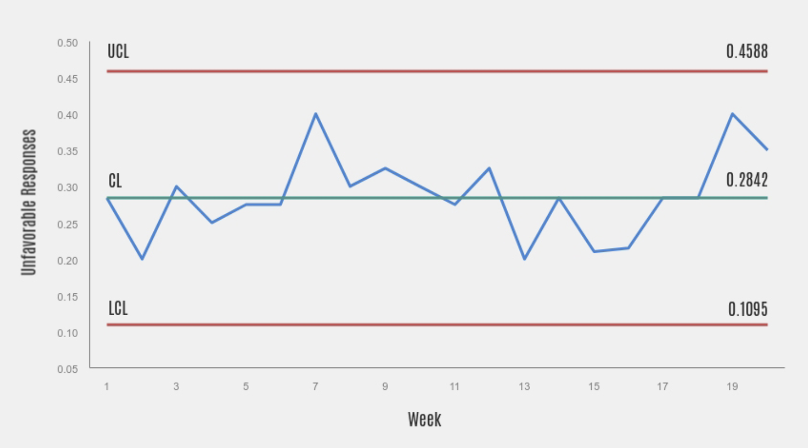
The “hero” challenge: Provide value early by closing the loop
ETL
Pipeline
Data
from business systems
Data
Product
Reporting
Do something clever ?!
ML
Pipeline
Well structured warehouse data
Notes:
Closing the loop usually requires building 3-5 different

Slide 8
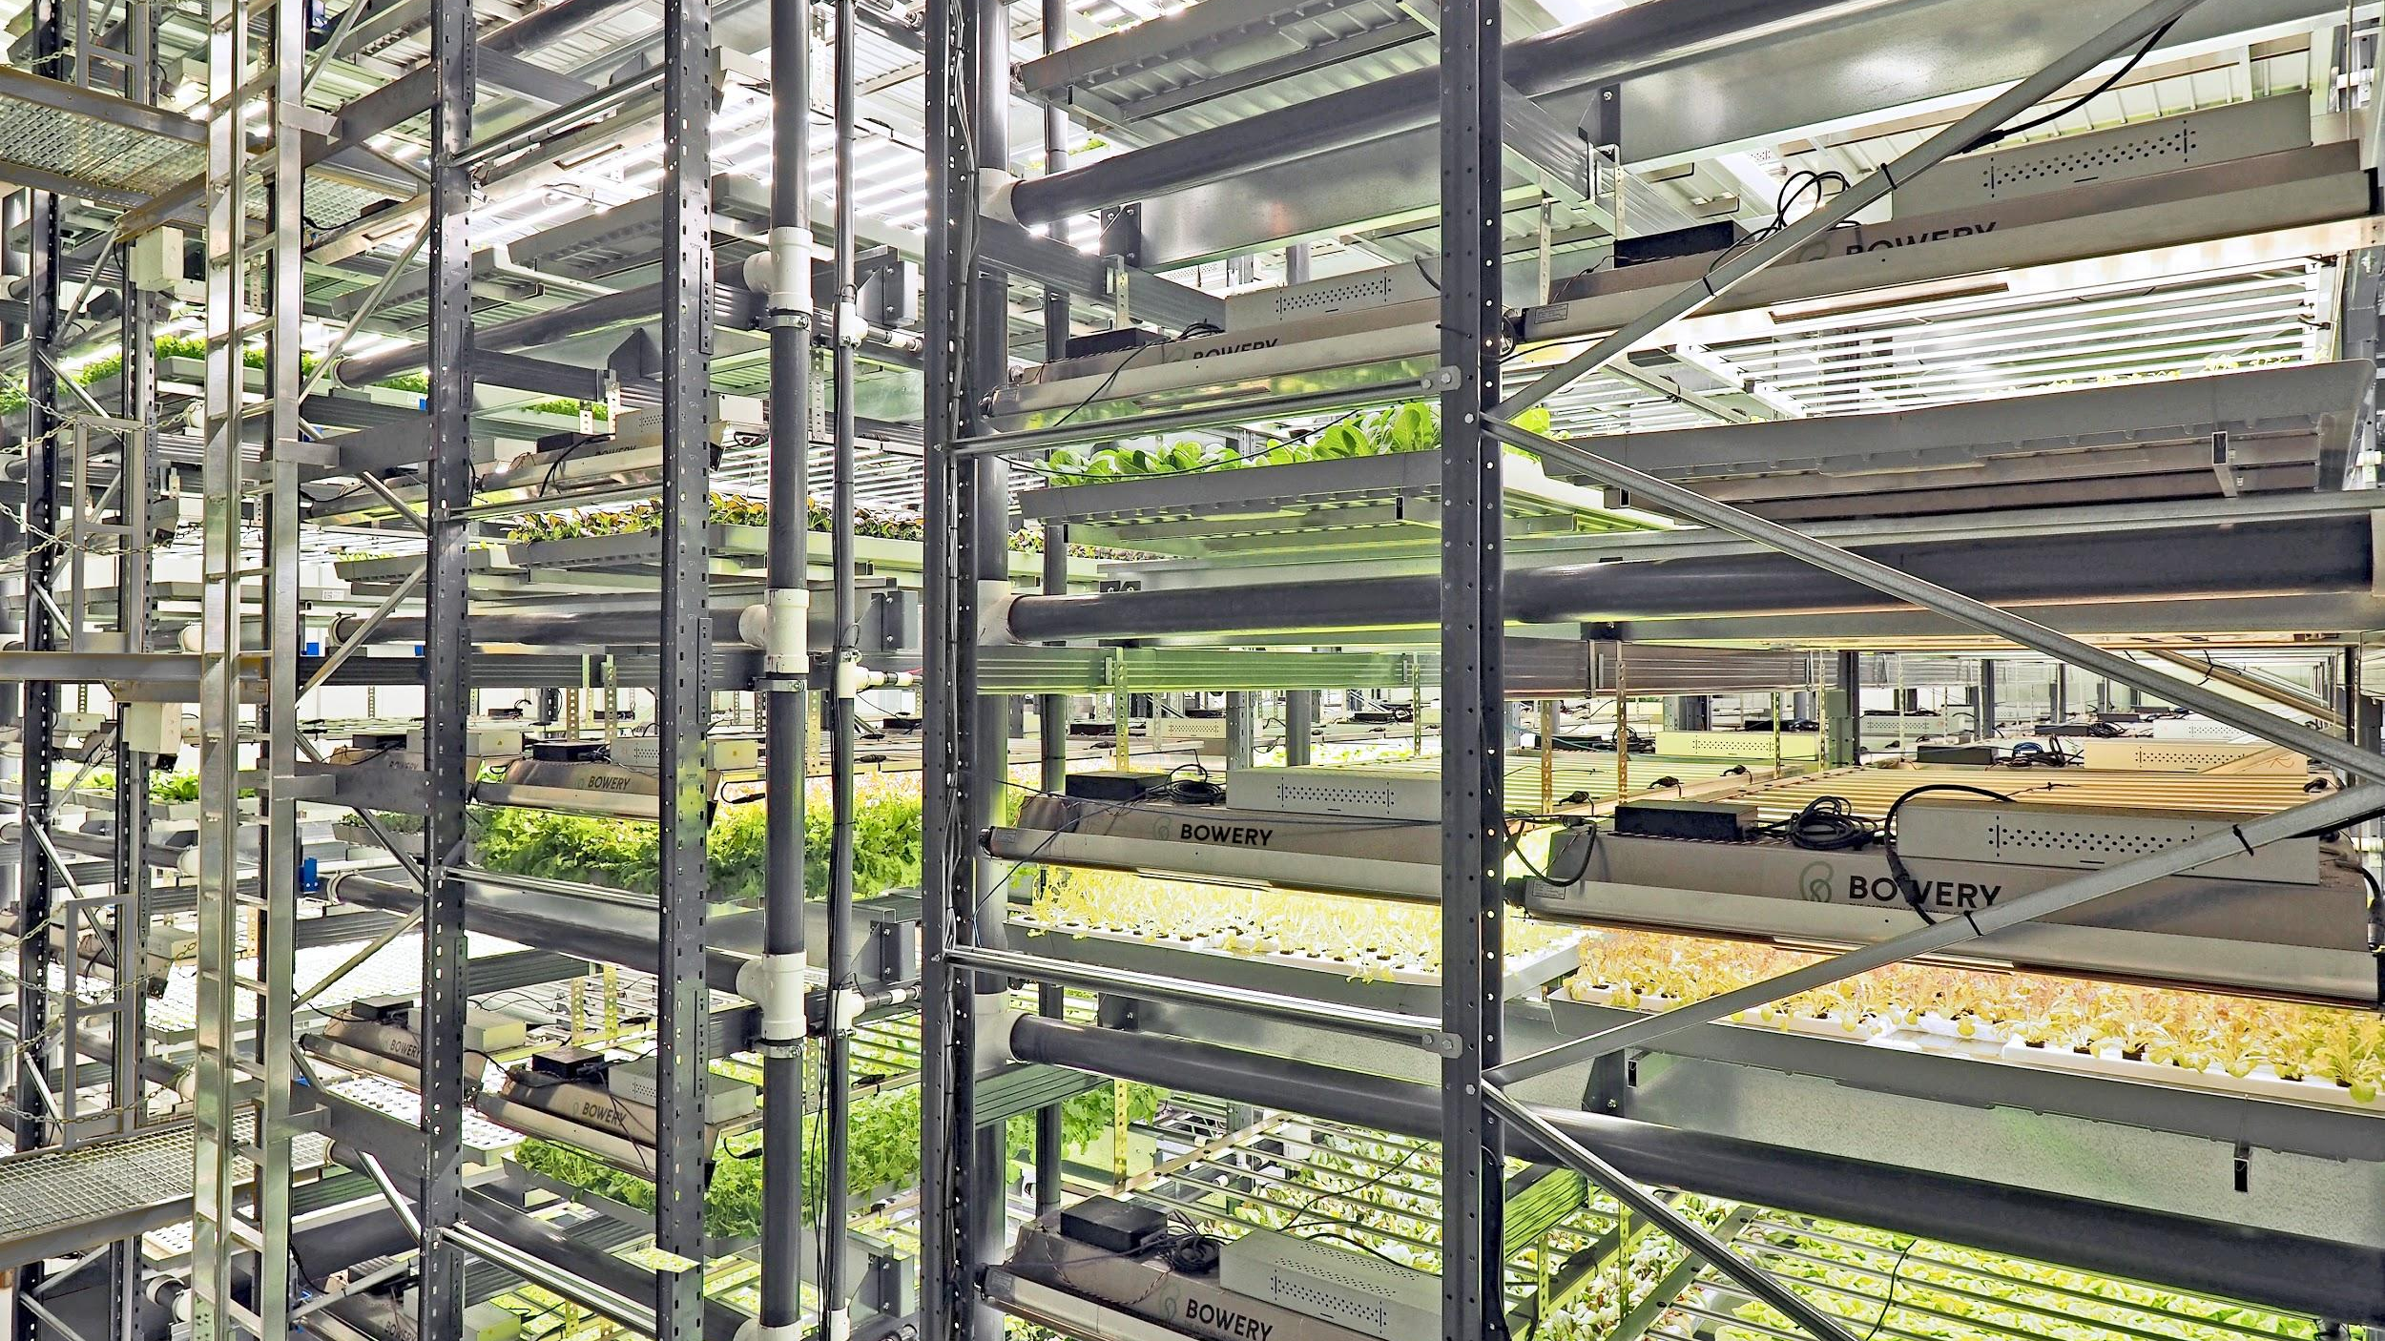

Slide 9
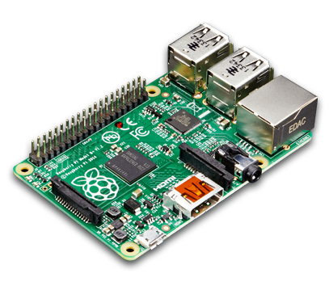














The Bowery Farming (data) ecosystem
load
ingest
warehouse
Notes:
Almost entirely 1st party data
Environmental sensors from a network of IoT devices
Task times and completions
Crop

Slide 10

Streaming load
IoT sensing and control
SNS / SQS message bus
Redshift load schema
1st party applications
on EC2
Kinesis Firehose
load
Images and data artifacts
0n S3

Slide 11
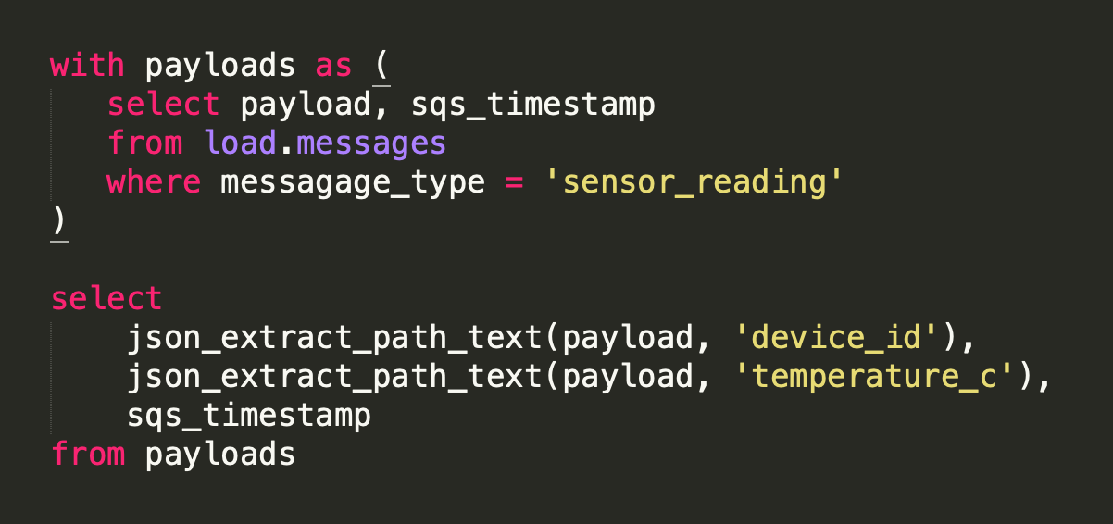
Incremental extract
load
ingest

Slide 12
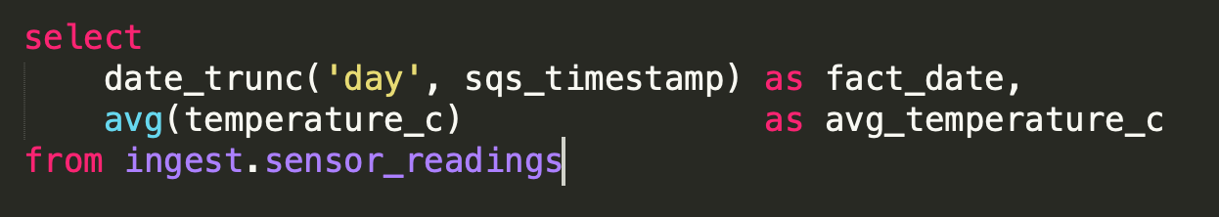
Batch transform
ingest
warehouse

Slide 13
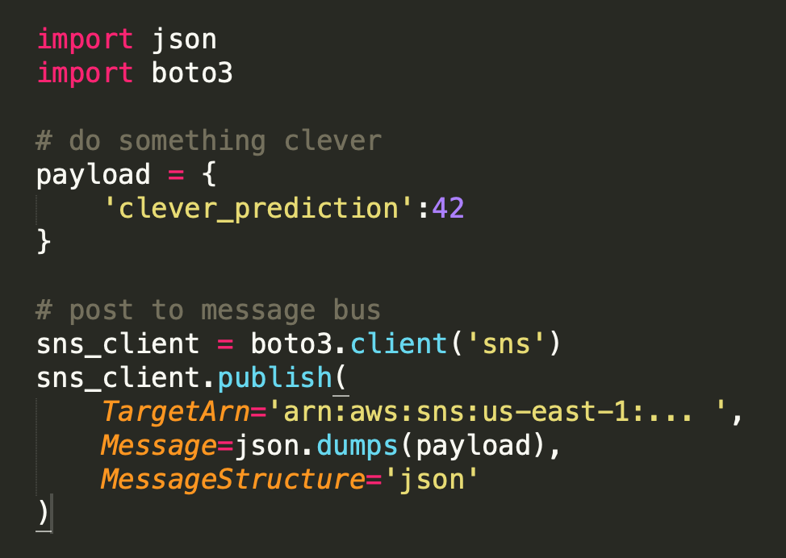
Infinitely Flexible Data
Products
SNS / SQS message bus
warehouse

Slide 14
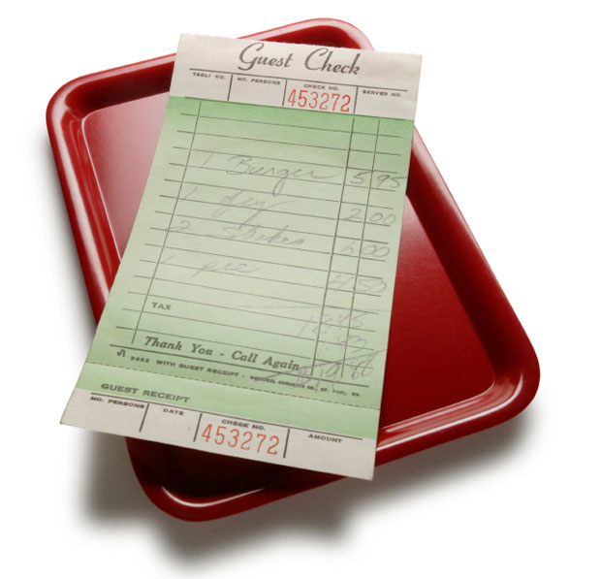
And it’s all so cheap!
$ 46 SNS
$ 308 SQS
$ 3 Kinesis
$ 100 S3
$ 186 Redshift
$ 100 Sinter
$ 100 EC2 t3.medium x 3
------
<$1000 for
~ 10^7 messages / month

Slide 15
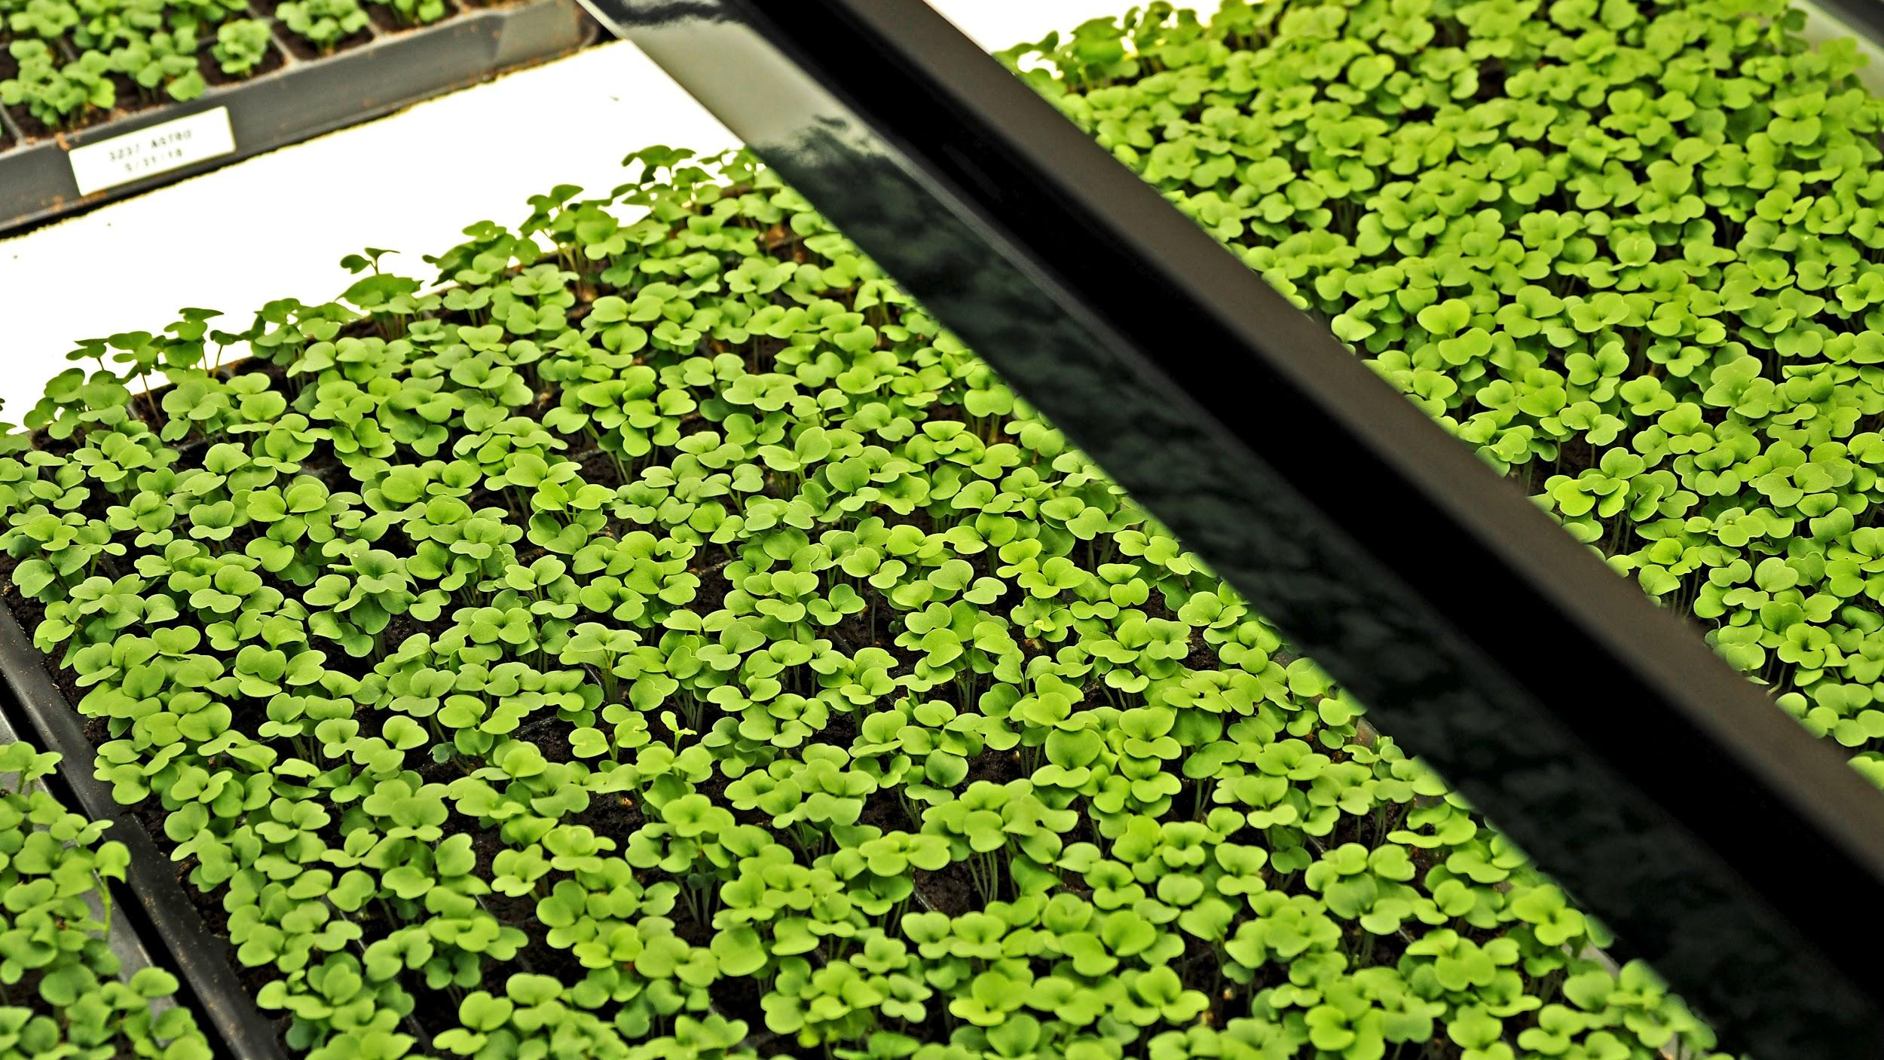

Slide 16
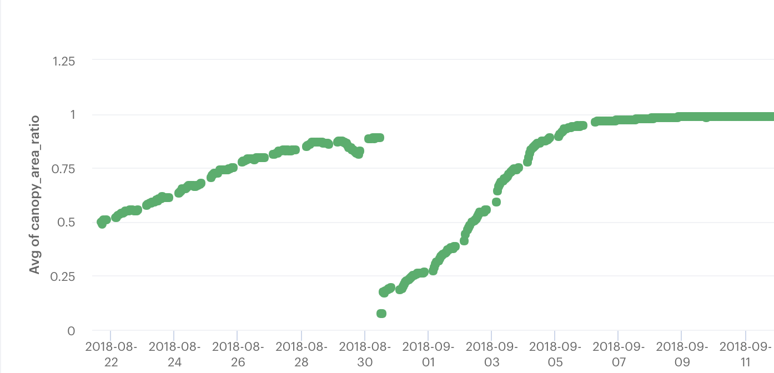
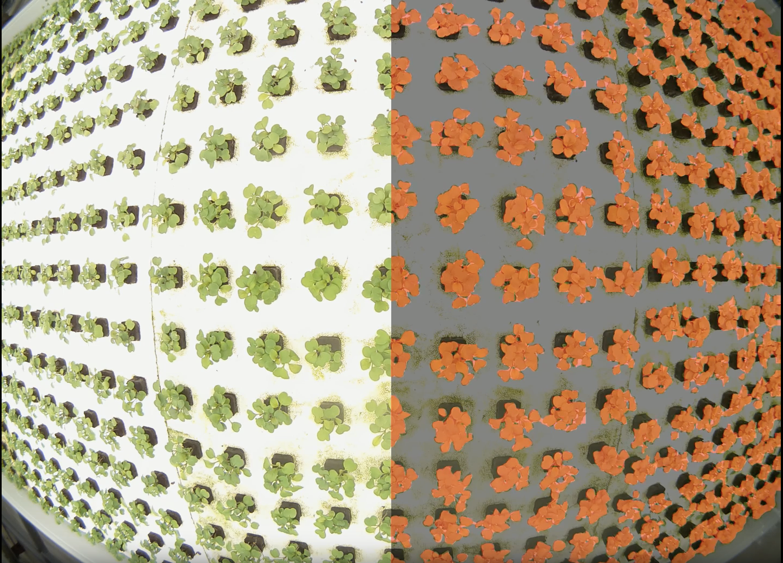

An integrated example: Canopy Area
Notes:
Trained in-house on top of TensorFlow DeepLab, which is a CNN

Slide 17

Notes:
Trained in-house on top of TensorFlow DeepLab, which is a CNN

Slide 18
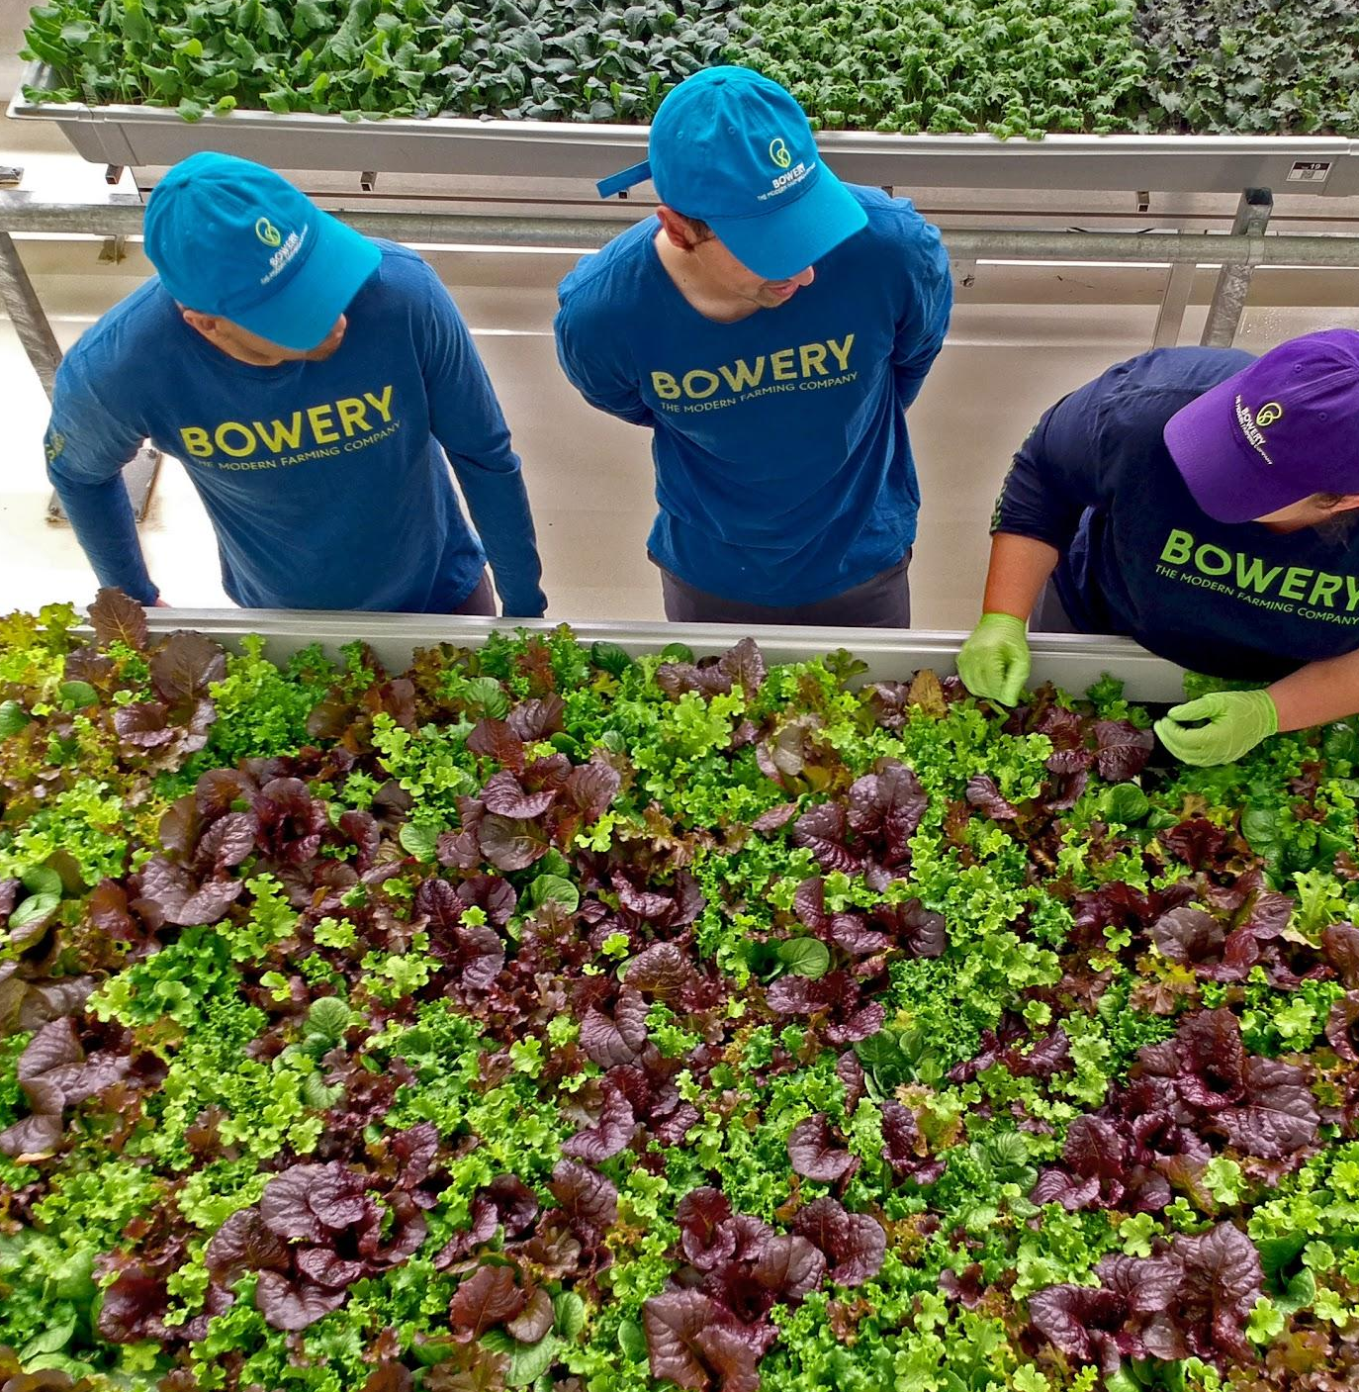
Acknowledgements
“team of 1” isn’t quite accurate ....
Henry Sztul
Kevin Sheurs
Sae Hwang
Marianne Hoogeveen
Katie Yoshida

Slide 19
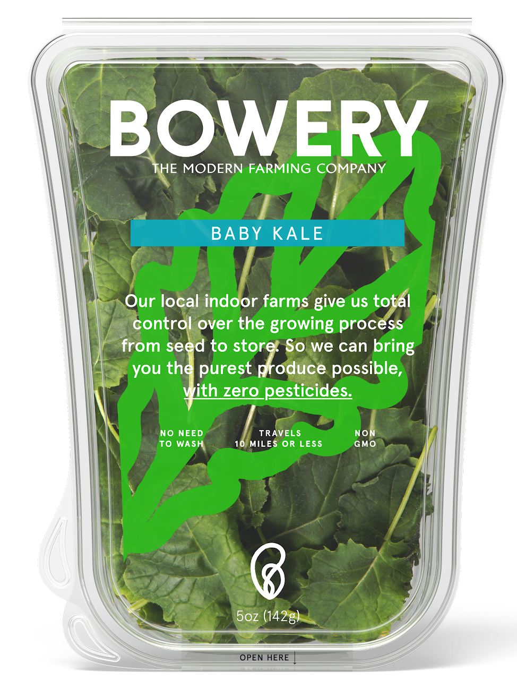
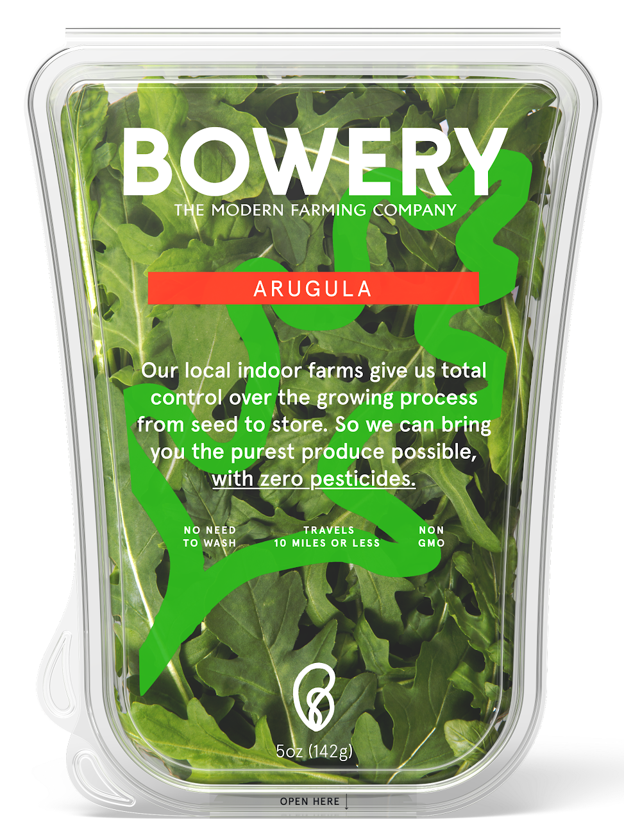
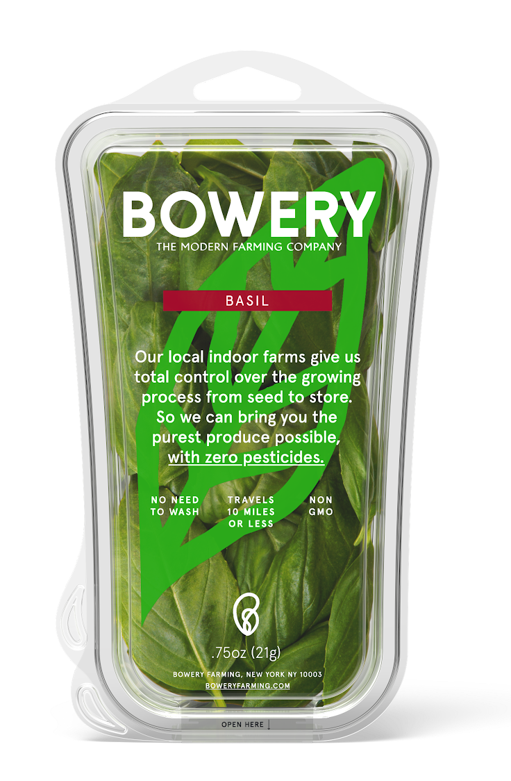
Come say hi!
Office hours immediately following
@swiftsam on twitter
@BoweryFarming on twitter/insta
We’re hiring
Find us in Manhattan and NJ Wholefoods

