Slide 1

Notes:
Thanks for invitation
Thank william for organizing track

Slide 2
Part 1: What Foursquare does
Part 2: Tips for predictive modeling
Notes:
Second half: tips for predictive modeling, specifically lessons learned by the data scientists at Foursquare over the past few years
In order to motivate the examples for that part, I need to explain to you what our team works on, and what Foursquare does

Slide 3
A brief history of Foursquare

Slide 4
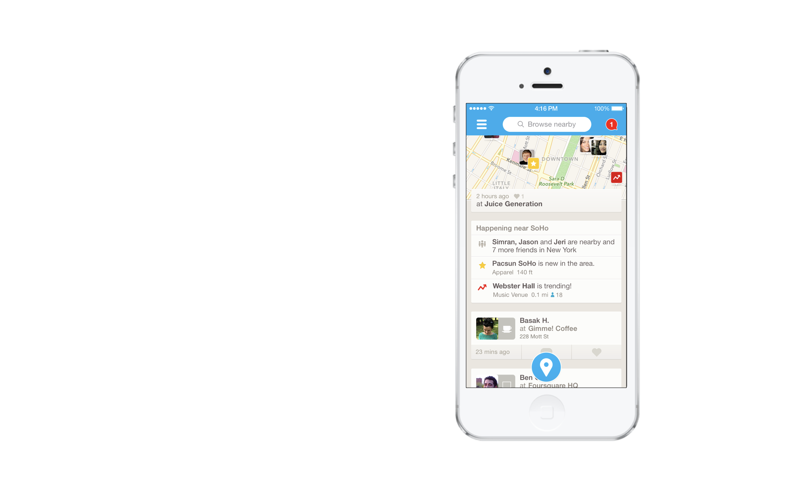

Slide 5
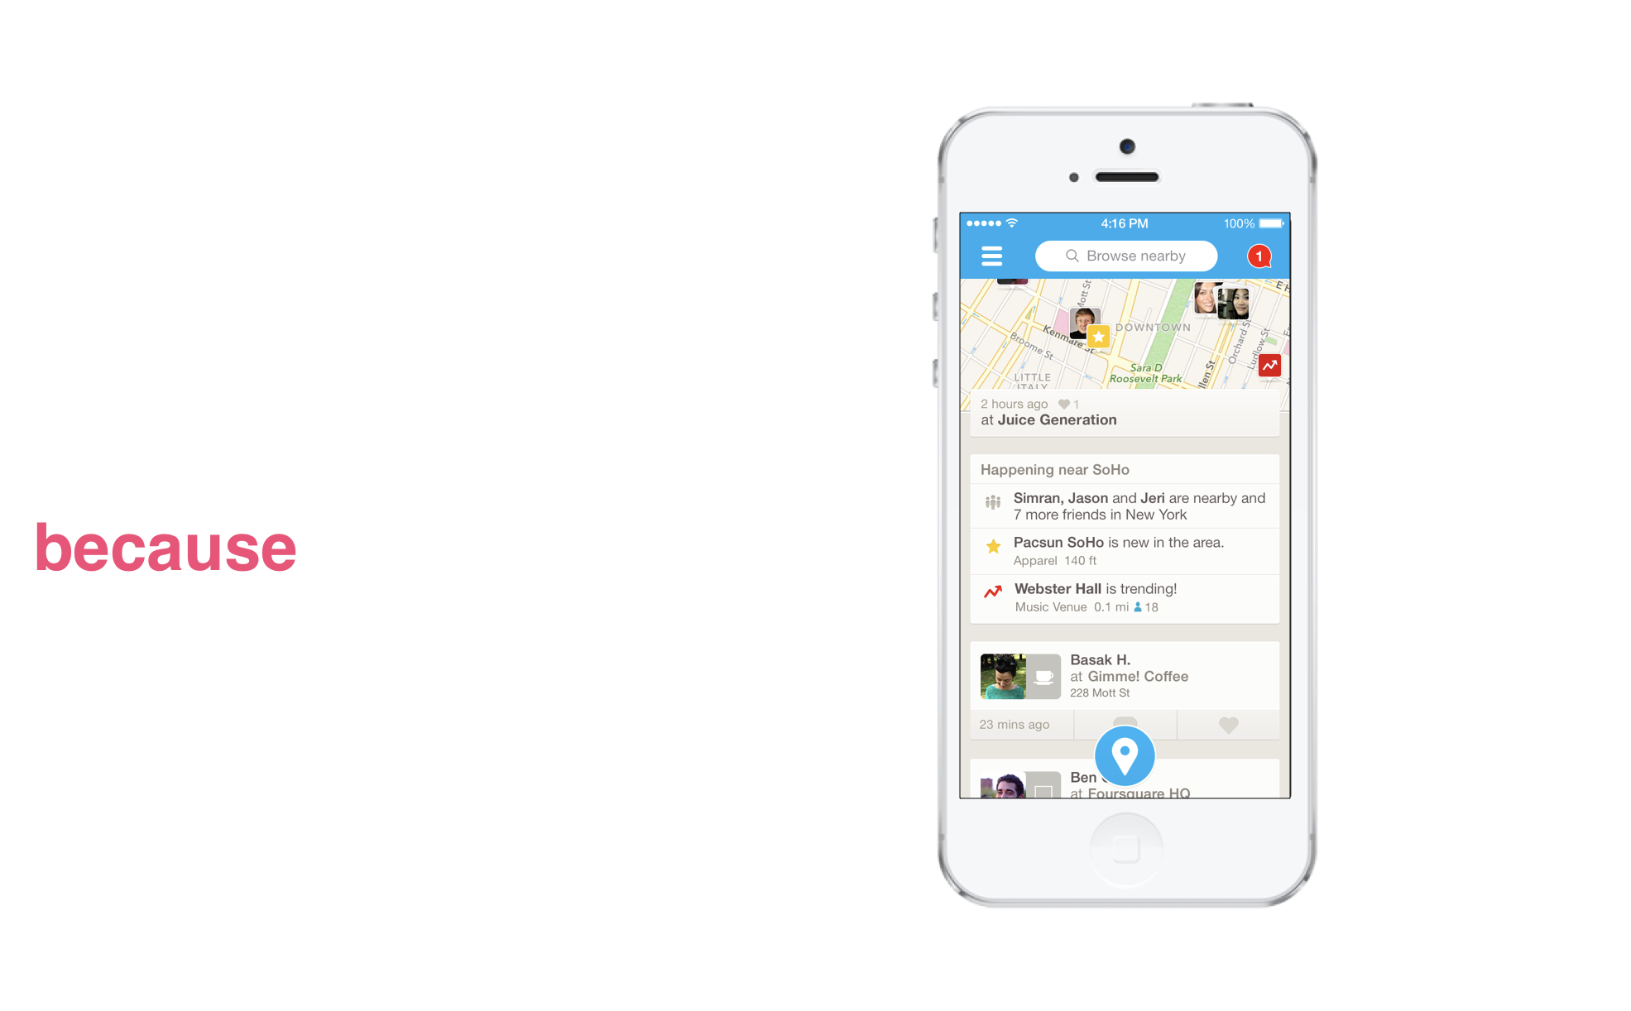
Notes:
When I used the app I liked the data it showed me, and so I joined the data science team at Foursquare so I could get my hands on this data

Slide 6


2014

Slide 7
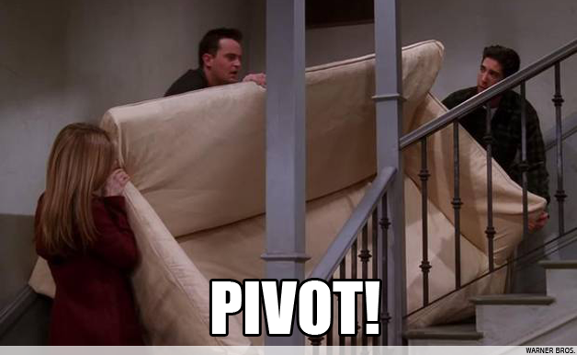
2016
Notes:
Second pivot was a much more dramatic change than splitting the apps

Slide 8

Notes:
Wikipedia: “process of deriving meaningful insight from geospatial data relationships to solve a problems”
EXAMPLE OF LOCATION INTELLIGENCE IS THE PRODUCT I WORK ON CALLED PILGRIM

Slide 9

Pilgrim
Notes:
Born in 2013
Applied machine learning...that runs in the background of a mobile phone…
CHECKINFLOW IS DISRUPTIVE

Slide 10
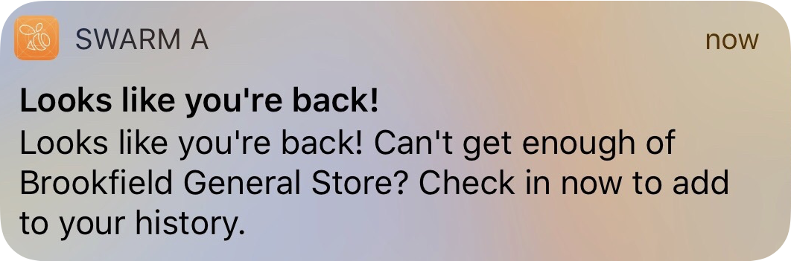

Slide 11
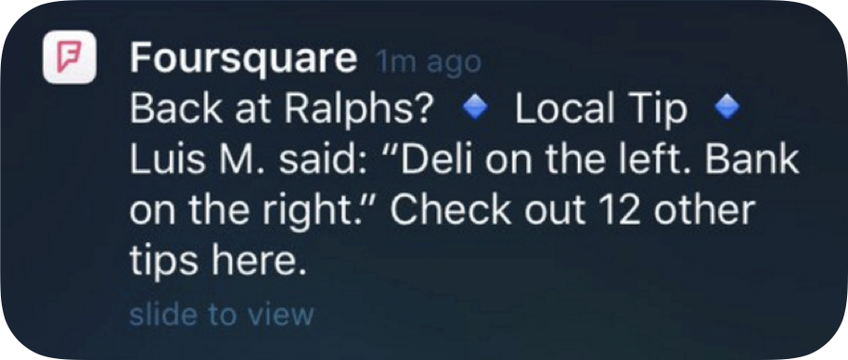

Slide 12
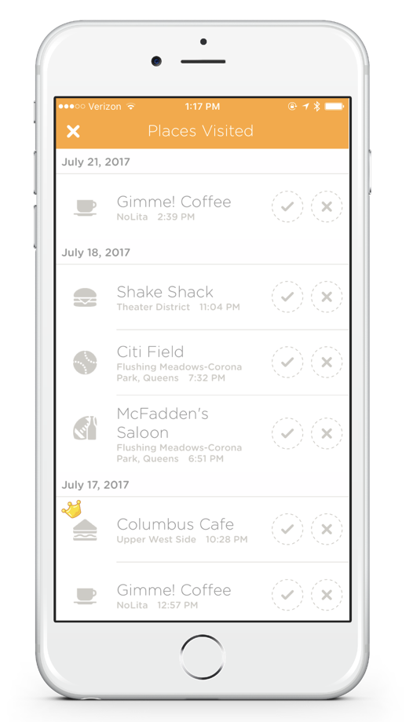

Slide 13
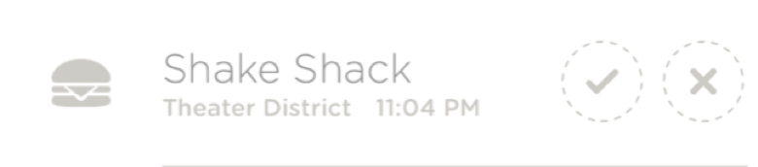

Slide 14



Slide 15
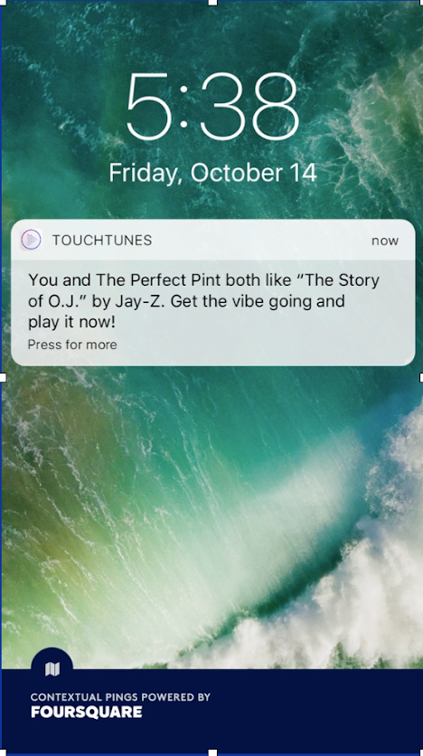

Slide 16
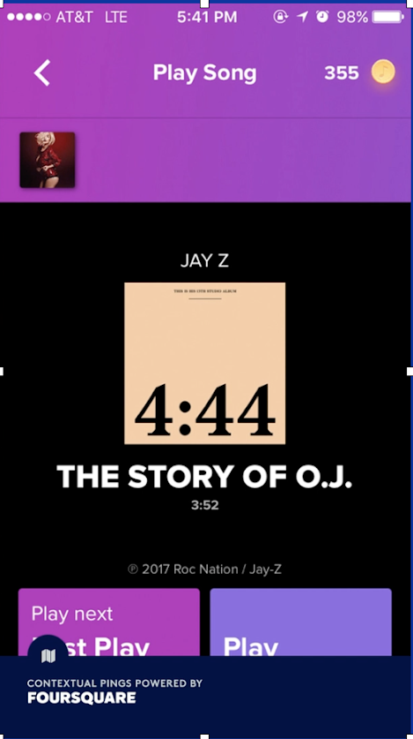

Slide 17
Foursquare’s data

Slide 18
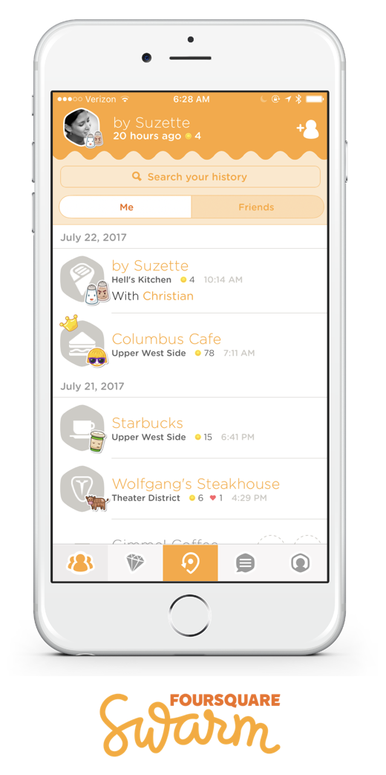
Swarm checkins

Slide 19

Swarm checkins

Slide 20
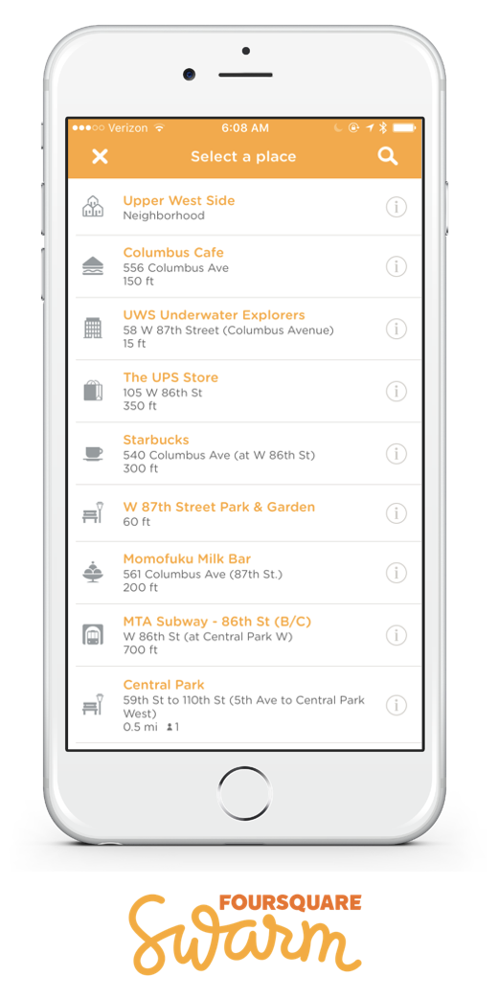
Swarm checkins

Slide 21
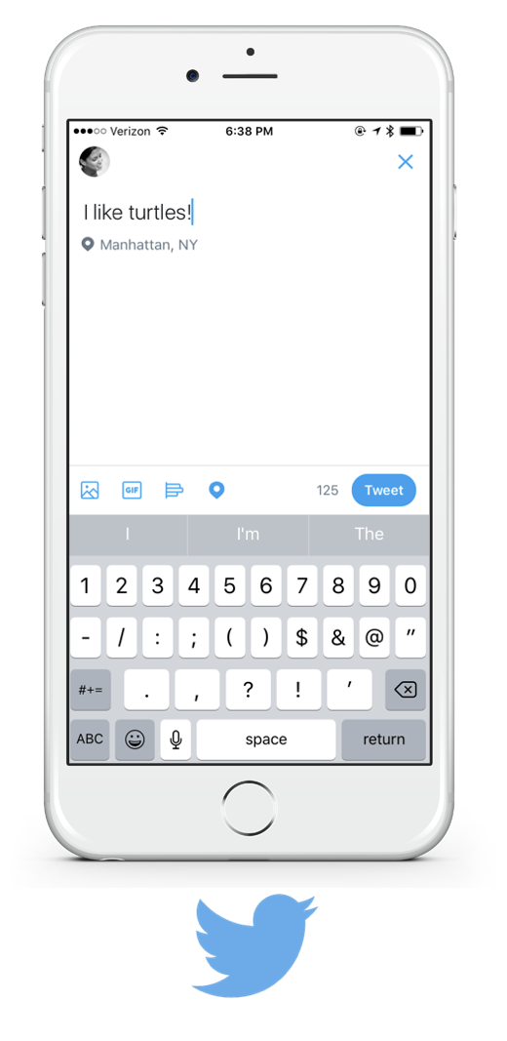
Partner data

Slide 22

Partner data

Slide 23
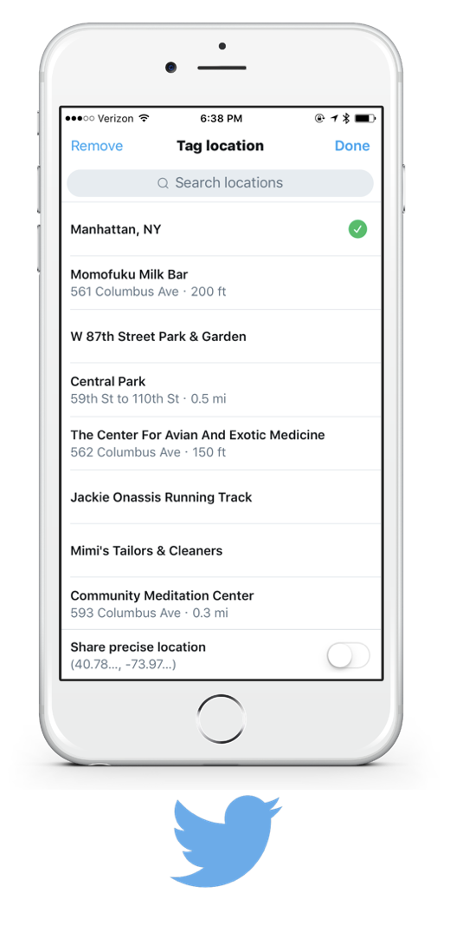
Partner data

Slide 24
PIlgrim SDK

Slide 25
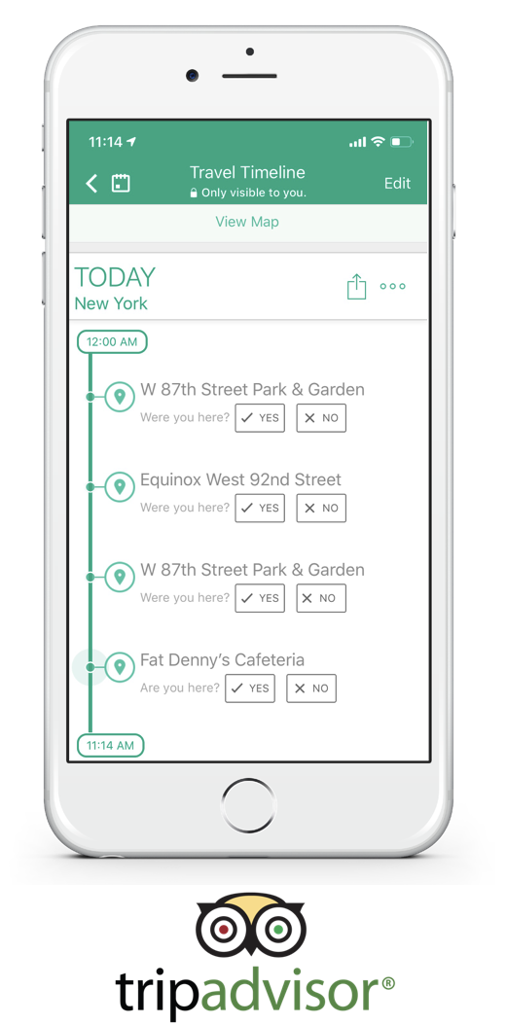
User confirmations

Slide 26
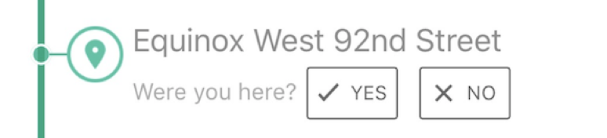
User confirmations

Slide 27
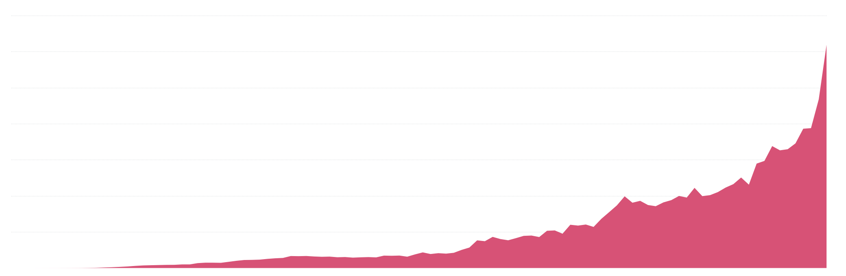
Visits detected by Foursquare

Slide 28


Slide 29
#1: Track the right metrics

Slide 30
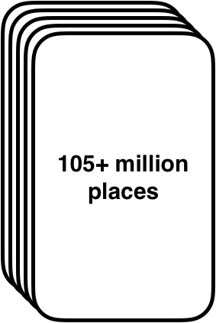

Slide 31
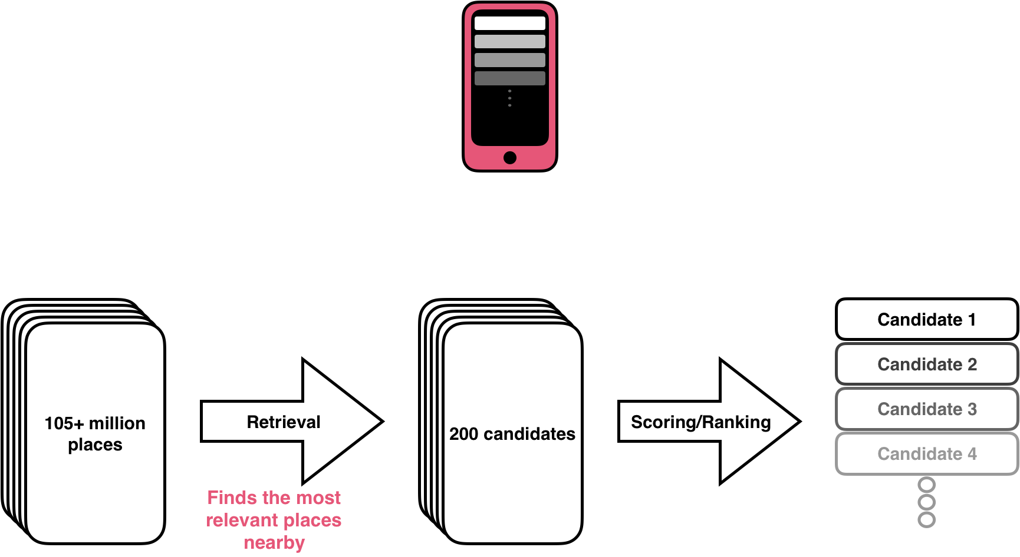

Slide 32
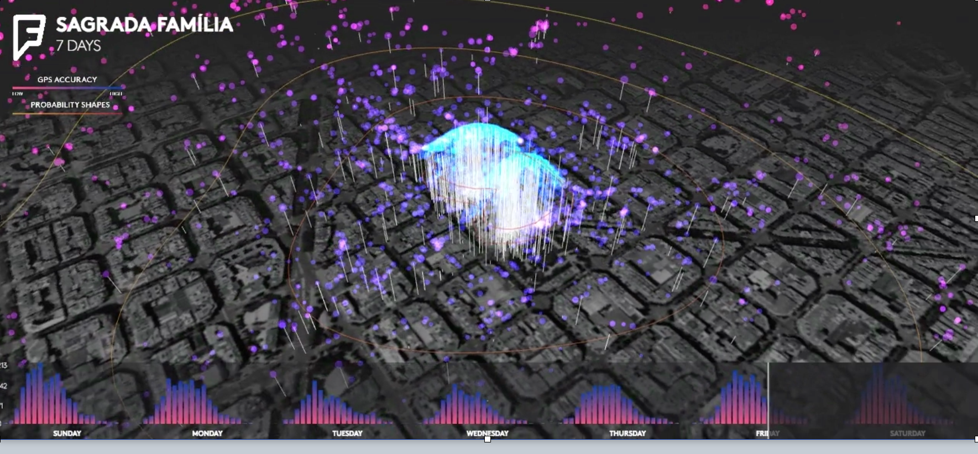
Place shapes

Slide 33
Place shapes

Slide 34
Place shapes
Wifi and bluetooth scans

Slide 35
Place shapes
Wifi and bluetooth scans
Popularity

Slide 36
Place shapes
Wifi and bluetooth scans
Popularity
Personalized

Slide 37
Place shapes
Wifi and bluetooth scans
Popularity
Personalized
Time of day

Slide 38
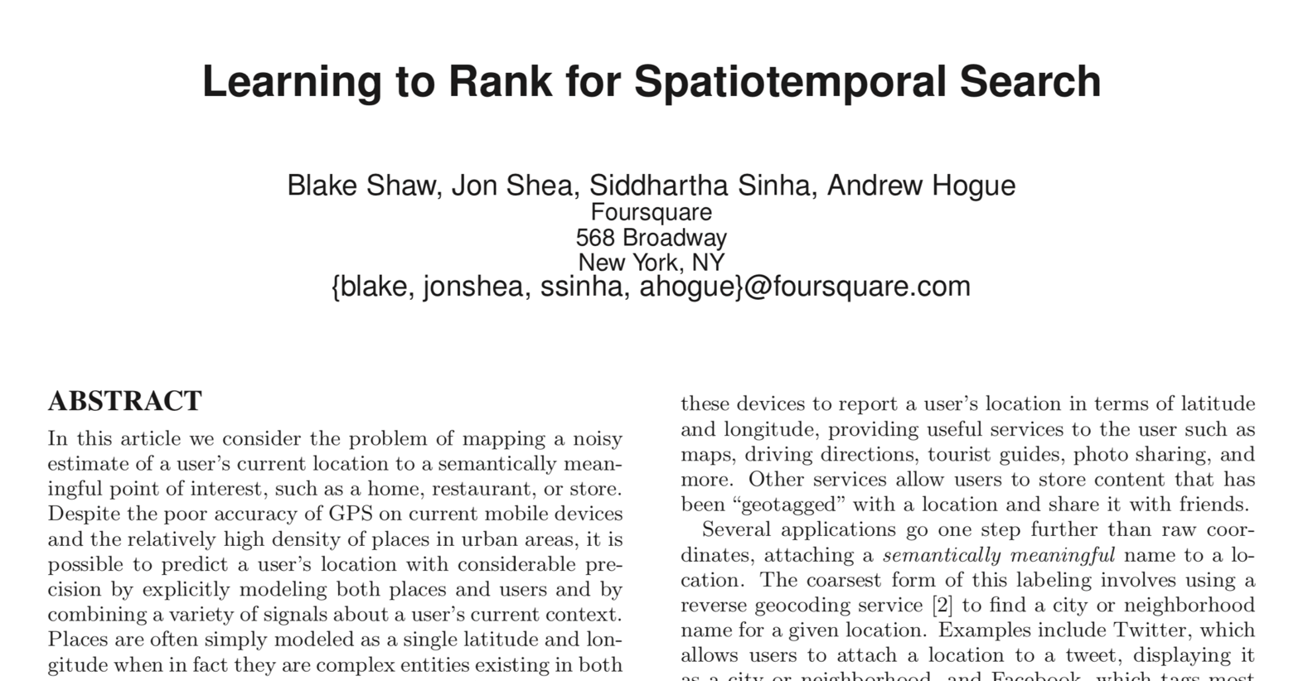

Slide 39
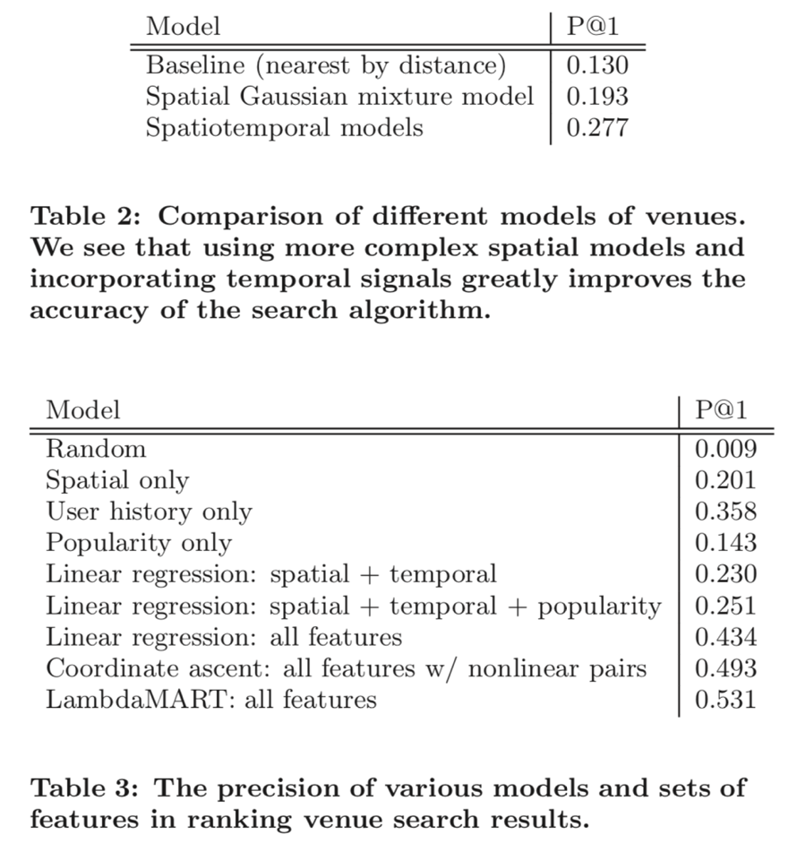
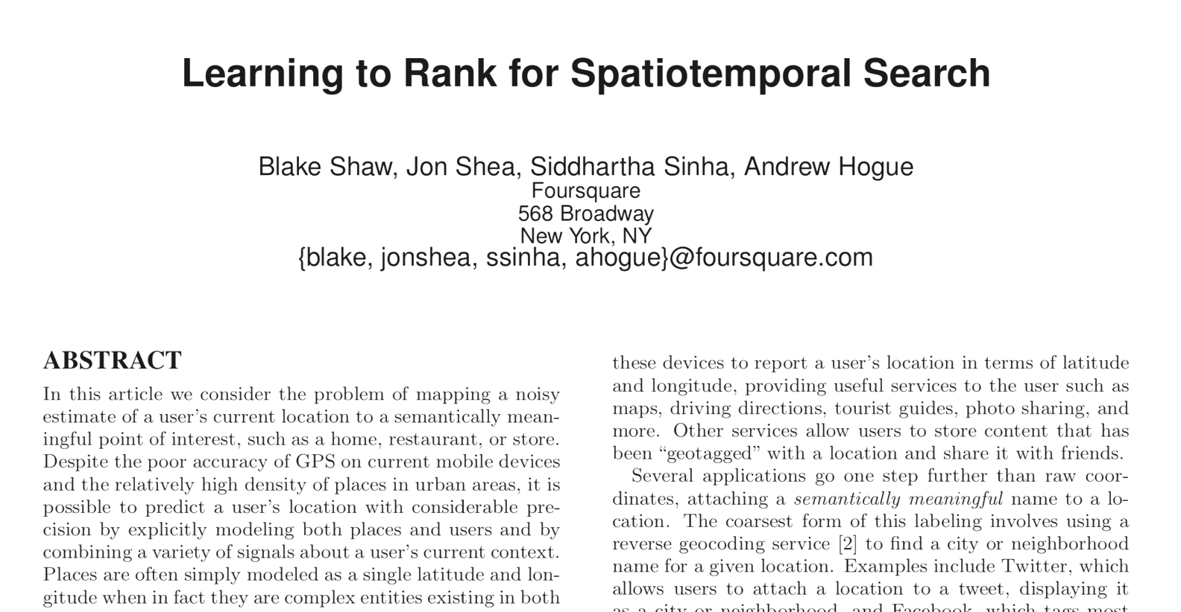

Slide 40
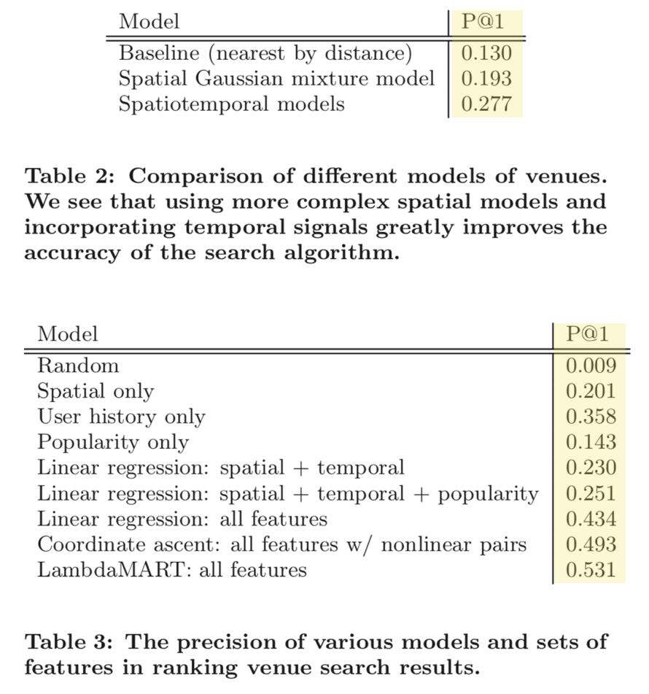

Slide 41
Is P@1 the right metric?

Slide 42

Is P@1 the right metric?

Slide 43
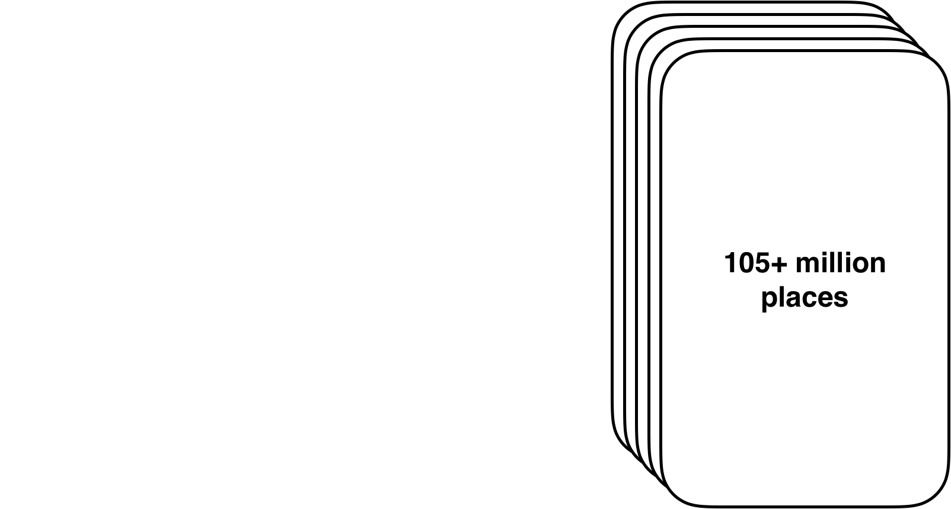

Slide 44
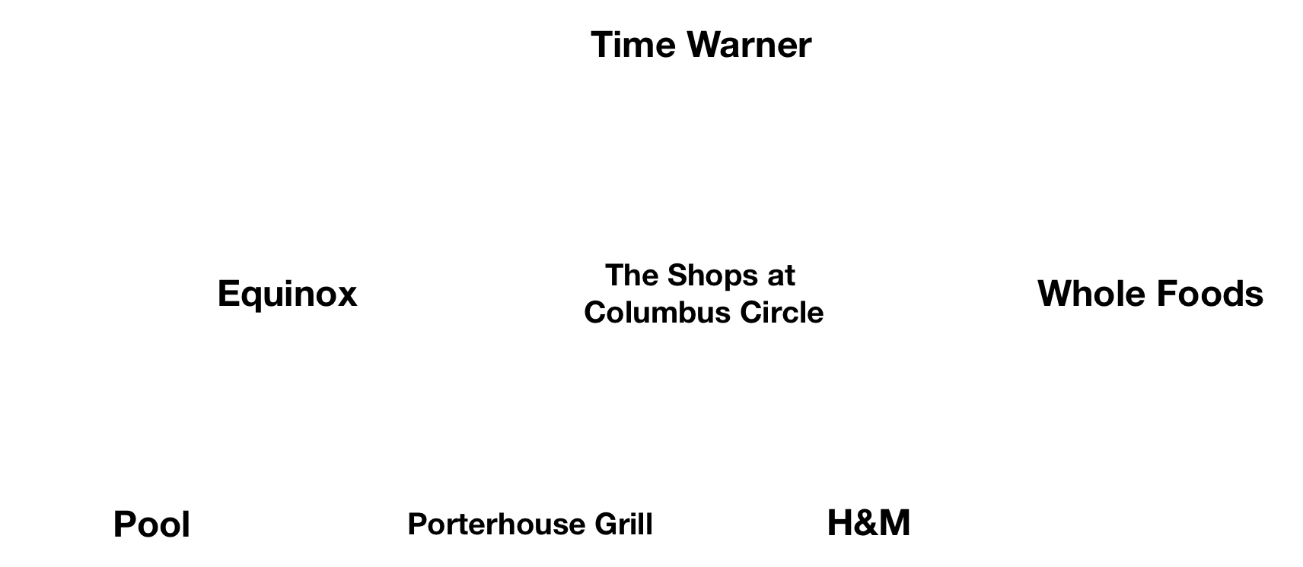

Slide 45
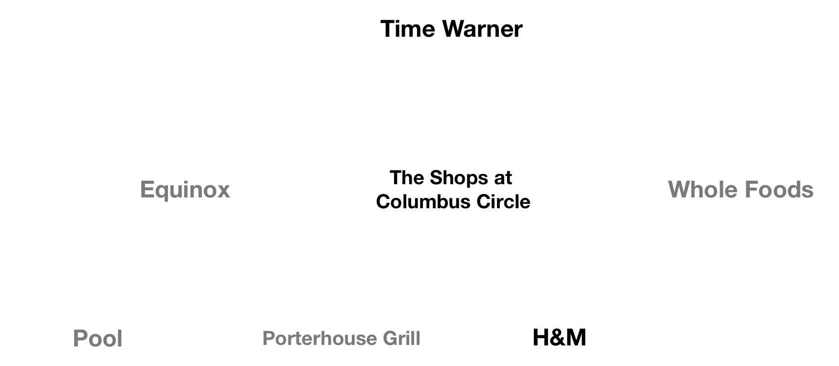

Slide 46
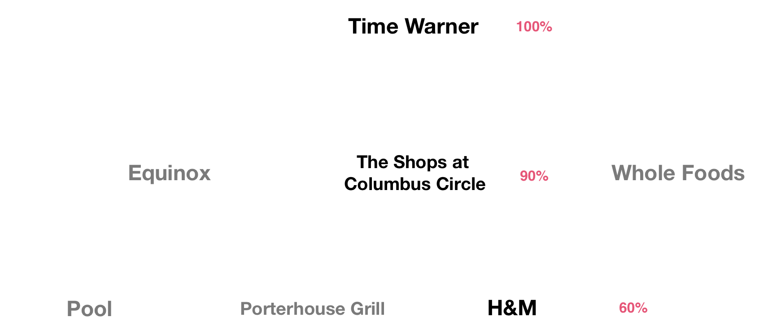

Slide 47
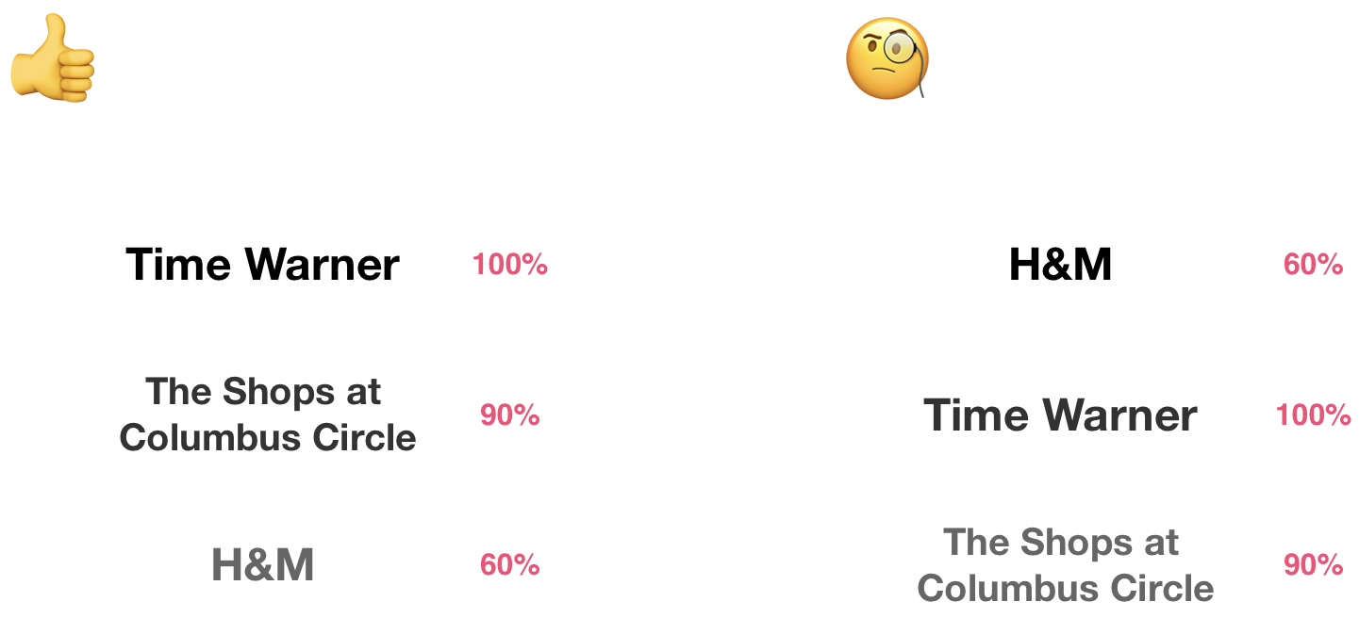

Slide 48
Are we detecting that right places in a hierarchy?
Are we only detecting the same places over and over?
Does our data make sense when compared to external sources?

Slide 49
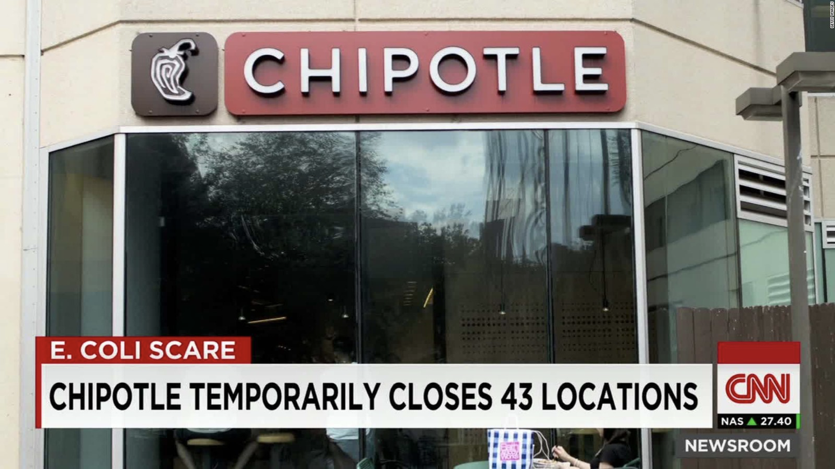
2016

Slide 50
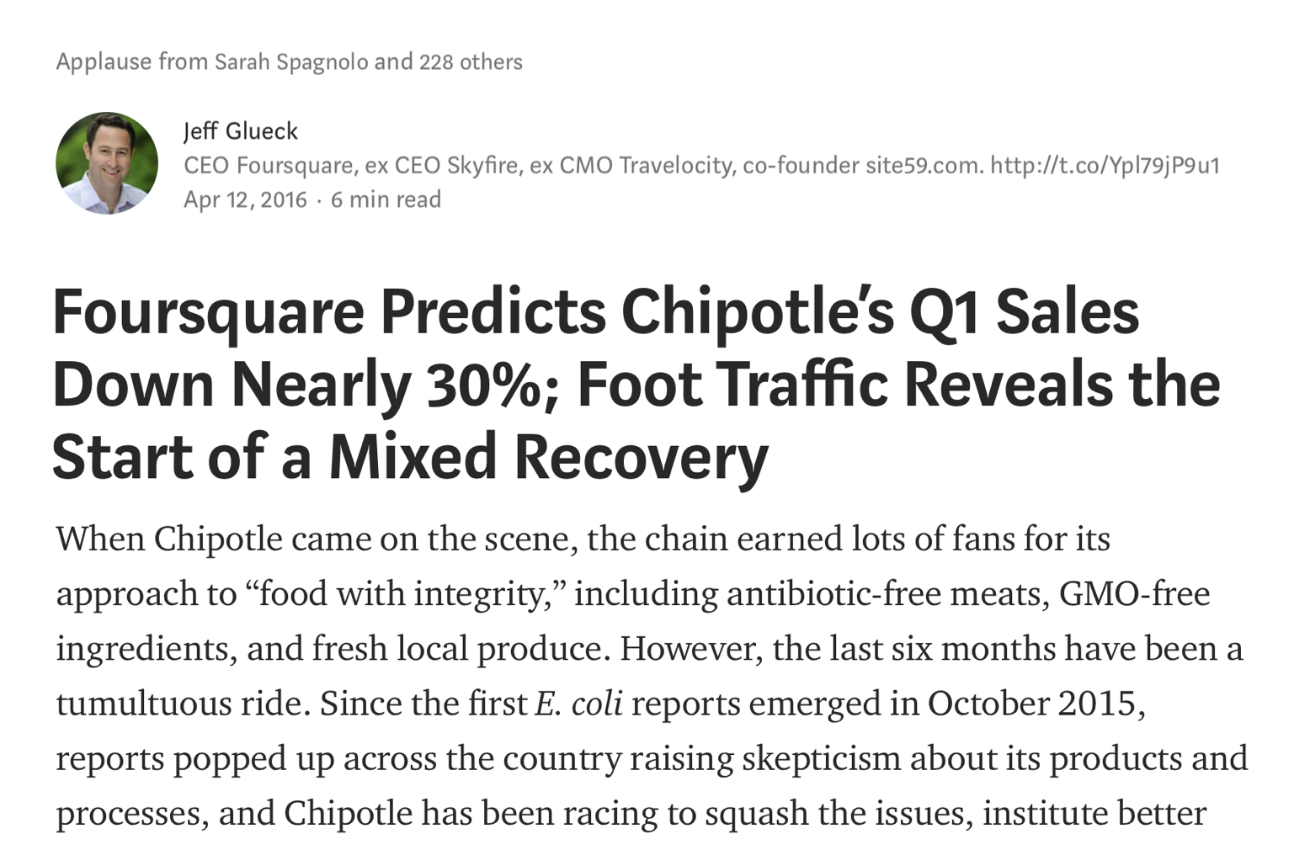
2016

Slide 51
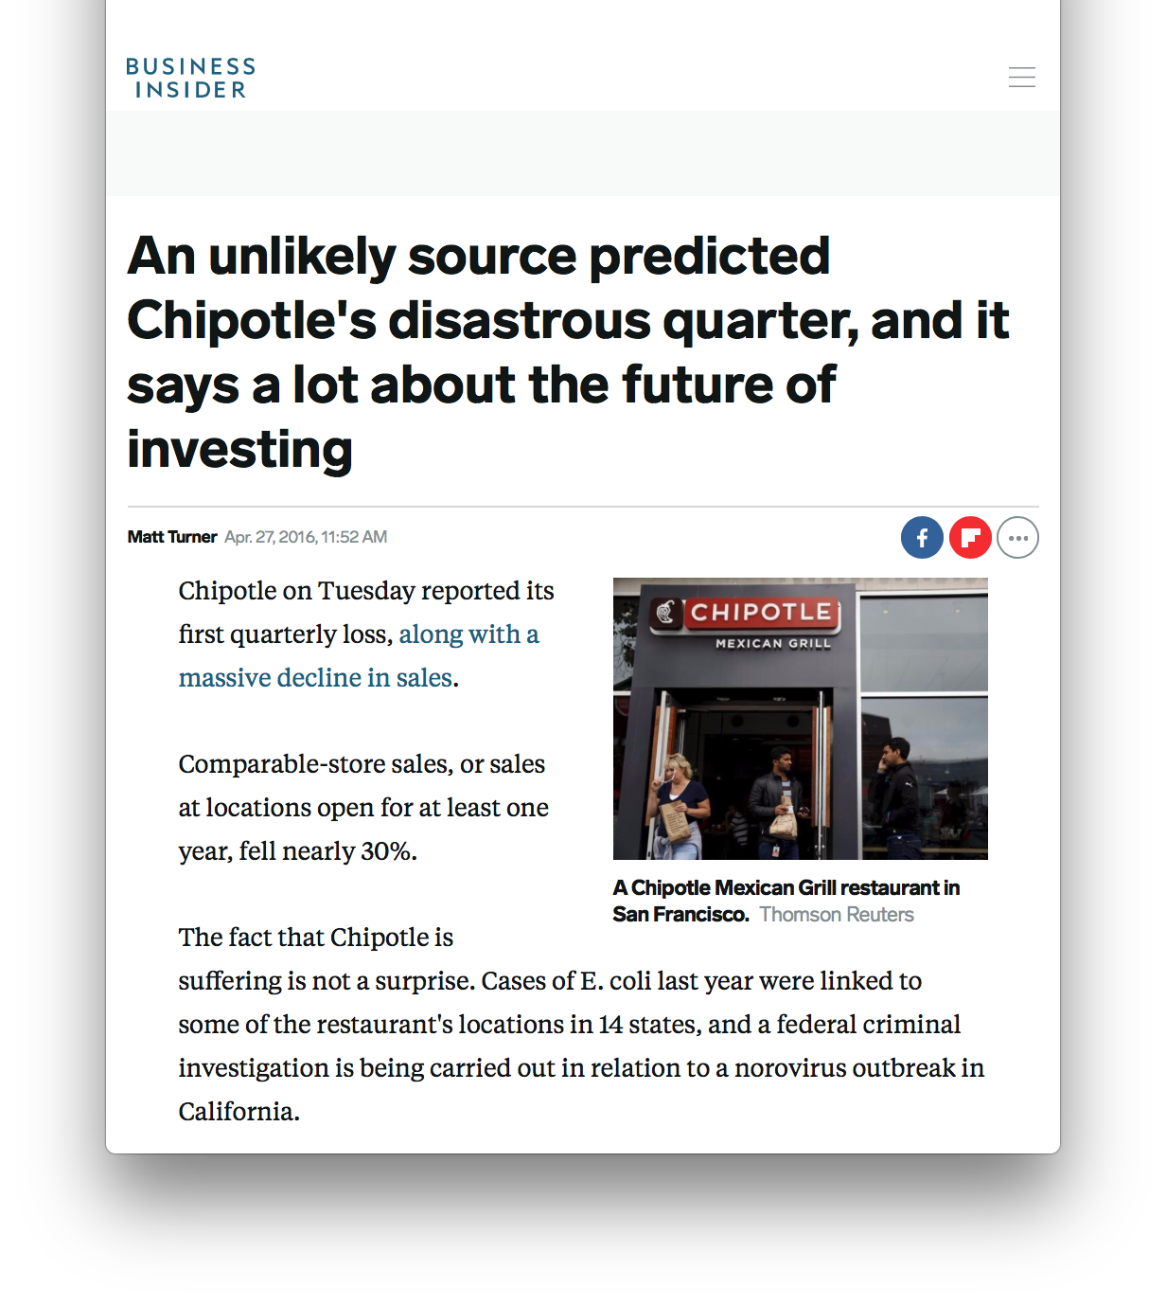
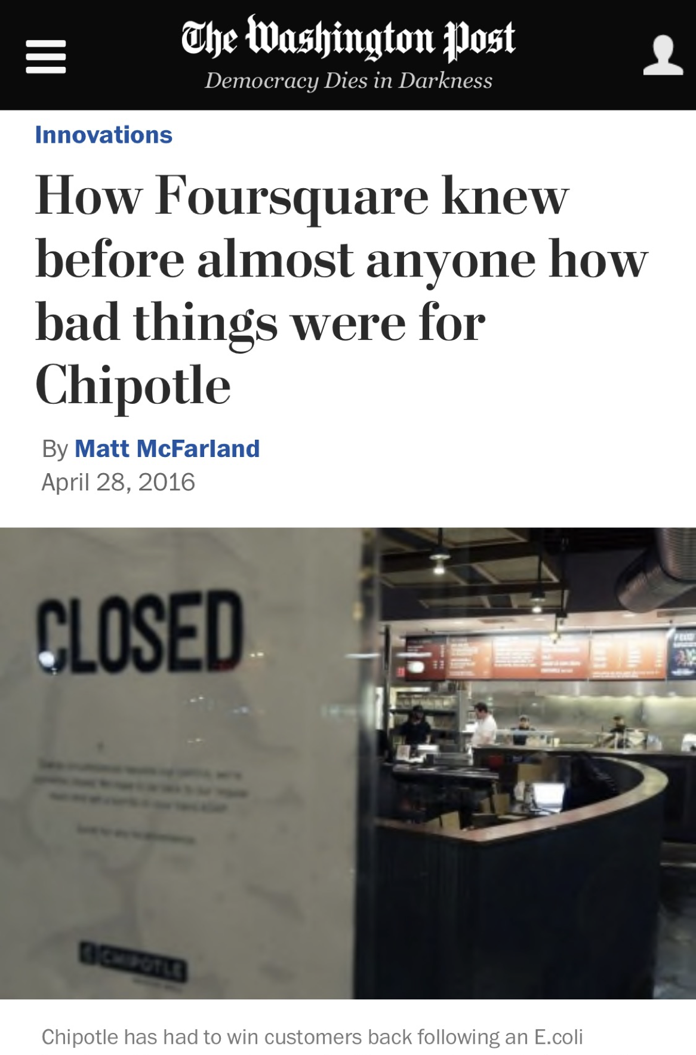
2016

Slide 52
#2: Engineer your features *

Slide 53
Time of day

Slide 54
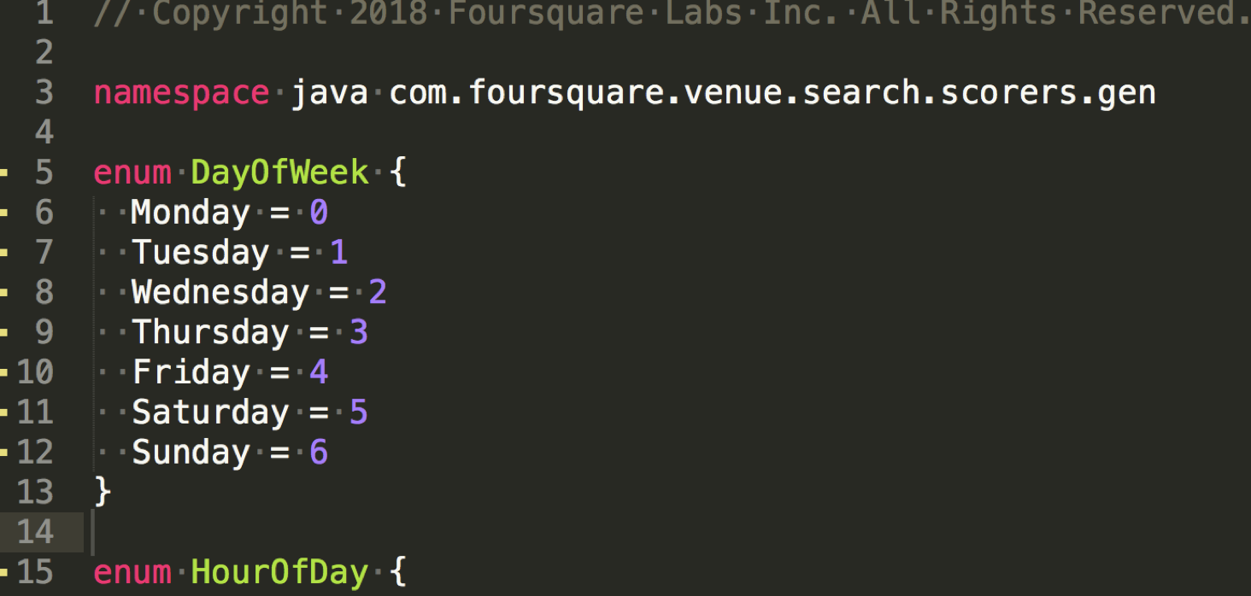
Version 1: Categorical

Slide 55
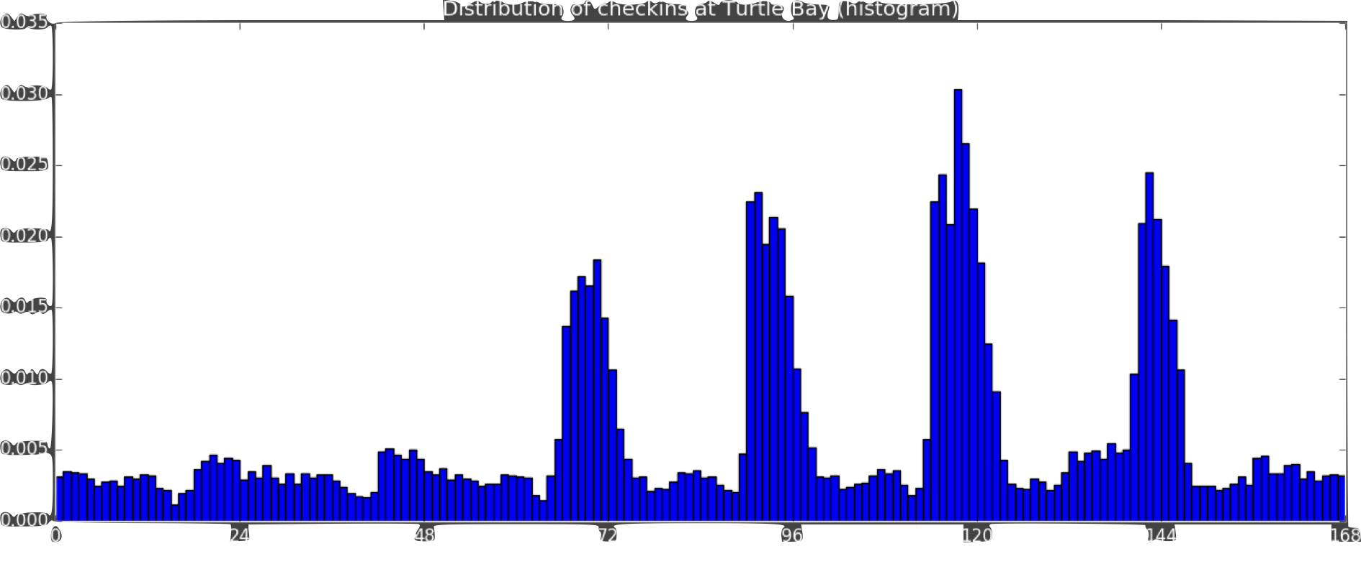
Version 2: Histogram

Slide 56
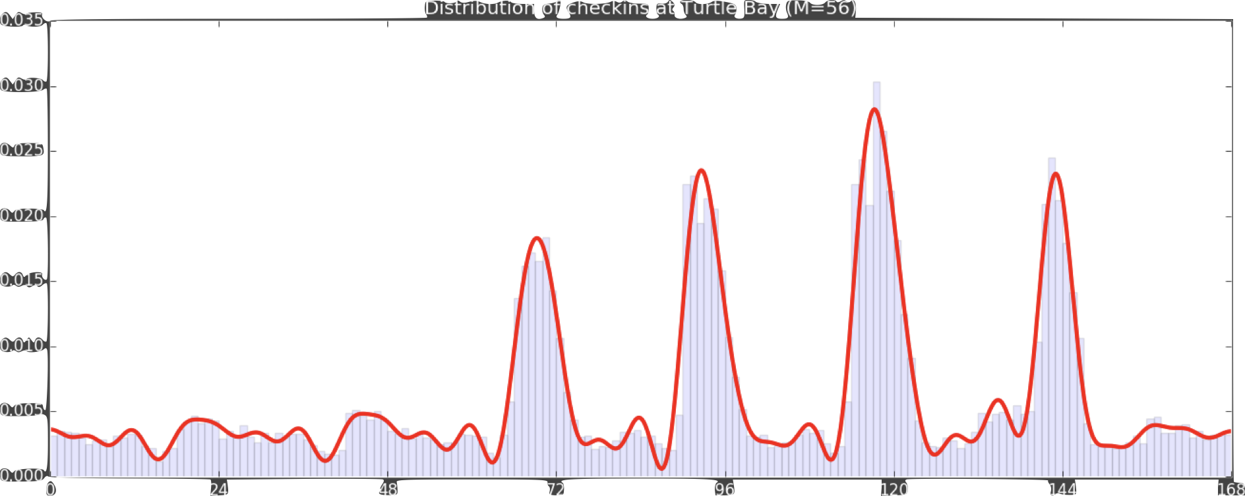
Version 3: Fourier approximation

Slide 57
Version 3: Fourier approximation
DID NOT WORK!

Slide 58
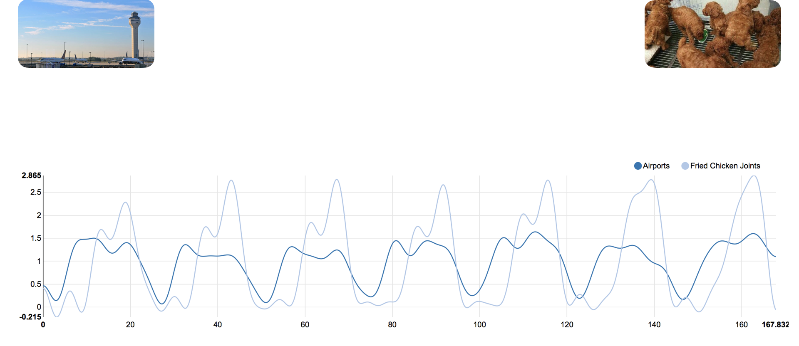
Airport versus Chicken

Slide 59


Slide 60
Airport versus Chicken

Slide 61
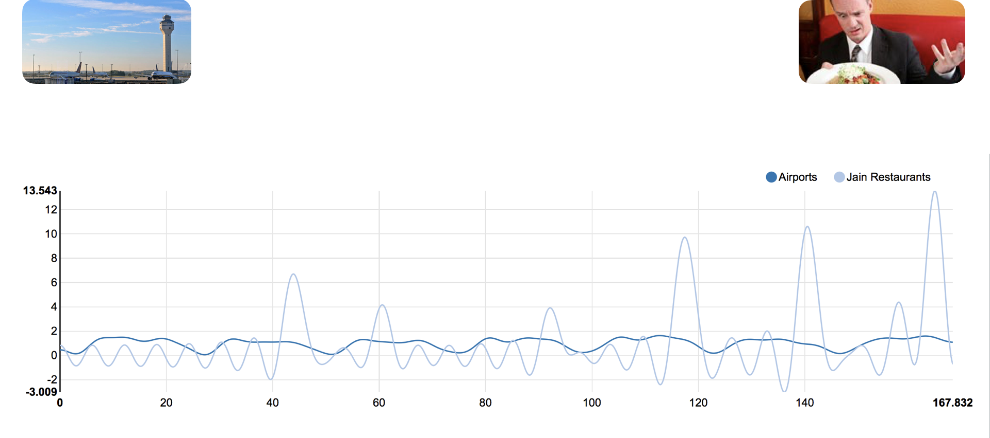
Airport versus Unpopular

Slide 62


Slide 63


Slide 64
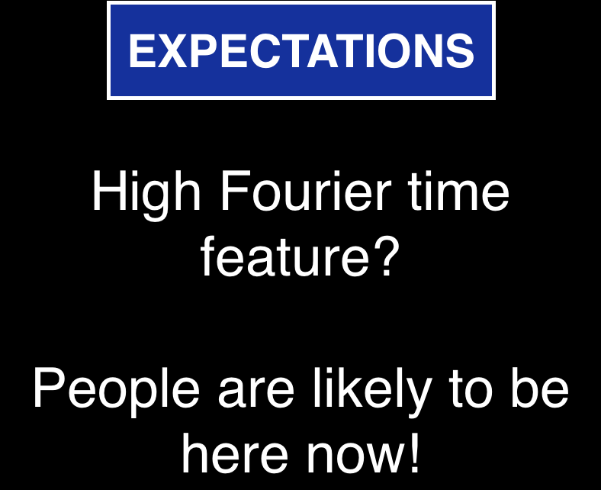

Slide 65


Slide 66
#3: Know your data

Slide 67


Slide 68
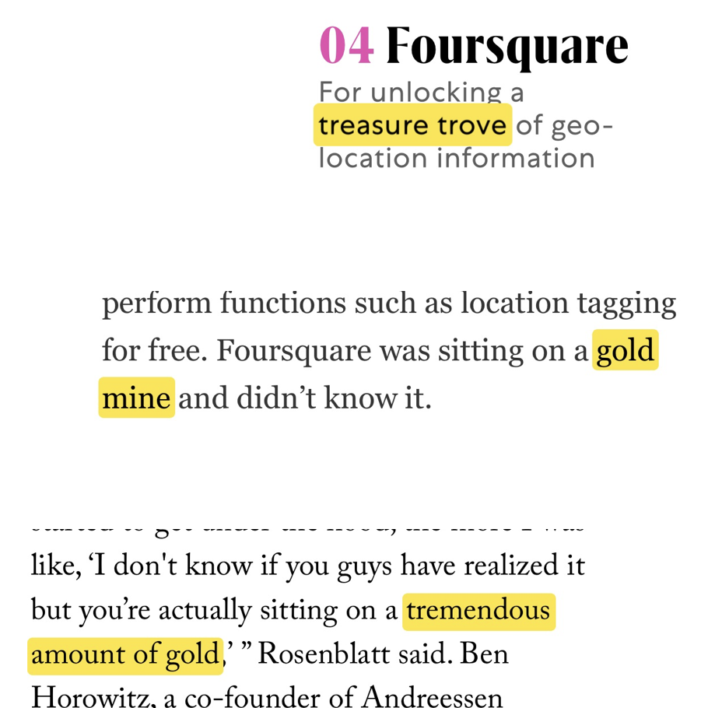

Slide 69
There’s still work to do!

Slide 70
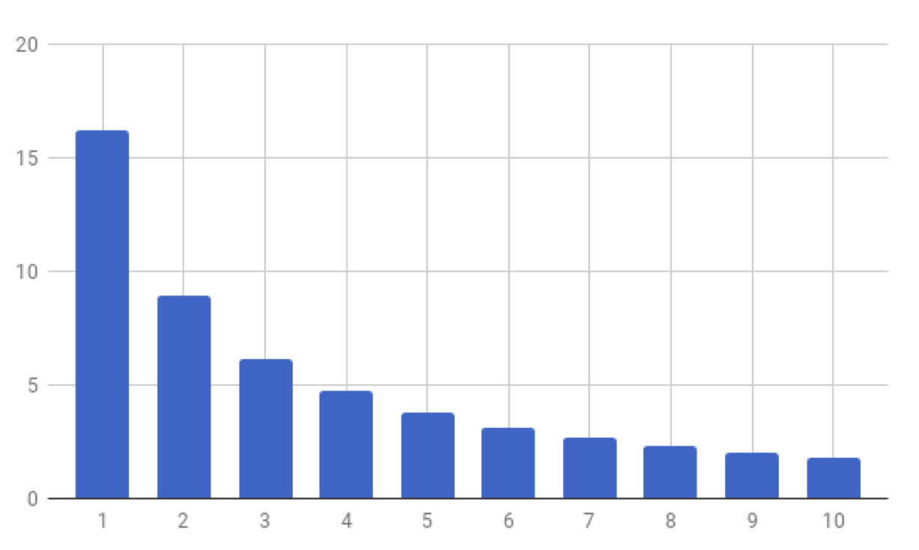
Number of places
Number of visits

Slide 71
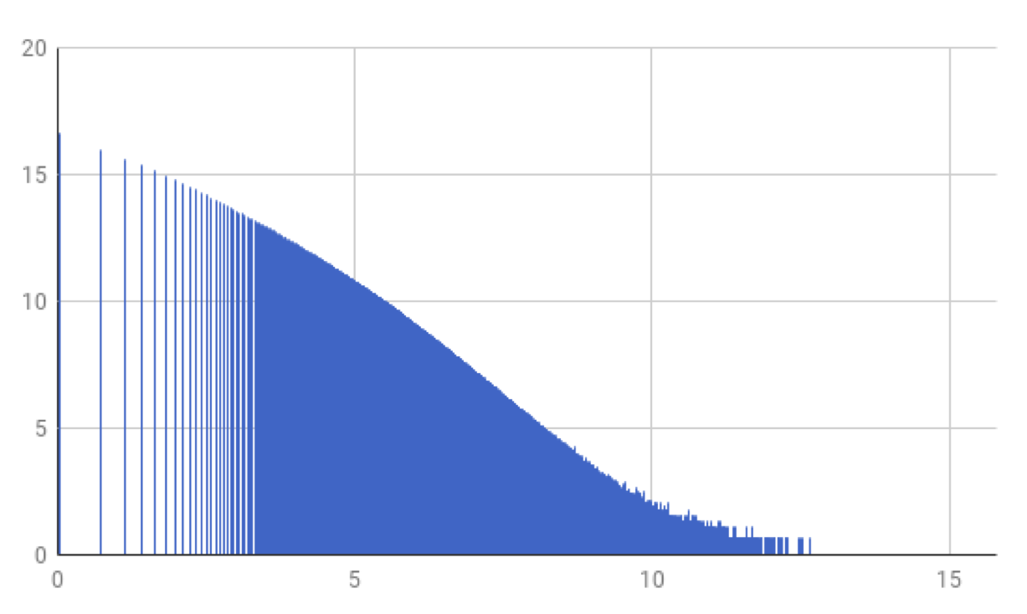
Log number of places
Log number of visits

Slide 72
Zipf’s law
Log number of places
Log number of visits

Slide 73
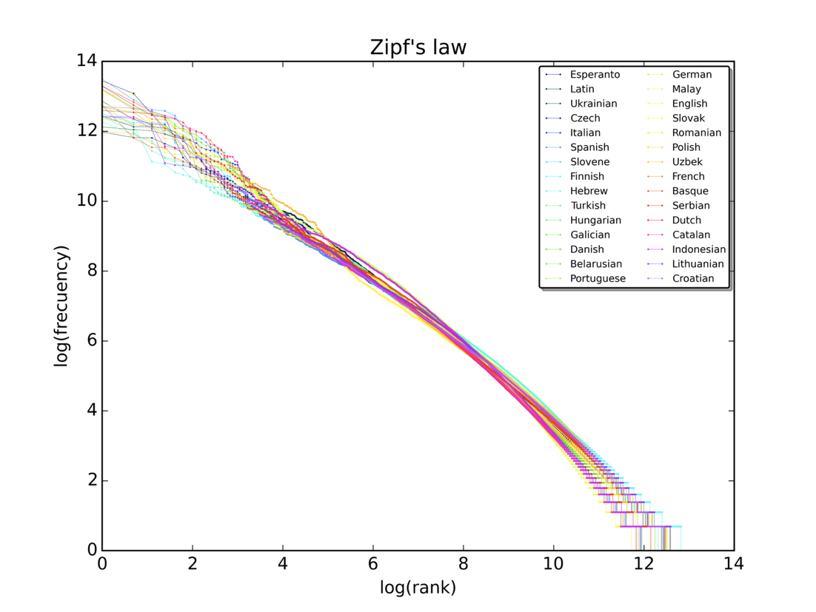
Zipf’s law

Slide 74
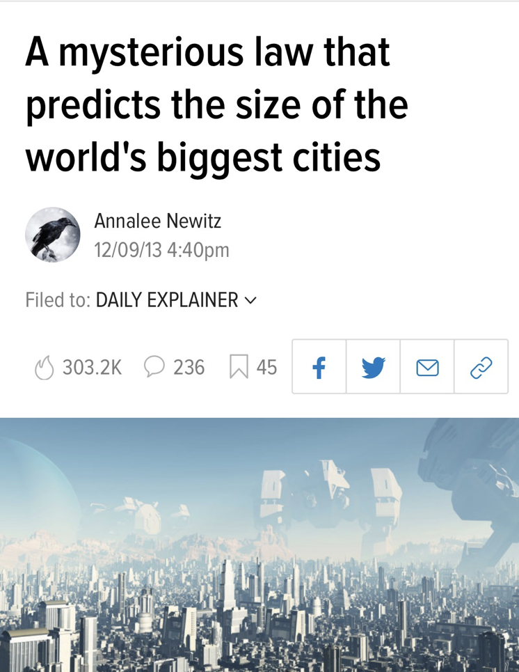
Zipf’s law

Slide 75
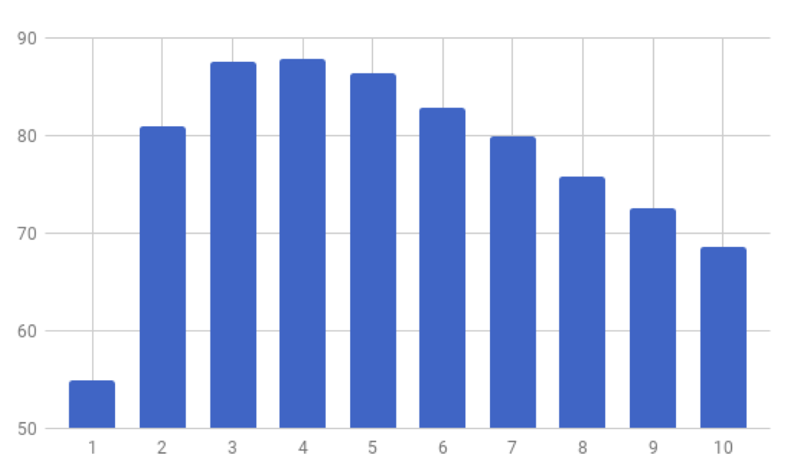
Not Zipf’s law
Log number of places
Log number of visits
Notes:
WE KNOW THAT OUR DATASET SATISFIES ZIPF’S LAW
There are parts of our platform that break this law that leads to problems
Let me put this in perspective

Slide 76
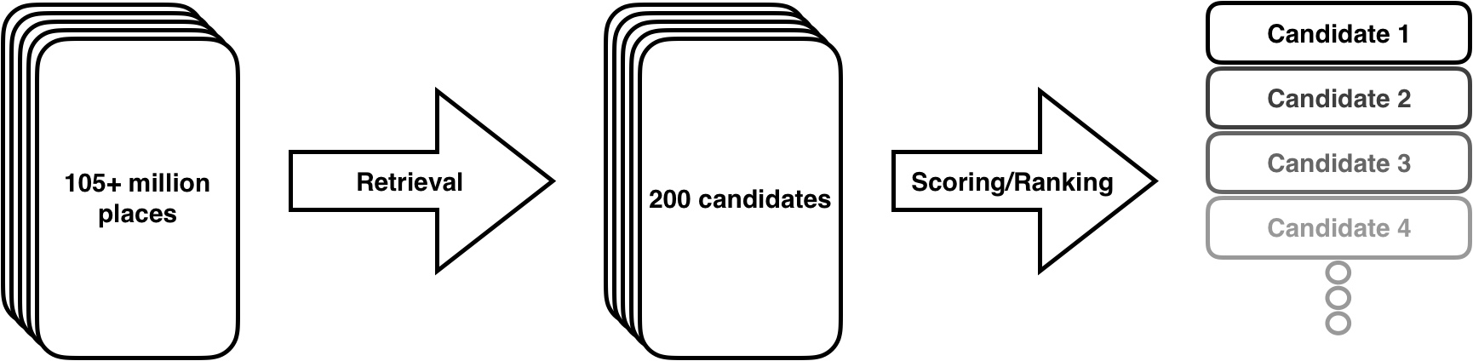

Slide 77
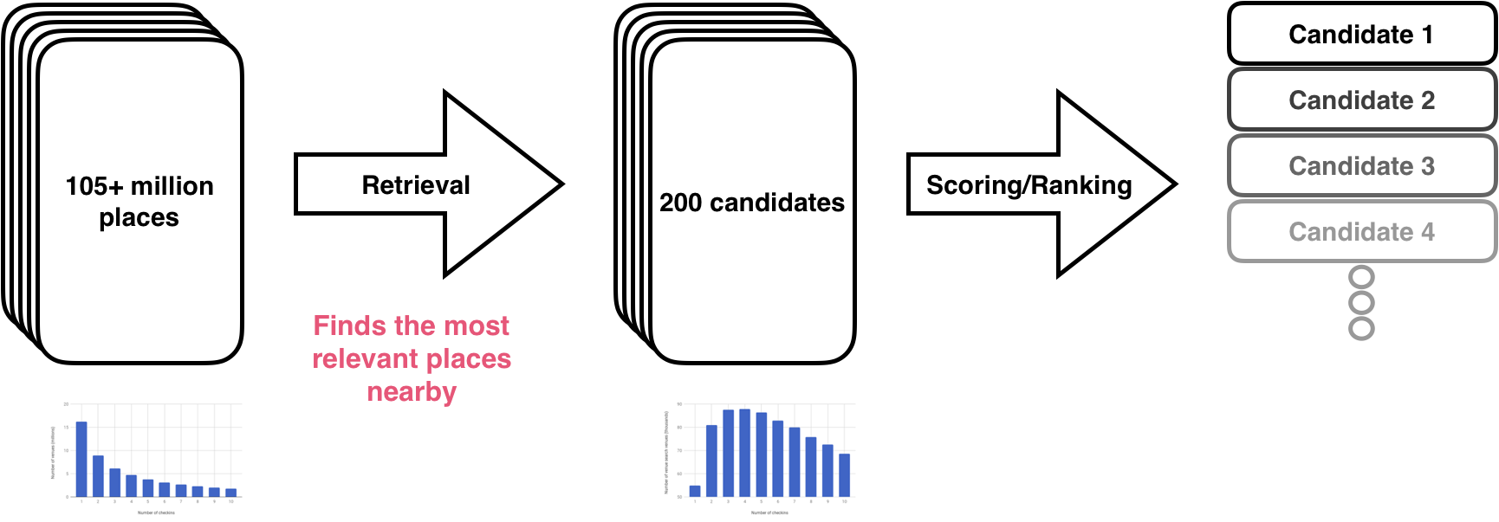
Zipf’s law
Not Zipf’s law

Slide 78
Zipf’s law
Not Zipf’s law
Used for model training!

Slide 79
Be popular

Slide 80
Be popular
Get retrieved

Slide 81
Be popular
Be confirmed
Get retrieved

Slide 82
Be popular
Be confirmed
Get retrieved

Slide 83
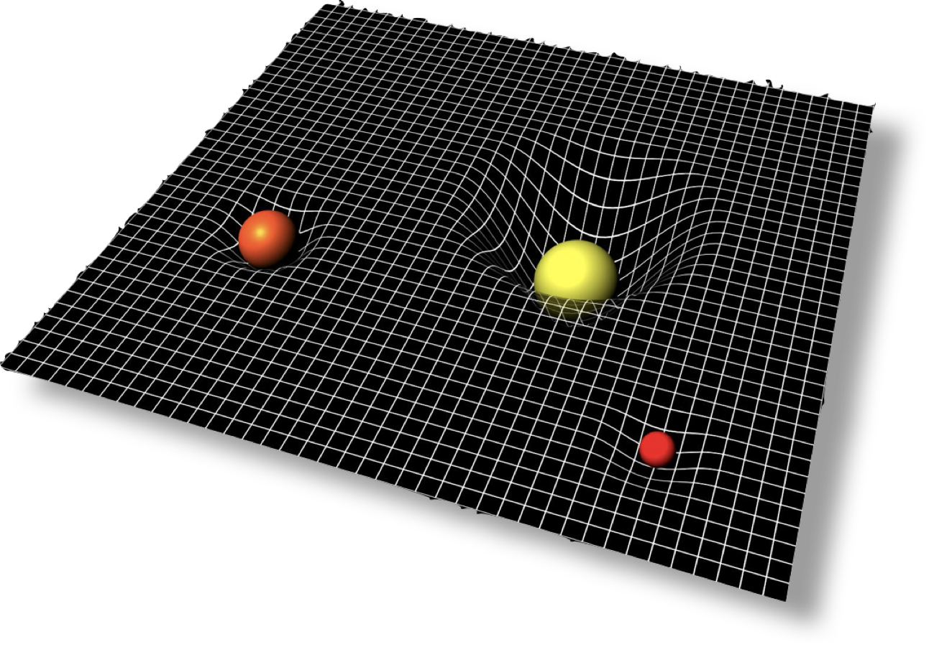
Visit gravity
Notes:
One of the eng managers gave me this picture to explain how he interpreted this feedback loop in terms of gravity.
CRITICAL MASS of visits starts to ABSORB NEARBY VISITS

Slide 84
Breaking the feedback loop:
Undersample popular places

Slide 85
Breaking the feedback loop:
Undersample popular places
Oversample unpopular places

Slide 86
Breaking the feedback loop:
Undersample popular places
Oversample unpopular places
Use Zipf’s law as a guide

Slide 87
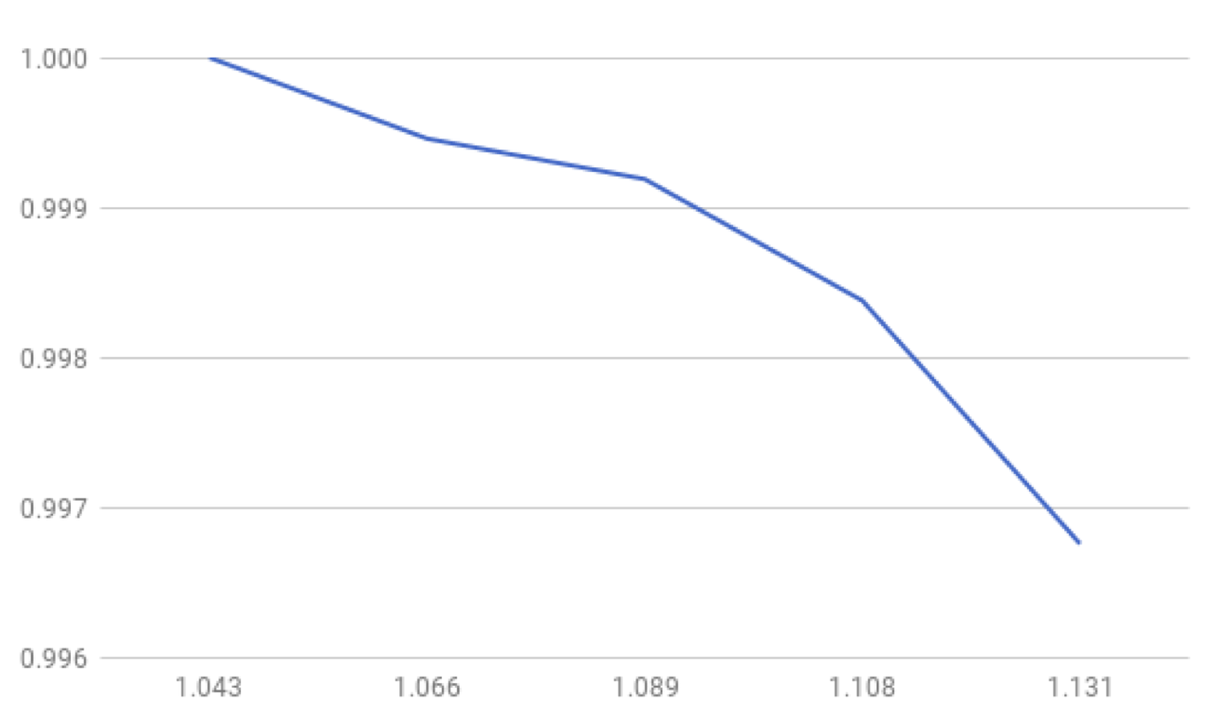
Breaking the feedback loop:
Relative P@1
Relative coverage
Notes:
Trained five models, each a varying level of aggressiveness controlling the our resampling rate
We tracked two metrics against each other P@1 vs place coverage. (select distinct place id from )
Read across the line that says 0.999 follow the gray line across the blue line represents the parameters for a model that, if you read down to the x axis for a 9% increase in place coverage

Slide 88
Summary
Keep track of the right metrics
Engineer your features
Know your data
Notes:
To summarize
Make sure your metrics are the right metrics
Don’t underestimate the value of feature engineering
Make sure you understand your ata

Slide 89

Pilgrim data team
Notes:
Give credit where credit’s due

Slide 90


