Slide 1
The Unreasonable Deceptiveness of
Bad Data
November 9, 2018
Notes:
What are we talking about today?

Slide 2
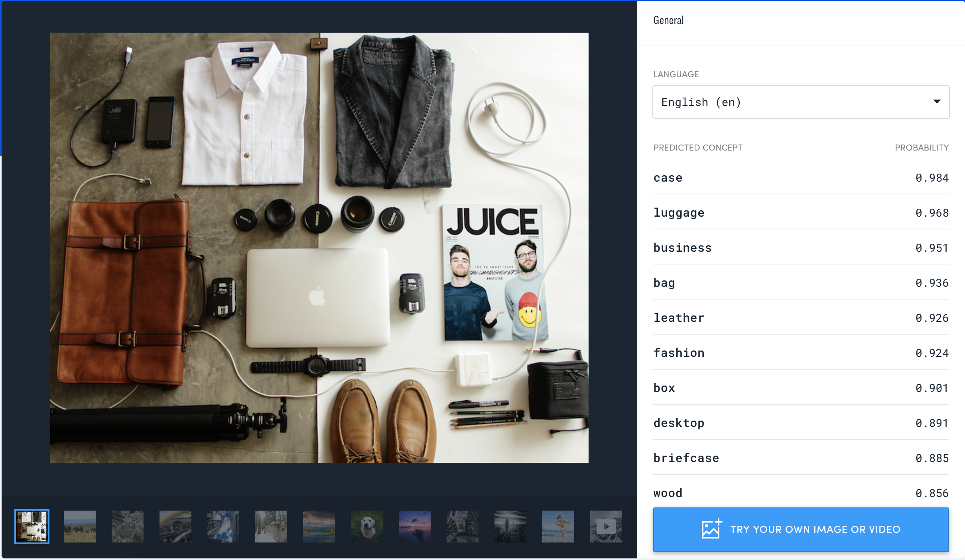
CLARIFAI
About our company
AI Platform for computer vision
ImageNet 2013
100+ Employees
Predict, Create, Search

Slide 3
APPLIED MACHINE LEARNING

Slide 4
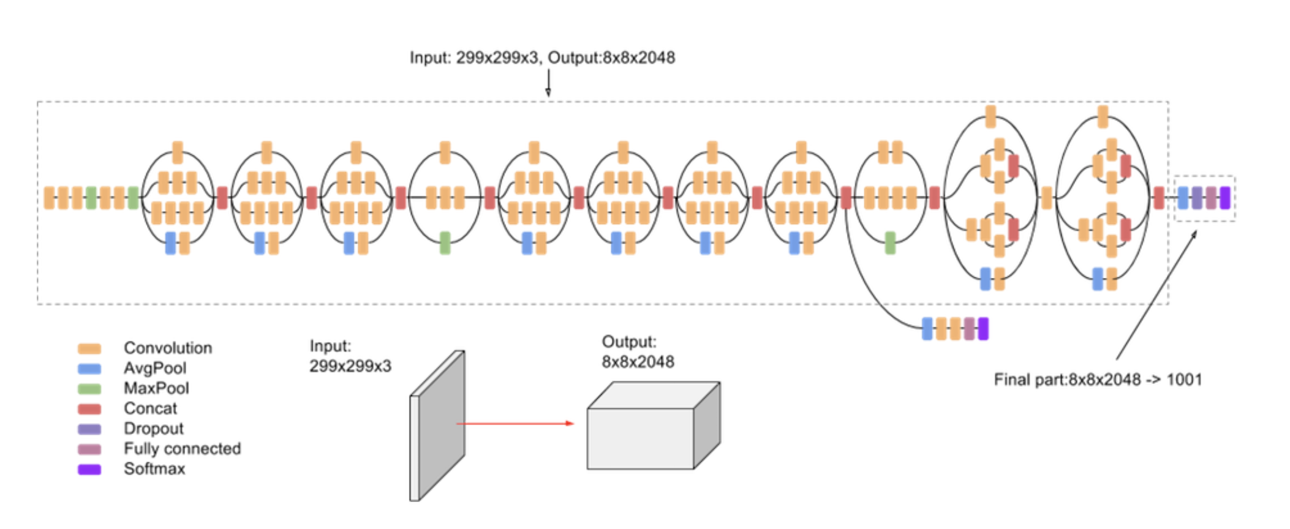
Notes:
Name the methods

Slide 5
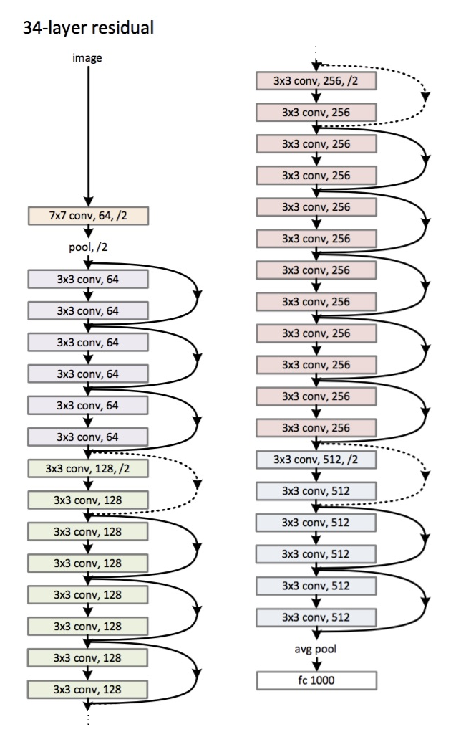

Slide 6
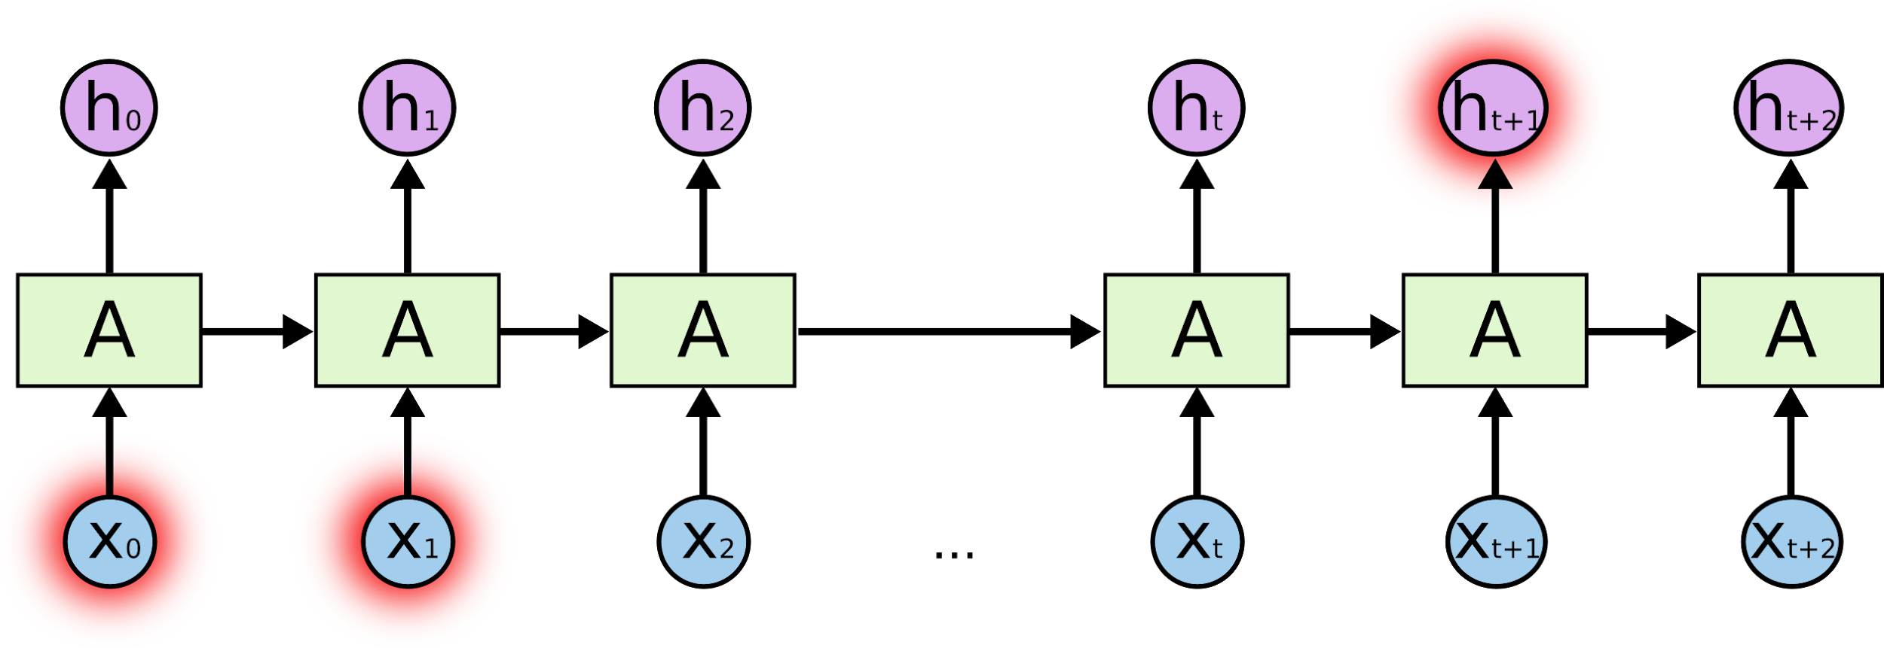

Slide 7
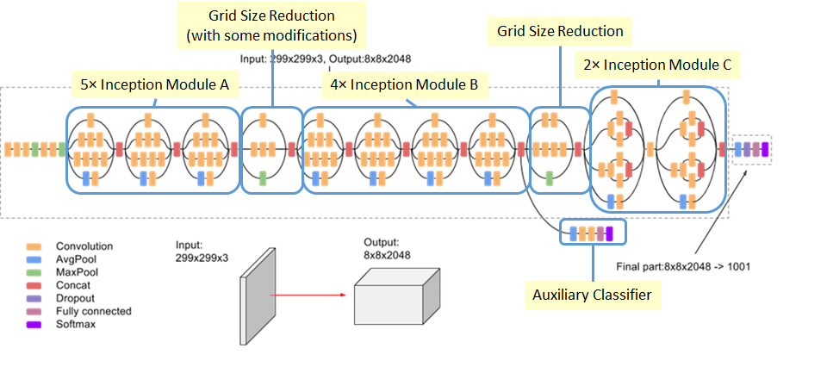

Slide 8
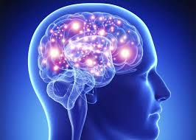

Slide 9
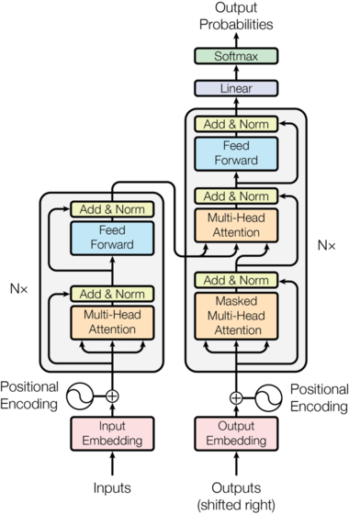
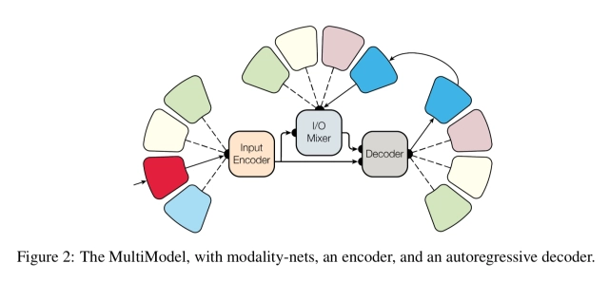

Slide 10




Slide 11
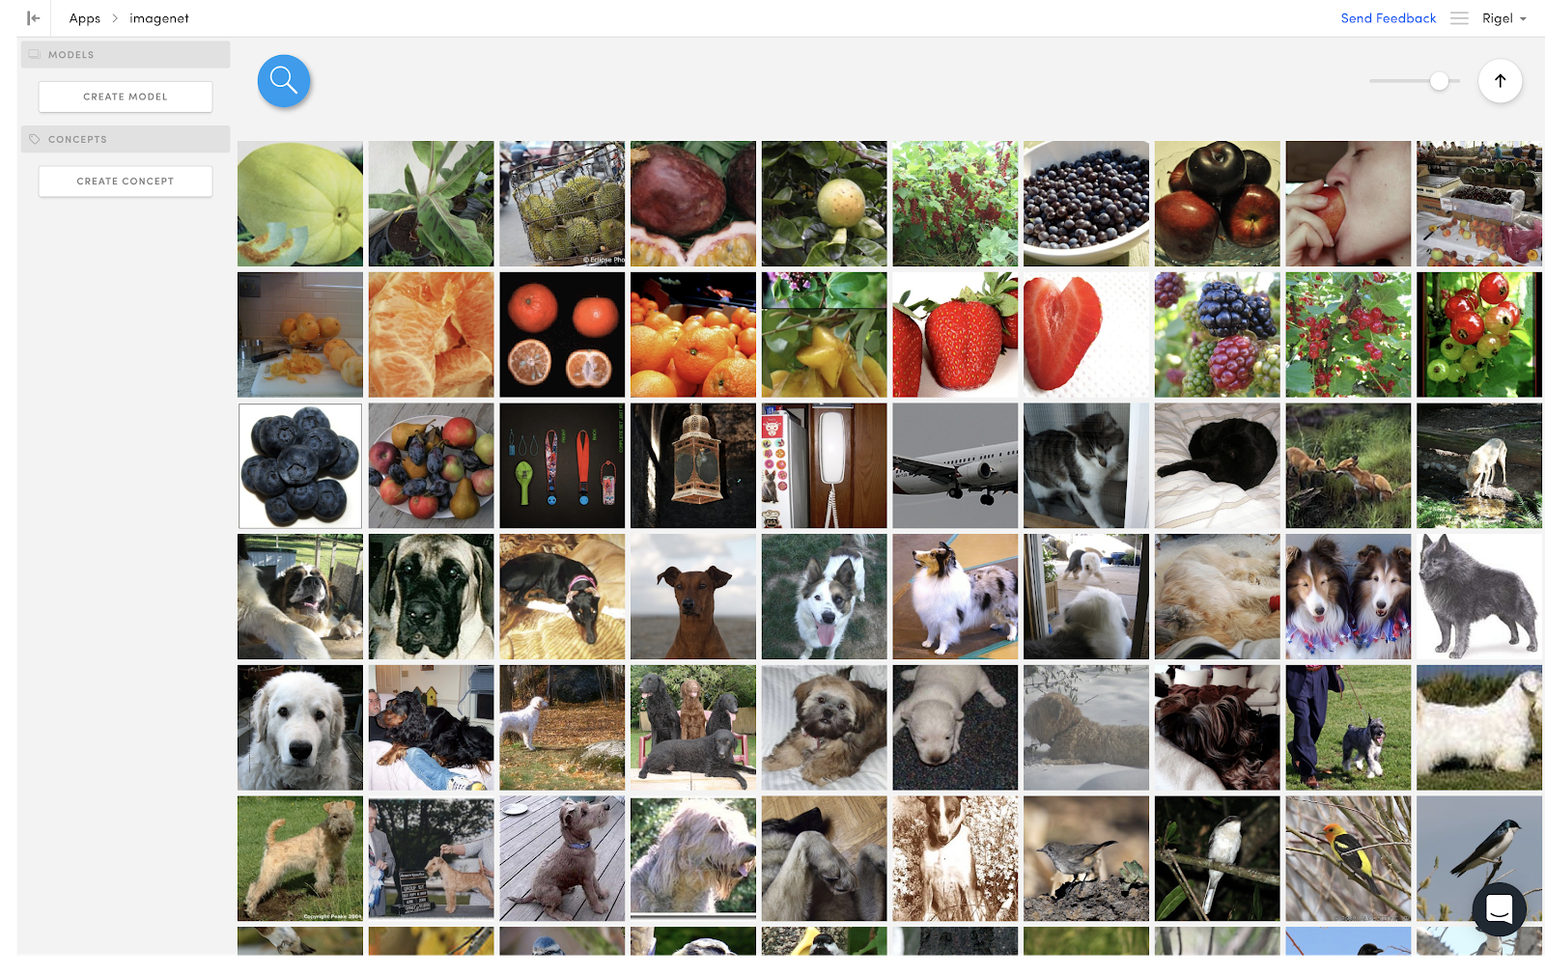
Notes:
Slow down

Slide 12
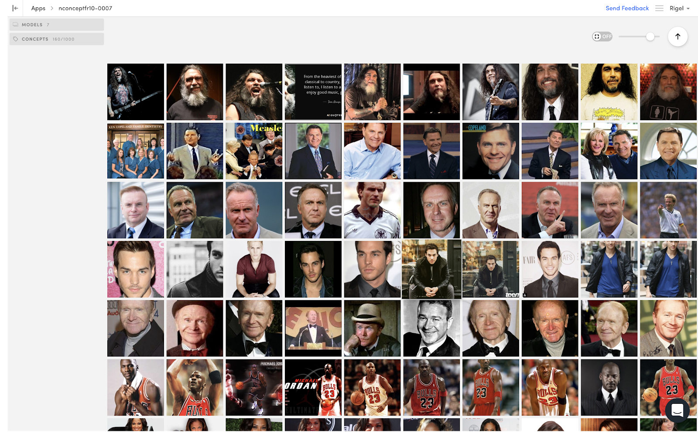

Slide 13
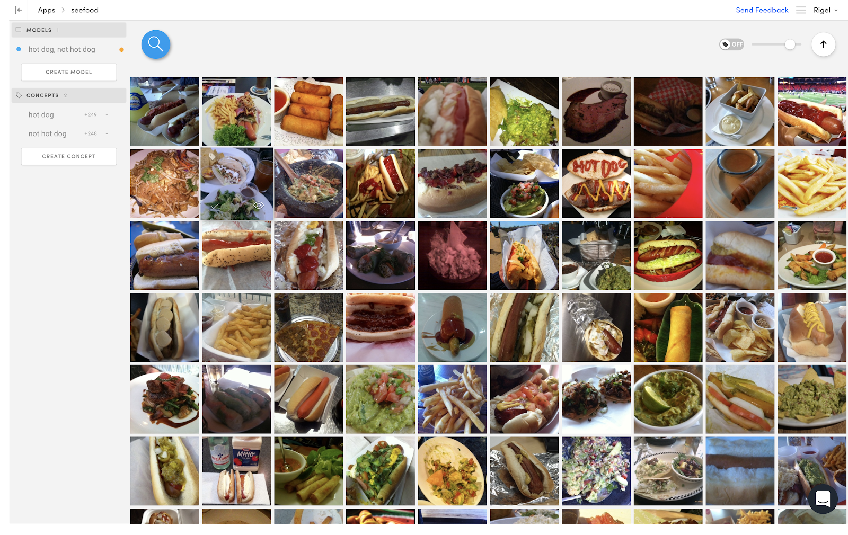
Notes:
NEXT: applied machine learning detail slide

Slide 14
APPLIED MACHINE LEARNING
Responsible for machine learning in production
Link between research and product
Train, evaluate, and deploy models
Tune ML algorithms like visual search
Increase efficiency of human labelers

Slide 15
APPLIED MACHINE LEARNING
Responsible for machine learning in production
Link between research and product
Train, evaluate, and deploy models
Tune ML algorithms like visual search
Increase efficiency of human labelers
Notes:
NEXT: agenda

Slide 16
AGENDA
01
02
03
04
WHAT IS BAD DATA?
WHAT’S SO BAD ABOUT IT?
HOW DO YOU EXPOSE BAD DATA?
HOW DO YOU MAKE BAD DATA INTO GOOD DATA?

Slide 17
WHAT IS BAD DATA?
01
Notes:
NEXT: “we need data”

Slide 18
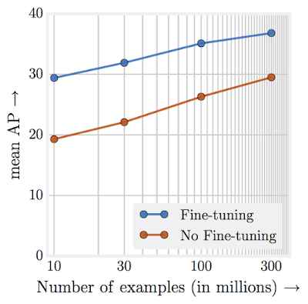
WE NEED DATA
C. Sun, A. Shrivastava, S. Singh, and A. Gupta. Revisiting unreasonable effectiveness of data in deep learning era. In ICCV, 2017.
Notes:
NEXT: blender

Slide 19
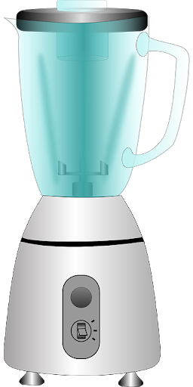

Slide 20
DATA

Slide 21


Slide 22
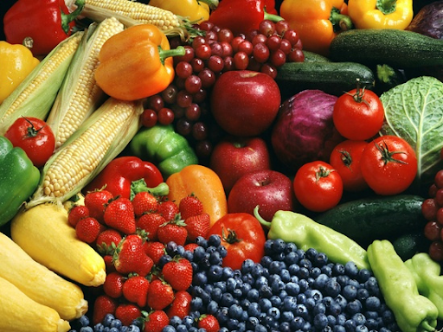

Slide 23

Notes:
gross

Slide 24
HONEST BAD DATA
This data is bad, and you know it

Slide 25
DECEPTIVE BAD DATA
This data is so bad, you think it’s good

Slide 26
WHAT’S SO BAD ABOUT IT?
02
Notes:
NEXT: bad models

Slide 27
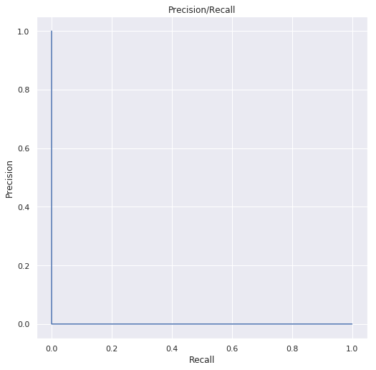
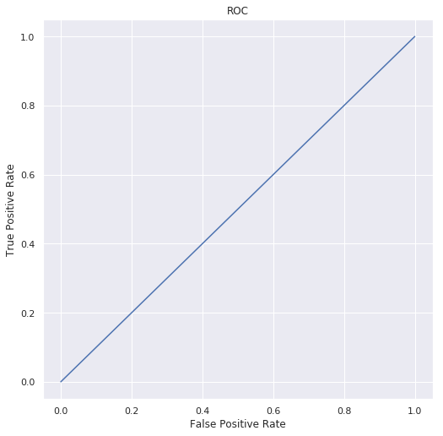
BAD MODELS
Notes:
NEXT: false confidence, blank

Slide 28
FALSE CONFIDENCE

Slide 29


FALSE CONFIDENCE
test set != real world
Notes:
NEXT: license plates

Slide 30
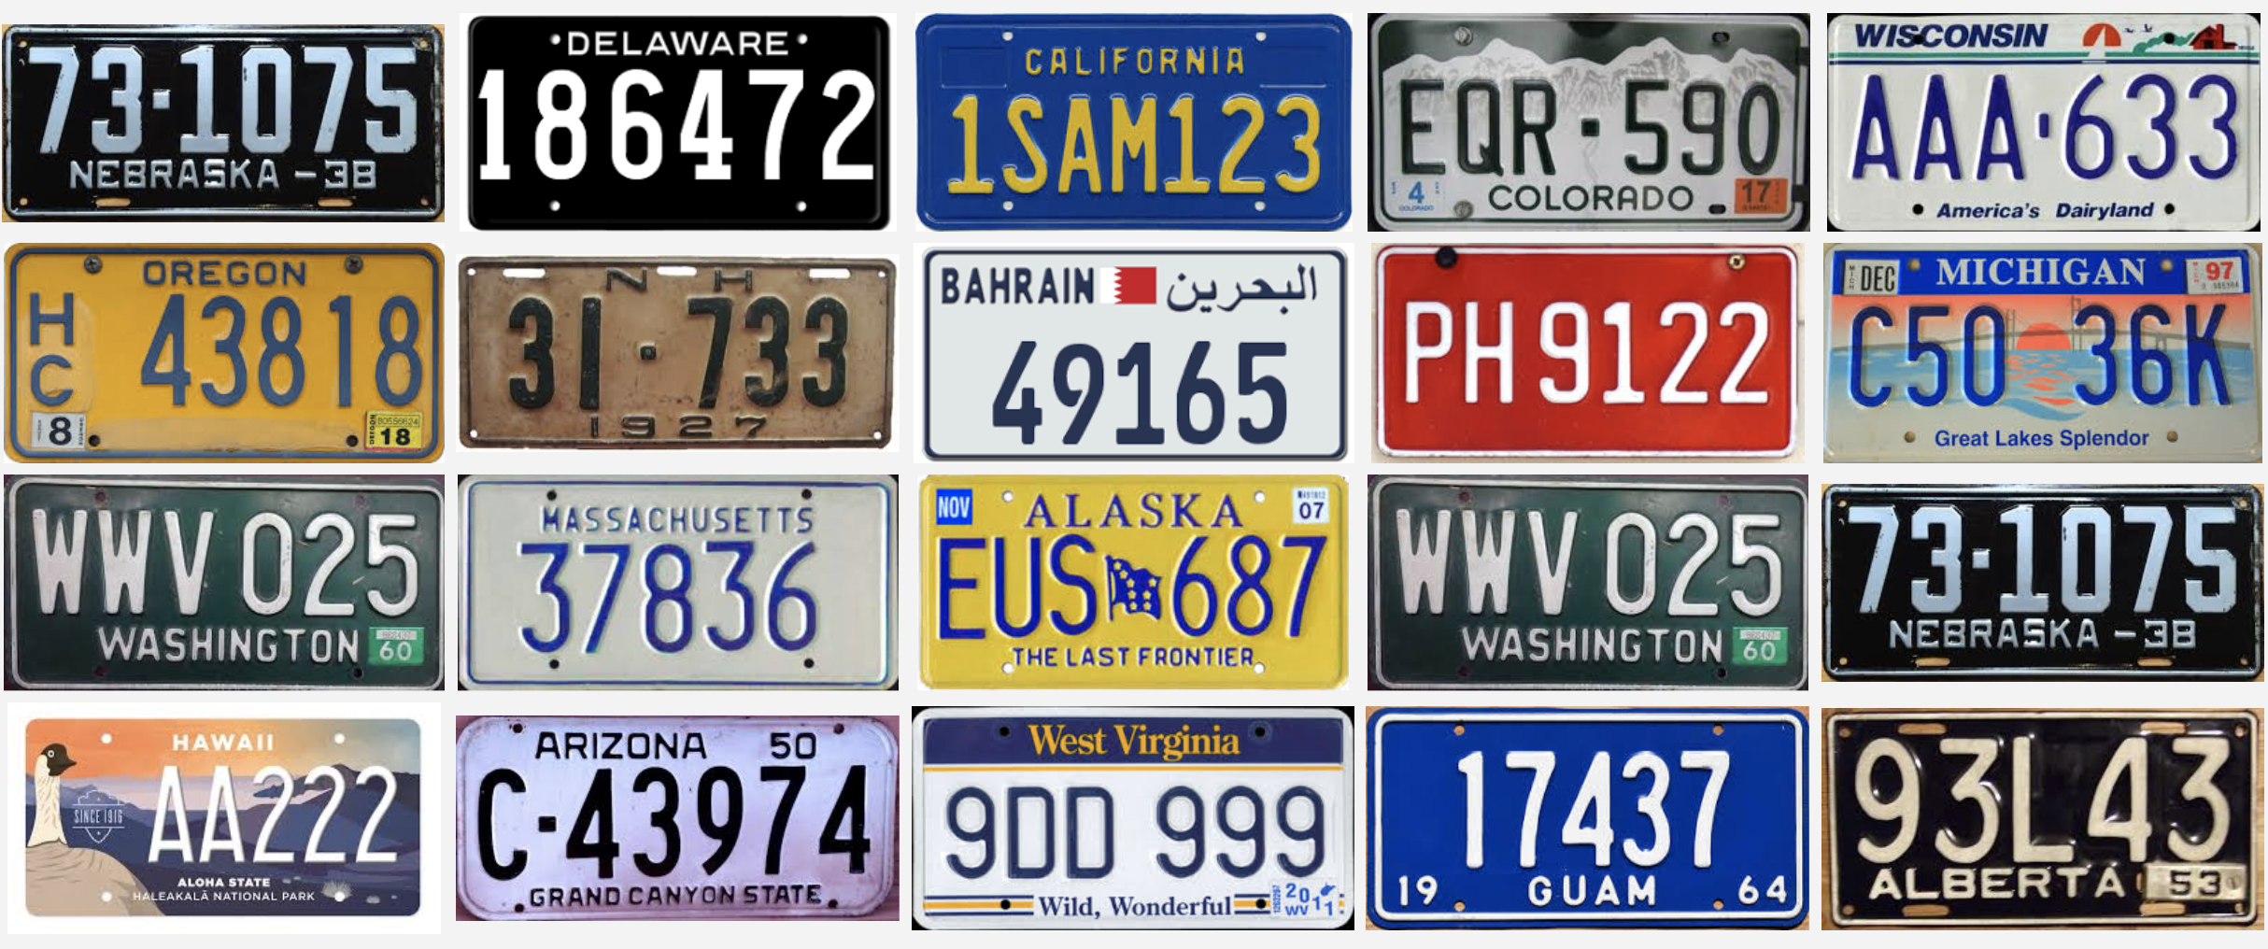

Slide 31
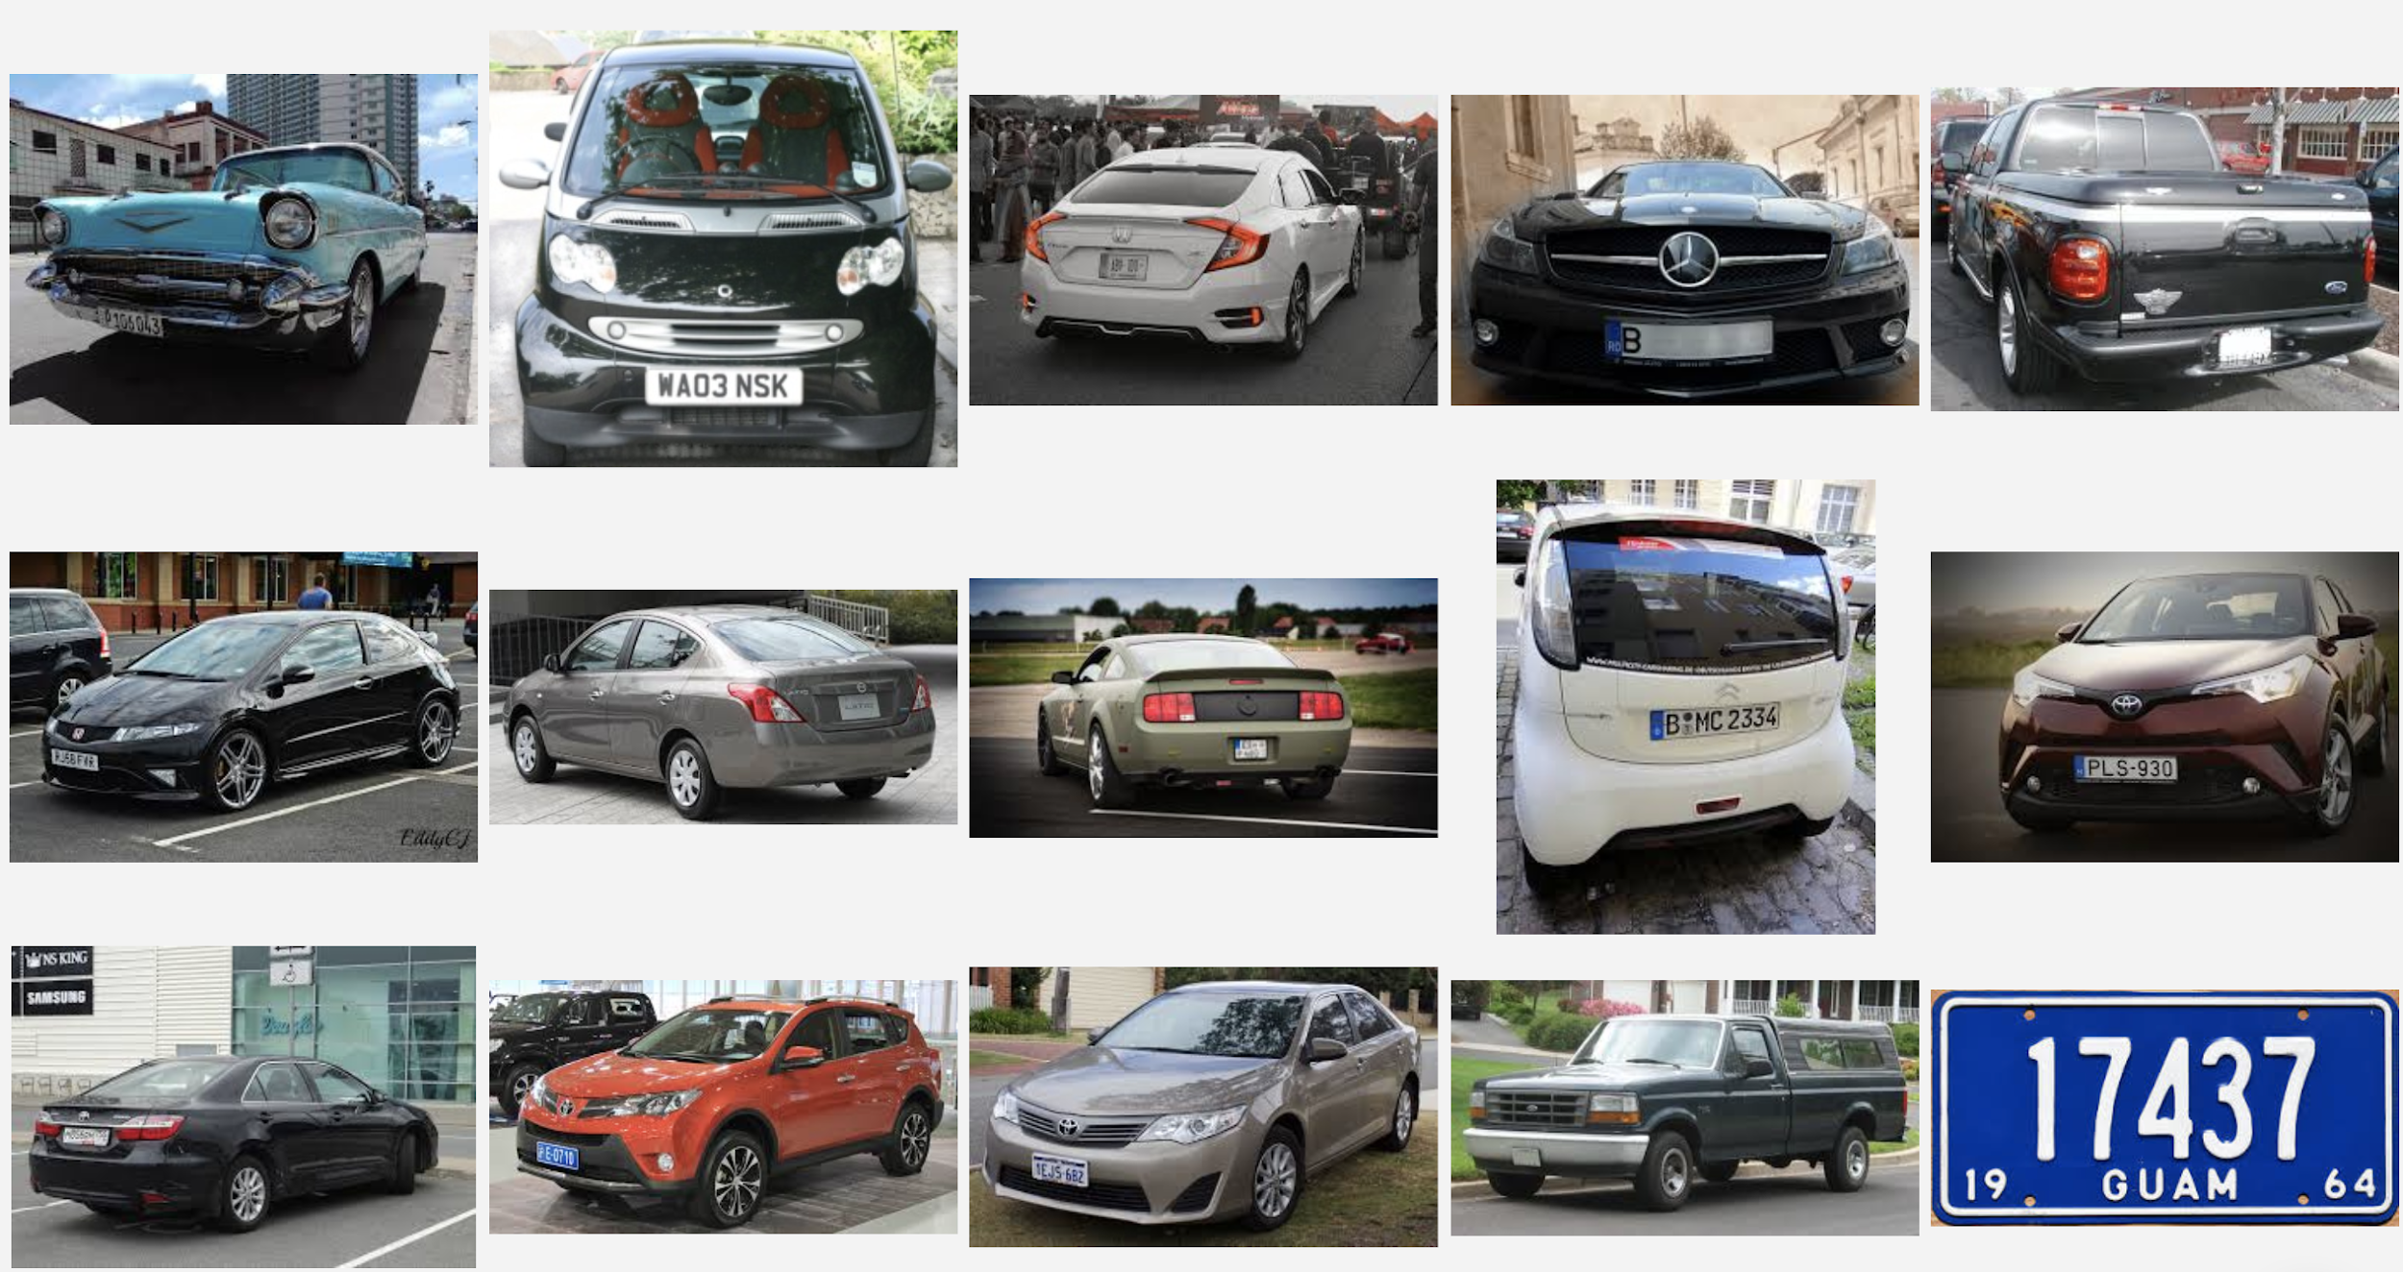
Notes:
NEXT: bias

Slide 32
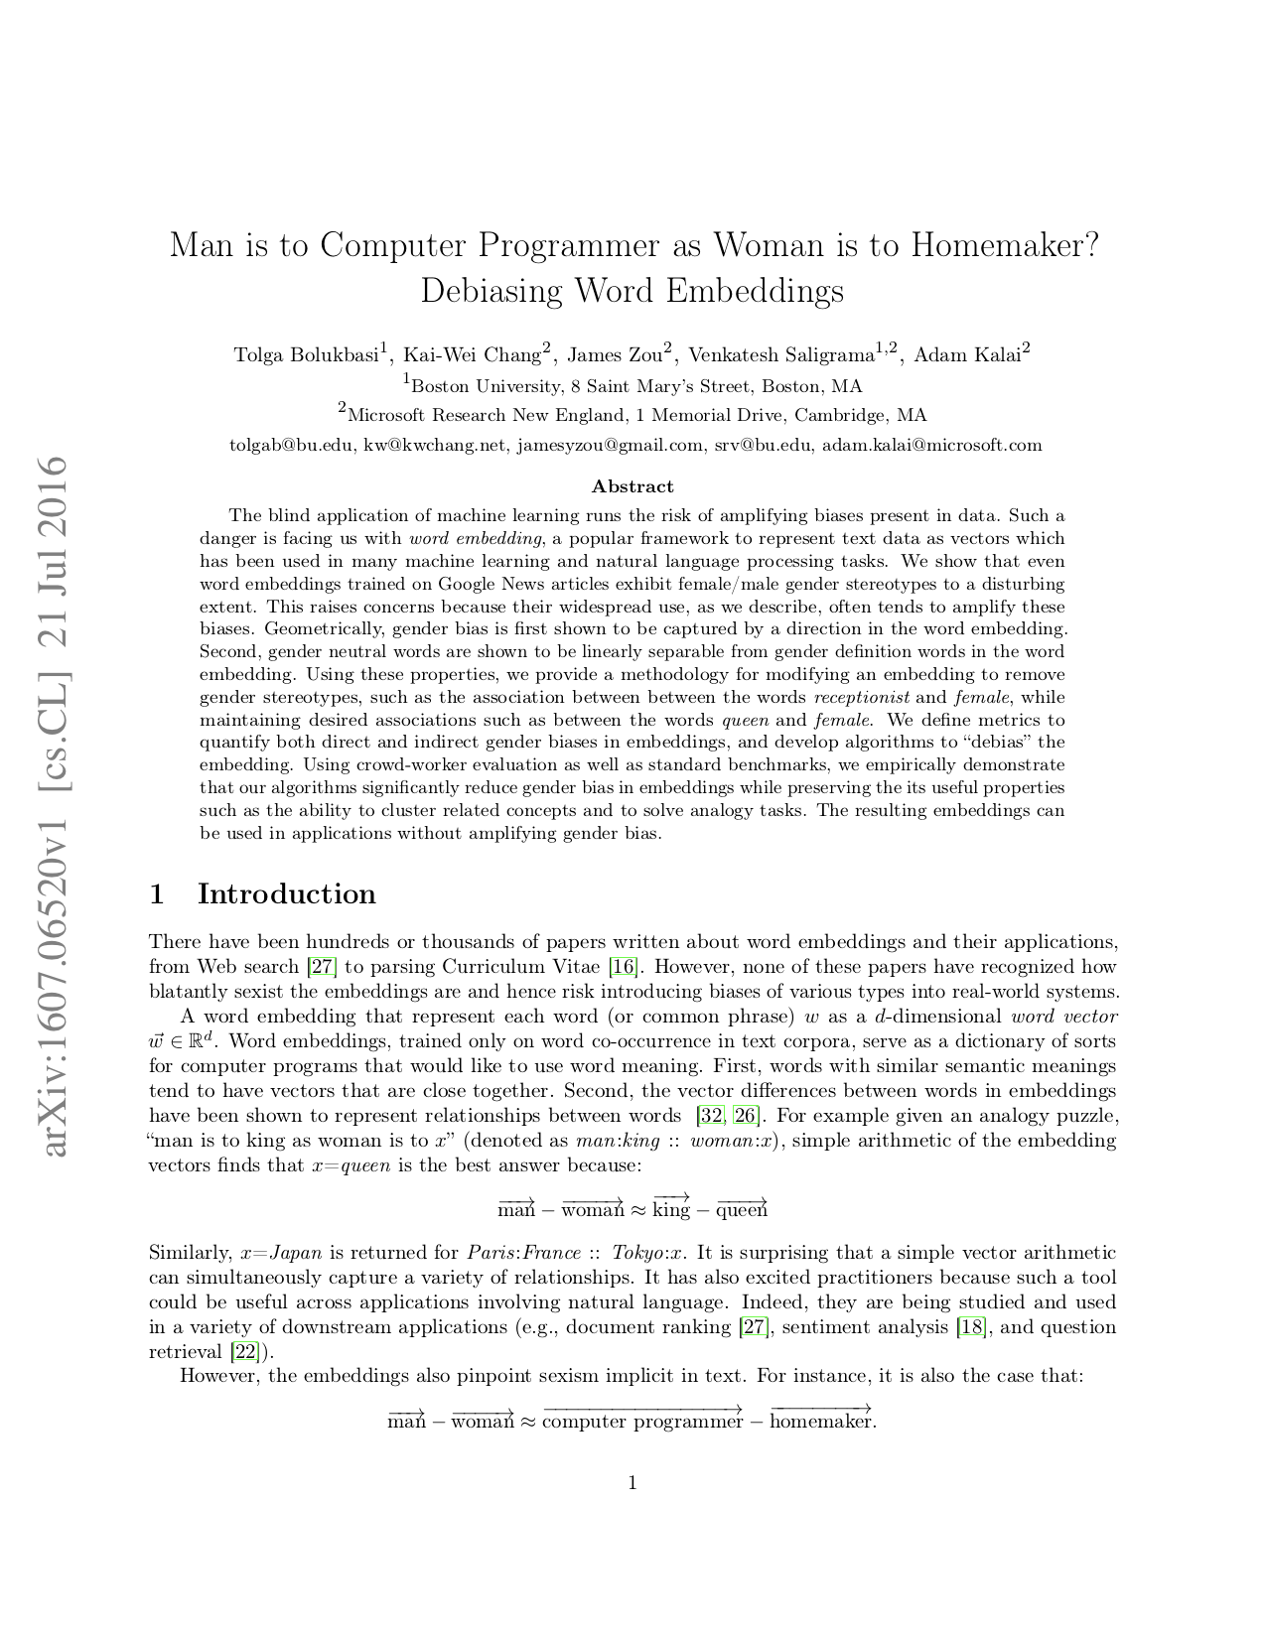
MACHINE BIAS

Slide 33
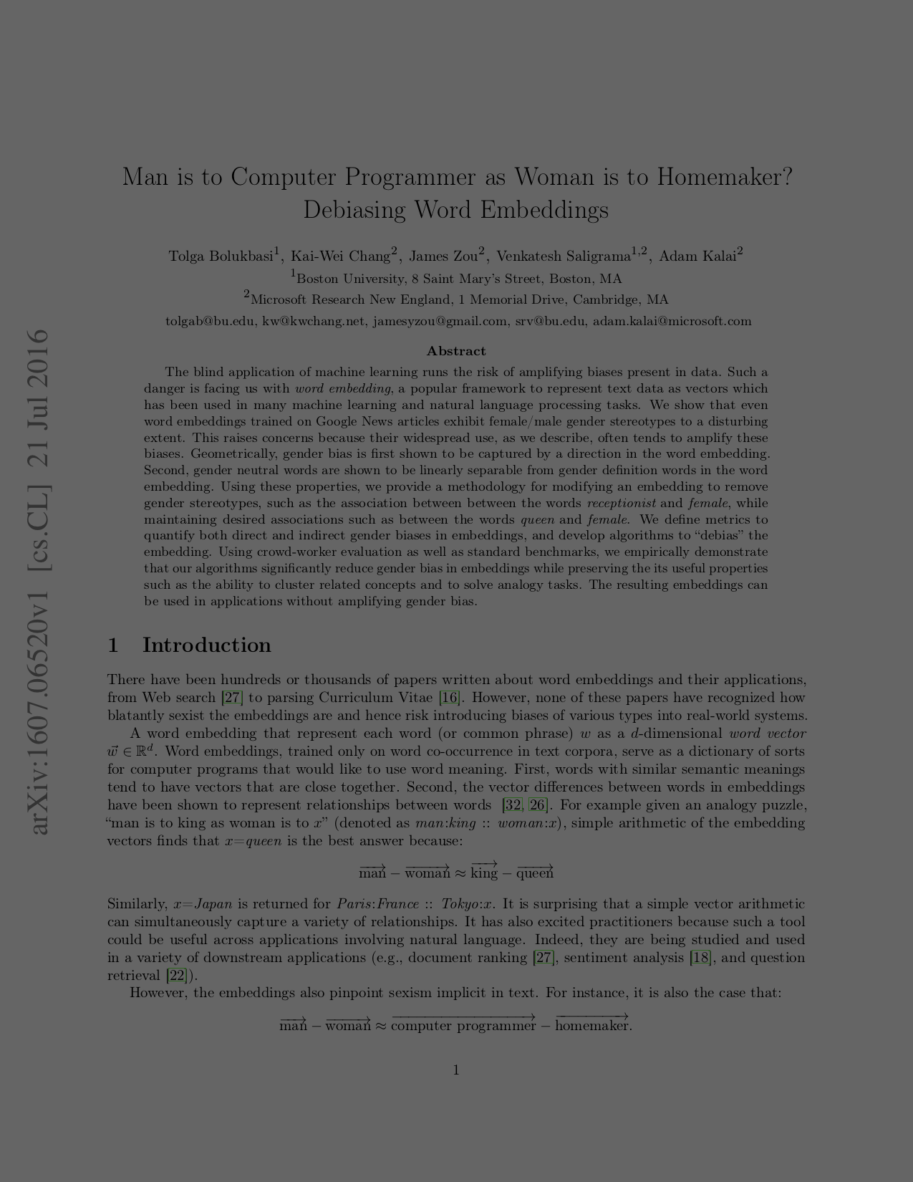
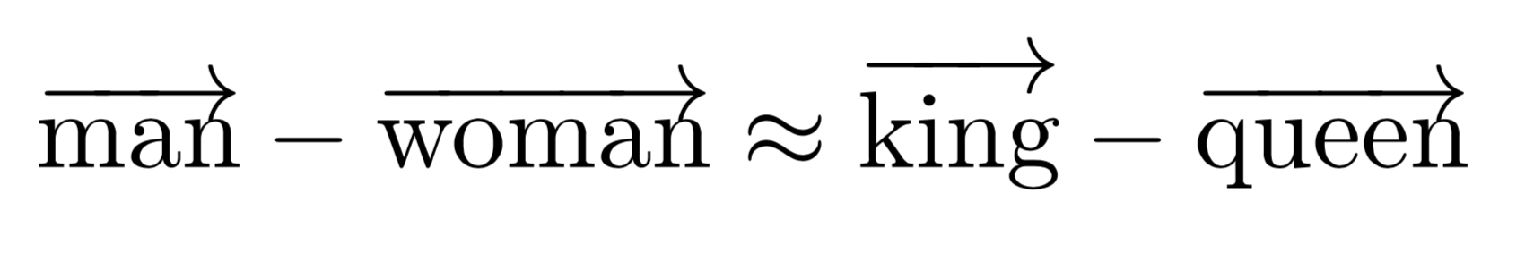
MACHINE BIAS

Slide 34
MACHINE BIAS

Slide 35
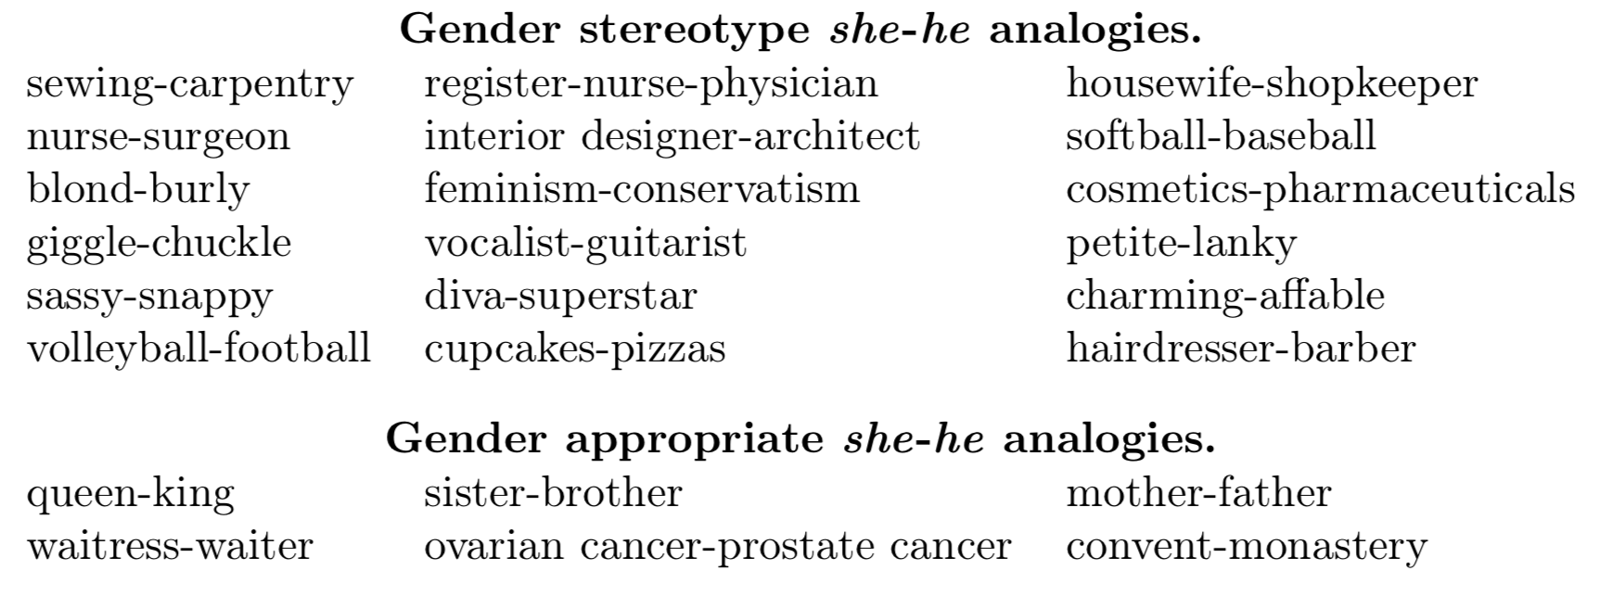
MACHINE BIAS

Slide 36
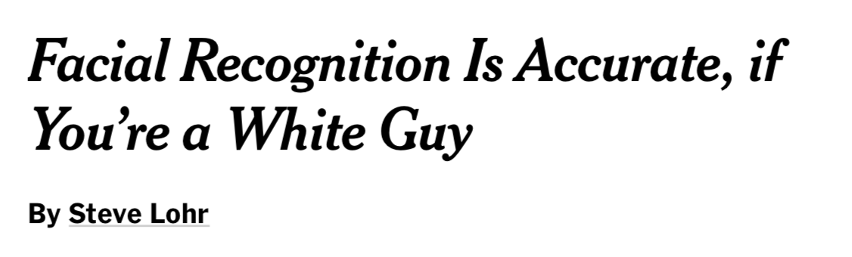
MACHINE BIAS
Notes:
NEXT: how do you know

Slide 37
SO FAR...
Threat countdown
Honest bad data
  Bad data
Deceptive bad data
  False confidence
  Machine bias

Slide 38
HOW DO YOU EXPOSE BAD DATA?
03

Slide 39
USE TOOLS
Clarifai Explorer
Visual Search over your dataset
Displaying labels
Training models
Searching with model predictions
Demo

Slide 40
USE TOOLS
Clarifai Explorer
Understood the training data
Identified failure cases
Added new data
Rinse & Repeat

Slide 41
HOW DO YOU MAKE BAD DATA INTO GOOD DATA?
04

Slide 42
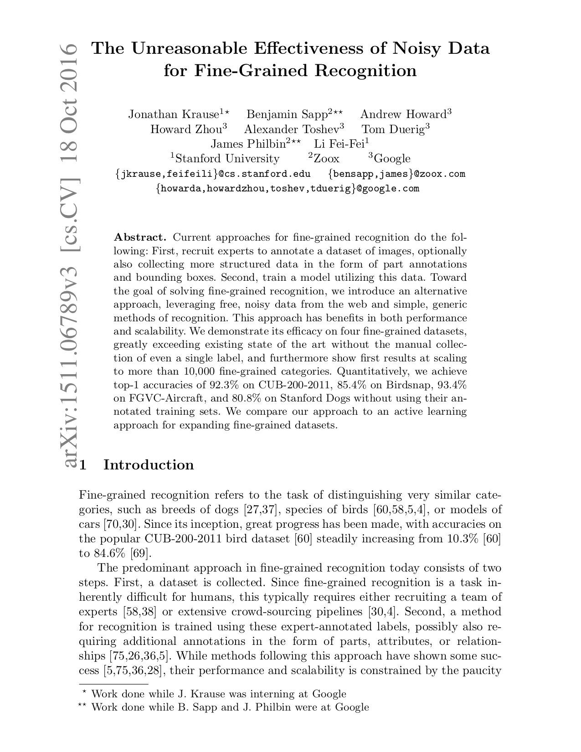
JUST USE IT

Slide 43
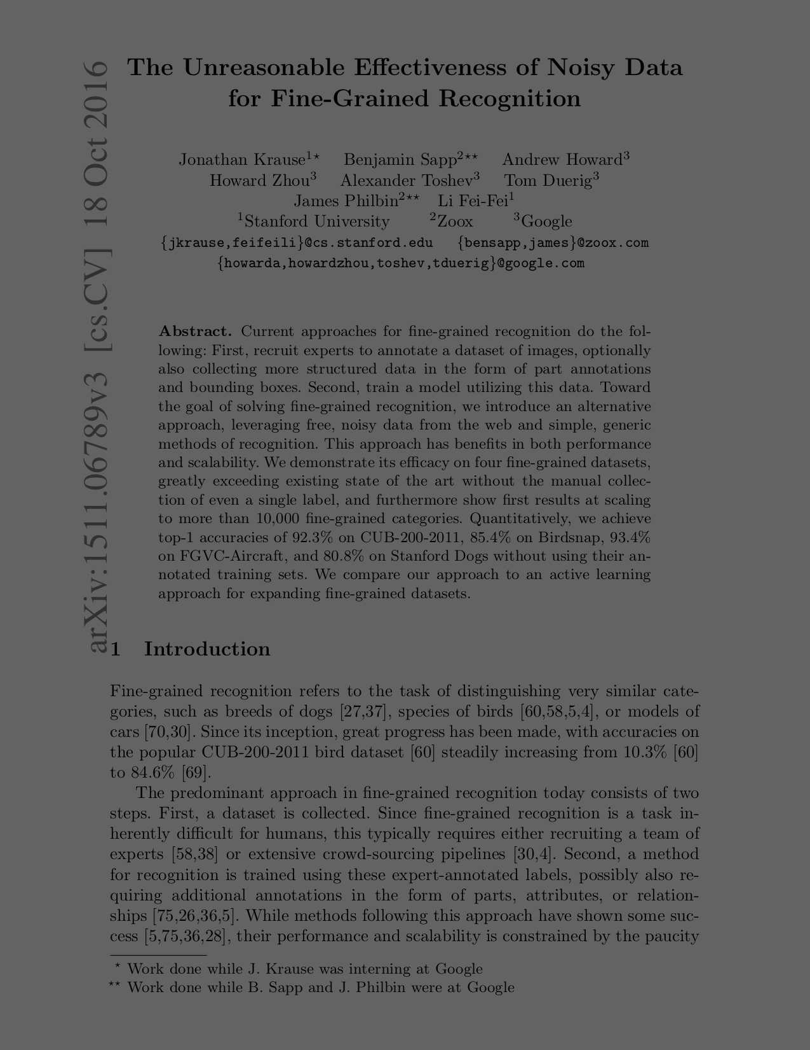
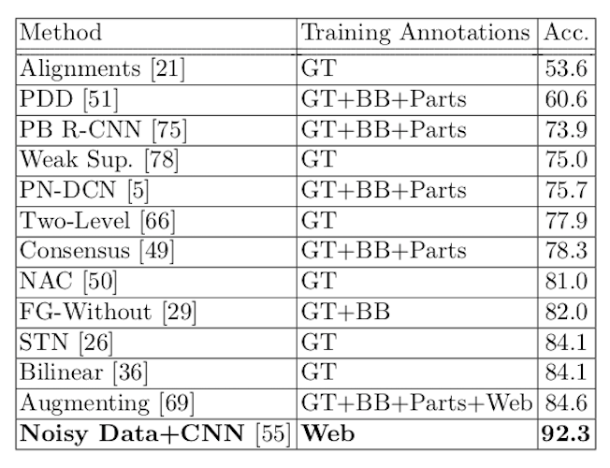
JUST USE IT

Slide 44
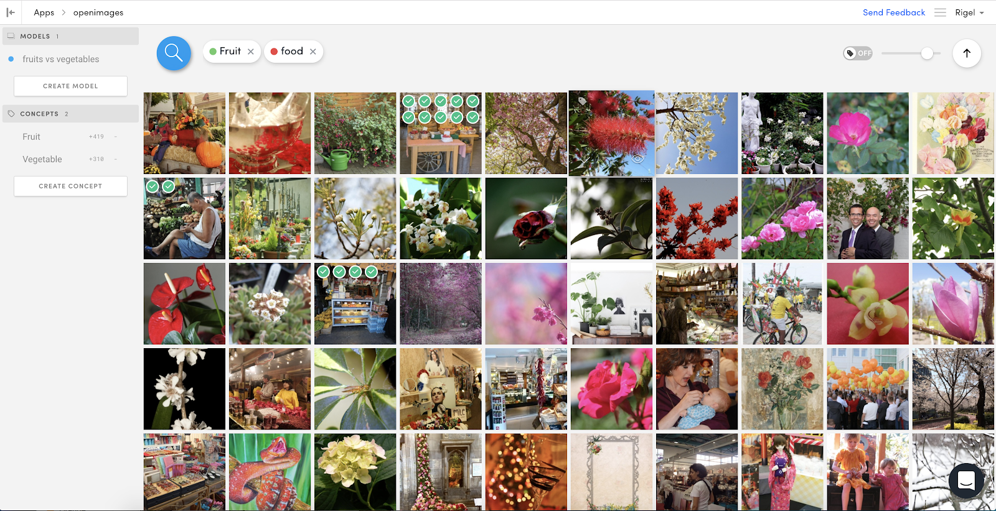
EXPLORE YOUR DATA
Notes:
Train it anyway, maybe it’s bad, but you can use it to find what’s there

Slide 45
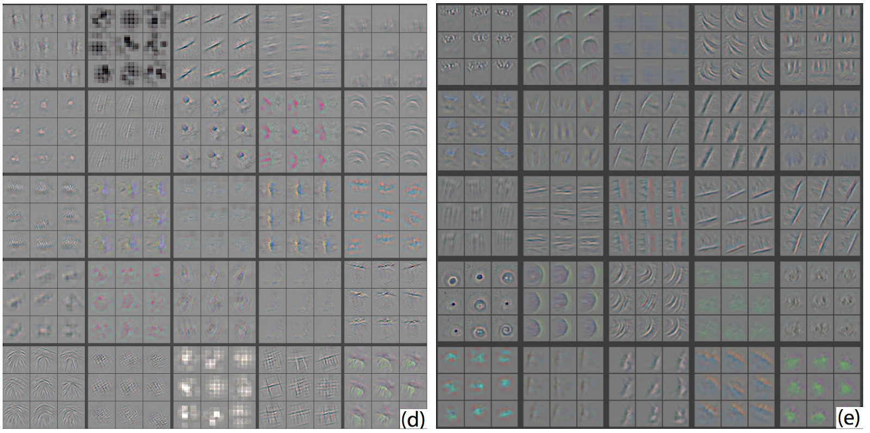
USE THE GOOD PARTS
Representation Learning
Zeiler and Fergus, “Visualizing and Understanding Convolutional Networks”, ECCV 2014

Slide 46
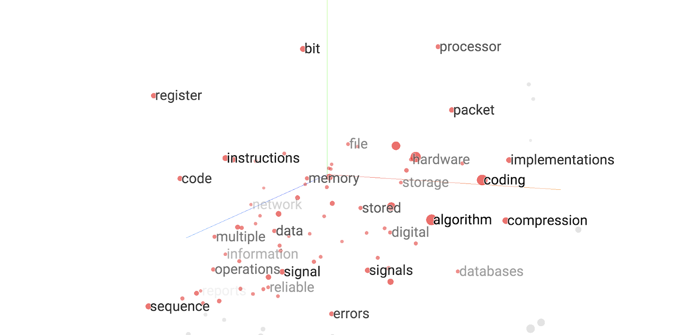
USE THE GOOD PARTS
Representation Learning

Slide 47
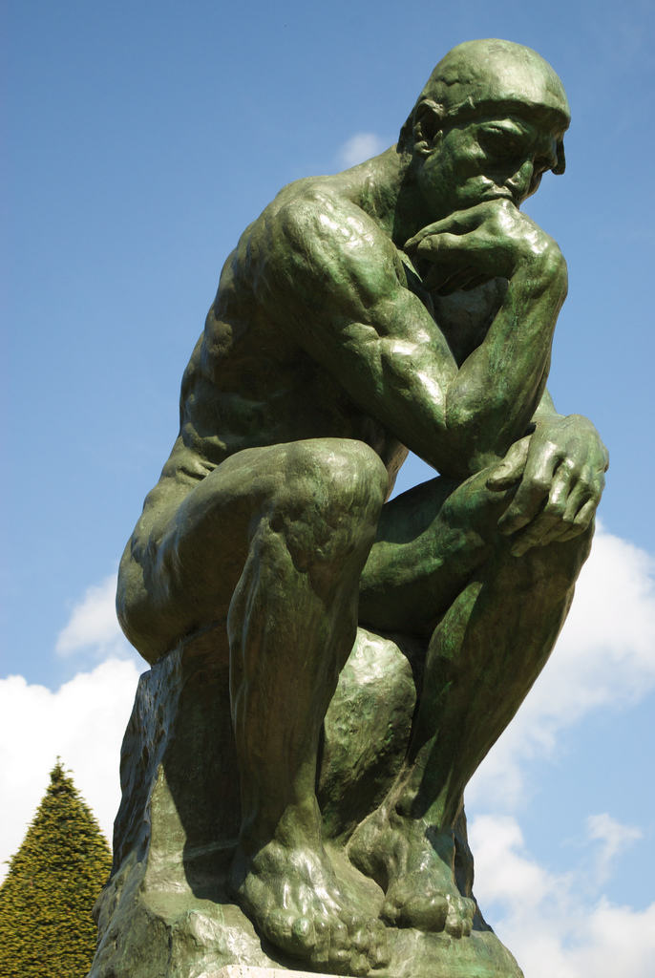

Slide 48
WRAP UP
What happened?
Bad data takes two forms
  Honest
  Deceptive

Slide 49
WRAP UP
What happened?
Bad data takes two forms
  Honest
  Deceptive
Use tools to:
  Evaluate your models
  Break through false confidence
  Expose inherent bias

Slide 50
WRAP UP
What happened?
Bad data takes two forms
  Honest
  Deceptive
Use tools to:
  Evaluate your models
  Break through false confidence
  Expose inherent bias
If you’re stuck with it:
  Try to use it anyway
  Create rich representations
  Reconsider your problem

Slide 51


REACH OUT
rigel@clarifai.com
Thanks to Hakka Labs and DataEngConf!

