Slide 1





The Customer as the Unit of Analysis:
Models, Metrics and a Multitude of Uses
, Nov 2018
Brian Bloniarz
Notes:
in the area of business analysis
talk is all about what happens when you stop thinking about business as flow of dollars
flow of dollars attached to customers
some non-obvious things that happen when you analyze in this way
modeling techniques which have been developed for dealing with them

Slide 2
Outline
Analyzing companies at the grain of a customer
Initial look at customer lifetime spend [metrics]
Estimation [models]
Models, applied to data [uses]
Questions?
Slides: github.com/b11z
Notes:
setup the framework
data
introduce models
a little bit results
Slides at my GitHub

Slide 3
I. Framework
Notes:
frame the question want to ask
Little bit of domain knowledge to make sure we’re answering the right questions
data sci, former software engineer, presenting corp finance basics

Slide 4
What happens when you set the unit of analysis to be a customer?
You start to think about all the accounting cash flows associated with that customer…
Purchases (Revenue)
Cost of goods sold (COGS)
Variable costs
Customer acquisition cost (CAC)
Notes:
cash flows that you see associated with a customers
revenue
the money your customer spends when they transact
costs
you’re spending money to build or buy what you’re selling, aka cost of goods sold

Slide 5
What happens when you set the unit of analysis to be a customer?
You start to think about all the accounting cash flows associated with that customer…
Purchases (Revenue)
Cost of goods sold (COGS)
Variable costs
Customer acquisition cost (CAC)
Notes:
variable costs: more holistic. This might be warehouses, salespeople

Slide 6
What happens when you set the unit of analysis to be a customer?
You start to think about all the accounting cash flows associated with that customer…
Purchases (Revenue)
Cost of goods sold (COGS)
Variable costs
Customer acquisition cost (CAC)
Notes:
acquisition
spend on marketing, then you’ll take that cost, divide by how many converted, and apportion that out
protip -- wanna sound cool, call it CAC

Slide 7
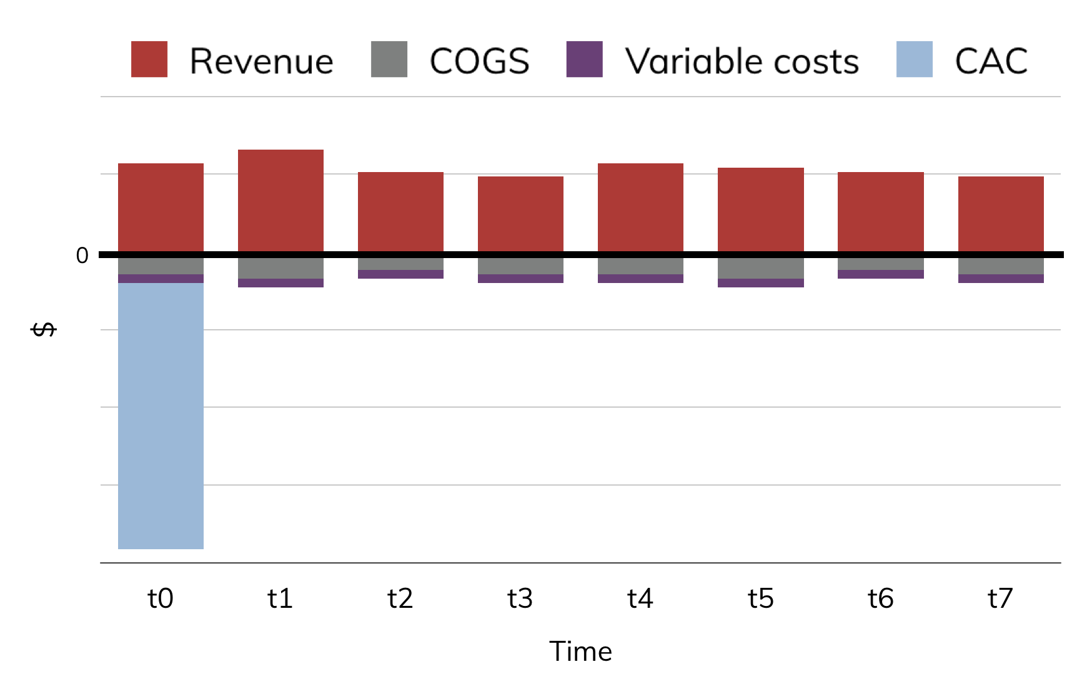
One way of looking at this…
Notes:
plot form
toy data
income above the y
expenditures below the y

Slide 8
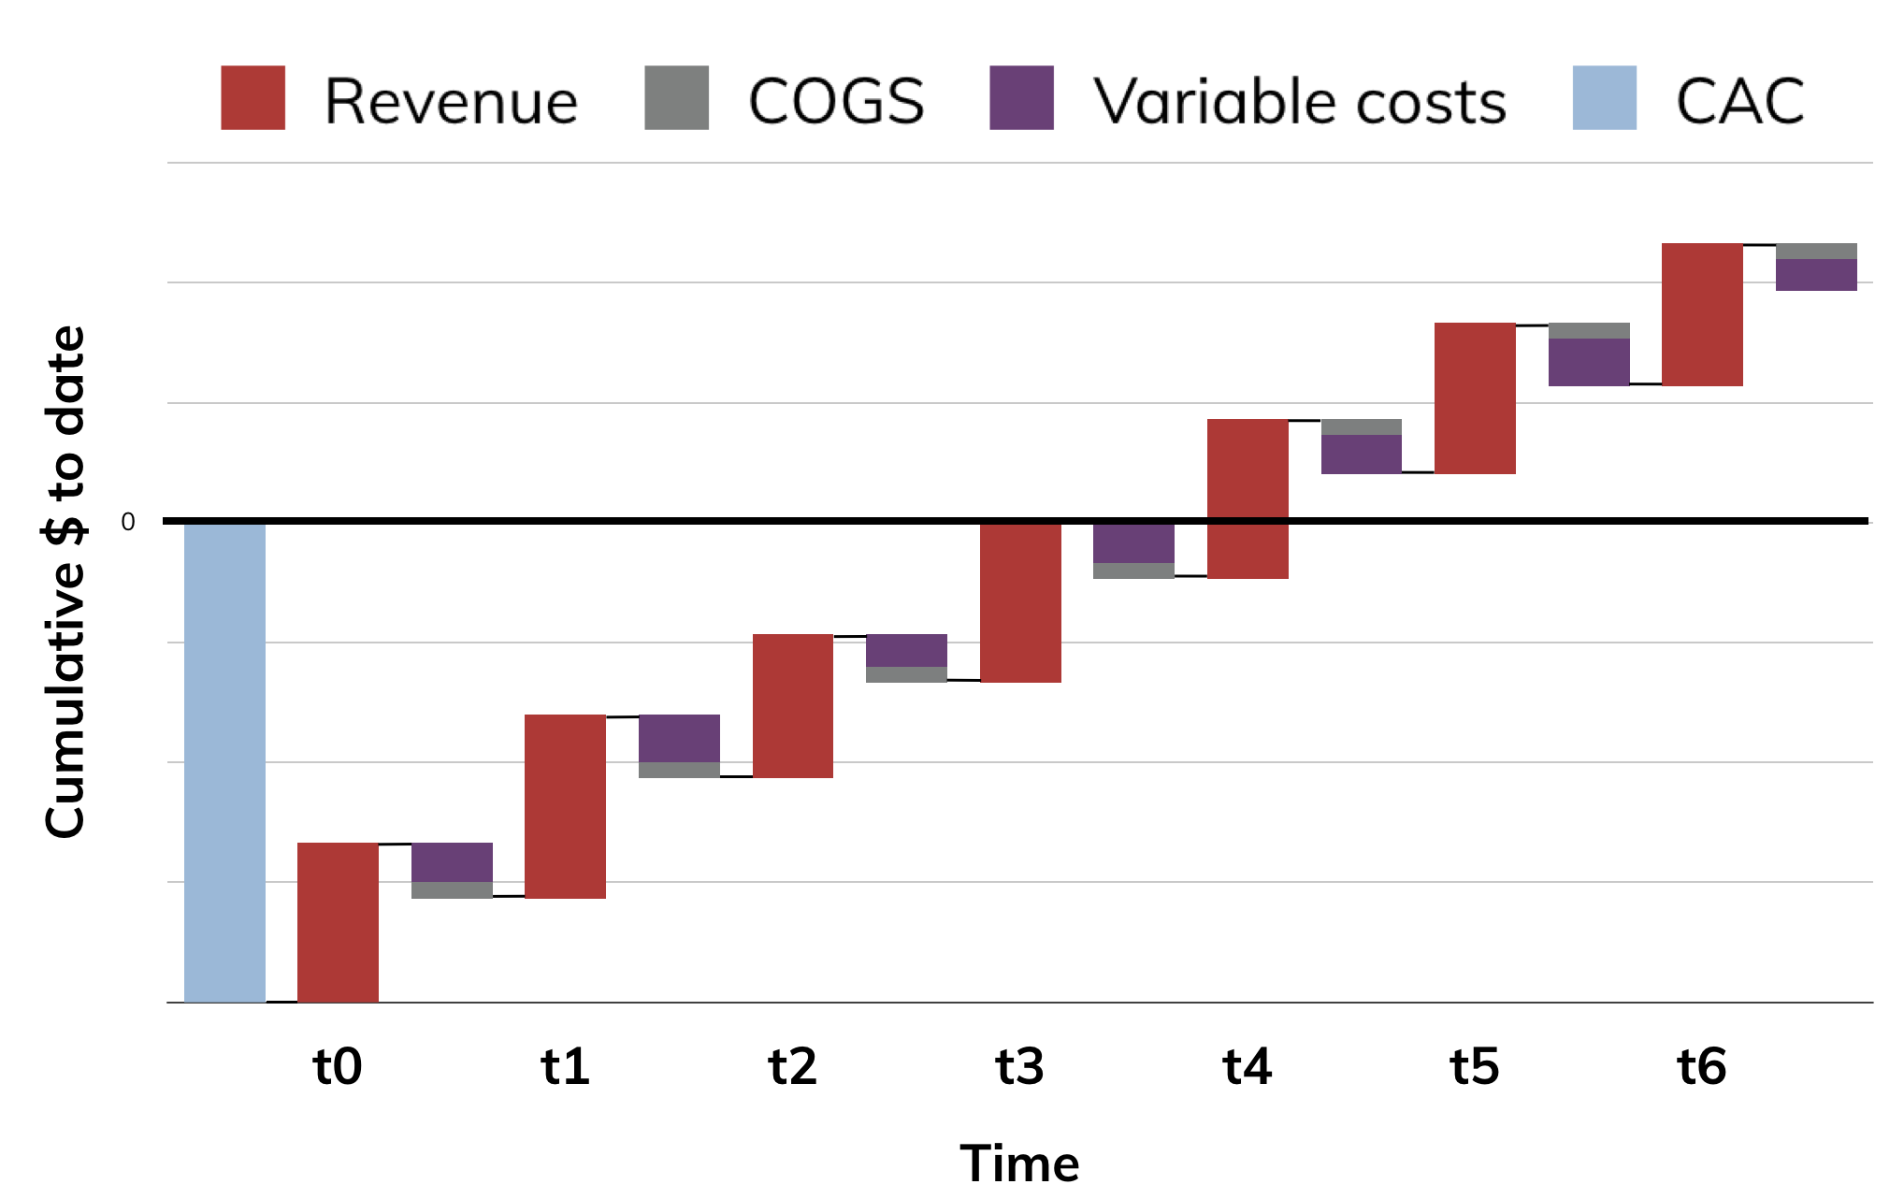
… replotted for shape …
Notes:
waterfall chart
cumulative total

Slide 9
Let’s define “Customer Lifetime Value”
Notes:
with this way of seeing things, i want to define concept of CLV
to do that, we need to add something, and remove something

Slide 10
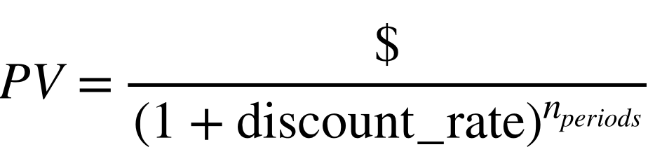
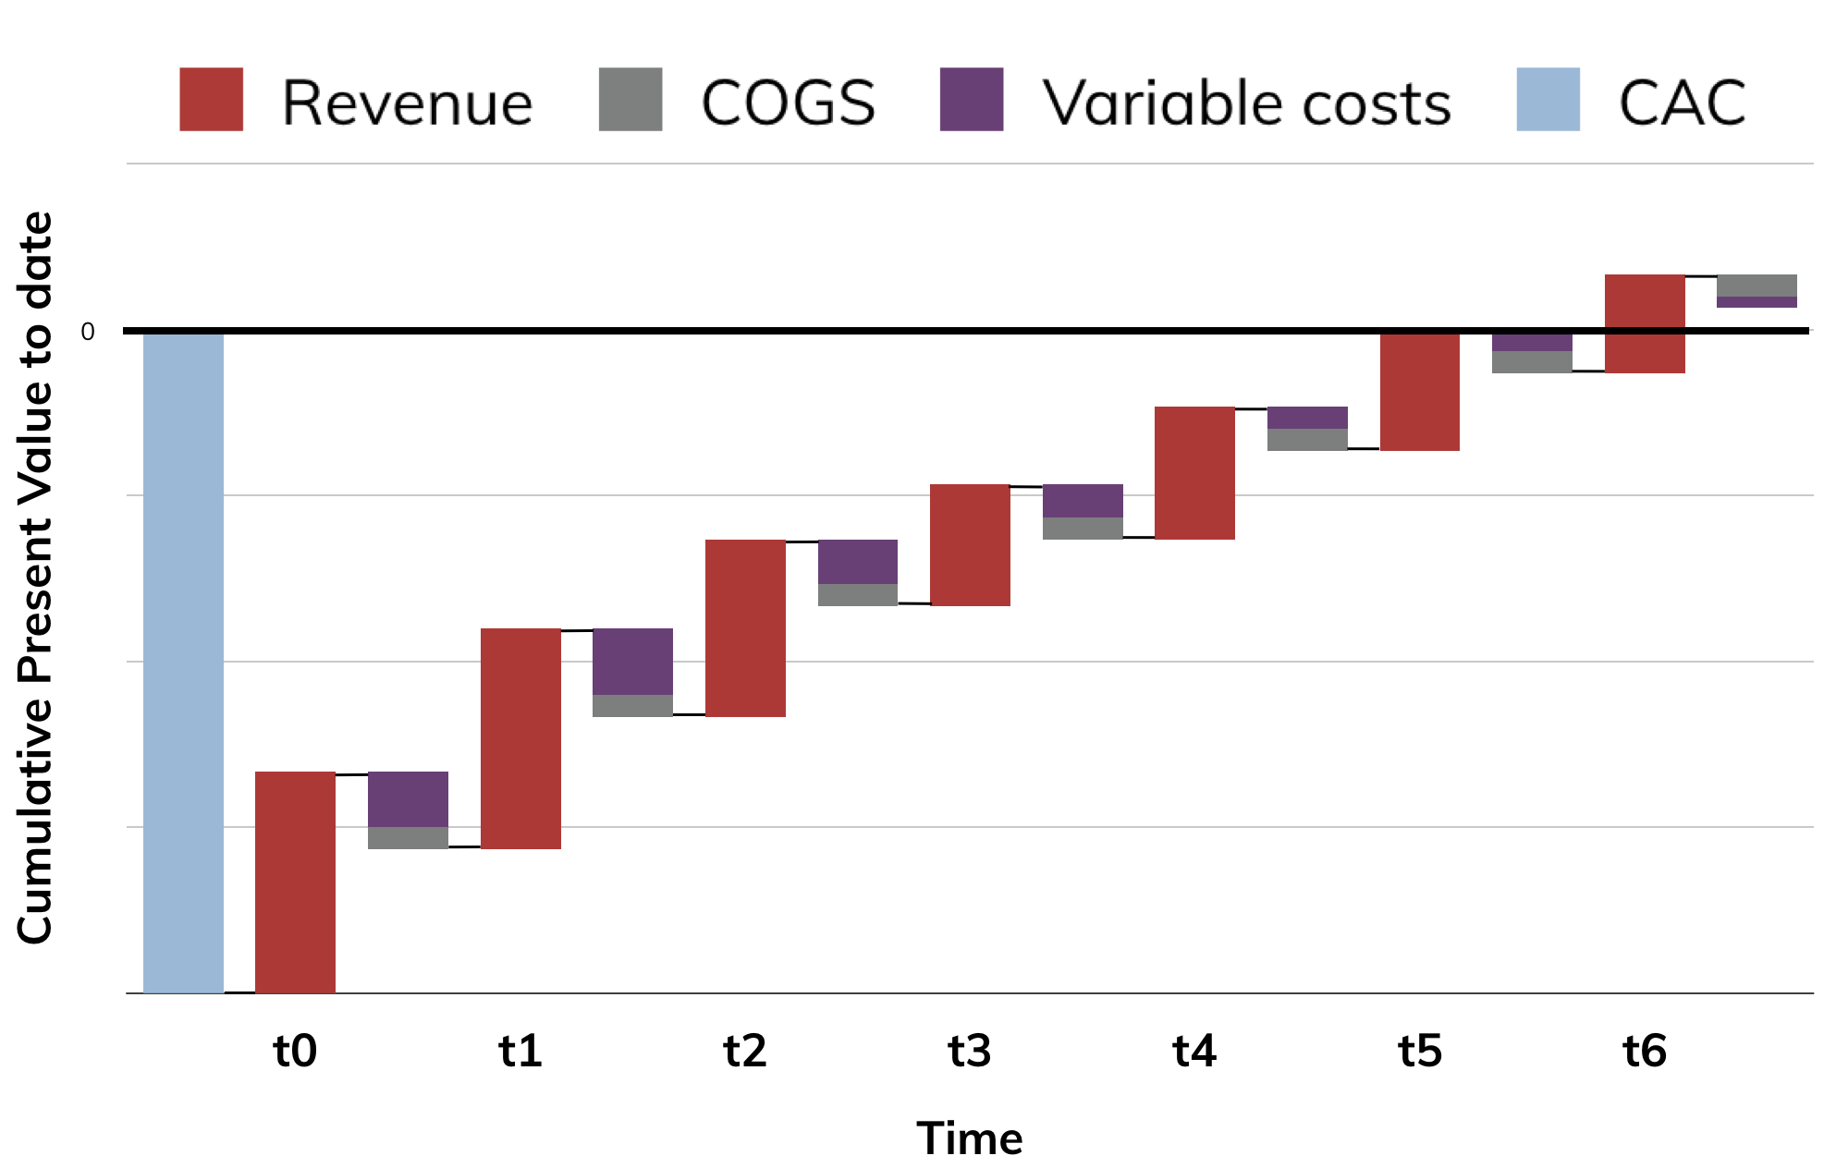
Net Present Value
Notes:
npv aka discounting
common corporate finance framework
sum up cashflows that are spread out over time, for analysis today, by adjusting for risk & opportunity cost
here you see the cash amounts getting smaller and smaller as time goes by
not because the actual amounts, but the discounted amounts are

Slide 11
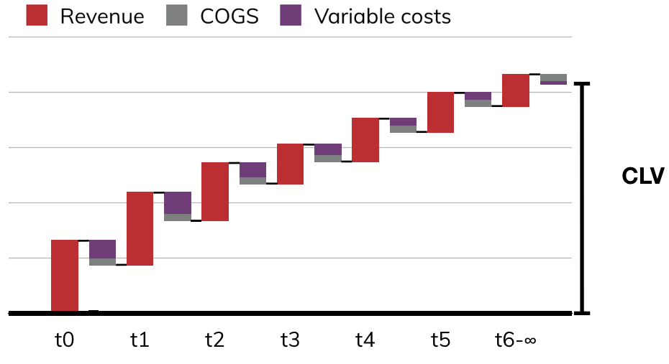
CLV typically defined as:
Revenue over lifetime
Minus variable costs (including costs of goods sold)
Discounted at a company-specific discount rate
[Does not include customer acquisition costs]
Notes:
CLV
Revenue over lifetime
Minus variable costs (including costs of goods sold)
Discounted at a company-specific discount rate
[Does not include customer acquisition costs]
Purpose of this is to summarize what’s contributed by a single customer down to one number, one single metric
you may find inconsistencies in the real world [e.g. cac in or out]
generally, define your metrics
maybe the words don't matter
but the meaning really important
the reason why it's important is in pursuit of internal consistency
where we’re accounting for the components of margin in one and only one place

Slide 12
Whatever you choose, please define your metrics.
Notes:
whatever you do define what you’re talking about
secondary protip, wanna sound cool, don't call it CLV

Slide 13
II. Exploration
Notes:
start looking at some real data

Slide 14
But first, about us:
Notes:
talk about where i work, where this data comes from
datasci head up the data team there

Slide 15
Second Measure analyzes billions of credit card transactions to answer real-time questions about consumer behavior

Slide 16
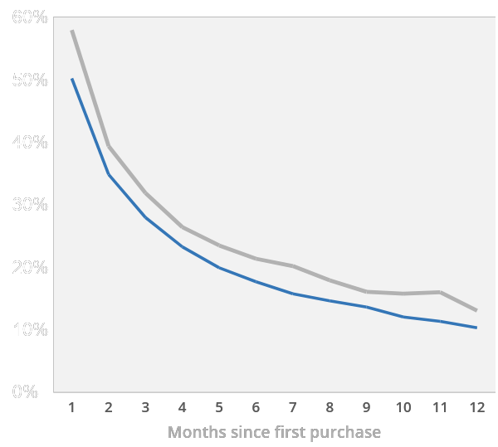
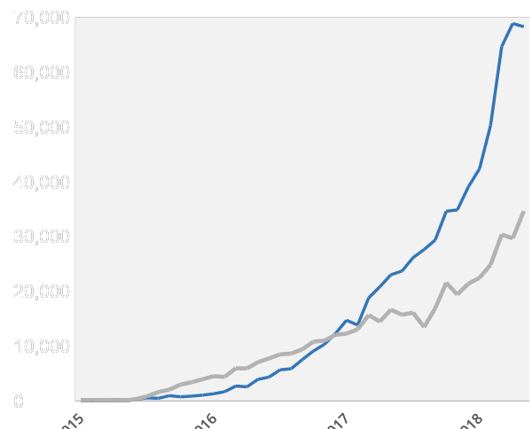
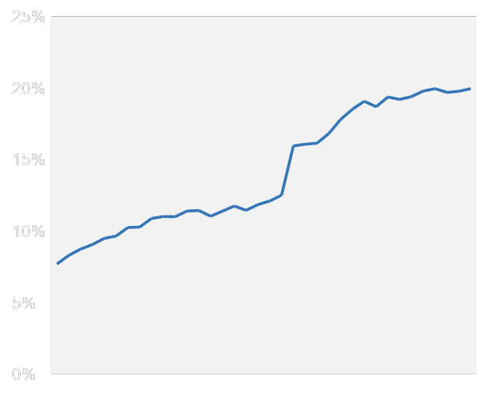
We answer questions like…
How well is Hello Fresh retaining its customers?
Is Waitr overtaking regional competitors?
Did Lyft benefit from #DeleteUber?
Customer Retention
Southern City Sales
Share of Riders Exclusive to Lyft
Waitr
2x
Sun Basket
DoorDash
#DeleteUber
HelloFresh
Notes:
leverage data to answer questions like this
Retention in the meal kit industry
Regional variation in food delivery
Analysis of deleteuber and its effect on lyft&uber

Slide 17
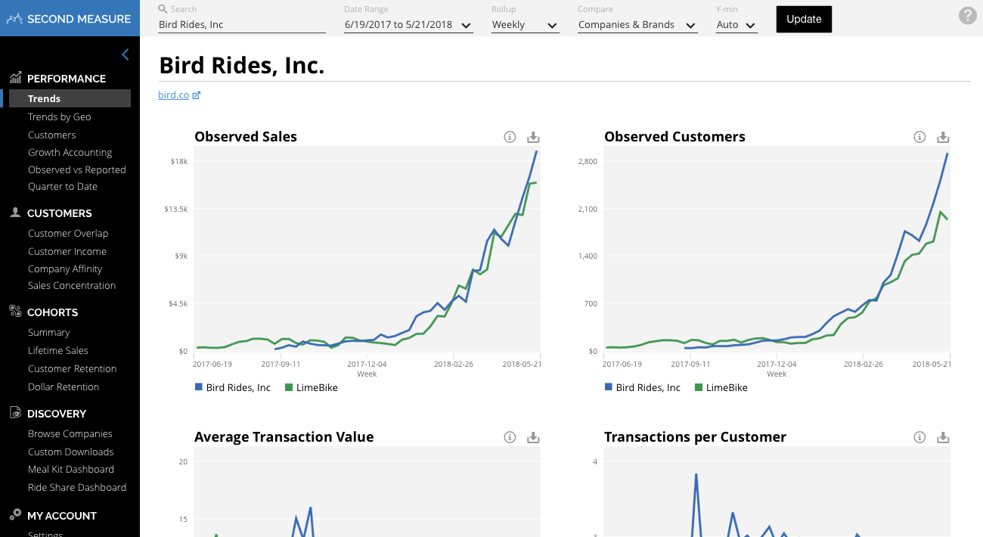
With a self-service analytics platform
Notes:
deliver as a self-service analytics platform
to clients

Slide 18
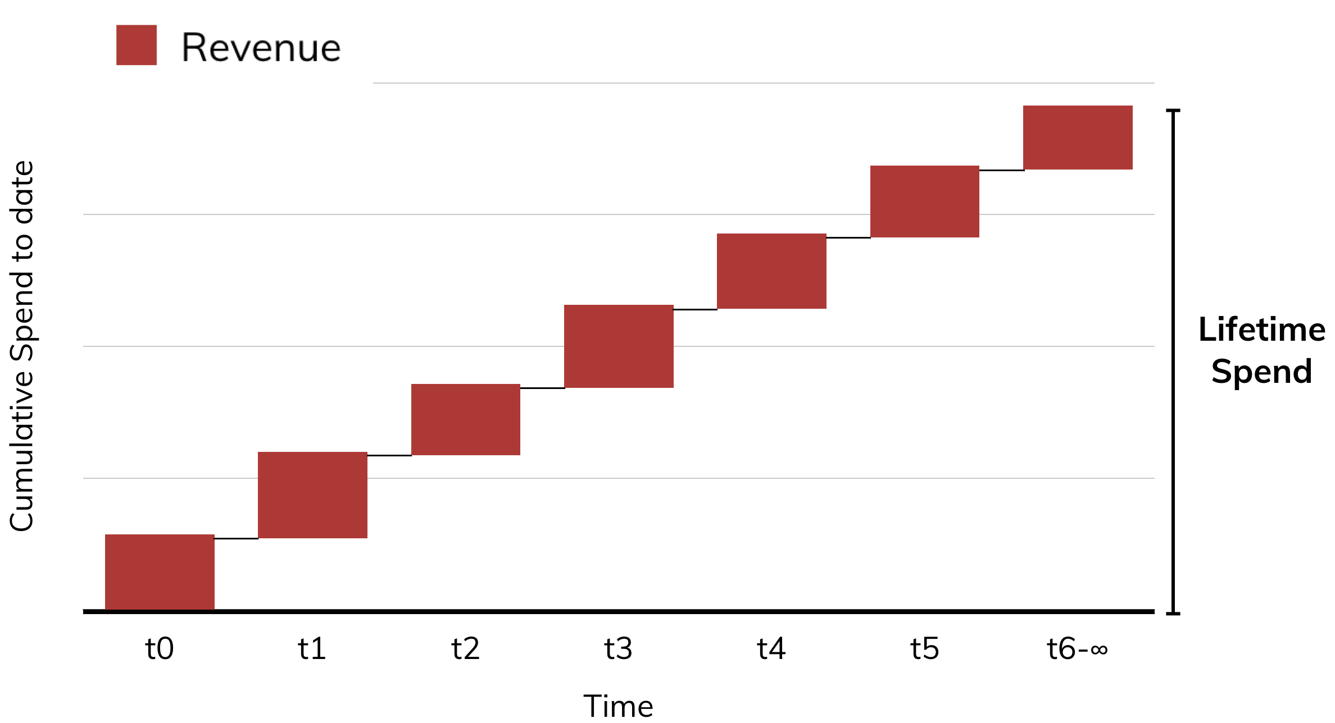
Confine ourselves to: lifetime spend
Notes:
because we're analyzing CC transactional data
revenue of businesses
not the whole, but it's an important part of it

Slide 19

Case study to begin with:
Dollar General
“an American chain of variety stores headquartered in Goodlettsville, Tennessee”
The company that “went where they ain’t”
Won a bidding war against Dolce and Gabbana for http://dg.com/ 💰
Notes:
look at some company data: dollar general
consumer goods store, variety store
focusing on rural areas, strategy of building stores where e.g. walmart won't go

Slide 20
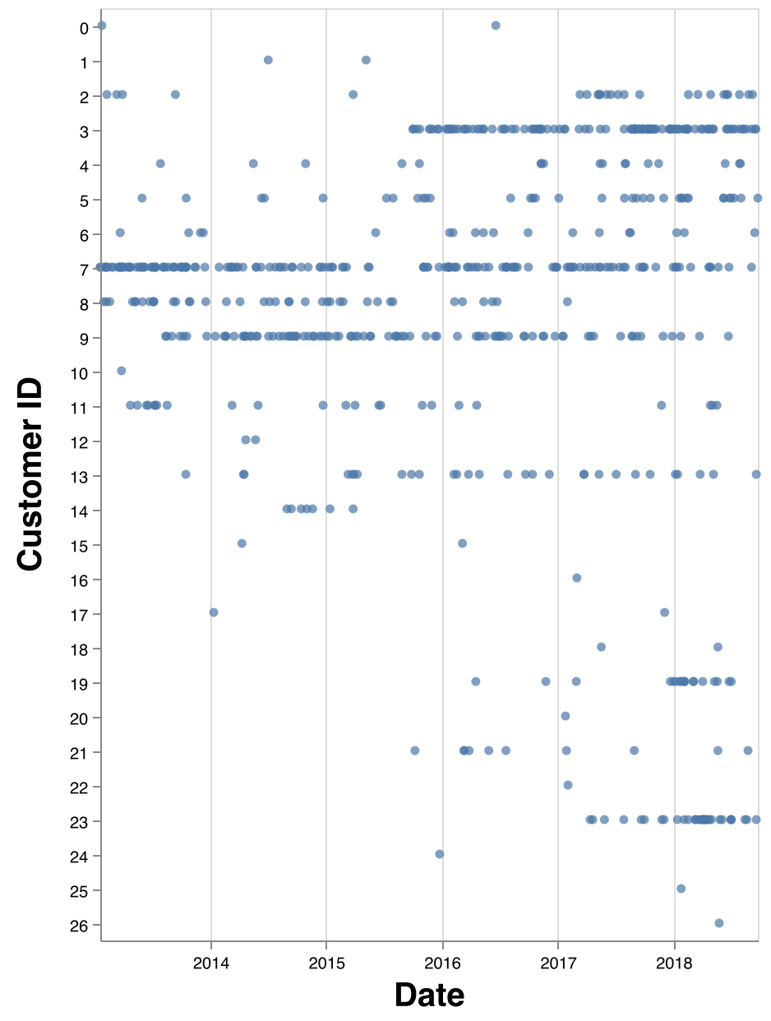
Raw purchases for Dollar General
Notes:
generally start with raw data
each purchase is a dot
each customer is a row in the data

Slide 21
Our first calculation (“lifetime spend”), defined:
Align all customers by the date of first purchase
Calculate cumulative spending to date over time
  Gross cumulative sales (including taxes)
  Undiscounted
  No costs netted out
Average across all customers
Notes:
do that thing again where we define our metrics
customers
aligned data so first purchases line up
cumu spending over time
averaged across all customers

Slide 22
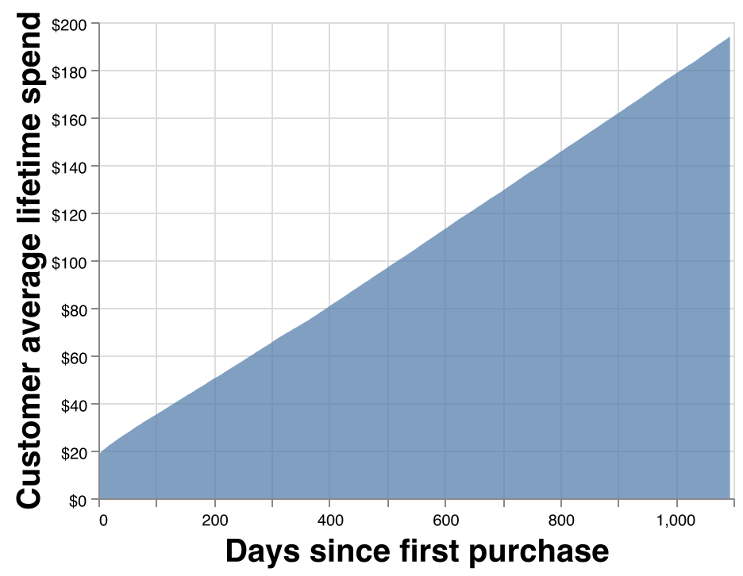
Dollar General Lifetime Spend
Notes:
didn't have great instincts, didn't appreciate how rare that that you'd get a straight line like this
DG very sticky
even in the the amazon and walmart era

Slide 23
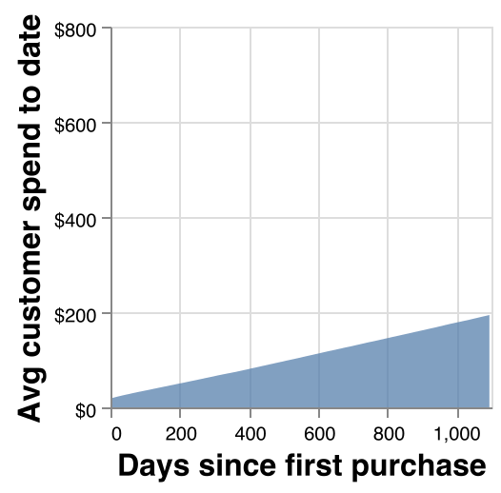
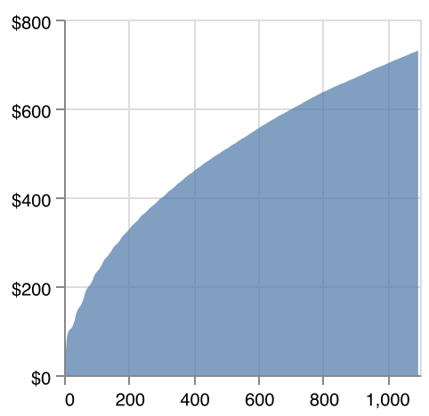
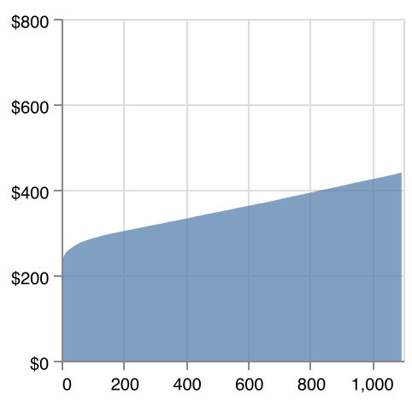
Stitch Fix
Dollar General
Wayfair
Notes:
stitchfix subscription clothing box
higher dollar value. stitchfix is pretty far upmarket from DG
churn: large number of customers active, over time more of them cancel out
wayfair online furniture retailer
front-loaded
retention problems

Slide 24
What’s unsatisfying about this picture?
Notes:
lifetime spend, kinda what want to reason about
why are we not done?
Failed to tell you the first time i walked through it

Slide 25
“Lifetime spend”, a hidden caveat
Align all customers by the date of first purchase
Exclude customers who don’t have enough history
(3 years)
Calculate cumulative spending to date over time
Average across all customers
Notes:
align over date
ignore anyone who don't have the full history
newest cust in the dataset we're looking at: 3 years old
dealing with partially observed data

Slide 26
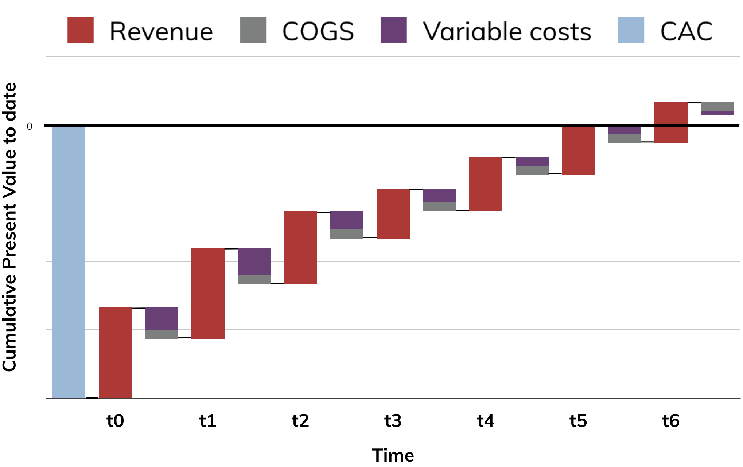
Notes:
as a datasci, i empower decisions
almost never need to make decisions on aplot that looks like this

Slide 27
Most analysis:
Today

Slide 28
Marketing analysis:
Today
Notes:
marketers
reason about hypothetical customers you want to acquire
estimate customer acquire cost

Slide 29
III. Estimation

Slide 30
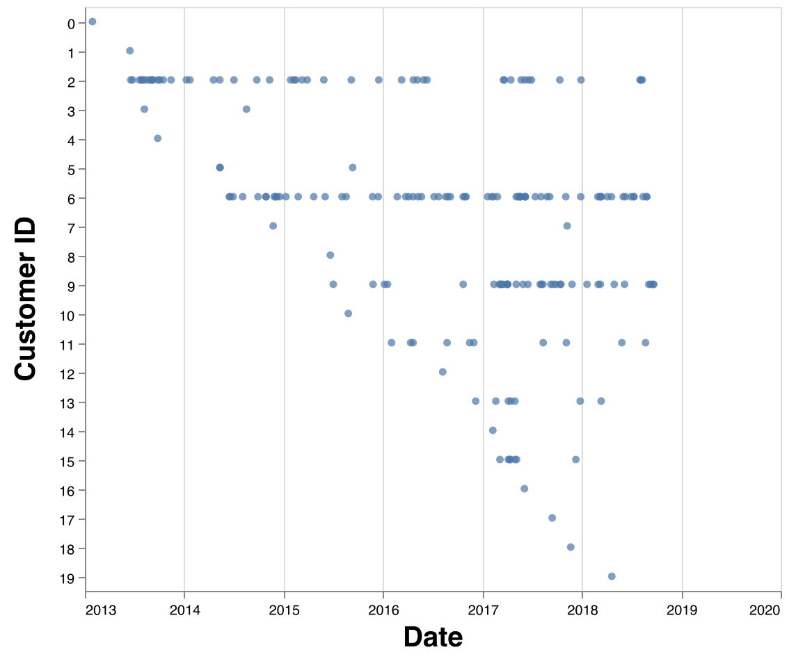
Notes:
gameplan
model based on observed data
impute observations beyond today, fill in with expectation values
analyze the combo of those 2 datasets: 2 data, expected future data

Slide 31
Factoring the problem
We’ll factor the estimation of customer purchase data into several steps. Let’s start by focusing on modeling transaction counts.
Notes:
Purchase data multifaceted
purchase counts
churn
transaction amounts
costs
we're going to have factor into problems
focus on purchase counts first

Slide 32
What’s the simplest thing that could work?
Notes:
start by asking what's the simplest thing that could work j? for counts of events per unit time?

Slide 33
  Answer: A Poisson process
Time
Notes:
a memoryless process, count modelled by a poisson
simplest event process you could imagine
turns out that that's a fairly bad fit for customer purchase events

Slide 34



🚫
Notes:
engage the audience: any guesses

Slide 35
🚫
Poisson
Don’t
Churn
Notes:
transaction counts
poisson processes keep going till infinity
people churn
people will be very engaged
then just drop off. they went to a competitor, they got tired with the space

Slide 36
Ok then, what’s the next simplest thing that could work?
Notes:
expand this model so it fits data better
one common approach

Slide 37
  Our assumed data generating process:
Time
Poisson process…
Alive
Dead
Filtered through a birth/death process…
Latent (unobserved)
Observed
Time
Notes:
probabilistic model with processes that are unobserved, that combine to form the data we do see
below the line
term: birth-death, name that comes from survival analysis for these kinds of assumptions
born exactly one
after that point, you're at risk of dying, can happen only once
hybridize: survival and poisson counts process

Slide 38
  Infer parameters given likelihood:
ƛ (i.e. rate parameter of Poisson distribution)
Hazard of churn per unit time
Pr(Alive)
Inferred
Observed
Time
Notes:
write out the likelihood of this probabilistic process
infer back from observed data to parameters
the purchase rate (condition on not churning)
probability hazard rate
conditioned on this data, this is the prob over time that the churn has happened
we know they were alive until their last purchase, after that it decays
this probability is balancing the 2 possible explanations -- either their posson is taking a break, or they've churned

Slide 39
Factoring the problem
In this framework, we factor customer estimation into:
Transaction count
Churn date
Modeled jointly. Then, separately:
Transaction amounts
Costs
…
Notes:
hints at how to factor problem
counts & churns jointly
other things separately

Slide 40
Are we sure this is simplest thing that might work?
Notes:
i was a little skeptical this joint mechanism was necessary
ask question again, is this the simplest thing that might work?

Slide 41
Customer ID | Period | Transaction count
1 | 2018-01-01 | 1
1 | 2018-01-03 | 3
1 | 2018-01-06 | 2
Notes:
illustrate that, think about toy data
purchase history
6 times, on 3 separate days

Slide 42
Customer ID | Period | Transaction count
1 | 2018-01-01 | 1
1 | 2018-01-03 | 3
1 | 2018-01-06 | 2
ƛ = Mean(txn count) = 2
Notes:
average transaction count over these 3 observations
is that what we truly expect
Answer is no, I intentionally set this up to be a bad approach

Slide 43
Customer ID | Period | Transaction count
1 | 2018-01-01 | 1
1 | 2018-01-02 | 0
1 | 2018-01-03 | 3
1 | 2018-01-04 | 0
1 | 2018-01-05 | 0
1 | 2018-01-06 | 2
Notes:
esp if i redraw the table like this
so i was ignoring the negative space
overestimating the rate
every time i go to do this, i make this mistake

Slide 44
Customer ID | Period | Transaction count
1 | 2018-01-01 | 1
1 | 2018-01-02 | 0
1 | 2018-01-03 | 3
1 | 2018-01-04 | 0
1 | 2018-01-05 | 0
1 | 2018-01-06 | 2
ƛ = Mean(txn count) = 1
Notes:
include zeros
new way of looking at it, can compute mean over 7
little more subtle, but
still overestimate

Slide 45
Customer ID | Period | Transaction count
1 | 2018-01-01 | 1
1 | 2018-01-02 | 0
1 | 2018-01-03 | 3
1 | 2018-01-04 | 0
1 | 2018-01-05 | 0
1 | 2018-01-06 | 2
1 | 2018-01-07 | 0
1 | 2018-01-08 | 0
Notes:
there may be more negative space that occurs after their last purchase

Slide 46
Customer ID | Period | Transaction count
1 | 2018-01-01 | 1
1 | 2018-01-02 | 0
1 | 2018-01-03 | 3
1 | 2018-01-04 | 0
1 | 2018-01-05 | 0
1 | 2018-01-06 | 2
1 | 2018-01-07 | 0
1 | 2018-01-08 | 0
How many rows of “negative space”
should we account for after the last purchase?
Notes:
the amount that we're ignoring depends on the rate
naive approach: overestimate the rate

Slide 47
Simulation results: bias by rate
True rate (events per unit time) | Percentage bias
0.1 | 158%
0.2 | 63%
0.5 | 19%
1 | 6.4%
2 | 1.6%
5 | 0.19%
10 | 0.01%
Notes:
simulation study of how bad this bias gets
not too bad if you rollup, but you have to roll up to the granularity where expectation of 1-2 events per unit time
we analzye thousands of companies, and this disqualifies them almost all of them
you'd be rolling up to quarters
illustration that churn and purchase rate entangled such that they need to be estimated jointly
if we knew the “churn date”, we’d be talking about survival analysis, but that date has to be inferred from purchases
And if we do it based on looking at their last purchase date, we’ll be biased. This is a bias that doesn’t go away with more data

Slide 48
The first big idea: a hybrid probabilistic model
Notes:
one big idea
build this hybrid likelihood, composed from familiar probabilistic parts
these are "counting your customers" models, named after the first paper framed in this way

Slide 49
The second big idea: customer heterogeneity
Notes:
next big idea: "customer heterogeneity", which you'll hear referred to a lot the papers on these models

Slide 50
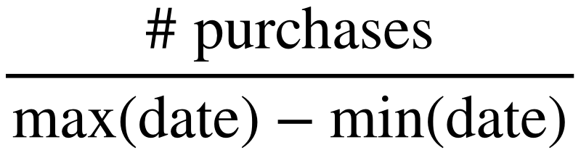
Purchases per day
Observational unit: one customer
Calculation:
Notes:
Each row is one customer
Calculate # purchases / # days

Slide 51
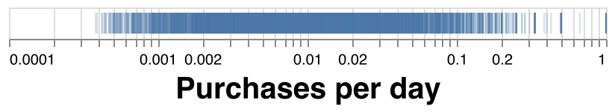
Purchases per day (for Dollar General)
Observational unit: one customer
Calculation:
Notes:
Plot - each tick is one customer
variability is extreme
logarithmic x axis for it to fit
data spans at least 3 orders of magnitude
customers span a huge range of activity for your business
pretty universal

Slide 52
Notes:
another way of looking at that
when you saw this, if you're like me you pictured lots of customers orderly fashion marching up this plot
think about the average as an aggregate over the raw data

Slide 53
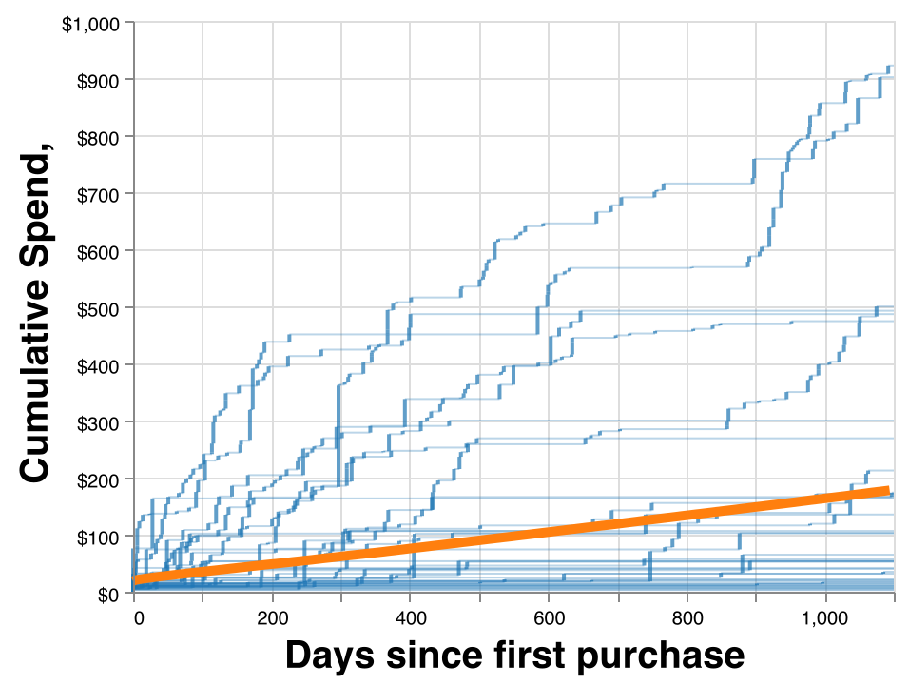
Not so orderly now, huh?
Blue = each customer, orange = average
Notes:
many stay along the x axis
small # of very high value customers

Slide 54
?
Observational unit: one customer
Calculation:
Notes:
second thing -- what are these synthetic
they look kinda alien, whereas the rest was so smooth and organic
high rate
what is this, elon musk

Slide 55
Observational unit: one customer
Calculation:
Notes:
you can see the cause fairly easily if we look back at the thing we're calculating
what if we split this plot based on the size of the denominator
true variability, vs pure noise
corrupted

Slide 56
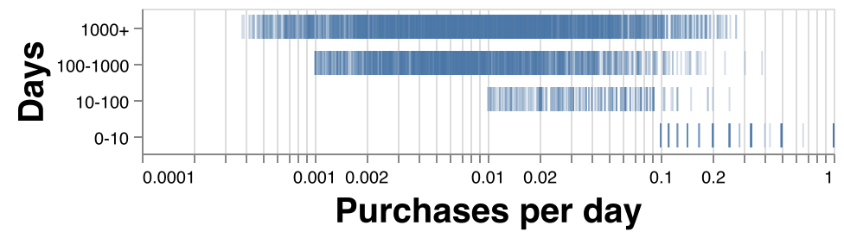
Split by the denominator:

Slide 57
A solution: multilevel models
Jointly Estimate customer rate and a distribution over all
those rates; distribution is fit from data and acts as a prior
for rates with small N.
Notes:
essence of the idea
multilevel models aka hierarchical models aka random effects / mixed effects
setup assumption of an explicit probabilistic process that generated your data
aware of
bayesian approach
prior for these customers where you have very level data
prior over all customers is fit from this data, along with the customer estimates
and so the prior will leverage your
powerful & general idea
fit richly parameterized models
but do sensible things about the customers with no data

Slide 58
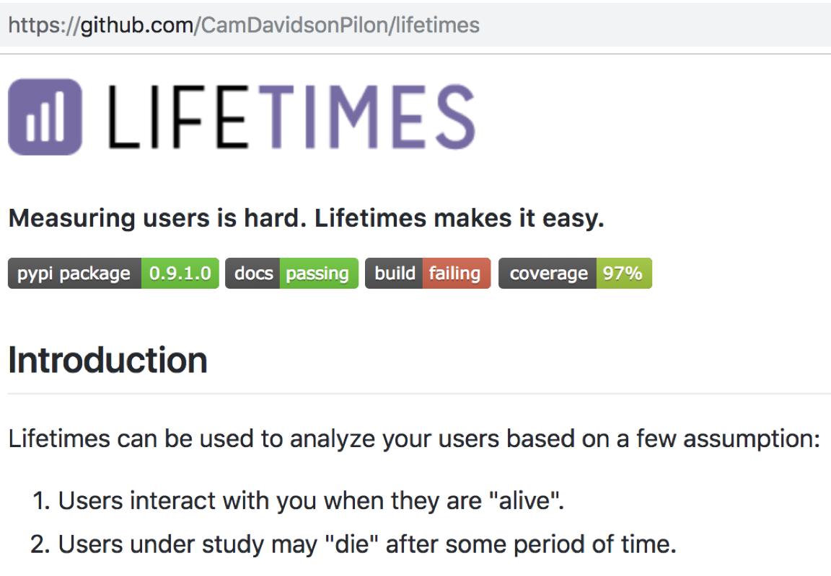
Estimate Your Lifetimes
Notes:
introduce lifetimes
cam davidson pee-lon
data scientist at shopify
and they use at shopify to count their customers

Slide 59
“Counting your Customers” Models in Lifetimes
Model | Paper | Comments
Pareto / Negative Binomial Distribution | Schmittlein, Morrison & Columbo 1987 | The originator
Beta Geometric / Negative Binomial Distribution | Fader, Hardie & Lee 2005 | Tweaked churn process that allows for a more efficient implementation; has a limitation in Pr(Alive) estimand
Modified Beta Geometric / Negative Binomial Distribution | Batislam, Denizel & Filiztekin 2007 | Fixes limitation in BG/NBD’s Pr(Alive)

Slide 60
Recommendation: use this!
Model | Paper | Comments
Pareto / Negative Binomial Distribution | Schmittlein, Morrison & Columbo 1987 | The originator
Beta Geometric / Negative Binomial Distribution | Fader, Hardie & Lee 2005 | Tweaked churn process that allows for a more efficient implementation; has a limitation in Pr(Alive) estimand
Modified Beta Geometric / Negative Binomial Distribution | Batislam, Denizel & Filiztekin 2007 | Fixes limitation in BG/NBD’s Pr(Alive)
Notes:
opinionated: MBG/NBD
2005: extended more performant to fit
2007: fixed some limitations in the 2005 generated
used by shopify
name the model
names come from the probabilistic assumptions we're making
MBG/NBD
Next up lets look at some results

Slide 61
Next up: Bird Rides, Inc.
Santa Monica-based scooter share startup and well known hockey-stick
Notes:
let's try and illustrate how you can use that models
introduce new company
local flavor than dollar general
bird santa-monica based scooter share startup

Slide 62
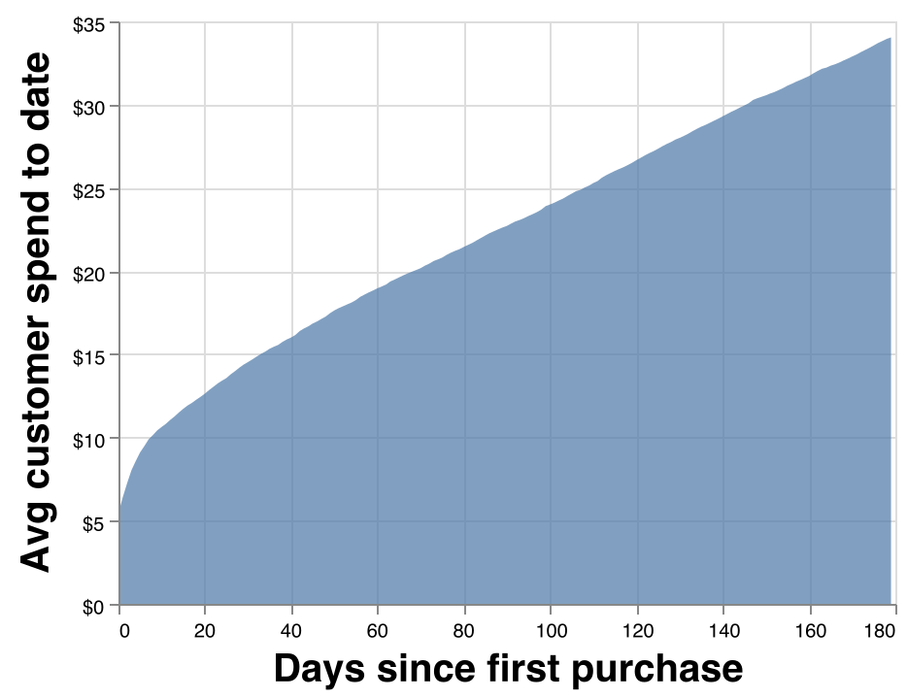
An unsatisfying lifetime spend chart
Notes:
make plot we made before
really unsatisfying
only can do 180 days
had to throw out 80% of customers, because bird is growing like a rocket

Slide 63
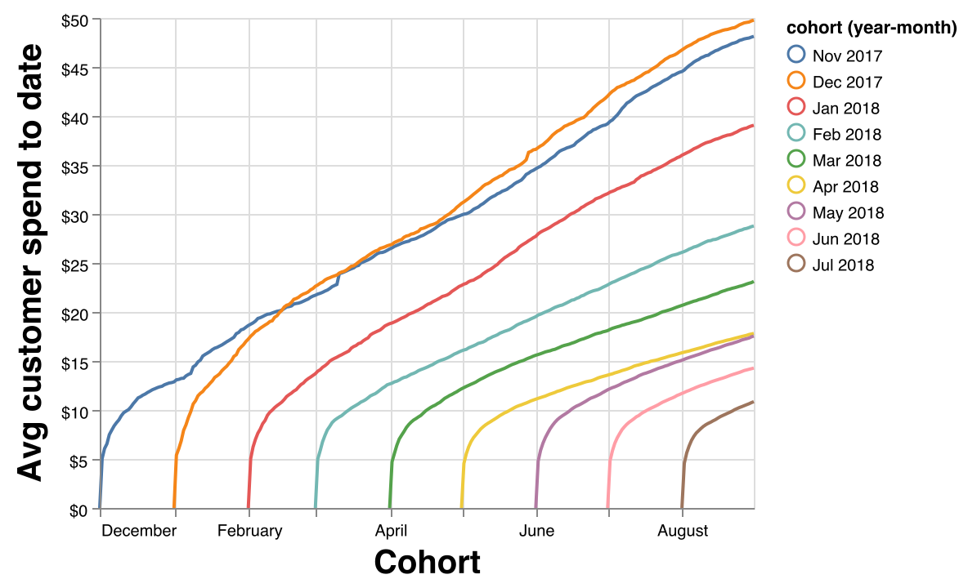
A band-aid: cohorted lifetime spend
Notes:
another attempt: cohort
grouped our data by the date of each customers first purchase
for each cohort, customer average spend to date
illustrates the partial data issues
newer cohorts less data
fit mbd/nbg model
estimate future data, fill in these curves
find out something over how bird is trending

Slide 64
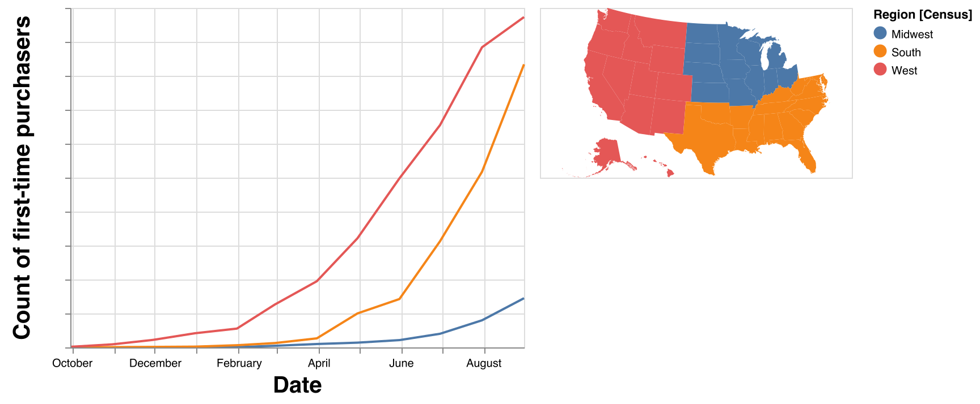
Bird: count of new customers by geo
Notes:
geo subregions
3 regions bird is operating in
y axis count of new customers
west grew early on
south grew later on and caught up
comparing spend, btw s and w almost impossible
very different mix of customer vintage, meaning how long since their first purchase
control for that

Slide 65
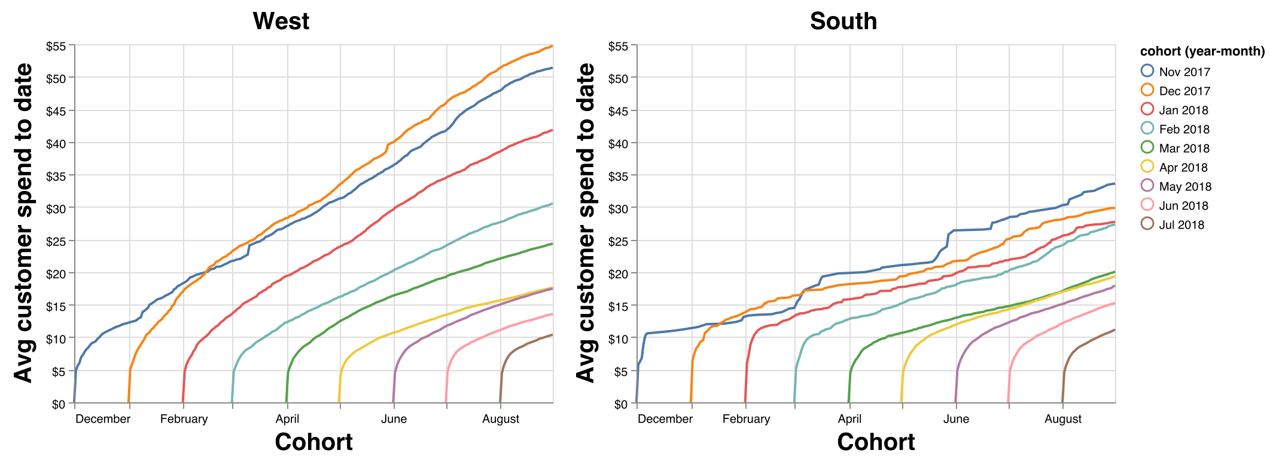
Cohorted lifetime spend by geo
Notes:
can try plot
use models to summarize into expectation for randomly chosen individual

Slide 66
Bird: Model estimates
24 month expected total sales (including taxes)
Undiscounted
Region | Estimated 24 month sales | % difference
West | $44 | 0%
South | $37 | -16%
Midwest | $27 | -37%
Notes:
summarize est sales over 24mo period
doing that thing where i'm defining our metrics. eh eh?
you might make diff conclusion eyeballing this chart
60% of the transactions we have come from the past 4 months
so for bird, takeaway is customers act differently and they can't assume new markets behave the same as the proven ones
they (bird) know this, now we do too

Slide 67
90% of business analysis is reasoning about this
Notes:
why do we care about this chart
central to lots of decision making
lots business revolves around reasoning about what happens to groups of customers
finding groups of potential customers who are expected to end up above the Y
hopefully way above the y
ensuring that they stay there

Slide 68
Wrap-up: the core ideas
Workflow: build models from past data, project the near future. Analyze the 2 combined
Probabilistic models can be composed of familiar building blocks to fit tailored situations
Mind the noise!
Customers vary widely
Define your metrics, please!
Notes:
think back to some of the ideas
workflow: build models, model the past, project the near future. analyze the 2 combined
probabilistic models can be composed of familiar building blocks to fit tailored situations
mind the noise!
don't expect your customers to all be the same
define your metrics, please

Slide 69
Learn More
Corp finance: Aswath Damodaran’s YouTube lectures
Multilevel Models: Statistical Rethinking by McElraith
Counting Your Customers: Lifetimes, Shopify blog
Survival Analysis usecases: talk from Opendoor
Notes:
learn more
net present value: aswath damodaran: professor at NYU stern
turns internal consistency into an art form
survival analysis: some former colleagues of mine

Slide 70
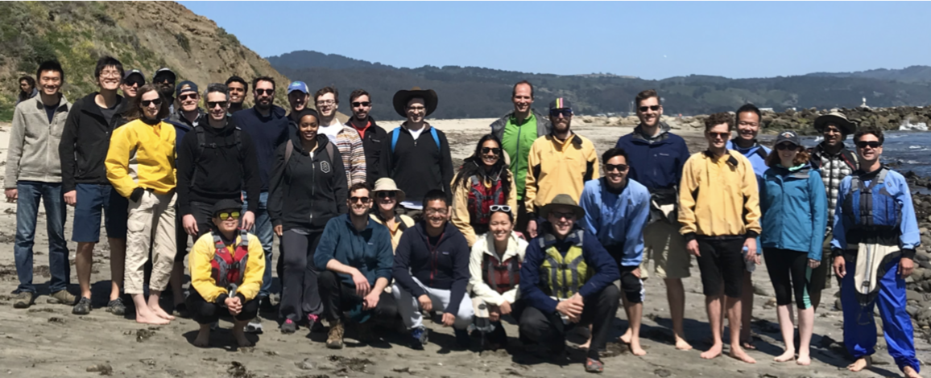
Thank you!
brian@secondmeasure.com
Read http://blog.secondmeasure.com!
We’re hiring! In the bay area! Datasci, social scientists, data engineering & ETL, analysts
Notes:
some of our work and our data is on our blog, so check that out
hiring, we're in san mateo, we'd love to meet some people
I hope this sparked some ideas that you’ll find useful in your work
Thanks

Slide 71
Questions?
brian@secondmeasure.com
Read http://blog.secondmeasure.com!
We’re hiring! In the bay area! Datasci, social scientists, data engineering & ETL, analysts

