Slide 1


Scaling Personalization via Machine-Learned Assortment Optimization
Ethan Rosenthal
Dia&Co
DataEngConf NYC 2018
11/8/2018
eprosenthal
EthanRosenthal
www.ethanrosenthal.com

Slide 2


Slide 3
Nearly 70% of women in the U.S. are plus-size, but they represent only 16% of apparel spend

Slide 4


Slide 5


Slide 6
Algorithmically style all boxes for a day at once

Slide 7


Slide 8
Greedy Humans-in-the-loop

Slide 9


Slide 10


Queue

Slide 11
Queue

Slide 12
Queue

Slide 13
Queue

Slide 14
Queue

Slide 15
Queue

Slide 16
Queue

Slide 17
Queue

Slide 18
Queue

Slide 19
Pre-distribution of Wealth

Slide 20
Batch

Slide 21
Batch

Slide 22
ML + OR

Slide 23
Machine Learning
Analytics
Machine Learning
+
Operations Research
Operations
Research

Slide 24
Machine Learning
Send emails at 9 AM on Tuesdays because they have the highest open rates
Analytics
Machine Learning
+
Operations Research
Operations
Research

Slide 25
Machine Learning
Analytics
Machine Learning
+
Operations Research
Each customer receives email at time that they are most likely to open
Operations
Research

Slide 26
Given deliverability and throughput, distribute email sends across the week
Machine Learning
Analytics
Machine Learning
+
Operations Research
Operations
Research

Slide 27
Machine Learning
Given deliverability, throughput, and customer’s behavior
maximize opens
Analytics
Machine Learning
+
Operations Research
Operations
Research

Slide 28
Integer Programming 101

Slide 29
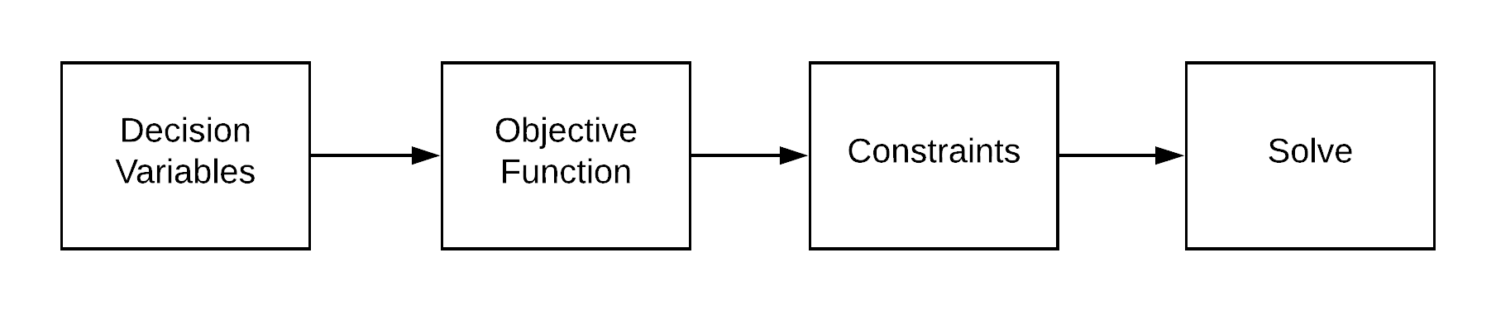

Slide 31
<math><code>

Slide 32
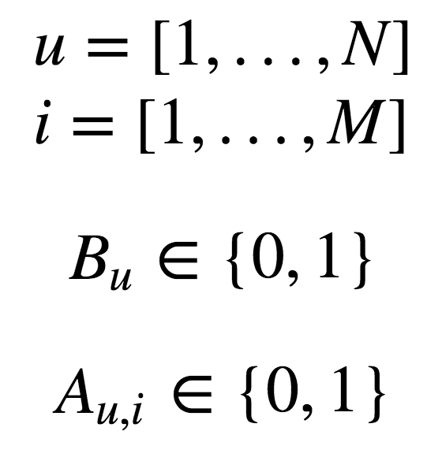
Decision Variables
from pulp import LpVariable
users = range(N)
items = range(M)
user_indicators = {}
for u in users:
user_indicators[u] = LpVariable(f'user_{u}', cat='Binary')
user_item_indicators = {}
for u in users:
for i in items:
user_item_indicators[u, i] = LpVariable(
f'user_{u}_item_{i}', cat='Binary'
)

Slide 34
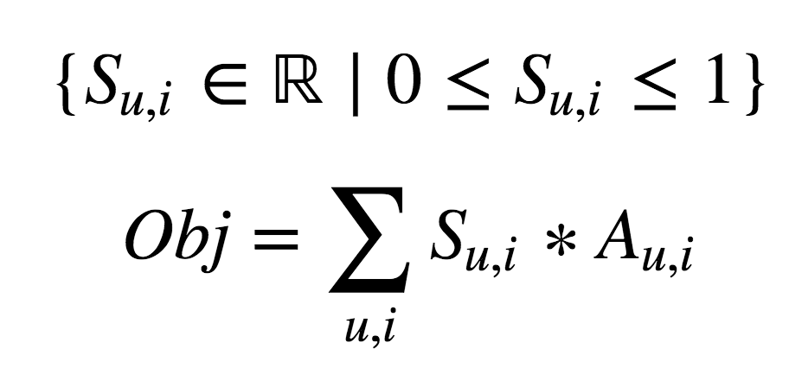
Objective Function
Machine Learning
from pulp import lpSum, lpProblem, lpMaximize
problem = lpProblem('BoxMaker', lpMaximize)
objective_function = []
for u in users:
for i in items:
value = scores[u, i] * user_item_indicators[u, i]
objective_function.append(value)
problem += lpSum(objective_function)

Slide 36
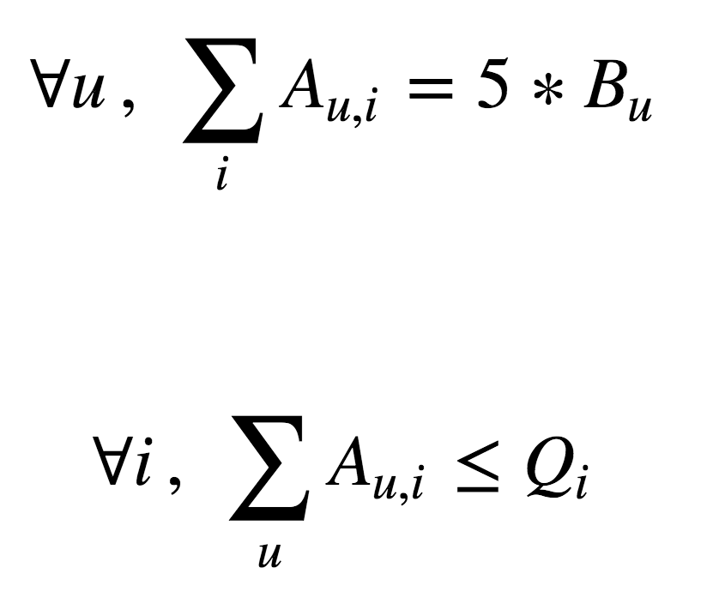
Constraints
for u in users:
users_item_count = lpSum(
user_item_indicators[u, i] for i in items
)
problem += users_item_count == 5 * user_indicators[u]
for i in items:
quantity_used = lpSum(
user_item_indicators[u, i] for u in users
)
problem += quantity_used <= quantity_available[i]

Slide 38
Solve
¯\_(ツ)_/¯
problem.solve()

Slide 39
</math></code>

Slide 40
Productionizing

Slide 41
Productionalizing

Slide 42
Making this thing automatically and reliably run in the cloud

Slide 43
Software Architecture
Testing
Interfaces
Failure Planning
Iteration

Slide 44
Software Architecture
Testing
Interfaces
Failure Planning
Iteration

Slide 46
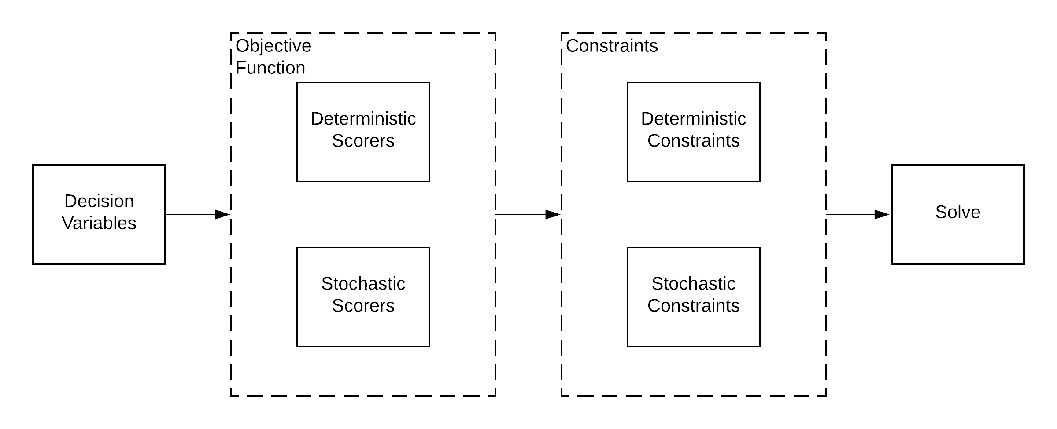

Slide 48
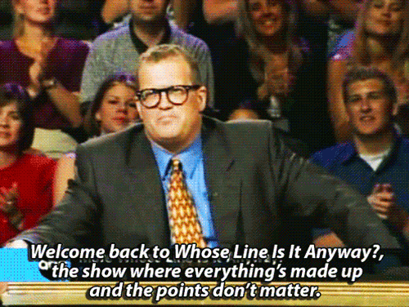
Objective Function

Slide 49

Deterministic Scorers
Problem
“If item is in-budget, +50 points”
Solution
Pre-calculate and aggregate

Slide 50

Stochastic Scorers
Problem
“If `outfit` in box, +100 points”
Solution
Create mini-optimization problem with new decision variables and constraints
Pro Tip: Use “Big M”
(carefully, see Perils of “Big M” blog post)

Slide 52
Deterministic Constraints
Problem
“User can only receive items that fit”
Solution
Don’t make these decision variables
Pro Tip: Use graph structure (networkx) to store sparse many-to-many relations

Slide 53

Stochastic Constraints
Problem
“Customers must receive between X and Y shirts”
Solution
Mental gymnastics to define constraints

Slide 54
Software Architecture
Testing
Interfaces
Failure Planning
Iteration

Slide 55
Unit Tests are Hard

Slide 56
Test for Behavior

Slide 57
Invest in Test Setup Functions

Slide 58
Software Architecture
Testing
Interfaces
Failure Planning
Iteration

Slide 59
Microservices

Slide 60
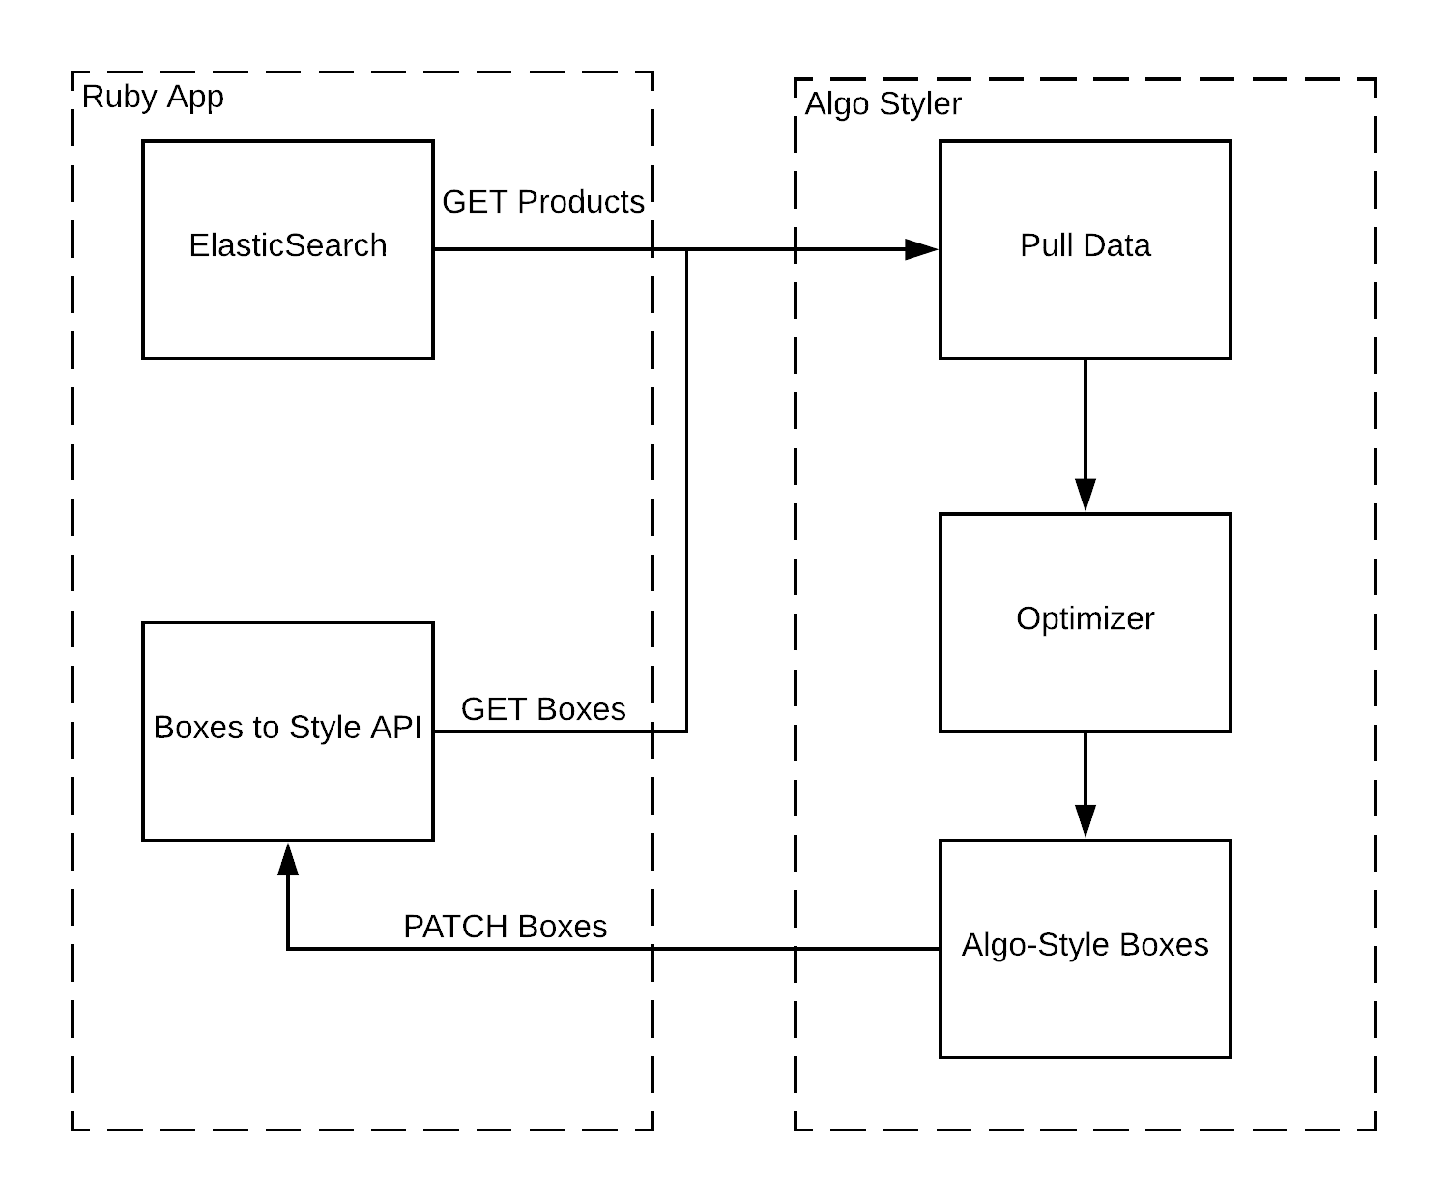

Slide 61
Software Architecture
Testing
Interfaces
Failure Planning
Iteration

Slide 62
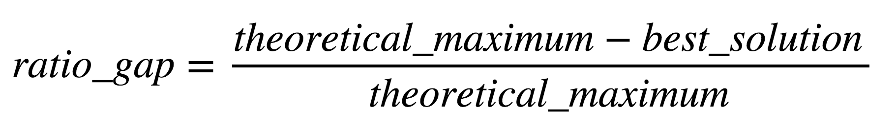
Perfect is the
enemy of good

Slide 63
Minimum Viable Solution

Slide 64
Software Architecture
Testing
Interfaces
Failure Planning
Iteration

Slide 65




Frequent Deployments

Slide 66
Model Improvements

Slide 67


Tests

Slide 68


Slide 69
Points -> Coefficients
Each scorer becomes an indicator “feature”
Each observation/sample is a box
Learn to predict some box-level metric

Slide 70
number_items_
in_budget
outfit_in_box
number_items_kept,
revenue,
etc...
box 1
box 2
.
.
.
box n
0
4
.
.
w_0
w_1
.
.
.
w_n
?
?
.
.
.
?
1
5
.
.
.
.
.
.
~
*
.
.
.
.
.
.
.
.
1
3
.
.
f(X) = X * w ~ y

Slide 71
Thank You!
We’re hiring! www.dia.com/careers
eprosenthal
EthanRosenthal
www.ethanrosenthal.com

