Slide 1
Predictive Modeling On Its Head: A Pipeline That Finds Cancer, Asthma, and Hemophilia
Marlene Guraieb
November 2018
Notes:
Brief intro of oscar

Slide 2
TL;DR
1.
2.
3.
When people talk about healthcare data/problems can mean any number of things
Our data/problems [as an insurance company] belong in the behavioral space
We can think of them as a behavioral problem taking place in the context of a rich clinical background

Slide 3
So what?
1. Selection ⇒ missing data
2. ≠ Success metrics and expectations
3. Predictive modeling:
- Likelihood rank
- Find patterns
- Create their own metris
Notes:
When people talk about healthcare data/problems they mean very different things
Our data/problems [as an insurance company] belong in the behavioral space
The difference is the clinical aspect has them embedded in a much more complex landscape
This changes our metrics of success and our expectations from models
The more complex the behavioral landscape the less stellar will be our results from our usual classification and clustering tools within the predictive framework
This does not mean that our models cannot generate great value, help guide crucial business decisions and become the language with which we communicate and structure our data.

Slide 4
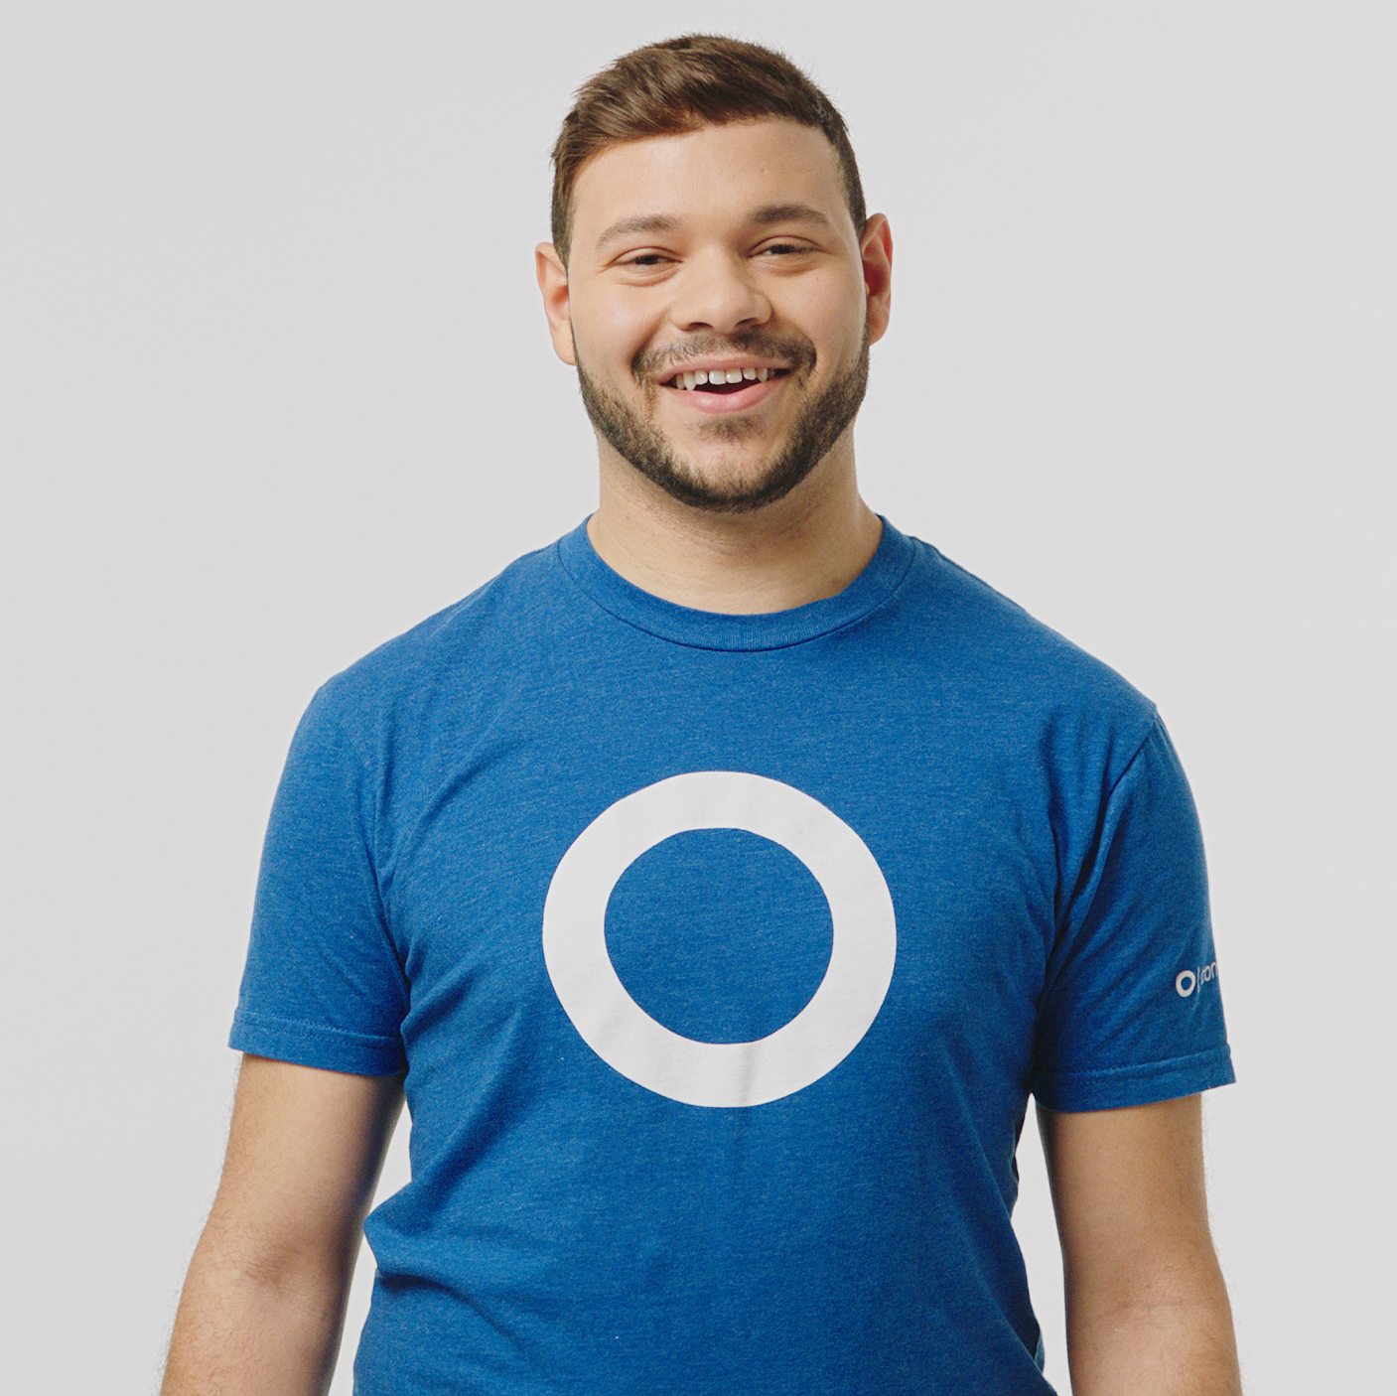
What is this member’s health status?
ACA has a provision to transfer funds from issuers with low actuarial risk to those with high actuarial risk.
Insurers with relatively healthier people have
to pay insurers with sicker people.
It’s worth on average 10% (and as much as 20%) of premiums in 2017.
We need a model that tells us, at any point in time, what is the likelihood that member X has disease Y.

Slide 5



Predictive model pipeline: from claims to phone calls
Baselines
Logistic regressions that calculate based on comorbidities and demographics what the prior probability for each member of having which condition is.
Call members
Have our clinicians call members and verify whether they have the condition stated in the model
Score the gov’t
model
Every member’s diagnoses are processed to see which conditions members have and what the status of our population is at the moment
Add signals:
DRUGS
PROCEDURES
PRIOR AUTHORIZATIONS
LAB TESTS
SURVEYS
Buy charts
Buy member’s medical histories to see if the condition that we are looking for is documented anywhere.
✓✖️
Add up model
predictions

Slide 6
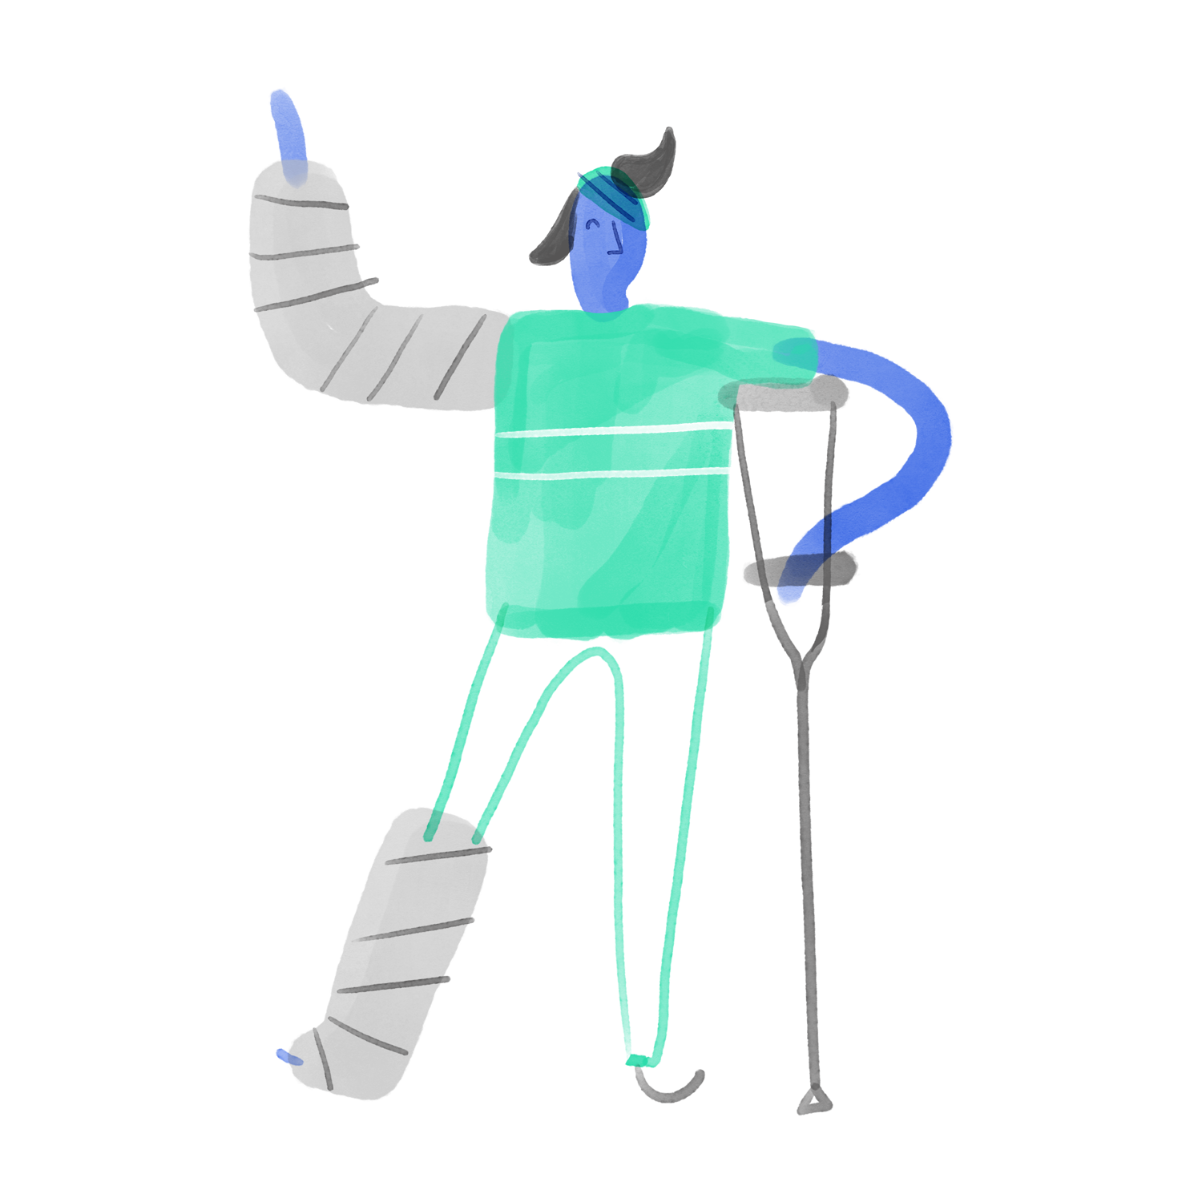








Generative process: selection, complexity, and error source
Patient
Provider
Diagnosis
Procedure
Charged
Line 1
Mr. Matt Dee
Dr. Jones @ Mt. Sinai
Torn ACL
ACL Surgery
$7,500.00
Surgery

Slide 7
Known unknowns: common but less intuitive cases
1. Member is asymptomatic
2. Been to dr, haven’t figured it out
3. In remission/cured
4. Diagnosed long ago not in treatment
Notes:
This is the more complex clinical framework behavioral decision. A lot of things can be happening

Slide 8
Known unknowns: common but less intuitive cases
1. Member is asymptomatic
2. Been to dr, haven’t figured it out
3. In remission/cured
4. Diagnosed long ago not in treatment

Slide 9
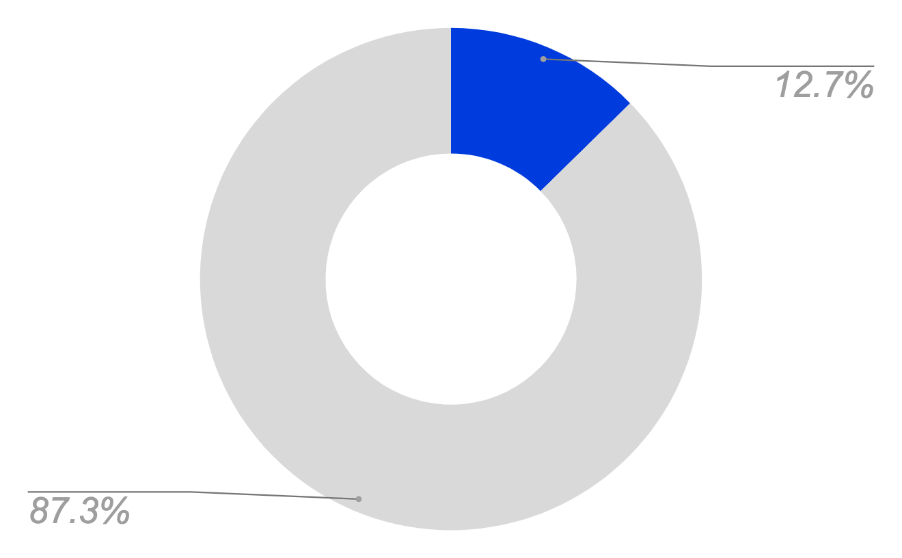

Getting rid of noise: procedure-diagnosis weighting
Members with the diagnosis:
30,245
Procedure j_6585z: Red blood cell sedimentation rate, to detect inflammation
Diagnosis HHS_CC056: Autoimmune disease
Members without the diagnosis:
220,371

Slide 10
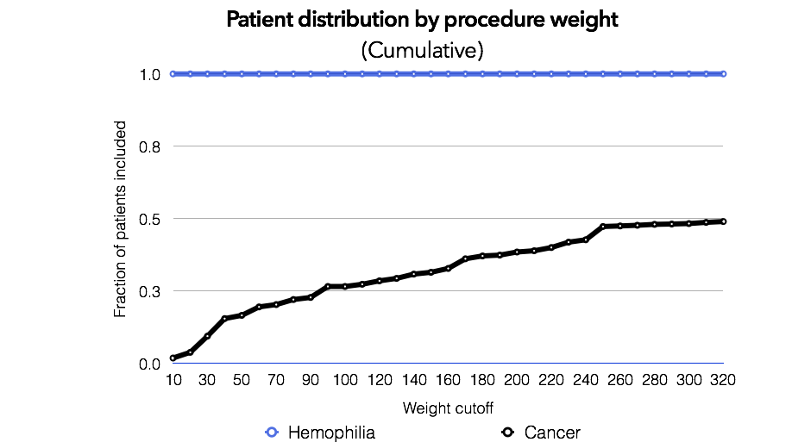
Similar decision context ≠ clinical landscape

Slide 11
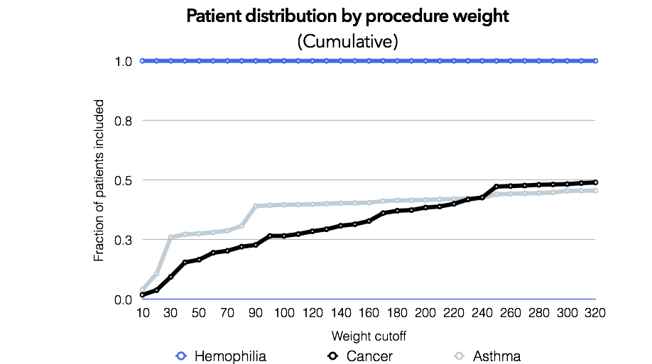
Similar decision context ≠ clinical landscape

Slide 12
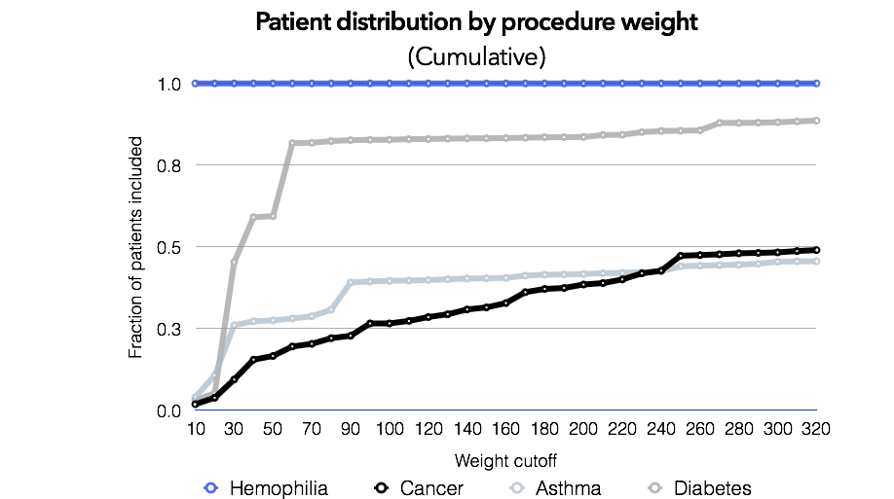
Similar decision context ≠ clinical landscape

Slide 13
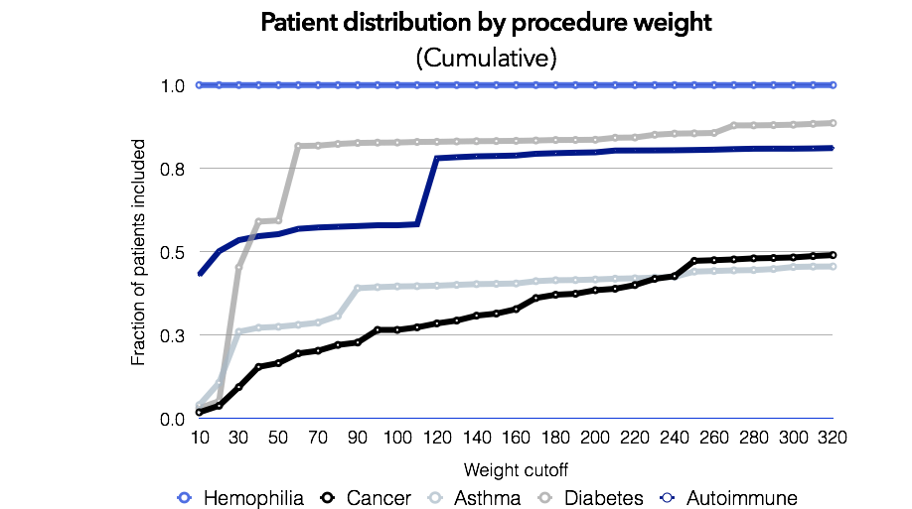
Similar decision context ≠ clinical landscape

Slide 14
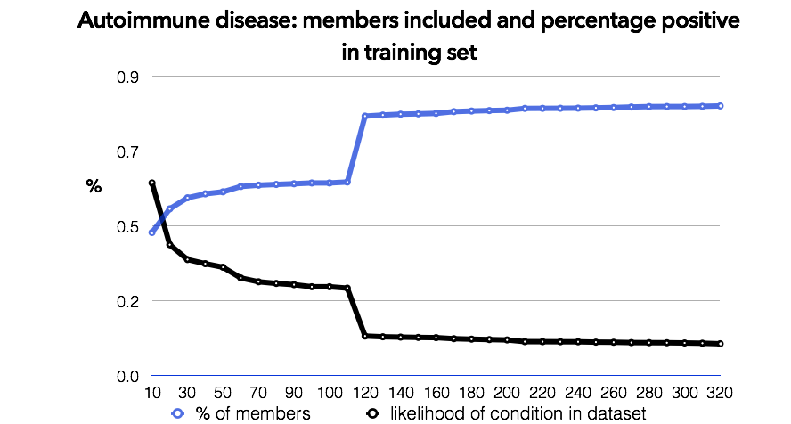
… and knowing where to stop
Knowing:
In a systematic way [parametrized]
That makes clinical sense [doctor ok’d]

Slide 15
How well do the models do?
… depends.

Slide 16
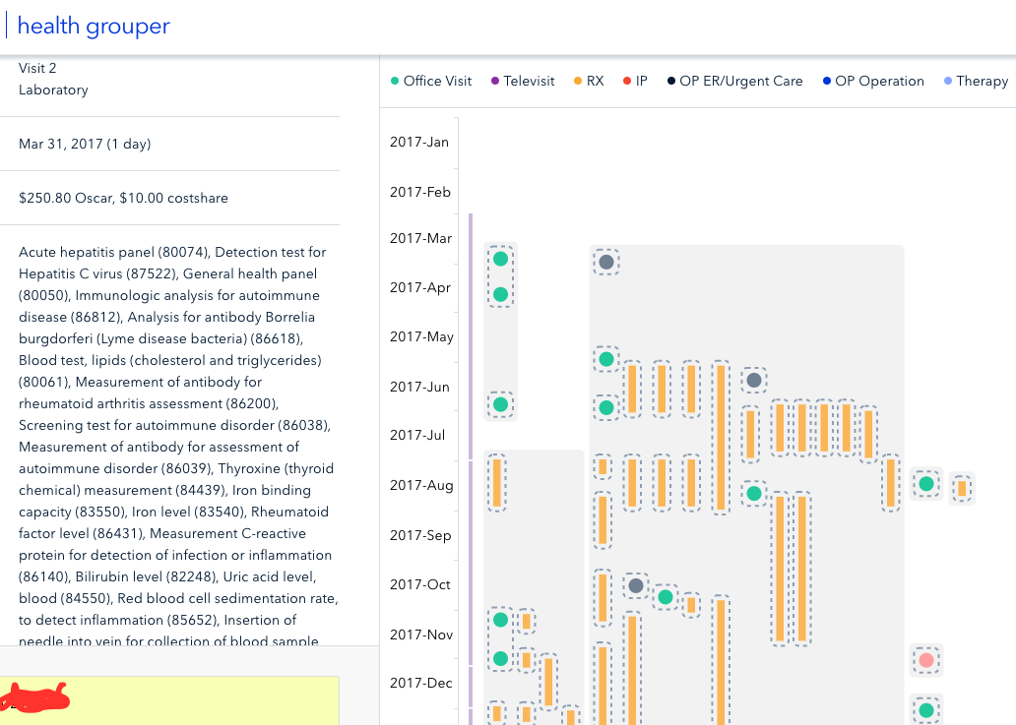

A success case
Measurement of antibody for rheumatoid arthritis assessment
Rheumatoid factor level
Notes:
Only diags are:
1
Joint Disorders
2017-03-29
61
2
Neurotic, Stress-Related And Somatoform Disorders
2017-03-29
61
3
Systemic Lupus Erythematosus and Other Autoimmune Disorders
2017-08-21
38

Slide 17
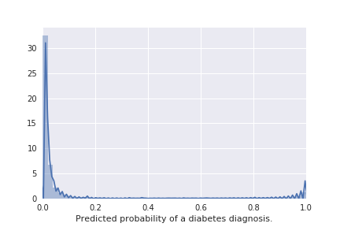
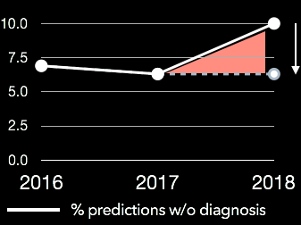
Simple(ish):
diabetes
Raw prob between 10-25%
99.5% people in training
Sparse treatments

Slide 18
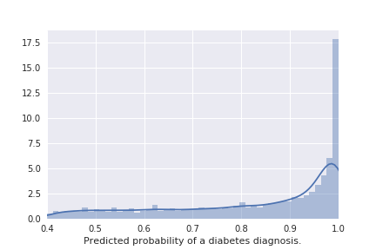
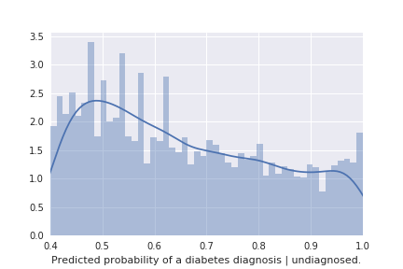
Simple(ish):
diabetes
I’m looking for uncertainty!
Likelihood of diagnosis | undiagnosed.

Slide 19
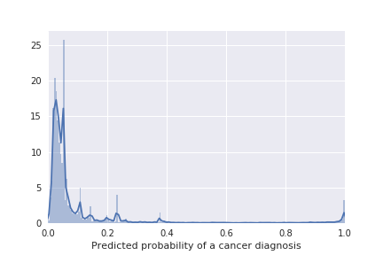
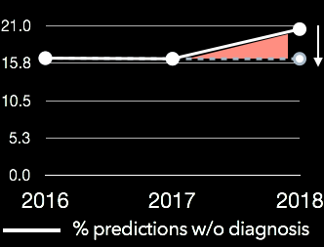
Sparse:
cancer
97% in training
common : 440 per 100,000

Slide 20
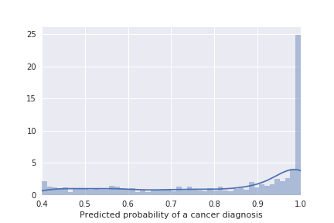
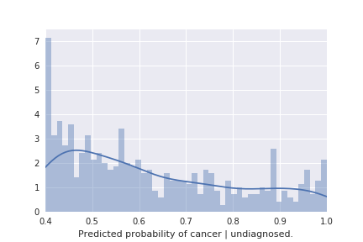
Sparse:
cancer
97% in training
common : 440 per 100,000
Complex treatments

Slide 21
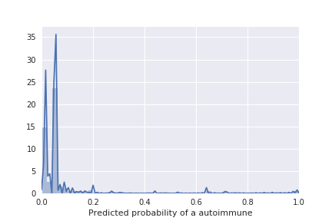
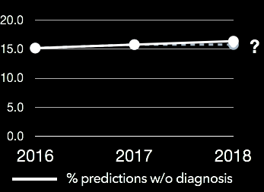
Concentrated treatment:
autoimmune
Very rare: 0.6%
88% in training

Slide 22
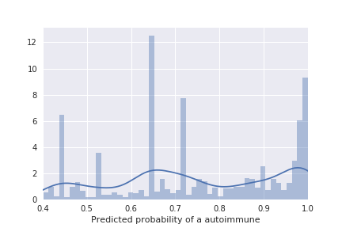
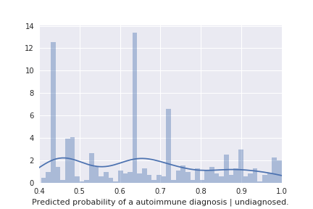
Concentrated treatment:
autoimmune
Very rare: 0.6%
88% in training
Multimodality = big tmt clusters
Notes:
'Antimetabolites',--Methotrexate
'Antimalarials',--Plaquenil
'Anti-TNF-Alpha - Monoclonal Antibodies'--Humira
Folic acid
('85651','85652') sedimentation rate inflamation test

Slide 23
Wrapping up
- Likelihood ranking
- Finding patterns
- Providing a holistic framework
Messy, behavioral, random models in complex clinical contexts can still be quite good at:

