Slide 1
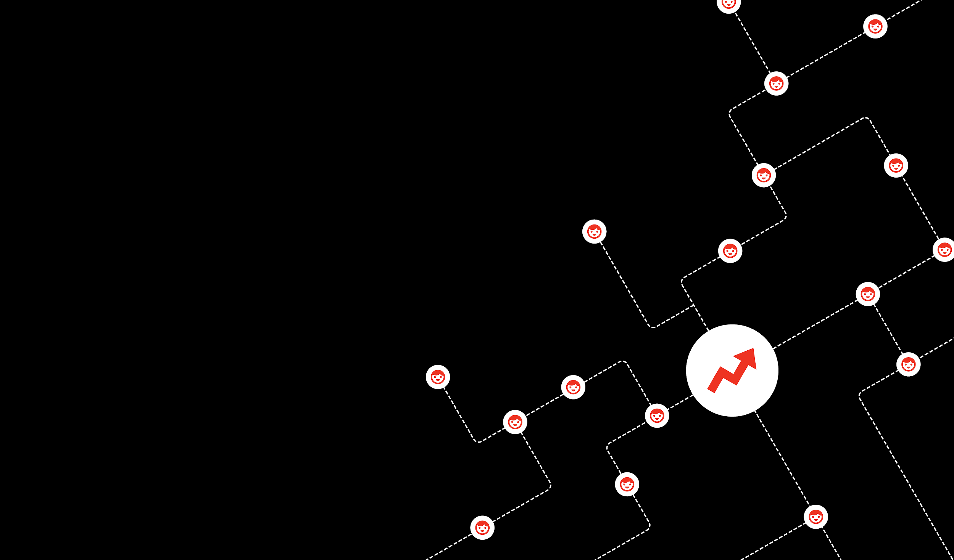
Related Content
@BuzzFeed
Carolyn Huangci

Slide 2
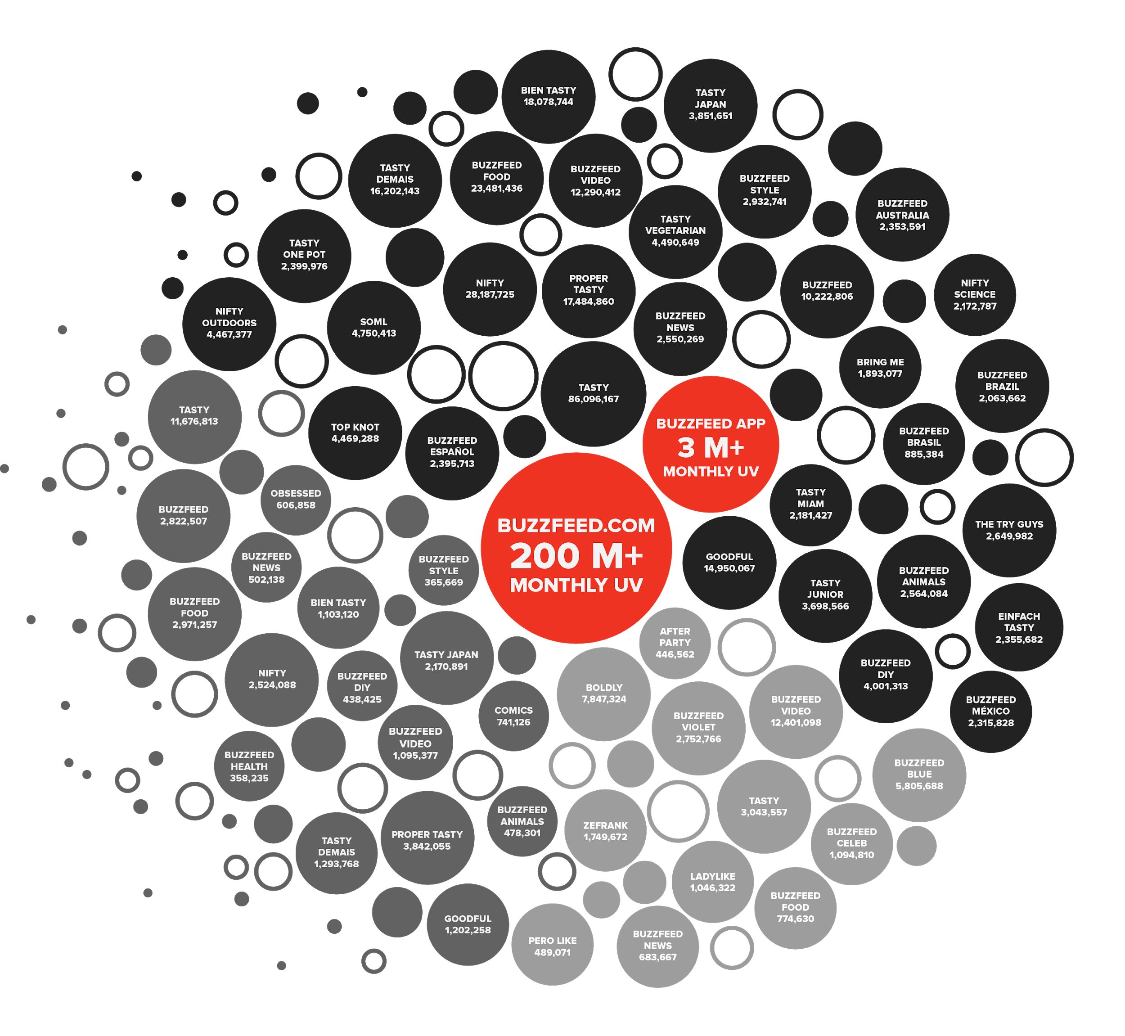
Top channels on Snapchat and YouTube
2.5B monthly video views on Facebook
Over 300M subscribers across Facebook and Youtube
9B global monthly views
Massively distributed content network
Notes:
We connect to our audiences regardless where they are.
BuzzFeed is unique in how it has embraced distributed platforms (earliest, wide capacity)
Every platform provides unique data points -- ways for us to stay closer to our readers

Slide 3

How do we keep growing?

Slide 4
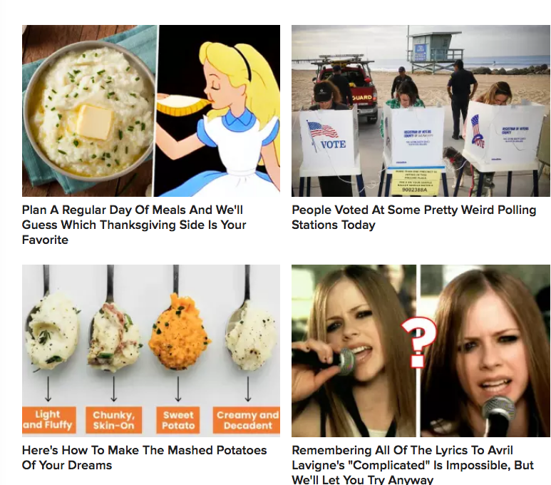
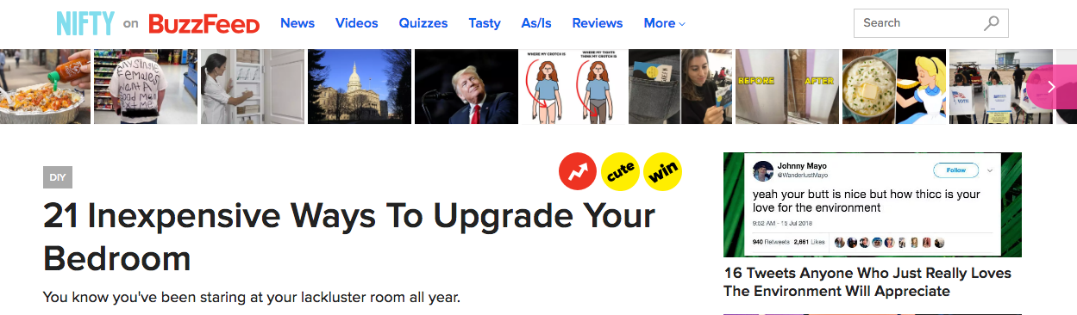
Context
I just read an article about how to decorate my room. How do I read more?
Problem:
Recirculation units on BuzzFeed pages were populated with a mix of recent, trending, and personalized content
There were no related content modules on Buzzfeed
Related links could only be generated manually by authors
Hypothesis: Surfacing related content would result in longer sessions (pageviews and time spent) and improve pagerank for SEO
Notes:
Reverse chronological feeds, trending calculated based on clicks over a sliding time window, CF, MAB CTR optimized
Authors may not know how to find most related articles as the entire content library is too large to sort through for a single person
Authors may bias towards their own work
We believe data gives our teams superpowers, and help us build more efficient tools, and better informed decisions.

Slide 5
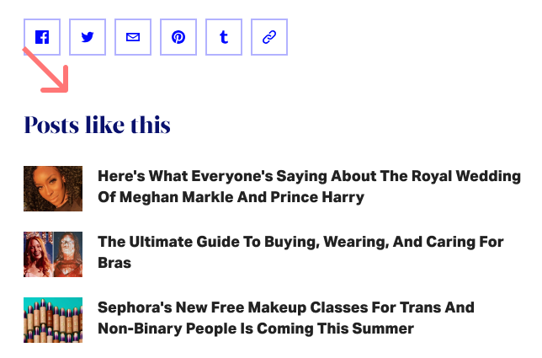
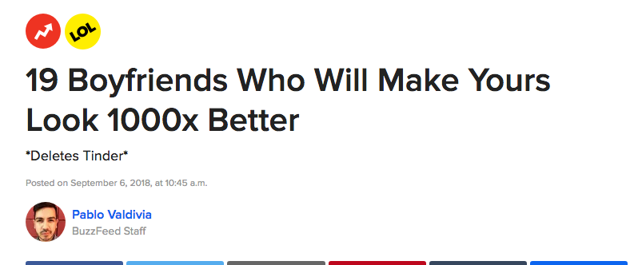
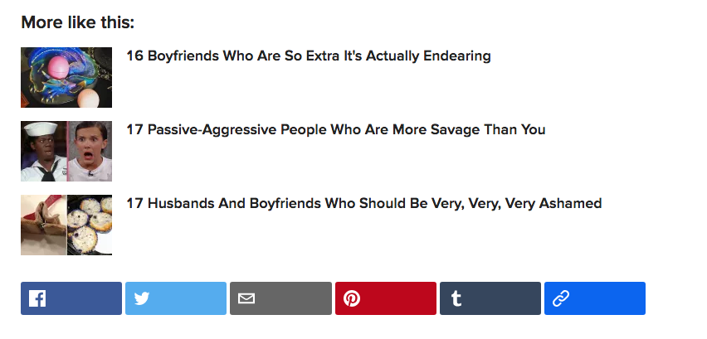
History
Model is tested and iterated using As/Is posts as a training corpus (~3000 articles)
Growth team!
As/Is tech and edit teams meet to discuss improving As/Is Recirc
Post migration happens and As/Is post training corpus increase 2-3x
Model is tested on BuzzFeed Original content and productionized
Notes:
I started on the As/Is team, buzzfeed’s beauty and style destination.
At the time, As/Is was recently launched and we had a discussion between tech and edit on how to improve recirc
The most popular idea from both groups was to include a unit that surface related content
At the time the training corpus was only 3k given we only planned to use it for As/Is
This helped inform some of the models I tried

Slide 6
Which Model?
Word Embedding Models - Word2Vec, FastText
Document Embedding models - Doc2Vec
Topic Models - Latent Dirichlet Allocation (LDA), Latent Semantic Indexing (LSI)
Notes:
For the first iteration of this model, we only care about evaluating document embeddings based on content similarity rather than more complicated tasks such as sentiment, objectivity/subjectivity, etc.
Buzzfeed articles, with Tasty and possibly News as exceptions, generally have a unique writing style and vocabulary usage so we did not use pretrained embeddings
First step of any text processing model is to transform a set of text is to vectorize
How? There are lots and lots of different embedding models
There are count based methods and predict based methods (lsi, word2vec)
Count based - computes co-occurance stats and applies dimensionality reduction to get a dense representation
Predictive - learns dense embeddings by predicting word neighbors
There are word and sentence based embeddings
The simplest count based model is one hot encoding of word and bag of words for document
This just counts words per article but how do we make it better?
Tfidf calculates relative importance of word to doucment (tf - time word appears/all words in doc) (idf - log(number of docs/number of docs word appears) aka if the word cake appears in a cake recipe many times but the rest of the recipes are about cookies, cake would be have a tf-idf weight
Main issues with bag of words models - very sparse and does not consider semantic relationships
Topic models main idea - A document is a mixture of topics and a topic is a mixture of words and represents a document as a topic distribution probability vector
Learn low dimensional embeddings based on word context

Slide 7
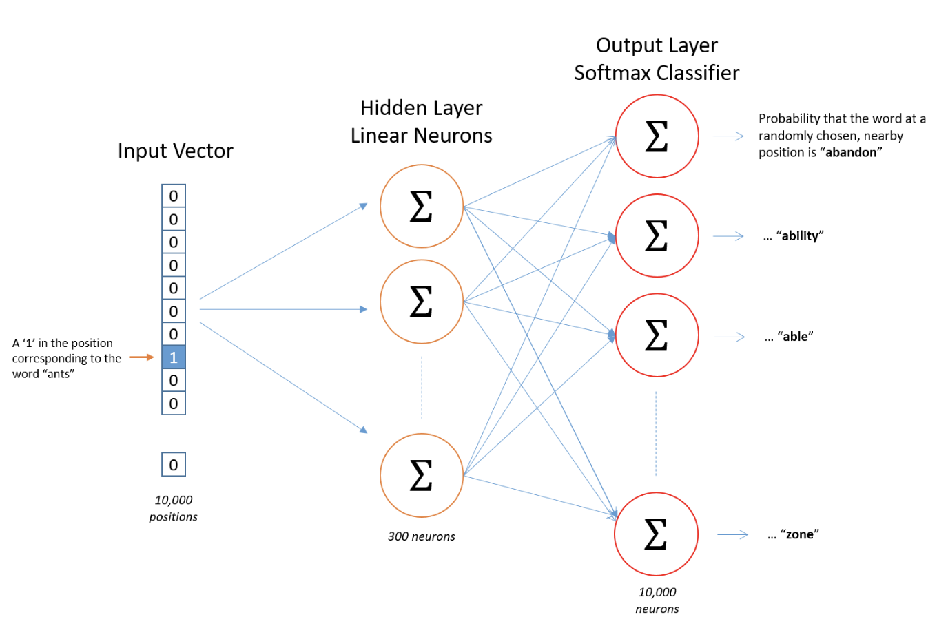
Quick Refresh: Embedding Models
Notes:
Train a shallow neural network on a task, Instead of using the outputs from the trained task we instead use the hidden weights!
Similar to how one might use an autoencoder to learn the lower dimensional representation of an input by using the hidden layer where the input layer is compressed and the output tries to the learn the input layer using the compressed hidden layer.
Two flavors continuous bag of words, skipgram
Hidden layer identity is passed to outer layer and the softmax is applied to the outer layer to maximize the probability of depending on cbow or skipgram, a target word given context words or context words given a target word
Skip gram we have a vector the size of our training corpus
Hidden layer is a weight matrix of dimensions our training corpus size and our embedding size
Output layer is a single vector of probabilities
Input layer is embedding matrix
Given what we train on the embeddings are learning how to predict the context of a word and as one can imagine words with similar meanings have similar contexts
How to scale up
Subsampling - we calculate the probability of keeping a word based on how frequently it appears in the corpus
Negative sampling - prevents the network from having to update the full set of weights on each training iteration by updating weights only for the positive (target word) and a subset of negative words. Negative words are calculated by frequency of word/ sum(frequency of all words)/

Slide 8
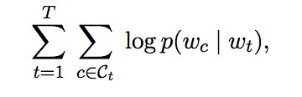
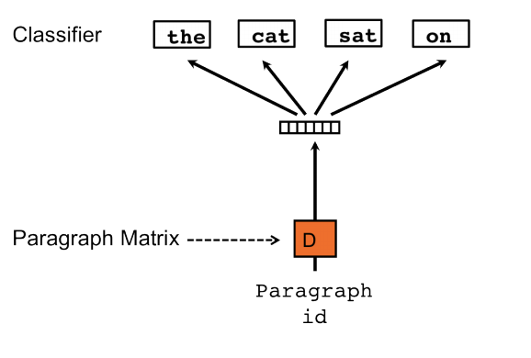
Quick Refresh: Embedding Models
Word2Vec (skipgram)
Doc2Vec
Input layer of paragraph/document ids is trained to predict words sampled from the document
FastText
Enriches Word2Vec w subword information by representing each word as the sum of its n-grams
Where = wh + whe + her + ere +re
Notes:
Doc2vec and fasttext are closely related to word2vec and use the same underlying architecture
Doc2vec also has the 2 variants, DMM and DBOW
DMM uses context words to predict target (like CBOW) but includes a document vector in the input layer and attempts to learn the document concept at the end of training
DBOW takes a input layer of document ids and learns a document vector based and is trained to predict the probability of words occuring within the document
FastText does not treat a word a single atomic entity
No parameter sharing and ignore internal word structure
Learn n-grams and represent the word as the sum of n-grams
Share subword infomration between words, good for rare words

Slide 9
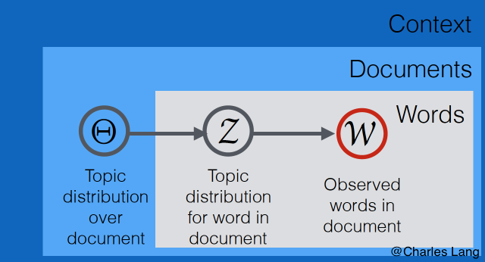
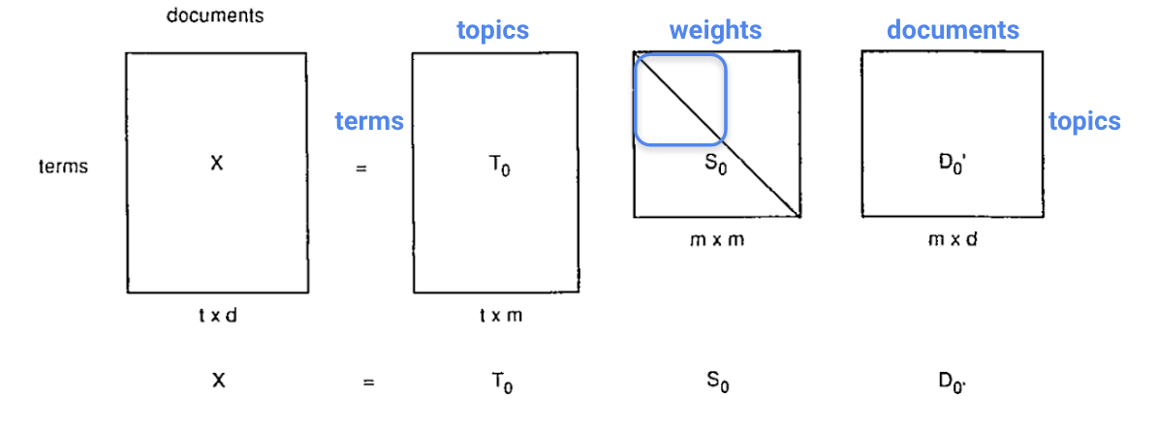
Quick Refresh: Topic Models
Latent Dirichlet Allocation
Choose K topics
Assign document terms to K topics
Iteratively assign document terms (w) to new topics (T) based on the probability topic T generated word w
Latent Semantic Indexing
Choose K topics
Create sparse document term matrix
Perform SVD to reduce the document term matrix into a document topic matrix
Notes:
A document is a mixture of topics and a topic is a mixture of words and represents a document as a topic distribution probability vector
Lets start with LSI
We begin with a sparse document term matrix (can just be the counts of the terms or tfidf)
We use SVD to decompoes the document term matrix into a document topic matrix, singular values, and term topic matrix
The document term matrix then reduces the document into a vector representing the topic mixture, we can choose
Largest singular values represent the most “important features”
Can’t interpret features
pLSA defines a probability distribution to generate our observed data
P(topic t|document d) - document-topic matrix
P(word w|topic t) - word-topic matrix
Generate our data given how given a document, what is it’s topic distribution, and given the topic distribution how likely will we find a word within that document
So topic distribution is singular value matrix
LDA is then just pLSA but uses the diririchlect priors to initialize the topic, d and word, topic matrix.

Slide 10
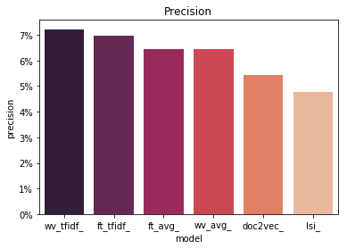
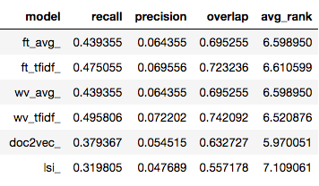
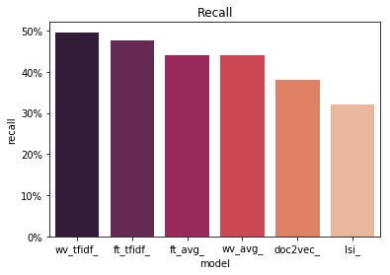
Validation
Model recommendations were compared again ~1700 editor curated related links
Notes:
Looked at precision (intersection/number of auto generated items)
Recall (intersetion/number of editor recommended)
Average ranking of editor generated recs
Number of articles where at least one auto generated rec overlapped with cthe editor generated

Slide 11
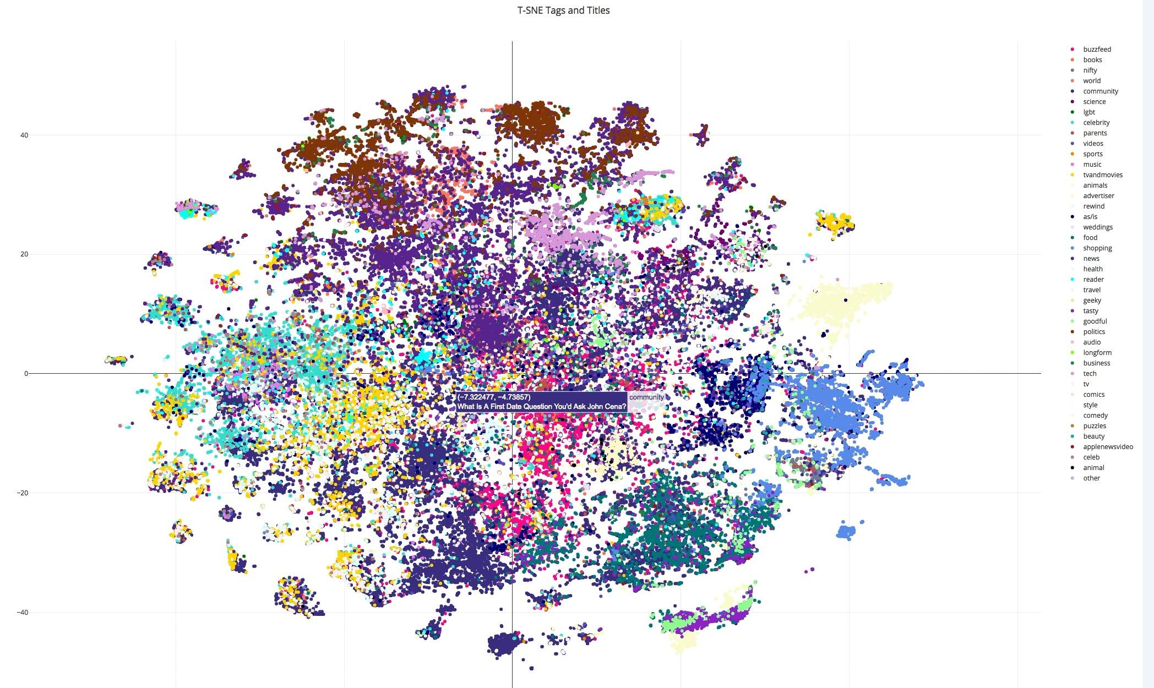

Slide 12
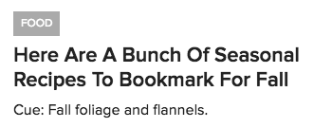
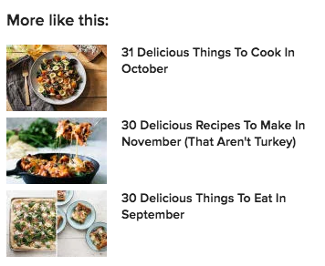
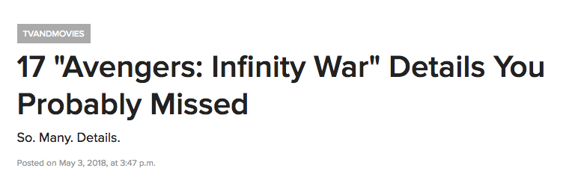
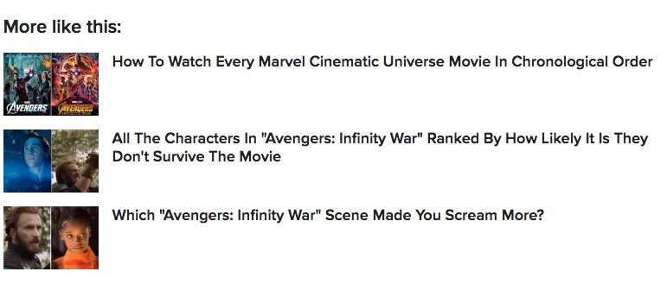

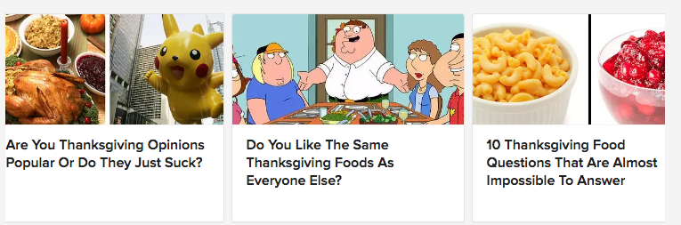
Final Model
Post Metadata = Title + Blurb + Article Text + Editor Tags + IBM Watson Concepts, Keywords
Model: Word2Vec with an embedding size of 160
Document Representation = ∑ TF-IDF Weight * Word Embedding

Slide 13
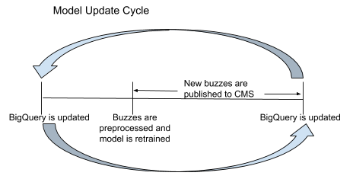
Going to Production
Batch Training
Run on Google Cloud instance
Trained using data stored in BigQuery
Generates word2vec keyed vectors, Phraser model, TF-IDF corpus
Incremental Training
Bigquery is not updated realtime
Related articles for posts published between model trainings are run using a queue reader that subscribes to publish events
Generates related articles using stored vectors generated during batch training
Notes:
A json file containing all the buzzes, their related content, and scores is sent to the recsys spark s3 bucket
Message is sent to a queue reader telling separate service to store vectors in redis

Slide 14
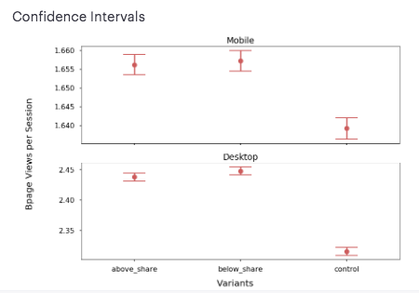
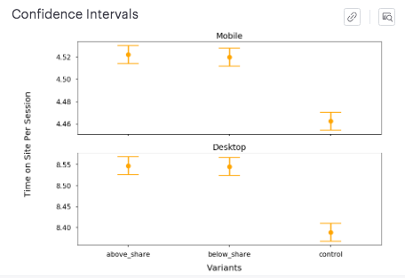
AB Testing
An AB test was run for 2 weeks by adding a related content was added to US-Edition BuzzFeed content
Pageviews per Session: Desktop: +5.62% | Mobile: +1.2%
Time on Site per Session: Desktop: +1.7% | Mobile: +1.3%

Slide 15
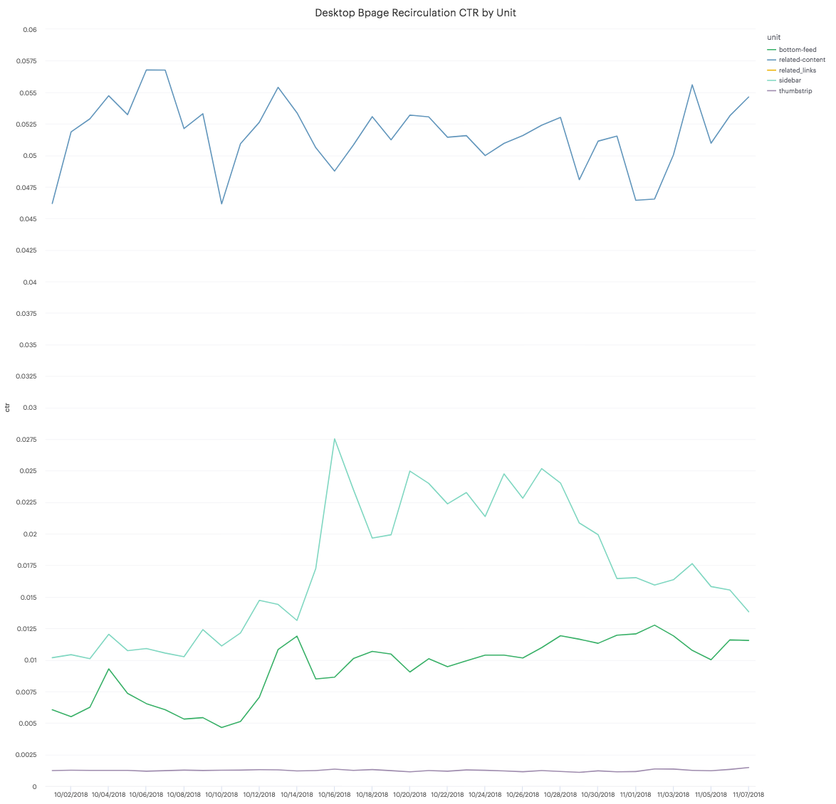
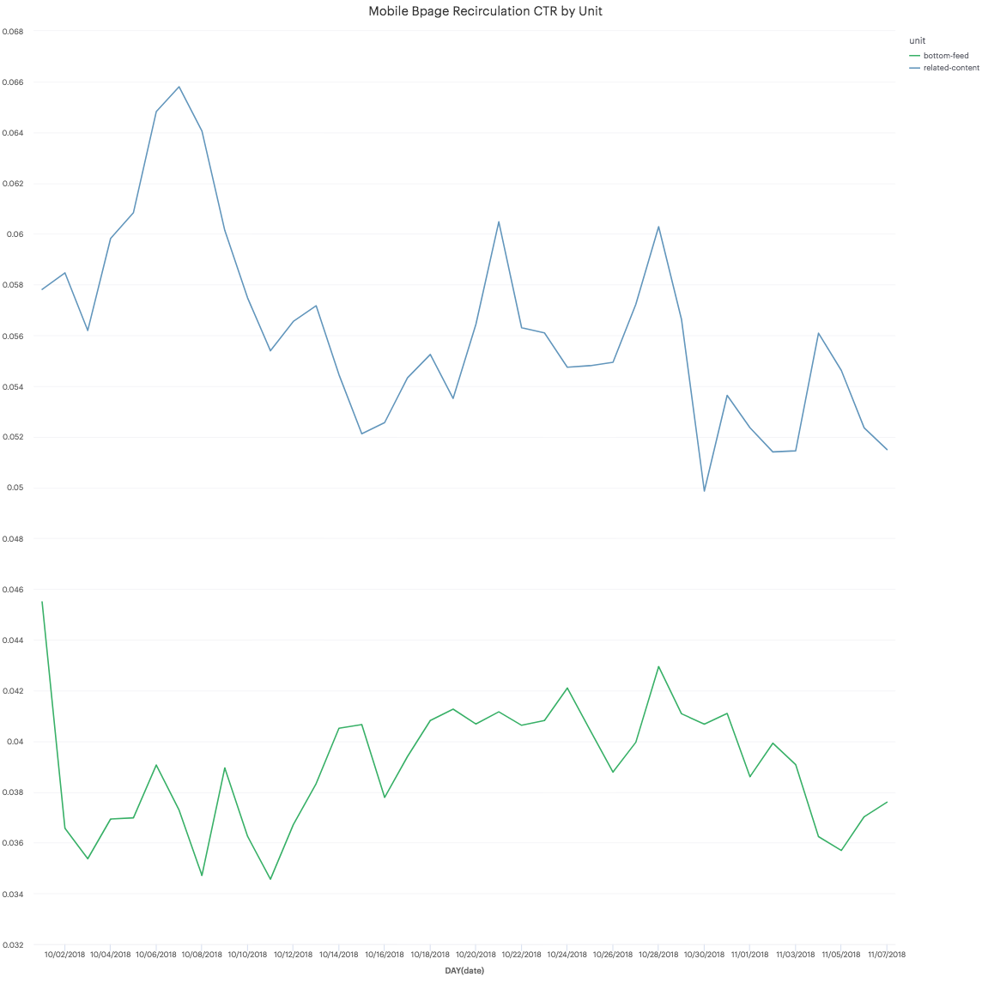
Post AB Testing
The related content unit was rolled out to all English BuzzFeed pages post AB test and is driving ~300k clicks per day

Slide 16

Future Work
Can we use document vectors to improve personalization?
How do we introduce more diversity into current recommendations?
Lots of different word and sentence embedding schemes to try! (p-means, DME)
How can we rank recommendations not only on similarity but other signals like recency and CTR?

Slide 17
THANK YOU

