Slide 1
Building data tools that work
Benn Stancil
Chief analyst, Mode Analytics

Slide 2
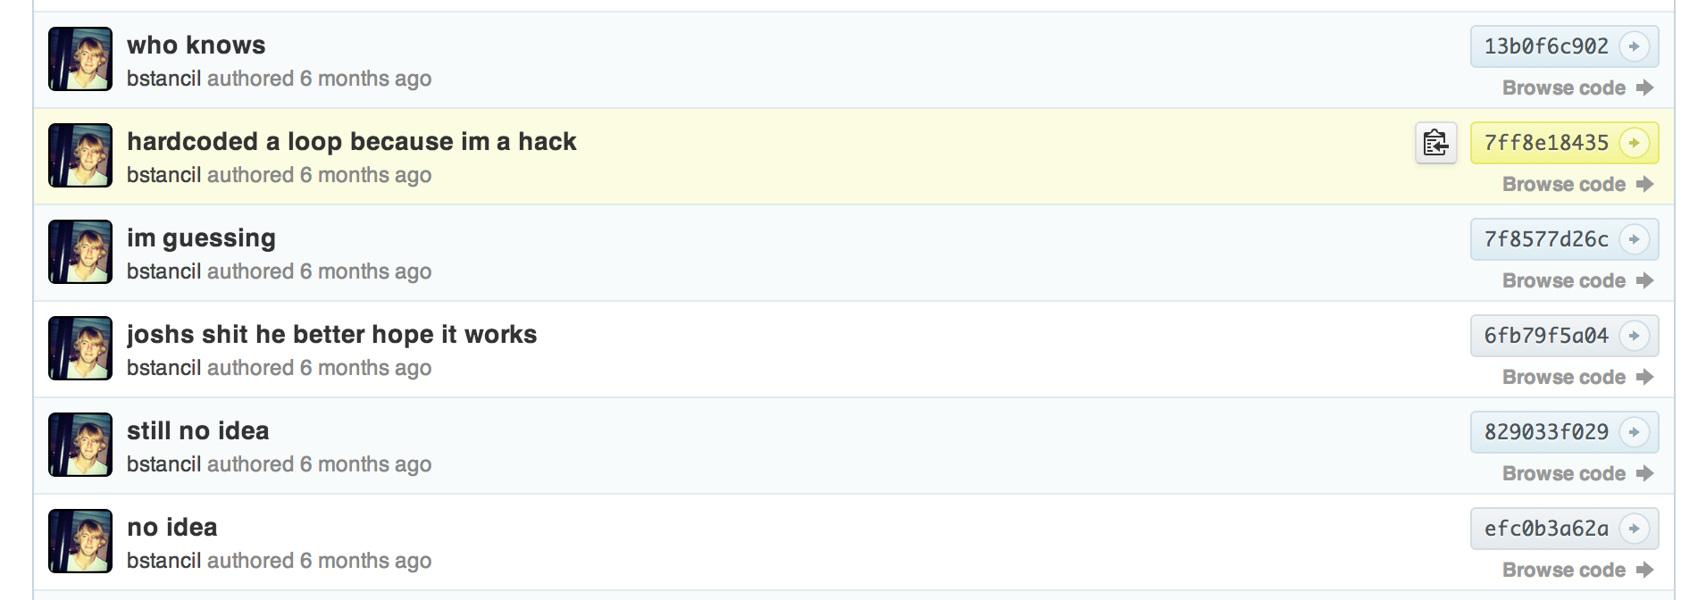
Notes:
As a quick introduction, I'm not an engineer. I work with data and data engineers a lot, but as you're see clearly illustrated throughout this talk, my background nor my work is not in engineering.

Slide 3


Slide 4

Notes:
Today, I do something slightly differently. A few years ago, I started a company called Mode to build tools for analysts.

Slide 5
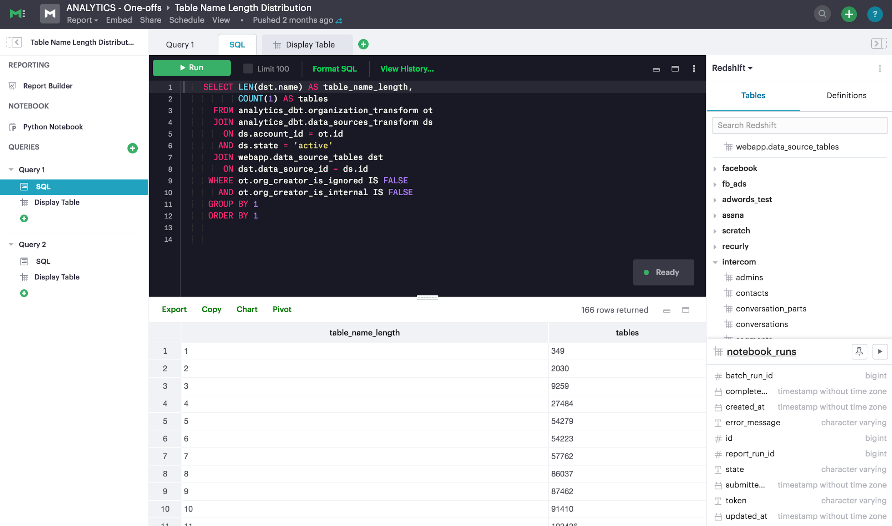
Notes:
For a little bit of reference, Mode looks something like this.

Slide 6
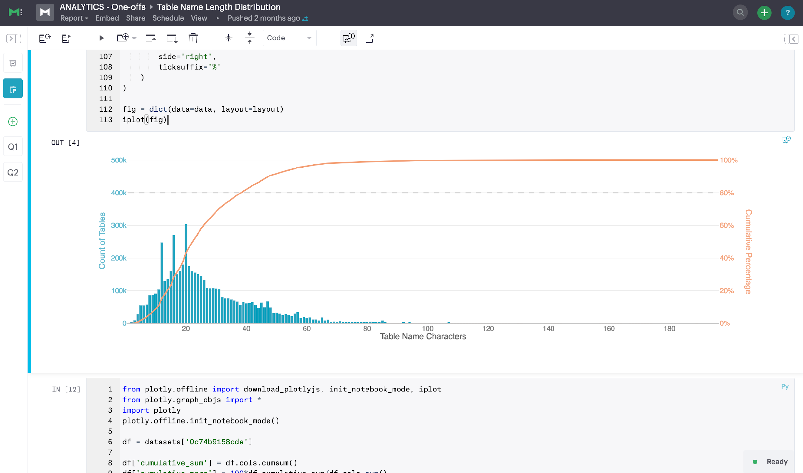
Notes:
And this. Our goal is to build a platform that could sit on top of all the things that data engineers like all of you build, to make analysts like me more productive.

Slide 7
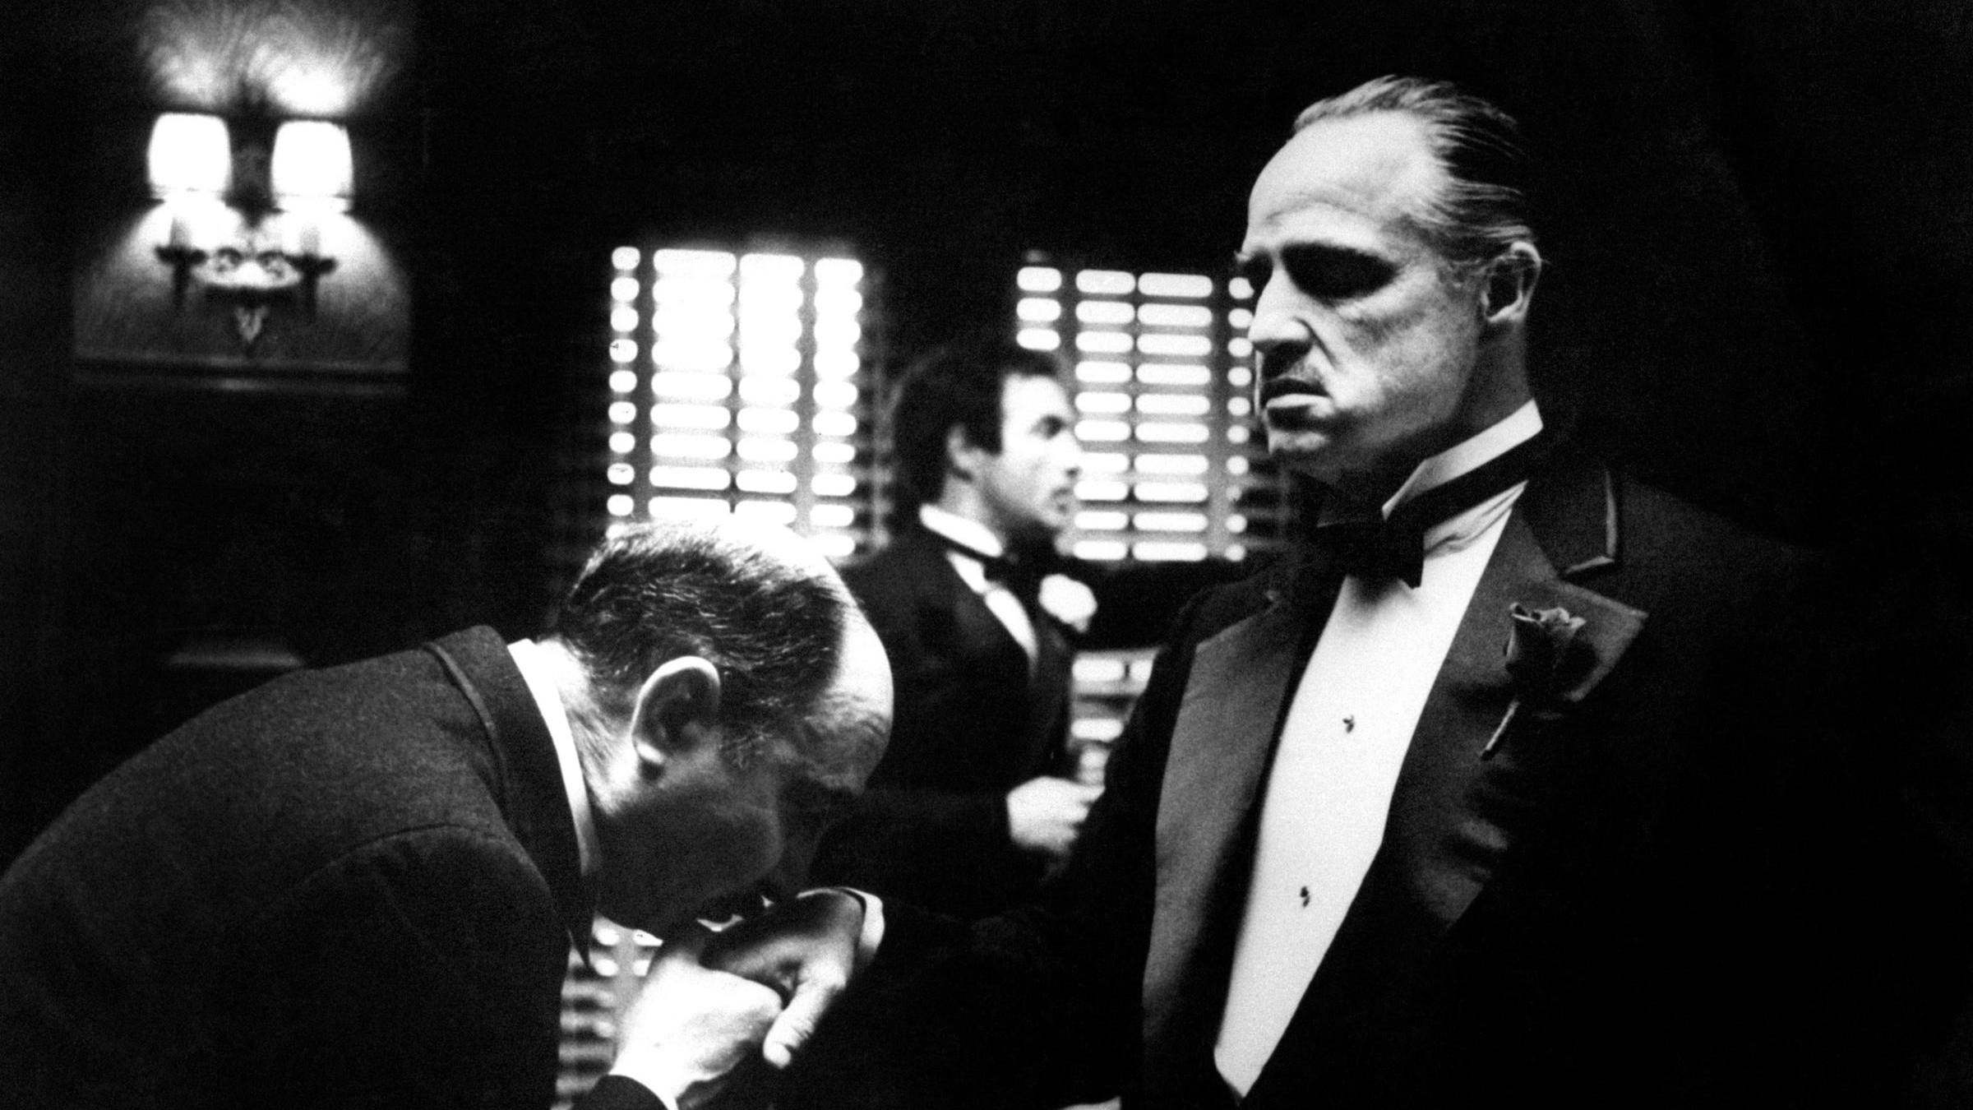
Notes:
A big part of my job at Mode has been as a product owner. And a big part of that job has been to understand our customers. To build tools for analysts, we have to understand analysts. The same is true for data engineers, or at least the ones working on tools that are meant to help analysts and data scientists. So that's what I want to talk about here. We talk to thousands of analysts.

Slide 8
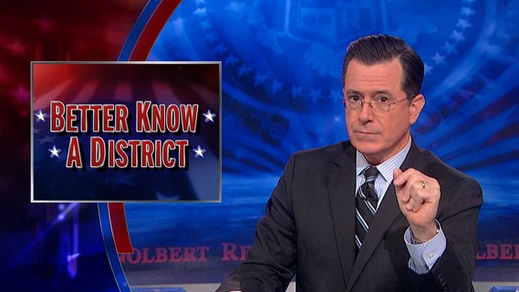
Notes:
For the rest of my time, I want to talk about analysts. Let’s better know

Slide 9
N ANALYST
AN
Notes:
An analyst.

Slide 10
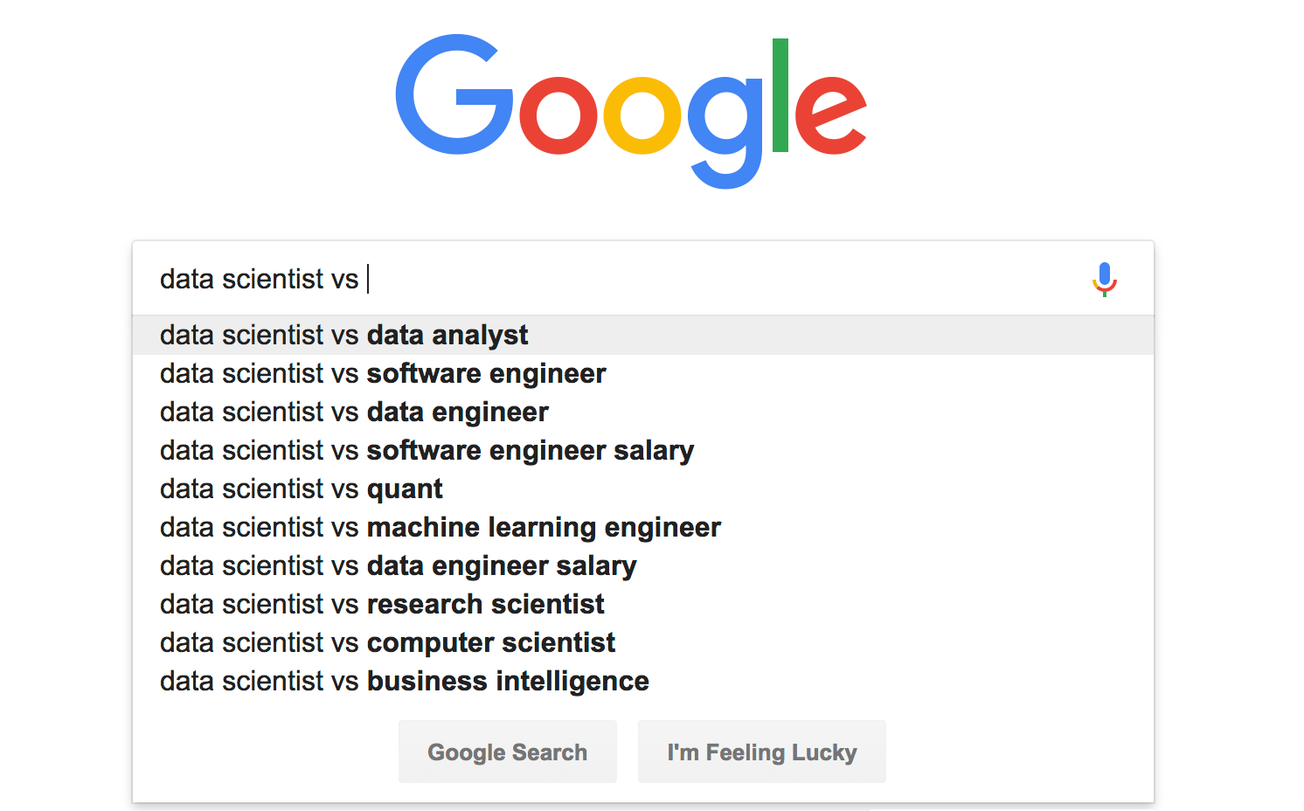
Notes:
Now, before getting into it, one bit of housekeeping. Some people will talk about data analysts, some people will talk about business analysts, some people will talk about data scientists. For the sake of this talk, I'll use the terms analysts and data scientists interchangeably. There is a passionate debate to be had about what's what, but I'm not interested in having that now. For the sake of this talk, I'm referring to anyone who works with data to answer questions in a mildly technical way as an analyst or data scientists. You may disagree; I don't care. Ok, let's get to it. Better know an analyst. Now, as a analyst turned PM turned analyst again, I'm going to present this in the only way I know how -

Slide 11
Self-
actualization
Esteem
Social belonging
Safety and security
Physiological needs
Notes:
Maslow’s hierarchy of needs

Slide 12
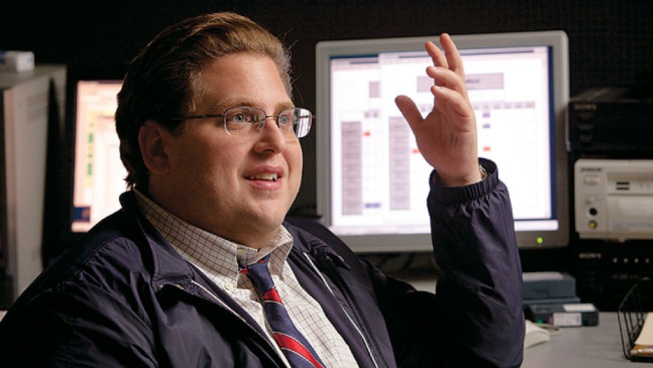
What do we need to do the job?
Notes:
Instead, my background is as an analyst. I began my professional career living in Excel, and have sense migrated to more “technical” tools like SQL and Python scripting. As an analyst, my job is to consume data, figure out what story it tells, and work with other people so that they can better understand their worlds or figure out problems because of it.

Slide 13
Self-
actualization
Esteem
Social belonging
Safety and security
Physiological needs
Notes:
We don't think a lot about data engineering. The latest and greatest data technologies don't matter that much to us. To us, it's like the engine of a car. It's important for it to work, and we think about it when there are problems. But when it's working, we often take it for a given. There are some results of data engineering we care about though.

Slide 14
Engineering
Business
expertise
Statistics
Notes:
Stats is often thought of as being a core part of what analysts do. This diagram is pretty common around the internet.

Slide 15
Data engineering
Self-
actualization
Esteem
Social belonging
Safety and security
Physiological needs
Notes:
We don't think a lot about data engineering. The latest and greatest data technologies don't matter that much to us. To us, it's like the engine of a car. It's important for it to work, and we think about it when there are problems. But when it's working, we often take it for a given. There are some results of data engineering we care about though.

Slide 16
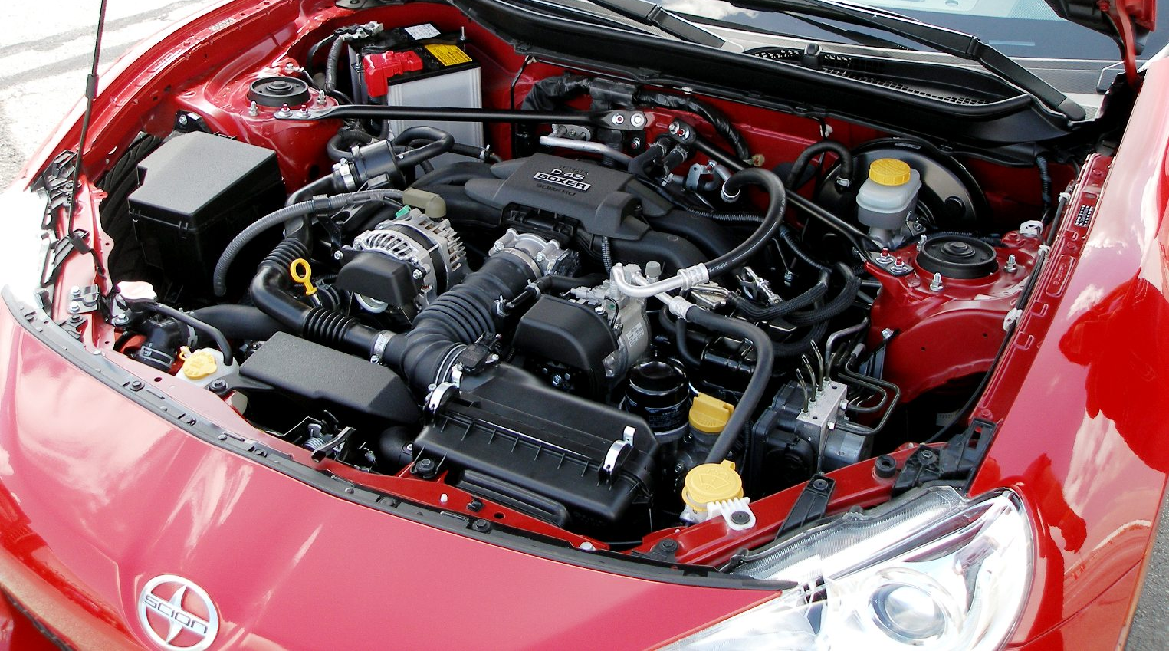

Slide 17
SQL
Self-
actualization
Esteem
Social belonging
Safety and security
Physiological needs
Notes:
As analysts, SQL is our foundation. It opens two doors - first, it opens the door to data. We typically can't go anywhere before getting data, and SQL is our entry point. Second, it opens the door to more technical work. It's an entry point to code. A lot of analysts who come from background in Excel will being their "coding" careers in SQL. As a result, we do some crazy stuff with it. Sessionize

Slide 18
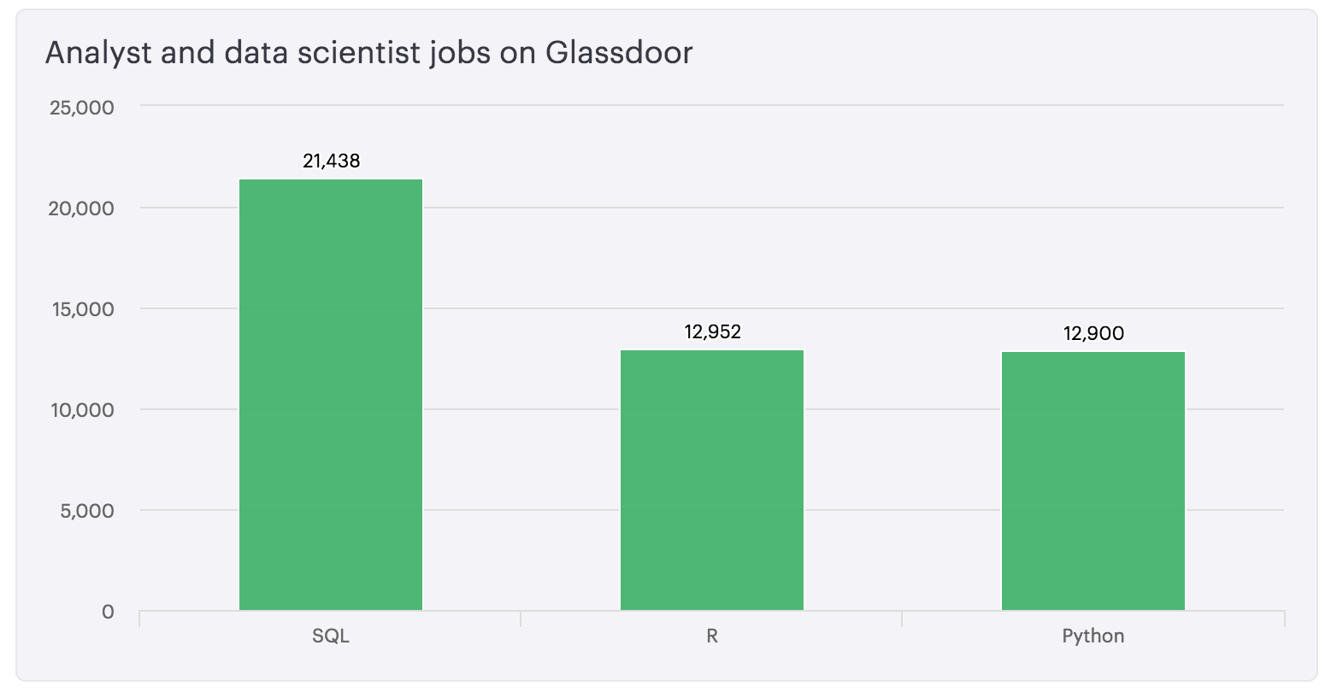

Slide 19
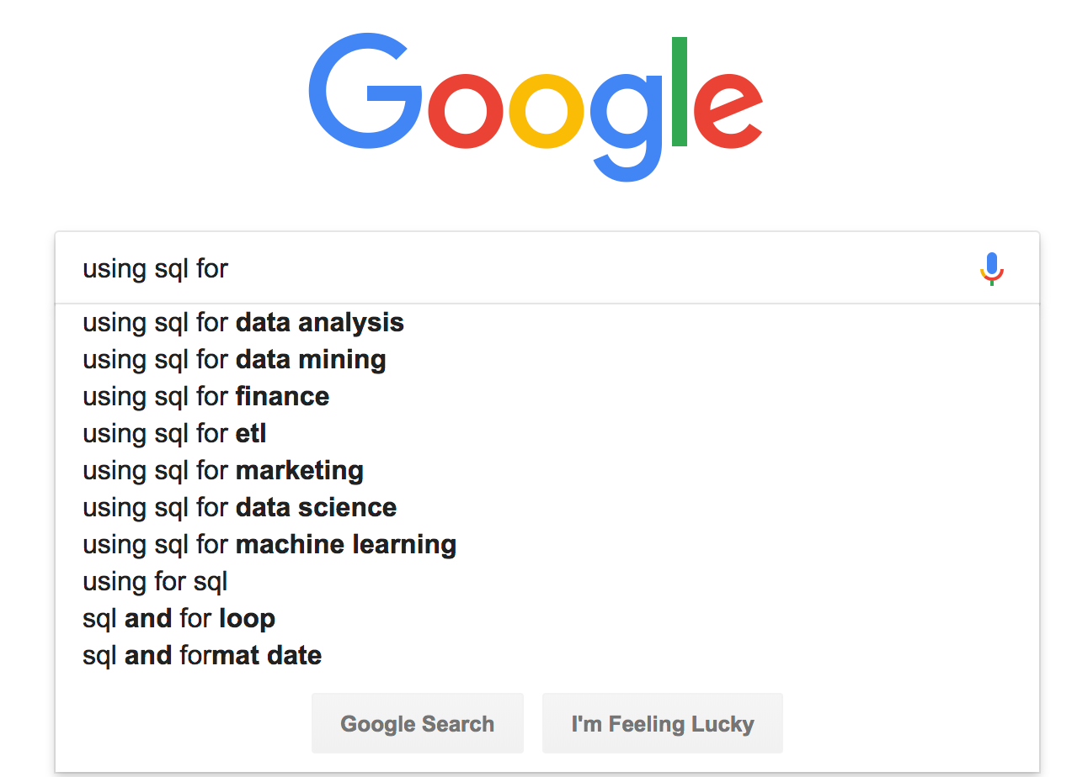

Slide 20
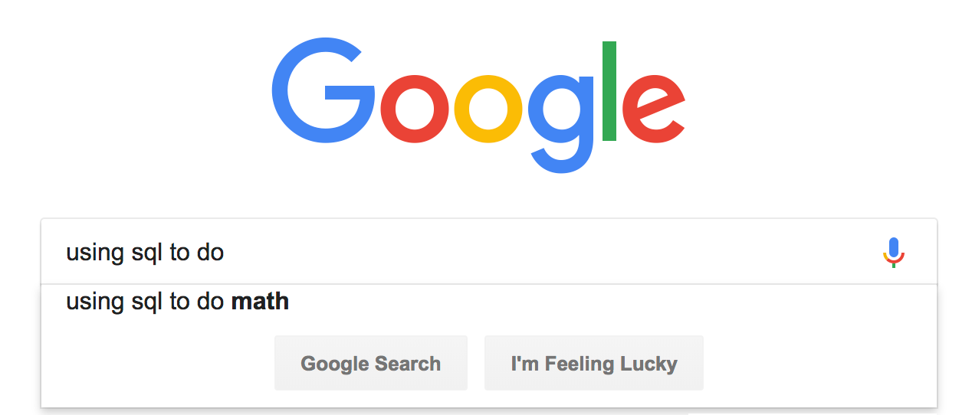

Slide 21
GROUP BY
Self-
actualization
Esteem
Social belonging
Safety and security
Physiological needs
Notes:
As analysts, SQL is our foundation. It opens two doors - first, it opens the door to data. We typically can't go anywhere before getting data, and SQL is our entry point. Second, it opens the door to more technical work. It's an entry point to code. A lot of analysts who come from background in Excel will being their "coding" careers in SQL. As a result, we do some crazy stuff with it. Sessionize

Slide 22
|------|----------|
| id | type |
|------|----------|
| 1 | normal |
| 2 | weird |
|------|----------|
SELECT type,
COUNT(id)
FROM quirks
GROUP BY type
Notes:
Sane people do this

Slide 23
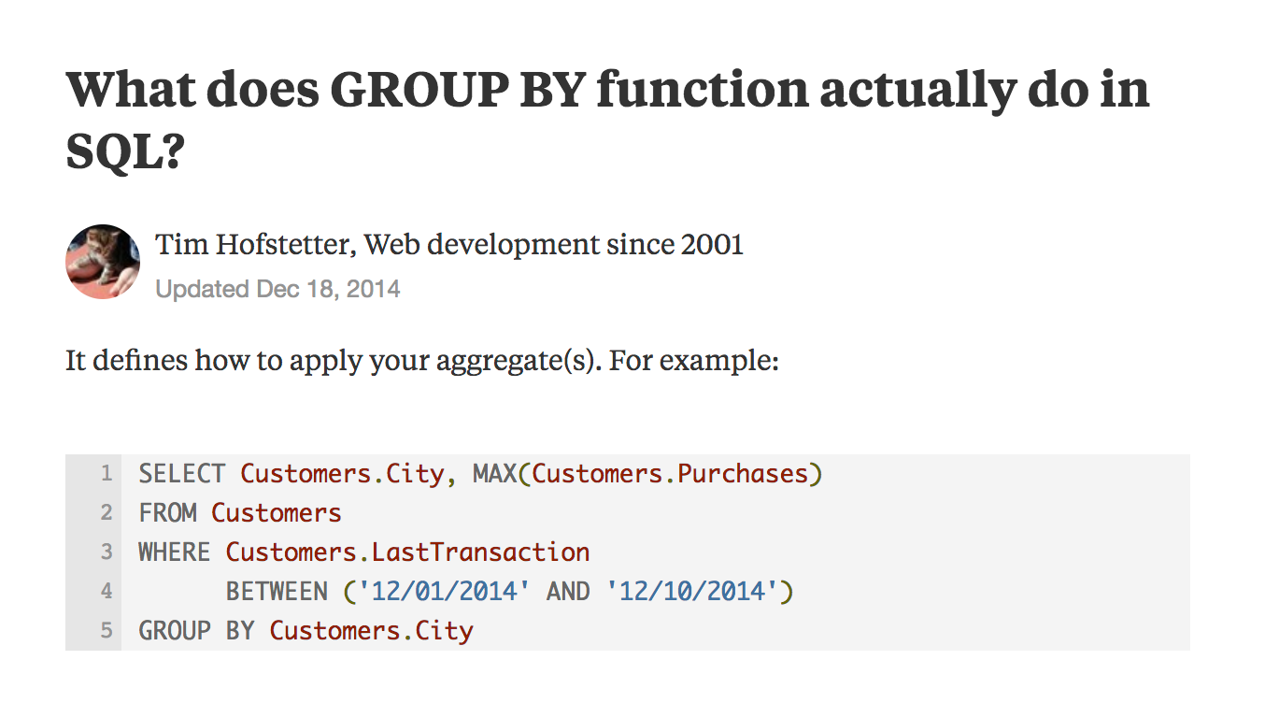
Notes:
GROUP BY is obviously a really important part of writing SQL. Thing is, very few of us actually know why it's there. And truth, very few of us ask. It's one of those things you have to do, and you just accept it.

Slide 24
User-friendly data
Self-
actualization
Esteem
Social belonging
Safety and security
Physiological needs
Notes:
For most analysts, data - not a web application - is the primary surface area of the pipelines engineers build. If that data is painful to query, we feel that pain often. Here are a few examples of places where I’ve seen this frequently go wrong.
And tables are really important to us. We have opinions about how they're set up in all sorts of ways. I'll show you a few examples

Slide 25
CREATE TABLE my_nightmare (
created_at timestamp,
started_at timestamp,
timestamp timestamp,
monster.type varchar,
IsRepDrm boolean,
SCARELEVEL float
)
Notes:
Say we’ve got this nightmare table

Slide 26
What’s the difference?
CREATE TABLE my_nightmare (
created_at timestamp,
started_at timestamp,
timestamp timestamp,
monster.type varchar,
IsRepDrm boolean,
SCARELEVEL float
)
Notes:
All this detail seems good. But what’s the difference?

Slide 27
CREATE TABLE my_nightmare (
created_at timestamp,
started_at timestamp,
timestamp timestamp,
monster.type varchar,
IsRepDrm boolean,
SCARELEVEL float
)
SELECT timestamp
FROM my_nightmare
ERROR!
Notes:
Sometimes columns are named reserved words. And in some databases, that won’t wokr.

Slide 28
CREATE TABLE my_nightmare (
created_at timestamp,
started_at timestamp,
timestamp timestamp,
monster.type varchar,
IsRepDrm boolean,
SCARELEVEL float
)
SELECT monster.type
FROM my_nightmare
ERROR!
Notes:
Sometimes columns have periods in them. Now those won’t work either.

Slide 29
What?
CREATE TABLE my_nightmare (
created_at timestamp,
started_at timestamp,
timestamp timestamp,
monster.type varchar,
IsRepDrm boolean,
SCARELEVEL float
)
Notes:
SOmetimes people aggressively abbreviate. What does this mean?

Slide 30
CREATE TABLE MY_NIGHTMARE (
created_at timestamp,
started_at timestamp,
timestamp timestamp,
monster.type varchar,
IsRepDrm boolean,
SCARELEVEL float
)
SELECT SCARELEVEL
FROM MY_NIGHTMARE
Notes:
And sometimes people use all caps.

Slide 31

Notes:
And every query we write yells at us.

Slide 32
Business expertise
Self-
actualization
Esteem
Social belonging
Safety and security
Physiological needs
Notes:
For most analysts, data - not a web application - is the primary surface area of the pipelines engineers build. If that data is painful to query, we feel that pain often. Here are a few examples of places where I’ve seen this frequently go wrong.
And tables are really important to us. We have opinions about how they're set up in all sorts of ways. I'll show you a few examples

Slide 33
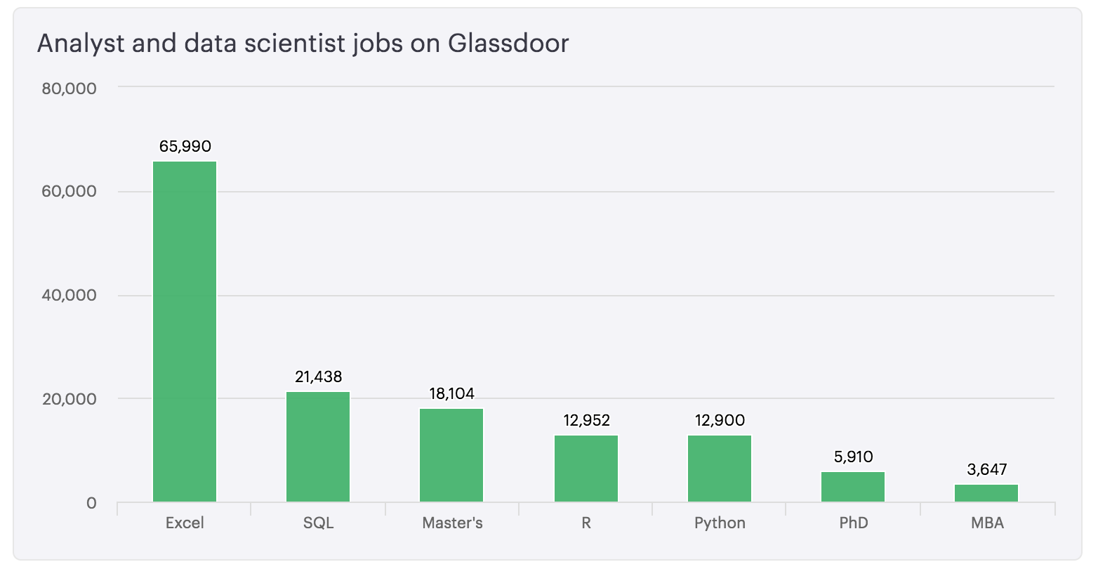

Slide 34
Statistics
Self-
actualization
Esteem
Social belonging
Safety and security
Physiological needs
Notes:
We know some about statistics.

Slide 35

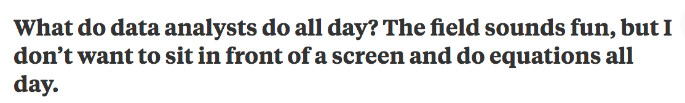

Slide 36
Analysts : Statistics :: Engineers : Algorithms
Notes:
In truth, analysts are to statistics to what engineers are to algorithms. We usually have some familiarity with it, some of us are the best in the world at it, we know enough to be useful and sometimes enough to be dangerous. Stats isn't our job, but a tool that can help yes be better at our jobs.

Slide 37
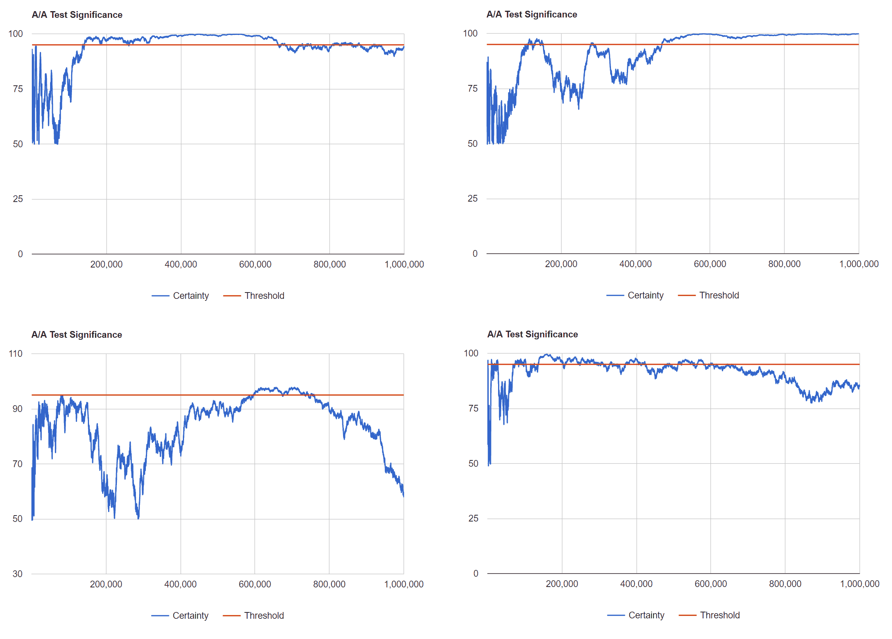

Slide 38
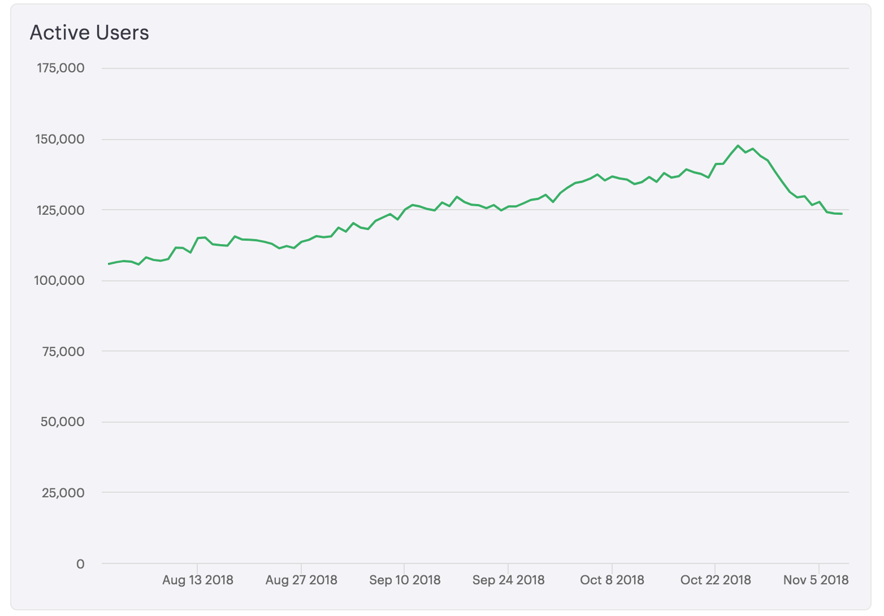
Notes:
A metric falls, an executive freaks, and the analyst is now sent to figure out why. Sometimes, the answer is easy. Sometimes, the answer is really hard and takes days to figure out - we mistreated people in an A/B test, and the overlap between that test and another test caused us to log them out when they logged in from our app. Sometimes, there is no answer.

Slide 39
Why are active users dropping?
Notes:
We ask this all the time. This is the core of our job. When working with people, this is most of what we do. [ y tho meme]. Our job is to ask why. We don't alway do it great [ bedside manner isn't always the best ] but it comes from a perspective of understanding how to answer a question

Slide 40
Why are active users dropping?
Don’t worry - it’s not statistically significant.
Notes:
We ask this all the time. This is the core of our job. When working with people, this is most of what we do. [ y tho meme]. Our job is to ask why. We don't alway do it great [ bedside manner isn't always the best ] but it comes from a perspective of understanding how to answer a question

Slide 41
Why are active users dropping?
…...
Don’t worry - it’s not statistically significant.
Notes:
We ask this all the time. This is the core of our job. When working with people, this is most of what we do. [ y tho meme]. Our job is to ask why. We don't alway do it great [ bedside manner isn't always the best ] but it comes from a perspective of understanding how to answer a question

Slide 42

What stresses us out?

Slide 43
Self-
actualization
Esteem
Social belonging
Safety and security
Physiological needs
Notes:
For most analysts, data - not a web application - is the primary surface area of the pipelines engineers build. If that data is painful to query, we feel that pain often. Here are a few examples of places where I’ve seen this frequently go wrong.
And tables are really important to us. We have opinions about how they're set up in all sorts of ways. I'll show you a few examples

Slide 44
Query speeds
Self-
actualization
Esteem
Social belonging
Safety and security
Physiological needs
Notes:
For most analysts, data - not a web application - is the primary surface area of the pipelines engineers build. If that data is painful to query, we feel that pain often. Here are a few examples of places where I’ve seen this frequently go wrong.
And tables are really important to us. We have opinions about how they're set up in all sorts of ways. I'll show you a few examples

Slide 45
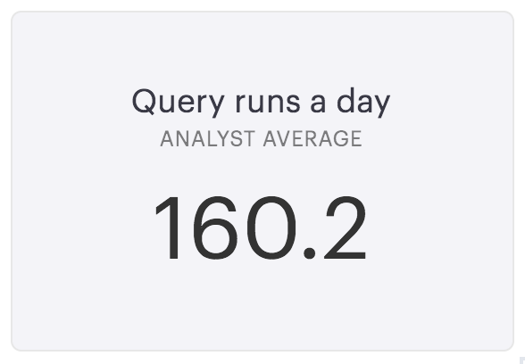
Notes:
[ Graph on the number ].

Slide 46
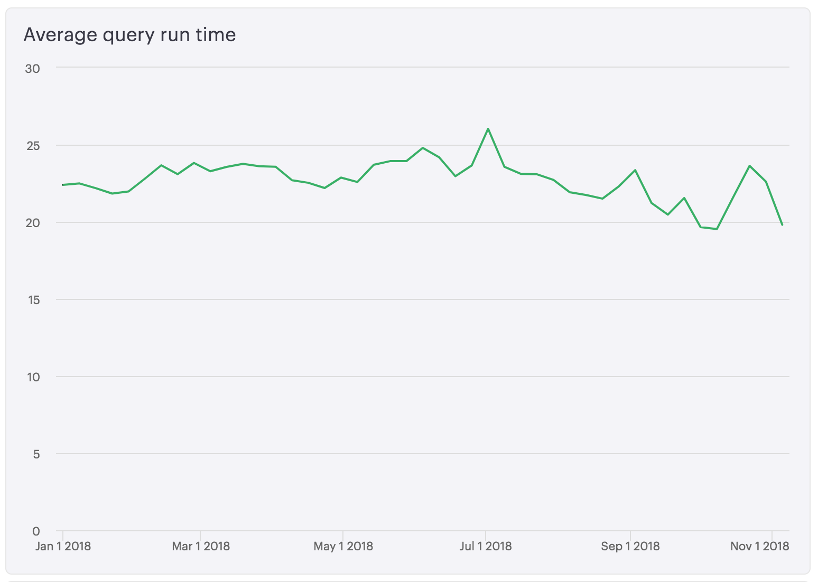
Notes:
Queries we run take an average of X seconds.

Slide 47
20 seconds
x 160 queries/day
53 minutes/day
Notes:
The average analyst, therefore, spends a little less than half an hour a day with queries running. If our queries get 25% slower, we lose 7 or 8 minutes a day. That's a lot. So we're very aware of small differences in query times. And for the most part, we don't know why they run how fast they do. We can optimize queries some, but at the end of the day, for most analysts, the database is a black box that queries go in and results come out. Every bit of time yall save to make it faster, the happier we'll be.

Slide 48
Changing data
Self-
actualization
Esteem
Social belonging
Safety and security
Physiological needs
Notes:
Sometimes, we'll be working on something, and the data will be different. One day

Slide 49
SELECT *
FROM users
|--------|---------|
| name | status |
|--------|---------|
| Beast | active |
| Gaston | active |
|--------|---------|
Notes:
It’ll look like this,

Slide 50
SELECT *
FROM users
|--------|---------|
| name | status |
|--------|---------|
| Prince | active |
| Gaston | deleted |
|--------|---------|
Notes:
And the next day, it’ll be this. We often have no idea why. I don't know how to solve this problem, but if y'all can, it'd make us very happy.

Slide 51
Git and Github
Self-
actualization
Esteem
Social belonging
Safety and security
Physiological needs
Notes:
We're told we need to know git. And a lot of us do. But most people only kinda sorta know what they need to get by. This is how a lot of us use git

Slide 52
$ git add .
$ git commit
$ git push
Notes:
Something like this

Slide 53
$ git add .
$ git commit
$ git push
..oops

Slide 54
$ git add .
$ git commit
$ git push
..oops
$ git pull
Notes:
Sane people do this

Slide 55
$ git add .
$ git commit
$ git push
..oops
$ git pull
$ git status
Notes:
Sane people do this

Slide 56
$ git add .
$ git commit
$ git push
..oops
$ git pull
$ git status
$ git pull
Notes:
Sane people do this

Slide 57
$ git add .
$ git commit
$ git push
..oops
$ git pull
$ git status
$ git pull
$ git pull
Notes:
Sane people do this

Slide 58
$ git add .
$ git commit
$ git push
..oops
$ git pull
$ git status
$ git pull
$ git pull
$ git status
Notes:
Sane people do this

Slide 59
$ git add .
$ git commit
$ git push
..oops
$ git pull
$ git status
$ git pull
$ git pull
$ git status
$ git pull origin master
Notes:
Sane people do this

Slide 60
$ git add .
$ git commit
$ git push
..oops
$ git pull
$ git status
$ git pull
$ git pull
$ git status
$ git pull origin master
$ sudo git pull
Notes:
Sane people do this

Slide 61
$ git add .
$ git commit
$ git push
..oops
$ git pull
$ git status
$ git pull
$ git pull
$ git status
$ git pull origin master
$ sudo git pull
$ git status
Notes:
Sane people do this

Slide 62
$ git add .
$ git commit
$ git push
..oops
$ git pull
$ git status
$ git pull
$ git pull
$ git status
$ git pull origin master
$ sudo git pull
$ git status
$ git reset --hard HEAD
Notes:
Sane people do this

Slide 63
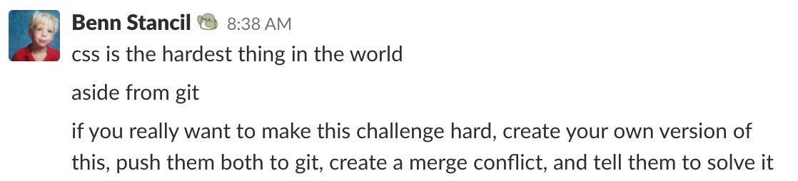
Notes:
Things like merge conflicts, don’t get me started on merge conflicts.

Slide 64
SQL
Self-
actualization
Esteem
Social belonging
Safety and security
Physiological needs
Notes:
We use a lot of SQL, and SQL does some weird stuff. Analysts are the people that find those cases. We don't really think about it, but we know a lot about it.

Slide 65
|------|----------|
| id | type |
|------|----------|
| 1 | normal |
| 2 | weird |
|------|----------|
Notes:
Sane people do this

Slide 66
|------|----------|
| id | type |
|------|----------|
| 1 | normal |
| 2 | weird |
|------|----------|
SELECT id,
type
FROM quirks
Notes:
Sane people do this

Slide 67
|------|----------|
| id | type |
|------|----------|
| 1 | normal |
| 2 | weird |
|------|----------|
SELECT id,
type
FROM quirks
SUCCESS!
Notes:
Sane people do this

Slide 68
|------|----------|
| id | type |
|------|----------|
| 1 | normal |
| 2 | weird |
|------|----------|
SELECT id
type
FROM quirks
Notes:
Sane people do this

Slide 69
|------|----------|
| id | type |
|------|----------|
| 1 | normal |
| 2 | weird |
|------|----------|
SELECT id
type
FROM quirks
ERROR!
Notes:
Sane people do this

Slide 70
|------|----------|
| id | type |
|------|----------|
| 1 | normal |
| 2 | weird |
|------|----------|
SELECT id
not_type
FROM quirks
Notes:
Sane people do this success

Slide 71
|------|----------|
| id | type |
|------|----------|
| 1 | normal |
| 2 | weird |
|------|----------|
SELECT id
not_type
FROM quirks
SUCCESS!
Notes:
Sane people do this success

Slide 72
|------|----------|
| id | type |
|------|----------|
| 1 | normal |
| 2 | weird |
|------|----------|
SELECT
FROM quirks
Notes:
Sane people do this

Slide 73
|------|----------|
| id | type |
|------|----------|
| 1 | normal |
| 2 | weird |
|------|----------|
SELECT
FROM quirks
SUCCESS!
Notes:
Sane people do this

Slide 74
Formatting SQL
Self-
actualization
Esteem
Social belonging
Safety and security
Physiological needs
Notes:
Nobody knows how to format SQL queries. We all have strong opinions about it, but none of us know how to do it.

Slide 75
SELECT
a.name AS account_name,
s.name AS sales_rep,
SUM(o.total) AS total_orders
FROM accounts a
JOIN orders o ON o.account_id = a.id
JOIN sales_reps s ON s.id = a.rep_id
GROUP BY 1,2
ORDER BY 3 DESC
Notes:
Some people do this

Slide 76
select
a.name AS account_name
,s.name AS sales_rep
,sum(o.total) AS total_orders
from
accounts a
join orders o
on o.account_id = a.id
join sales_reps s
on s.id = a.rep_id
group by 1,2
Notes:
Some people do this

Slide 77
SELECT a.name AS account_name,
s.name AS sales_rep,
SUM(o.total) AS total_orders
FROM accounts a
JOIN orders o
ON o.account_id = a.id
JOIN sales_reps s
ON s.id = a.rep_id
GROUP BY 1,2
ORDER BY 3 DESC
Notes:
Sane people do this

Slide 78
“Simple” questions
Self-
actualization
Esteem
Social belonging
Safety and security
Physiological needs
Notes:
This is really a stand in for one of the biggest challenges for analysts - answering what seems like simple questions that end up becoming incredibly complex.

Slide 79
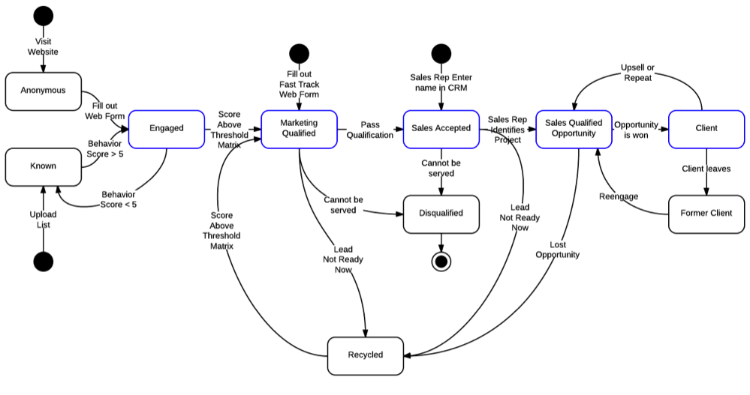
Notes:
To calculate revenue at organizations with sales teams, for instance, you sales data is in Salesforce. It's human entered. It's messy. You have to deal with trial contracts, contracts of variable lengths, upsells, renewals, free accounts for non profits, test accounts, early cancellations, refunds, expired credit cards. And you have to tie this with data from your billing system, maybe from your payments processor. It's always harder than you'd expect. We have to know answer this question, but it’s often frustratingly challenging to do so.

Slide 80
A dip in a dashboard
Self-
actualization
Esteem
Social belonging
Safety and security
Physiological needs
Notes:
This is the worst thing to happen to an analyst.

Slide 81
Notes:
A metric falls, an executive freaks, and the analyst is now sent to figure out why. Sometimes, the answer is easy. Sometimes, the answer is really hard and takes days to figure out - we mistreated people in an A/B test, and the overlap between that test and another test caused us to log them out when they logged in from our app. Sometimes, there is no answer.

Slide 82
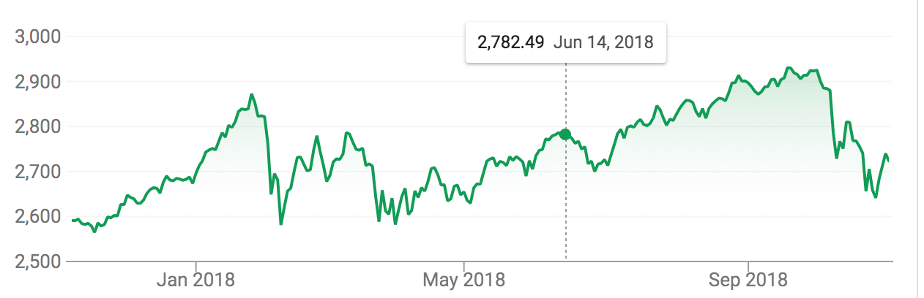
Notes:
We're chasing "what caused the stock market to drop." If we had easier ways to answer these questions, that would be amazing.

Slide 83
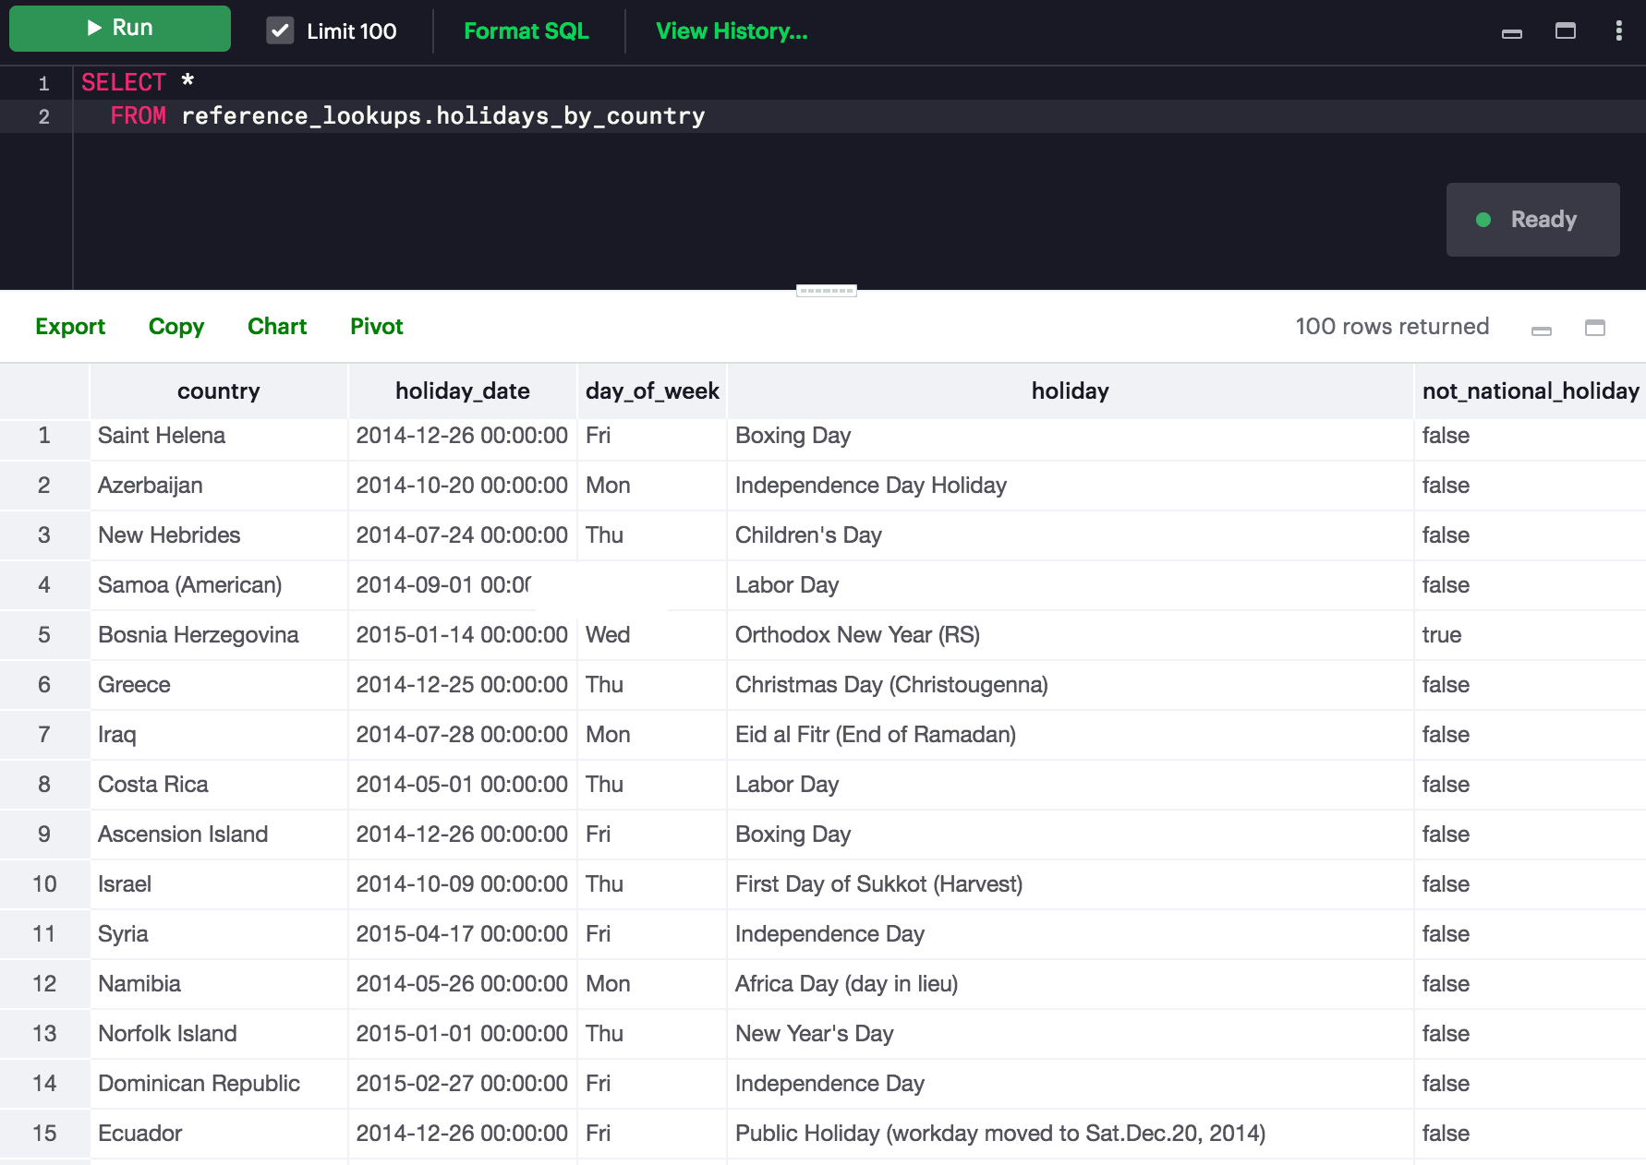

Slide 84
Change
Self-
actualization
Esteem
Social belonging
Safety and security
Physiological needs
Notes:
Our job is to answer questions. Part of trying to understand how the world is requires recognizing that world will change. There are always new products, new marketing campaigns, and new business goals that create new questions to be answered. As a result, data is constantly changing [ schema update frequency ]. We want tools and data that acknowledge this is the way we work.

Slide 85
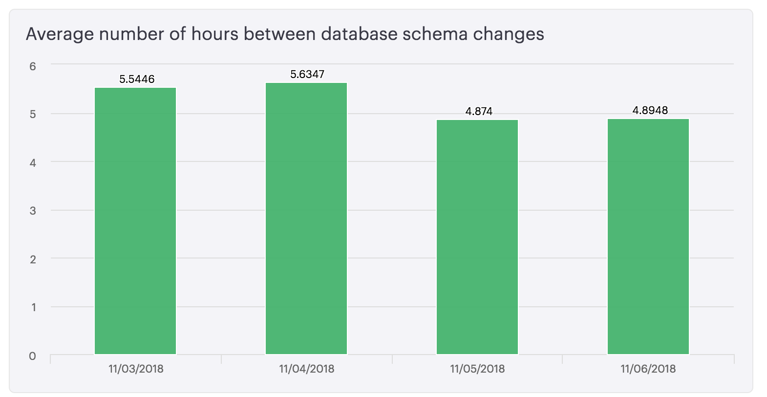

Slide 86

How do we connect with others?

Slide 87
Self-
actualization
Esteem
Social belonging
Safety and security
Physiological needs
Notes:
Our job is to answer questions. Part of trying to understand how the world is requires recognizing that world will change. There are always new products, new marketing campaigns, and new business goals that create new questions to be answered. As a result, data is constantly changing [ schema update frequency ]. We want tools and data that acknowledge this is the way we work.

Slide 88
Presenting our work
Self-
actualization
Esteem
Social belonging
Safety and security
Physiological needs
Notes:
Our job is to answer questions. Part of trying to understand how the world is requires recognizing that world will change. There are always new products, new marketing campaigns, and new business goals that create new questions to be answered. As a result, data is constantly changing [ schema update frequency ]. We want tools and data that acknowledge this is the way we work.

Slide 89
Collect
Store
Validate
Clean
Manipulate
Model
Analyze
Visualize

Slide 90
Collect
Store
Validate
Clean
Manipulate
Model
Analyze
Visualize
Communication and understanding

Slide 91
Analogies
Self-
actualization
Esteem
Social belonging
Safety and security
Physiological needs
Notes:
This does point to another point though...Analysts use a lot of analogies. Why? Analogies are shortcuts that strip out complexity from one situation and map the remaining skeleton onto a similar skeleton from some other situation. This represents two of the most important skills of an analyst - problem reduction and pattern matching. In so many analytical questions, the hardest and most important thing to figure out is what actually matters. What are the critical elements that I care about? What's the signal, and what's the noise? Reducing the problem to simple models clarify the idea and reveal further questions or solutions that you may not see in a more complex picture. Second, analogies train you to match patterns. What other situations in your life, from a movie you've seen, a book you've read, or an experience you've had, has the same skeleton? Finding these patterns makes you a better analyst.

Slide 92
“...simple intuitive stories are important, and deserve more credit.”
Paul Krugman
Notes:
simple intuitive stories are important, and deserve more credit.

Slide 93
Understanding questions
Self-
actualization
Esteem
Social belonging
Safety and security
Physiological needs
Notes:
We ask this all the time. This is the core of our job. When working with people, this is most of what we do. [ y tho meme]. Our job is to ask why. We don't alway do it great [ bedside manner isn't always the best ] but it comes from a perspective of understanding how to answer a question

Slide 94
Why are active users dropping?
Notes:
We ask this all the time. This is the core of our job. When working with people, this is most of what we do. [ y tho meme]. Our job is to ask why. We don't alway do it great [ bedside manner isn't always the best ] but it comes from a perspective of understanding how to answer a question

Slide 95

Why are active users dropping?
Notes:
We ask this all the time. This is the core of our job. When working with people, this is most of what we do. [ y tho meme]. Our job is to ask why. We don't alway do it great [ bedside manner isn't always the best ] but it comes from a perspective of understanding how to answer a question

Slide 96
Bedside manner
Self-
actualization
Esteem
Social belonging
Safety and security
Physiological needs
Notes:
We ask this all the time. This is the core of our job. When working with people, this is most of what we do. [ y tho meme]. Our job is to ask why. We don't alway do it great [ bedside manner isn't always the best ] but it comes from a perspective of understanding how to answer a question

Slide 97
todo
Notes:
We ask this all the time. This is the core of our job. When working with people, this is most of what we do. [ y tho meme]. Our job is to ask why. We don't alway do it great [ bedside manner isn't always the best ] but it comes from a perspective of understanding how to answer a question

Slide 98
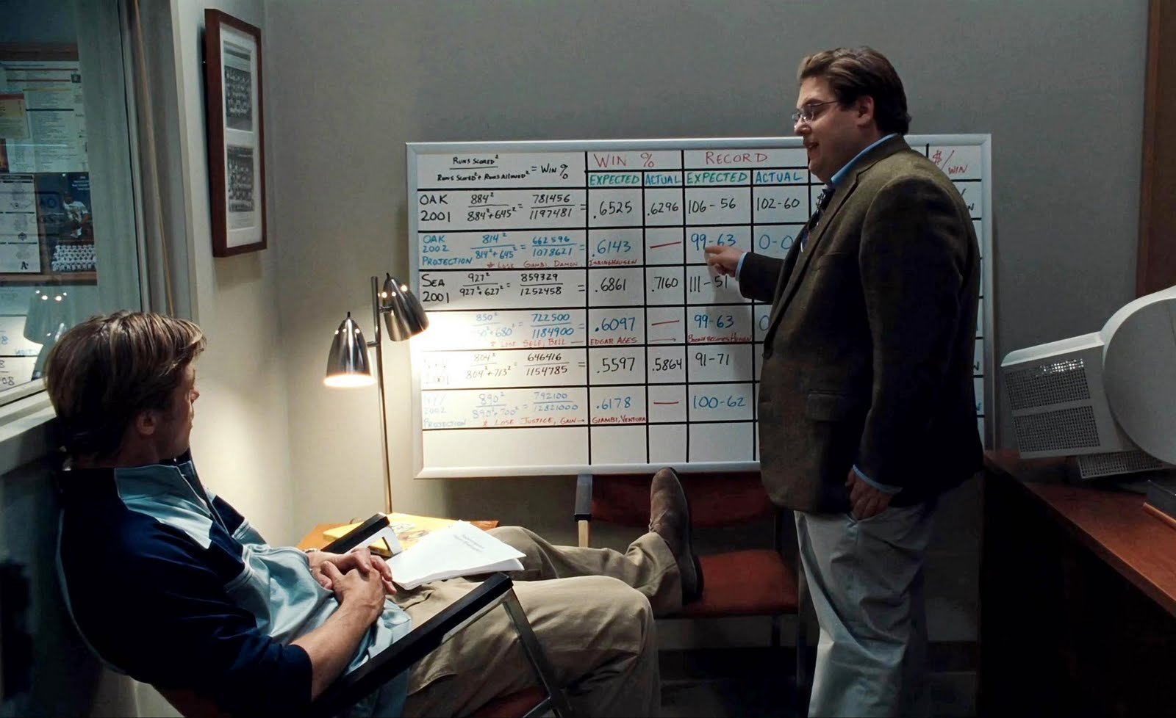
What makes us feel successful?

Slide 99
Self-
actualization
Esteem
Social belonging
Safety and security
Physiological needs
Notes:
These are the sorts of things that make us analysts. It's the questions that you see that make you curious about why something is that way. It's quesitons about whether all five star ratings are the same? Or which tips people choose on Square? Or some other thing [ should have three answers ]. What causes our interest in these things likely makes us an analyst. [ Show cofounder chart ] Often, this curiosity is what's at the heart of analyst's motivations

Slide 100
Figuring out how things work
Self-
actualization
Esteem
Social belonging
Safety and security
Physiological needs
Notes:
These are the sorts of things that make us analysts. It's the questions that you see that make you curious about why something is that way. It's quesitons about whether all five star ratings are the same? Or which tips people choose on Square? Or some other thing [ should have three answers ]. What causes our interest in these things likely makes us an analyst. [ Show cofounder chart ] Often, this curiosity is what's at the heart of analyst's motivations

Slide 101
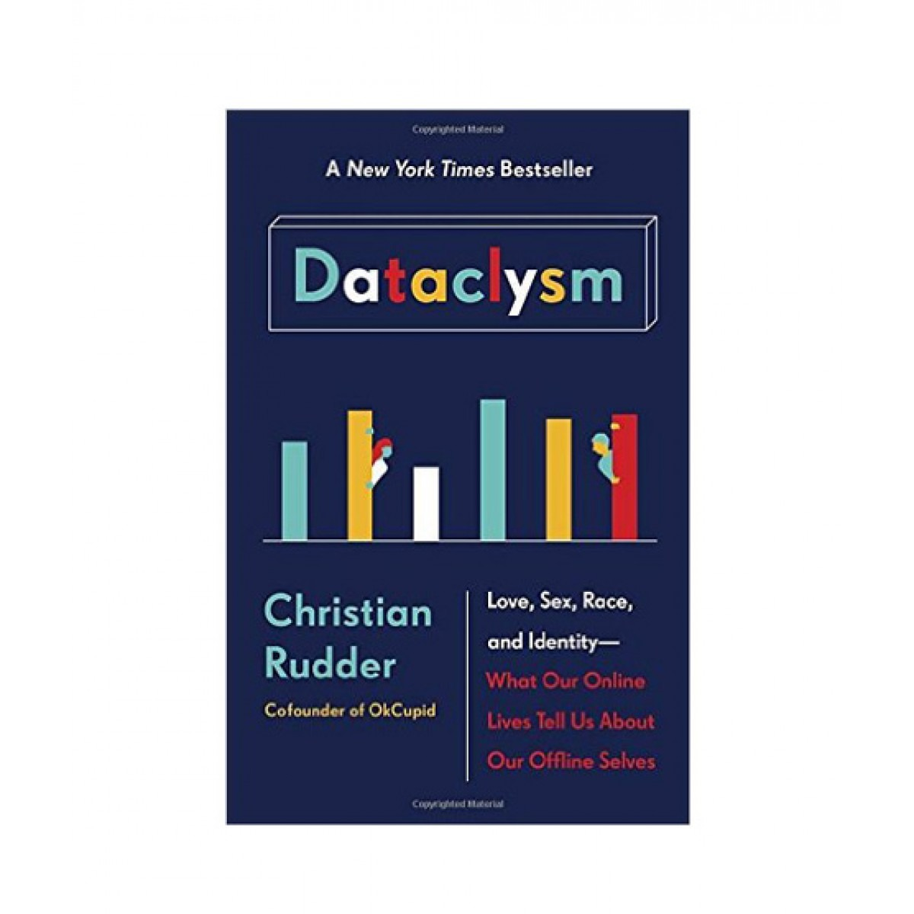

Slide 102
I wonder if...

Slide 103
I wonder if...
weather affects election turnout?

Slide 104
I wonder if...
weather affects election turnout?
(only in non-competitive elections)

Slide 105
I wonder if...
weather affects election turnout?
(only in non-competitive elections)
icing the kicker works?

Slide 106
I wonder if...
weather affects election turnout?
(only in non-competitive elections)
icing the kicker works?
(probably not)

Slide 107
I wonder if...
weather affects election turnout?
(only in non-competitive elections)
icing the kicker works?
(probably not)
younger founders are more successful?

Slide 108
I wonder if...
weather affects election turnout?
(only in non-competitive elections)
icing the kicker works?
(probably not)
younger founders are more successful?
(they aren’t)

Slide 109
I wonder if...
weather affects election turnout?
(only in non-competitive elections)
icing the kicker works?
(probably not)
younger founders are more successful?
(they aren’t)
West Virginia is in the South?

Slide 110
I wonder if...
weather affects election turnout?
(only in non-competitive elections)
icing the kicker works?
(probably not)
younger founders are more successful?
(they aren’t)
West Virginia is in the South?
(people think so, unless they live in West Virginia)

Slide 111
Understanding caveats and nuance
Self-
actualization
Esteem
Social belonging
Safety and security
Physiological needs
Notes:
As analysts, we want to present truth, and reality is messy. We rarely say "something is" but often speak in conjecture, saying something "suggests" and "points to." The trouble here is, this isn't always a good thing. People only hear pieces of what we say, and it won't always be the headlines. The more we muddy the point, or the more you say, the less likely people are to walk away with the thing you want them to walk away with.

Slide 112

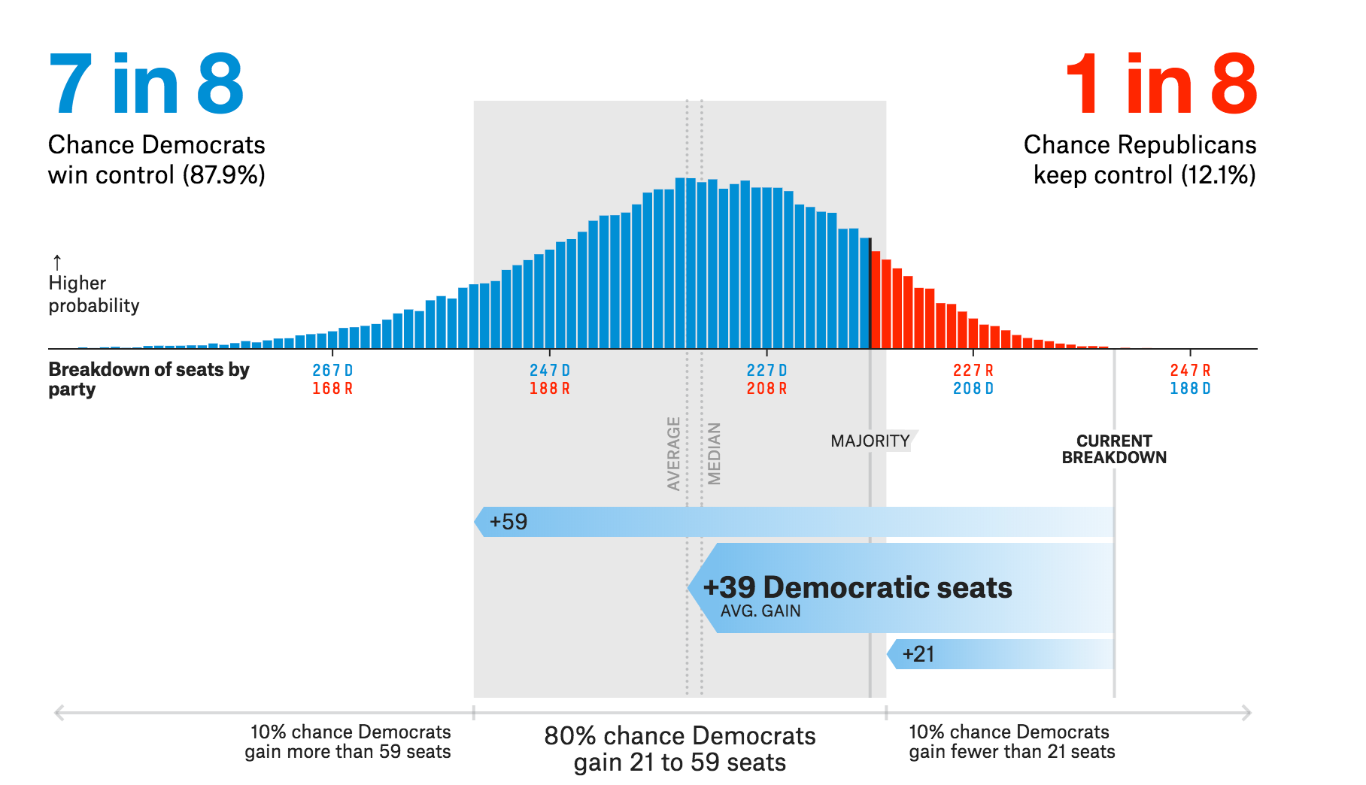

Slide 113

What fulfills us?

Slide 114
Self-
actualization
Esteem
Social belonging
Safety and security
Physiological needs
Notes:
We ask this all the time. This is the core of our job. When working with people, this is most of what we do. [ y tho meme]. Our job is to ask why. We don't alway do it great [ bedside manner isn't always the best ] but it comes from a perspective of understanding how to answer a question

Slide 115
Understanding “why”
Self-
actualization
Esteem
Social belonging
Safety and security
Physiological needs
Notes:
We ask this all the time. This is the core of our job. When working with people, this is most of what we do. [ y tho meme]. Our job is to ask why. We don't alway do it great [ bedside manner isn't always the best ] but it comes from a perspective of understanding how to answer a question

Slide 116
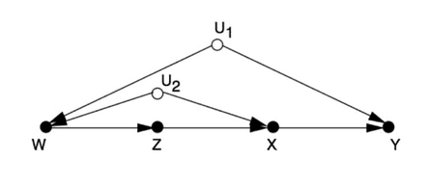

Slide 117
Telling the story
Self-
actualization
Esteem
Social belonging
Safety and security
Physiological needs
Notes:
This is a question we get asked a lot. People want a "data pull." As analysts, our job is to help people and our organizations make better decisions. Our value comes not just from providing data, but also from finding and presenting the story that data tells. When we ship a data pull, we can’t tell that story. We forgo our opportunity to be analysts.. Data pulls are a handoff, as if to say, “you take it from here.” In some cases, that’s the point — analysts can’t and shouldn’t be involved in everything with data. But if data is the most common thing we deliver, people involving us to solve problems and will start seeing us as people who fetch data. As analysts, we have lots of tools for helping people. But to paraphrase the old saying, if all we do is nail things, people are going to assume all we’ve got is a hammer. The best analysts focus not on just delivering data, but focus the places where they can truly affect the business. They make it clear that they’re here for helping solve problems.

Slide 118

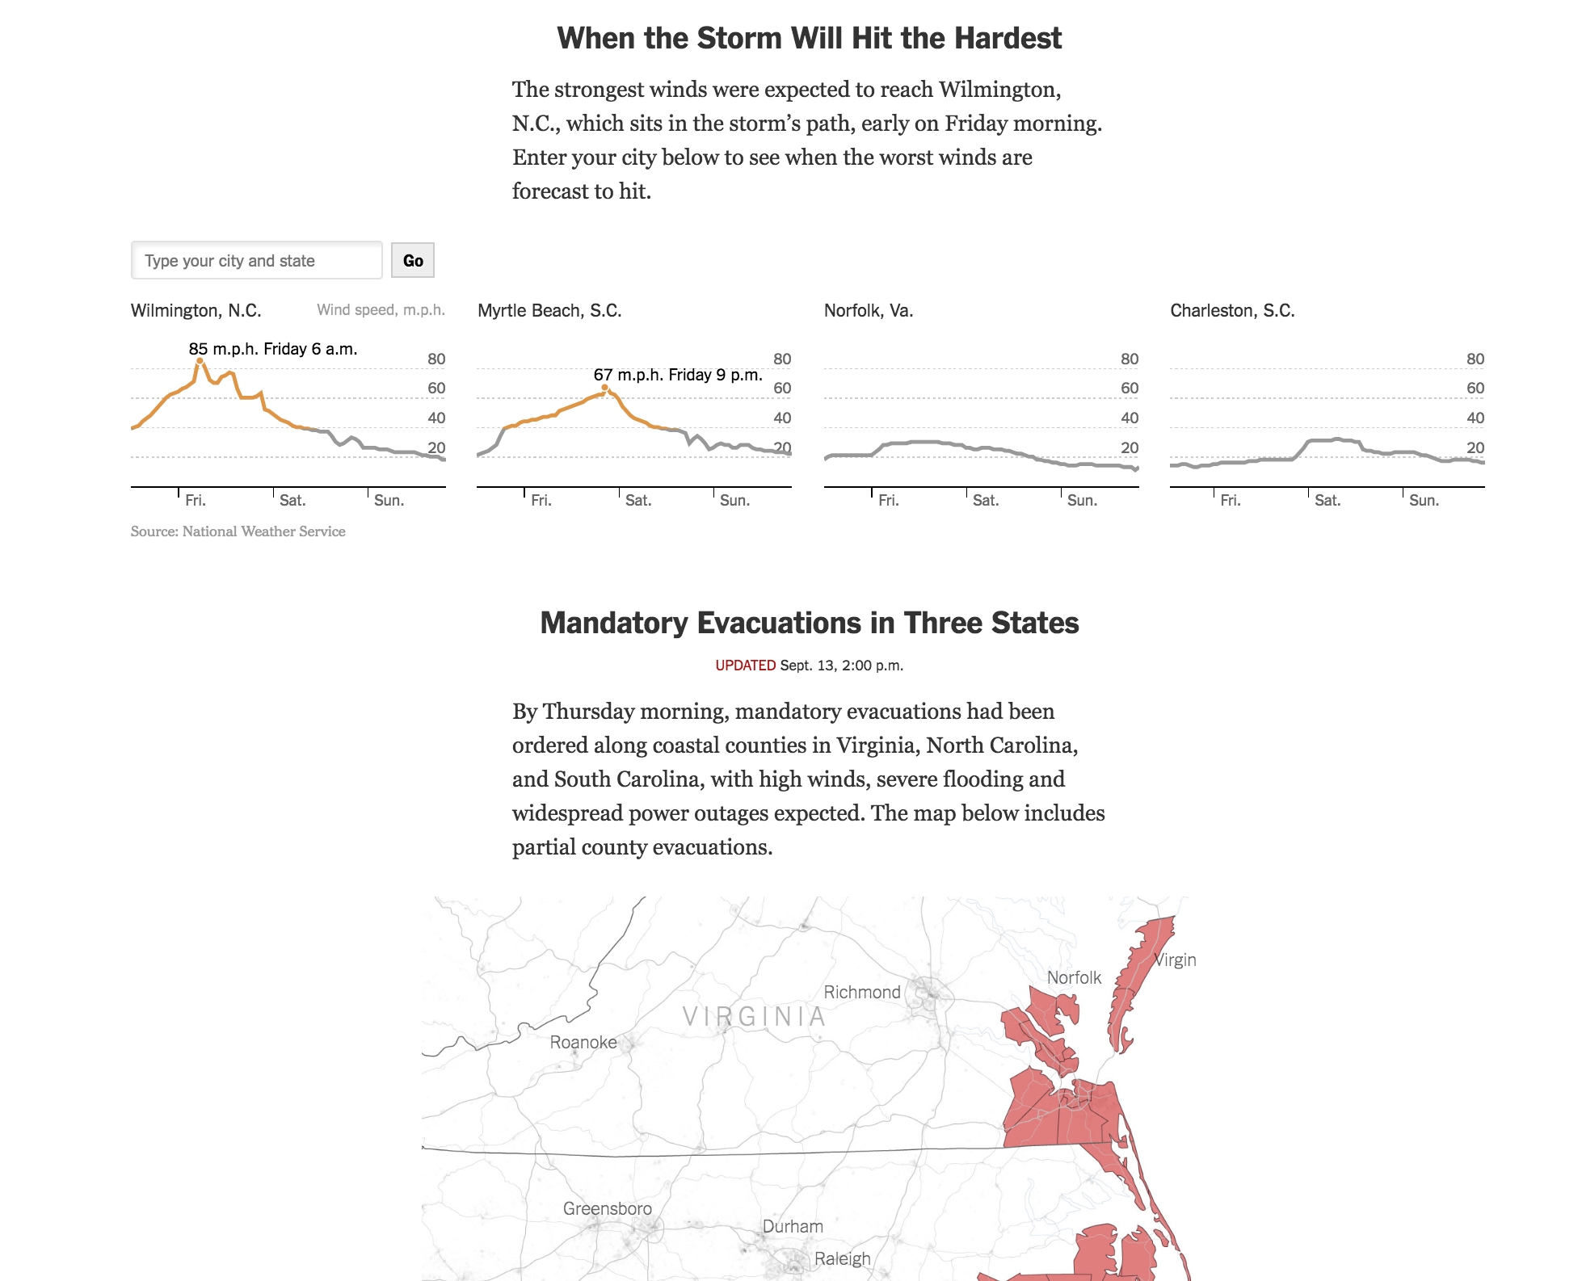

Slide 119

So what do we want?

Slide 120
Self-
actualization
Esteem
Social belonging
Safety and security
Physiological needs
Notes:
Maslow’s hierarchy of needs

Slide 121
Use technology, don’t prescribe it

Slide 122
Use technology, don’t prescribe it
Create data for humans, not machines

Slide 123
Use technology, don’t prescribe it
Create data for humans, not machines
Express complexity, don’t hide it

Slide 124
Use technology, don’t prescribe it
Create data for humans, not machines
Express complexity, don’t hide it
Be flexible to change, not undone by it

Slide 125
Use technology, don’t prescribe it
Create data for humans, not machines
Express complexity, don’t hide it
Be flexible to change, not undone by it
Share stories that tell why, not data that says what

Slide 126

Notes:
A better approach is to build radio towers. To get you to an answer, we want you to get there as fast as you can. If the question changes, it's cheap to build a new radio tower. And just as importantly, if that answer uncovers more answers, it's cheap to build more radio towers to pursue them.
We enable this by allowing analysts to put as little space between you and your data as possible. As an analyst, I can go from having never heard of Mode to using Mode to share an answer with a colleague in 15 minutes. Mode is incredibly unique in this regard. Most tools put a ton a friction in between these two things. With Mode, you can sign up, connect your data, query it directly, analyze it, deeply, and build reports, and share them right away.
That’s an incredibly powerful proposition, and something we have to always be committed to. Nothing we do should shorten “time to radio tower.” That’s our beachhead.
However, we’re not done.

Slide 127
Questions?

Slide 128
Backup

Slide 129
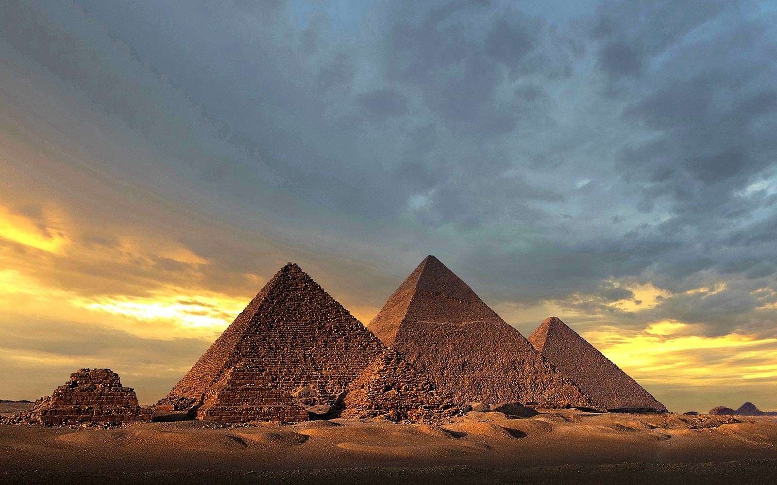
Notes:
Traditional BI is a pyramid. It takes for ever to build. You have to build it up, layer by layer. If you get all of this planning right, you end up with an incredibly sturdy structure. But, if you didn't, and you realize you actually needed to ask a different question - or if your business shifted as you were building toward an answer - you're in a lot of trouble. You have to rebuild a lot of foundation to move it.

Slide 130

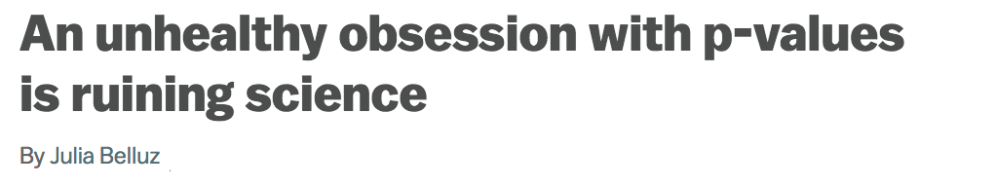

Slide 131
SQL……………………………....
Data engineering…………...
Business expertise………….
Statistics……………………….
Understanding the world..
Telling stories………………..
Flexibility……………………....
Love it but all over the place
Care about the output
Parts of it
A useful tool
It’s why we do this
It’s how we’re effective
It’s what makes our job possible

Slide 132
Being fast and flexible
Care about
Know about
Notes:
Like so many others, we're probelm solvers. Like engineers, we want to not just be given directions, but want to be given problems. The best analysts are those that find creative solutions to open ended problems, not those who can do hard math.

Slide 133
P-values
Care about
Know about
Notes:
One way that statistics shows up a lot is a lot of times, analysts get a question like "is it statistically significant?"

Slide 134
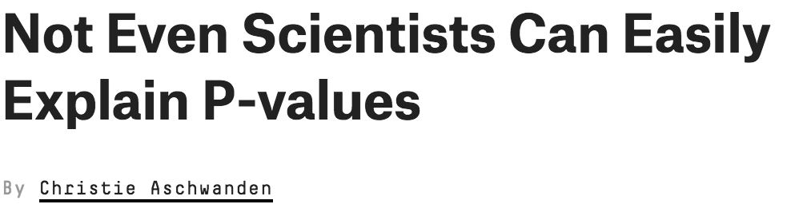
Notes:
We’re not as big of experts on what this means as we might like to be.

Slide 135
CASE WHEN val = 10
THEN TRUE
ELSE FALSE
END AS high
Notes:
We don’t even know how to do a case statement, which is a basic if statement. Sometimes it’s this.

Slide 136
CASE WHEN val = 10 THEN TRUE
ELSE FALSE END AS high
Notes:
Or this

Slide 137
CASE
WHEN val = 10
THEN TRUE
ELSE
FALSE
END
AS high
Notes:
Or this

Slide 138
CASE val WHEN 10 THEN TRUE ELSE FALSE END AS high
Notes:
Nobody should do this. Everybody has a different way of doing it, nobody agrees, but we care about it. And if you do it this way, you're wrong.

Slide 139
Use technology, don’t prescribe it
Reliable data for humans
Designed for sharing
Flexibility for a complicated world
Stories that tell why

