Slide 1




An update on
scikit-learn
0.20 and beyond
Andreas Müller
Columbia University, scikit-learn

Slide 2
What is scikit-learn?

Slide 3

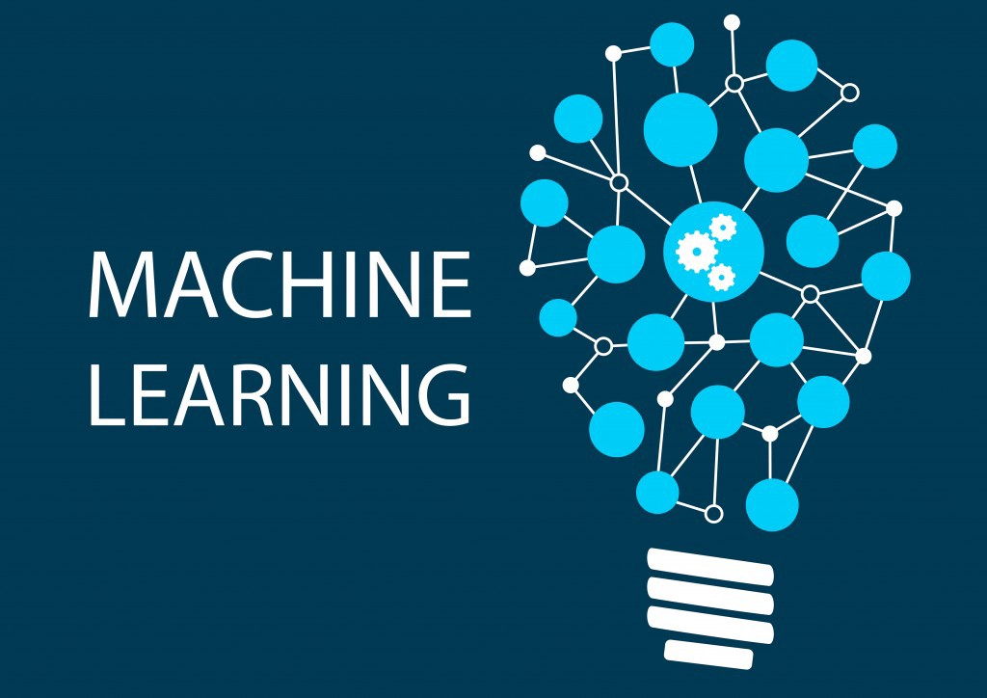


Slide 4
Basic API review

Slide 5
Representing Data
one sample
1.1 | 2.2 | 3.4 | 5.6 | 1.0
6.7 | 0.5 | 0.4 | 2.6 | 1.6
2.4 | 9.3 | 7.3 | 6.4 | 2.8
1.5 | 0.0 | 4.3 | 8.3 | 3.4
0.5 | 3.5 | 8.1 | 3.6 | 4.6
5.1 | 9.7 | 3.5 | 7.9 | 5.1
3.7 | 7.8 | 2.6 | 3.2 | 6.3
1.6
2.7
4.4
0.5
0.2
5.6
6.7
X =
y =
one feature
outputs / labels

Slide 6
clf = RandomForestClassifier()
clf.fit(X_train, y_train)
Training Data
Model
Training Labels
y_pred = clf.predict(X_test)
Test Data
Prediction
Test Labels
Evaluation
clf.score(X_test, y_test)

Slide 7
Basic API
estimator.fit(X, [y])
estimator.predict | estimator.transform
Classification | Preprocessing
Regression | Dimensionality reduction
Clustering | Feature selection
 | Feature extraction

Slide 8
Cross -Validated Grid Search
from sklearn.model_selection import GridSearchCV
from sklearn.model_selection import train_test_split
X_train, X_test, y_train, y_test = train_test_split(X, y)
param_grid = {'C': 10. ** np.arange(-3, 3),
'gamma': 10. ** np.arange(-3, 3)}
grid = GridSearchCV(SVC(), param_grid=param_grid)
grid.fit(X_train, y_train)
grid.score(X_test, y_test)
y_pred = grid.predict(X_test)

Slide 9
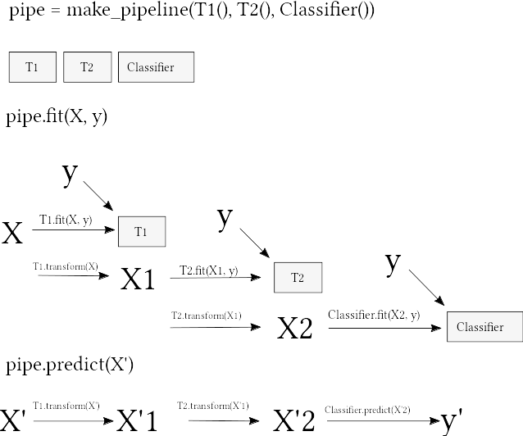
Pipelines

Slide 10
Pipelines
from sklearn.pipeline import make_pipeline
pipe = make_pipeline(StandardScaler(), SVC())
pipe.fit(X_train, y_train)
pipe.predict(X_test)
param_grid = {'svc__C': 10. ** np.arange(-3, 3),
'svc__gamma': 10. ** np.arange(-3, 3)}
pipe = make_pipeline(StandardScaler(), SVC())
grid = GridSearchCV(pipe, param_grid=param_grid, cv=5)
grid.fit(X_train, y_train)

Slide 11

0.20.0

Slide 12
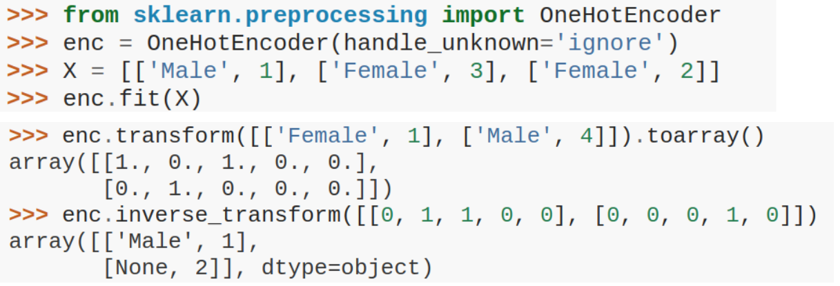
OneHotEncoder for Strings

Slide 13
ColumnTransformer
numeric_features = ['age', 'fare']
numeric_transformer = make_pipeline(SimpleImputer(strategy='median'),
StandardScaler())])
categorical_features = ['embarked', 'sex', 'pclass']
categorical_transformer = make_pipeline(
SimpleImputer(strategy='constant', fill_value='missing'),
OneHotEncoder())
preprocessor = make_column_transformer(
(numeric_features, numeric_transformer),
(categorical_features, categorical_transformer),
remainder='drop')
clf = make_pipeline(preprocessor, LogisticRegression())

Slide 14
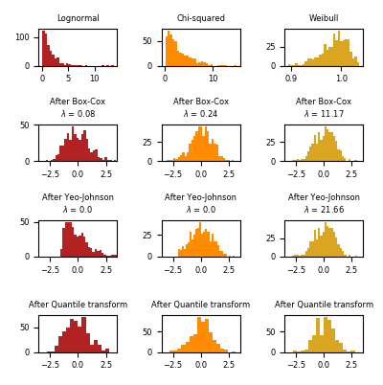

PowerTransformer

Slide 15
Missing Value treatment
Scalers
SimpleImputer
MissingIndicator

Slide 16
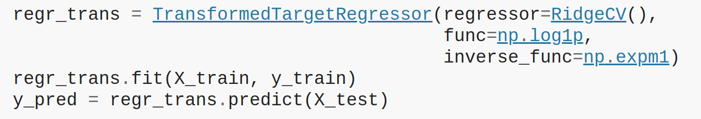
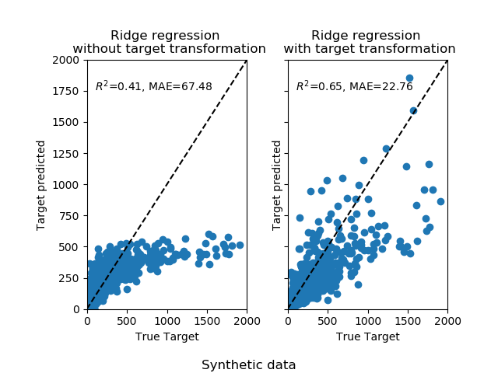
TransformedTargetRegressor

Slide 17
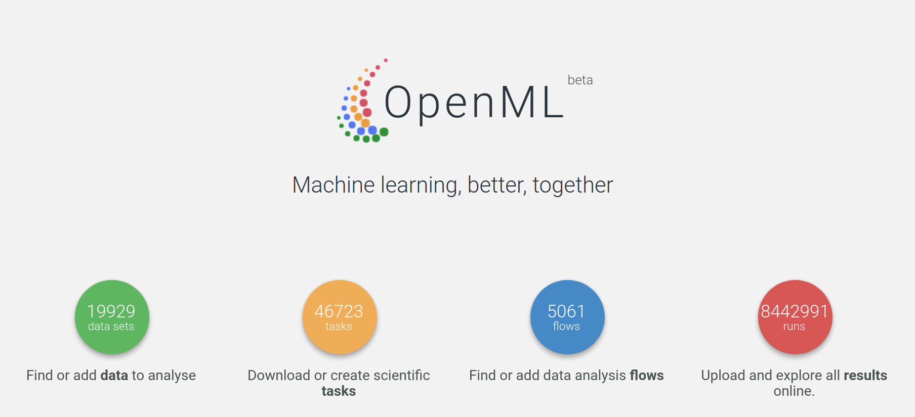
OpenML Dataset Loader

Slide 18
Loky
A Robust and reusable Executor
https://loky.readthedocs.io/en/stable/
An alternative for multiprocessing.pool.Pool and concurrent.futures.ProcessPoolExecutor
No need for if __name__ == "__main__": in scripts
Deadlock free implementation
Consistent spawn behavior
No random crashes with odd BLAS / OpenMP libraries

Slide 19
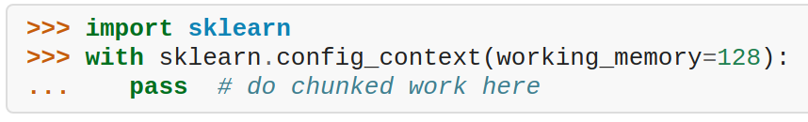
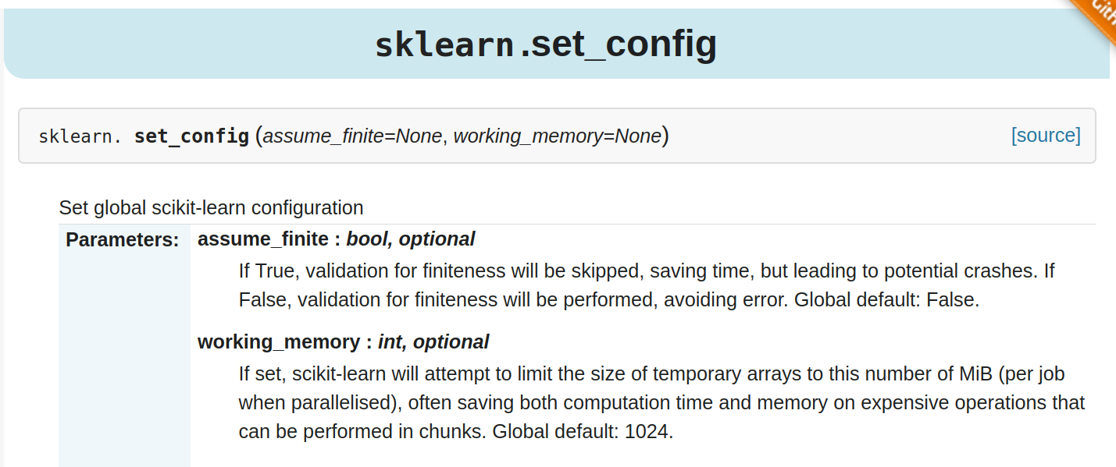
Global config and working memory

Slide 20
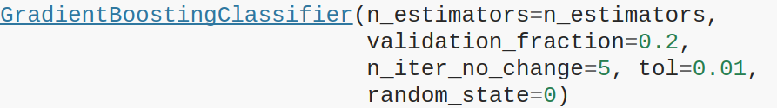
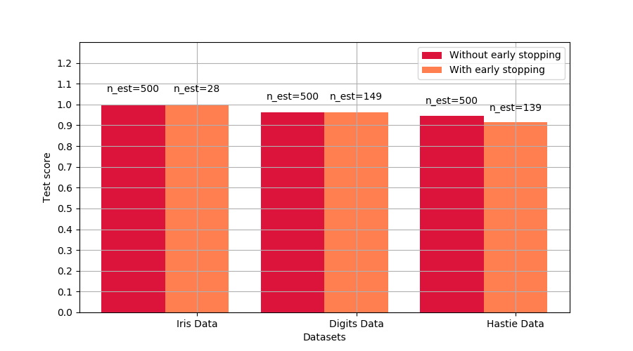
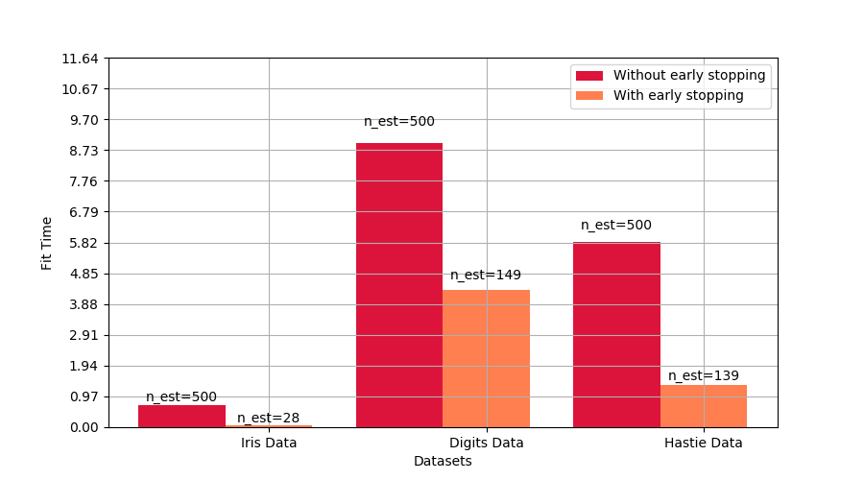
Gradient Boosting Early Stopping
Activated by “n_iter_no_change”

Slide 21

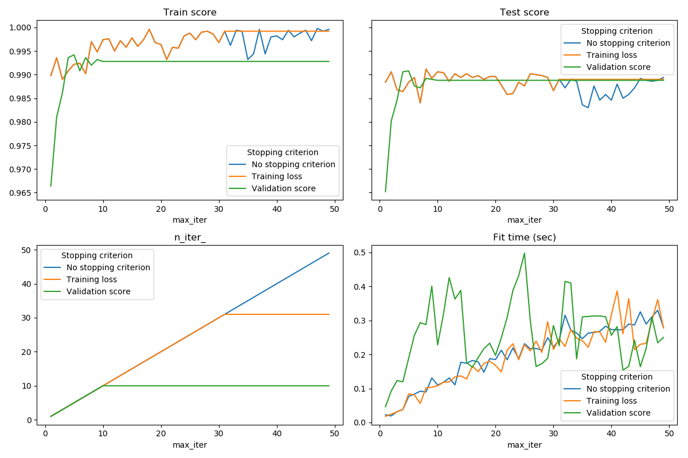
SGD et al early stopping

Slide 22
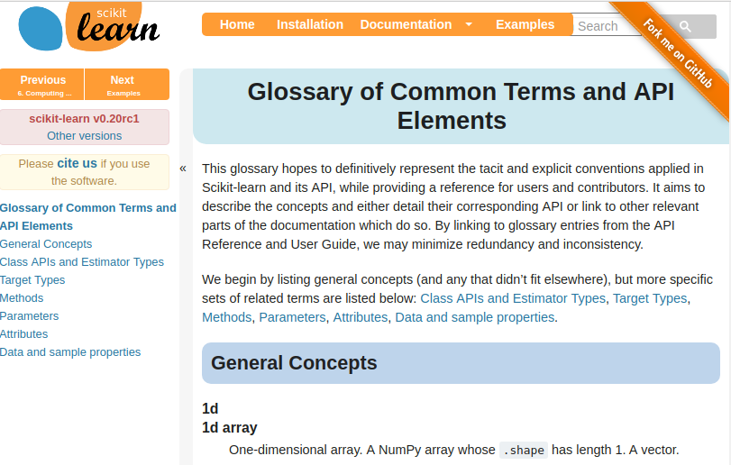

Slide 23
Better defaults
All random forests:
n_estimators from 10 to 100 (in 0.22)
Cross-validation:
cv from 3 to 5 (in 0.22)
Grid-Search:
iid to False (in 0.22)
Remove iid (in 0.24)

Slide 24
LogisticRegression defaults
solver=’lbfgs’ (from ‘liblinear’)
multiclass=’auto’ (from ‘ovr’)

Slide 25
A note on deprecations ...

Slide 26

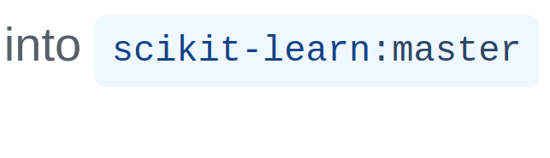

Slide 27
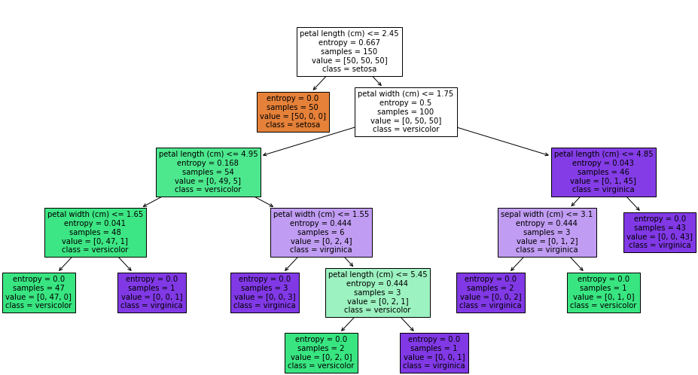
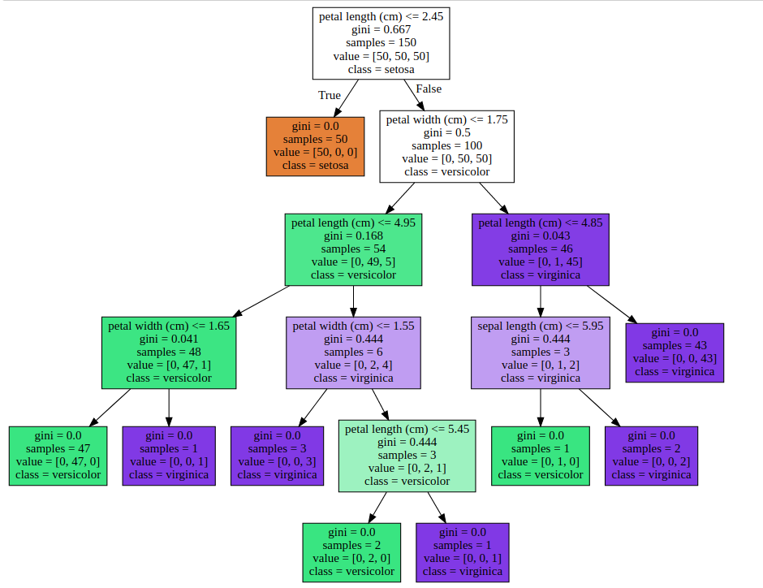
Matplotlib based tree plotting
Graphviz
Our own!

Slide 28

Work In Progress
Notes:
So now, lets talk to the somewhat further-out future.
What are the plans and ideas we have?

Slide 29
A (draft) Roadmap
https://github.com/scikit-learn/scikit-learn/wiki/Draft-Roadmap-2018

Slide 30
Dropping Python 2.7
(and 3.4!)

Slide 31
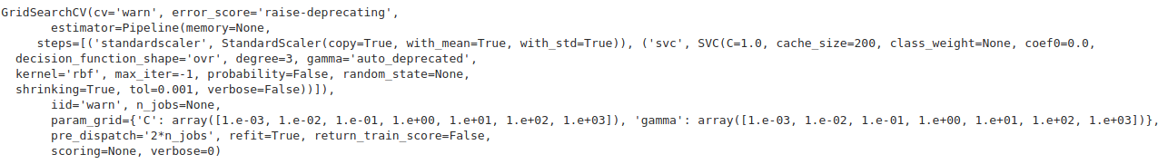
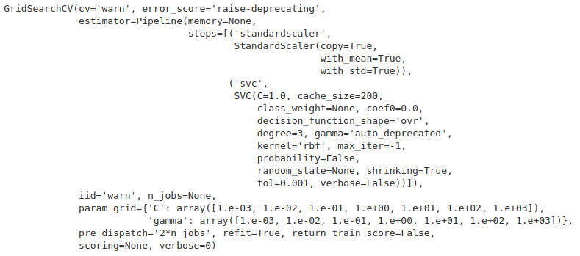
A new __repr__
Old
new

Slide 32
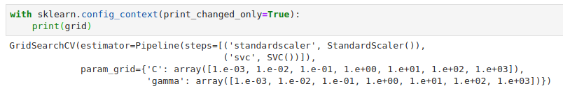
A new __repr__
compared to old:

Slide 33
Loky / OpenMP

Slide 34
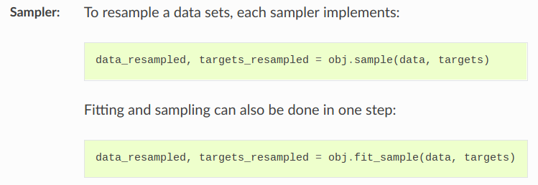
Imbalanced-learn integration

Slide 35
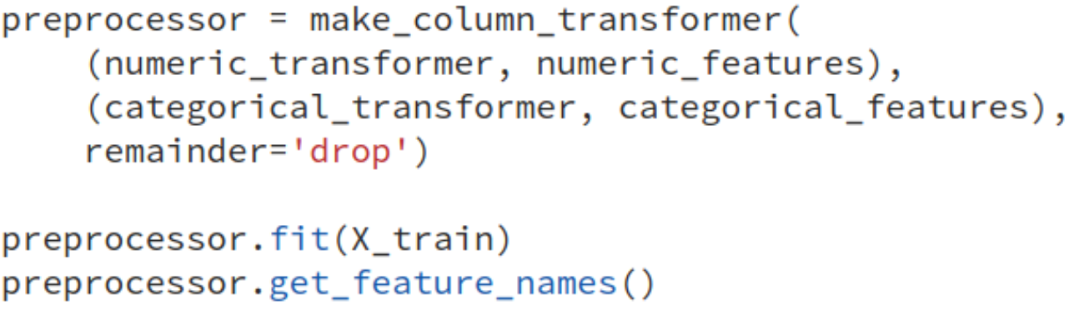
Pandas & Feature Names

Slide 36
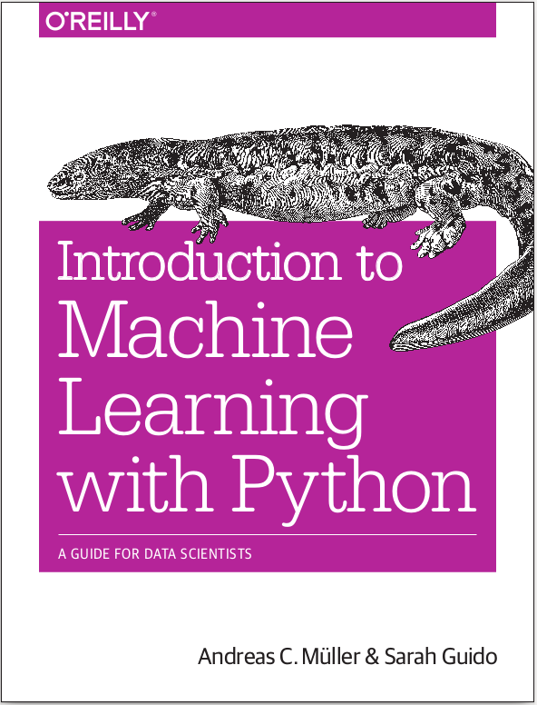




amueller.github.io
@amuellerml
@amueller
t3kcit
@gmail.com
Notes:
Alright, buy my book.
You can also find a lot of free videos and notebooks about machine learning and scikit-learn on my website. All the code from the book is BSD-licensed and on github.
Thank you for your attention and I’m happy to take any questions!

