Slide 1
Active Learning
WHY SMART LABELING IS THE FUTURE OF DATA ANNOTATION
Jennifer Prendki, PhD
VP of Machine Learning, Figure Eight

Slide 2

Jennifer Prendki, PhD
VP OF MACHINE LEARNING, FIGURE EIGHT
More about me:
Currently Expert Network @ International Institute for Analytics
Previously Chief Data Scientist @ Atlassian
Used to managed Applied Data Science Research in the
Search team @ Walmart Labs
  in particular, ran the Human Evaluation team
Have seen pretty much every type of data out there!

Slide 3
Our Mission
To empower data scientists to train, test, and tune machine learning for a human world

Slide 4
Agenda
THE SECRETS TO BUILDING THE ULTIMATE TRAINING SET
Big Data and Machine Learning
The Challenge of Big Data Labeling
Active Learning Tutorial
Active Learning: Digging Deeper
Conclusions

Slide 5
Big Data and Machine Learning
HOW BIG DATA ENABLES MACHINE LEARNING PROGRESS

Slide 6
A World of Infinite Data?
WHY BIG DATA MAKES ML SCIENTISTS HAPPY

Slide 7
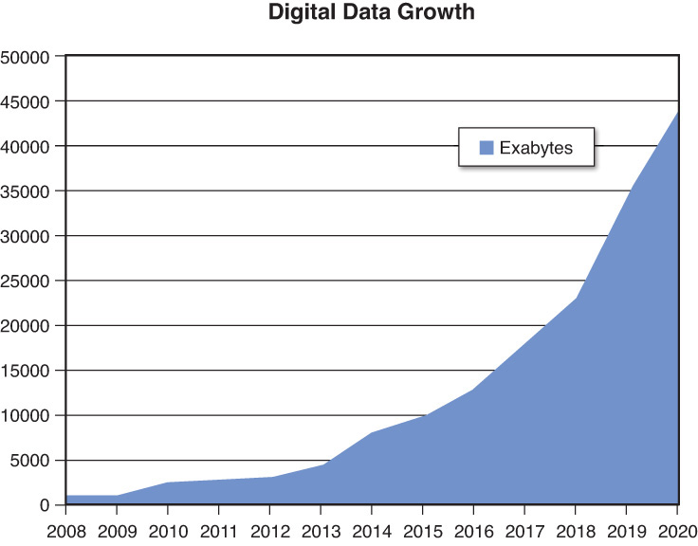
A World of Infinite Data?
WHY BIG DATA MAKES ML SCIENTISTS HAPPY

Slide 8
A World of Infinite Data?
WHY BIG DATA MAKES ML SCIENTISTS HAPPY

Slide 9
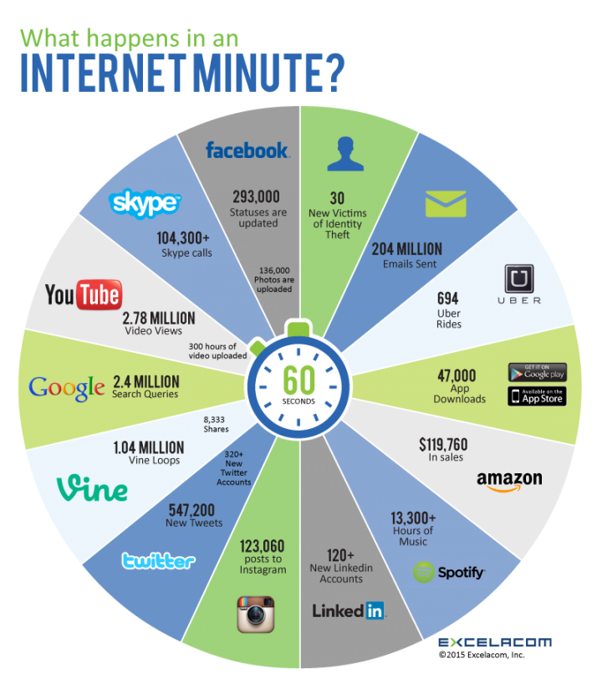
A World of Infinite Data?
WHY BIG DATA MAKES ML SCIENTISTS HAPPY

Slide 10
Why Now?
HAS THE HUMAN SPECIES SUDDENLY BECOME INTERESTING?

Slide 11
Why Now?
HAS THE HUMAN SPECIES SUDDENLY BECOME INTERESTING?
Because of a surge in new data formats

Slide 12
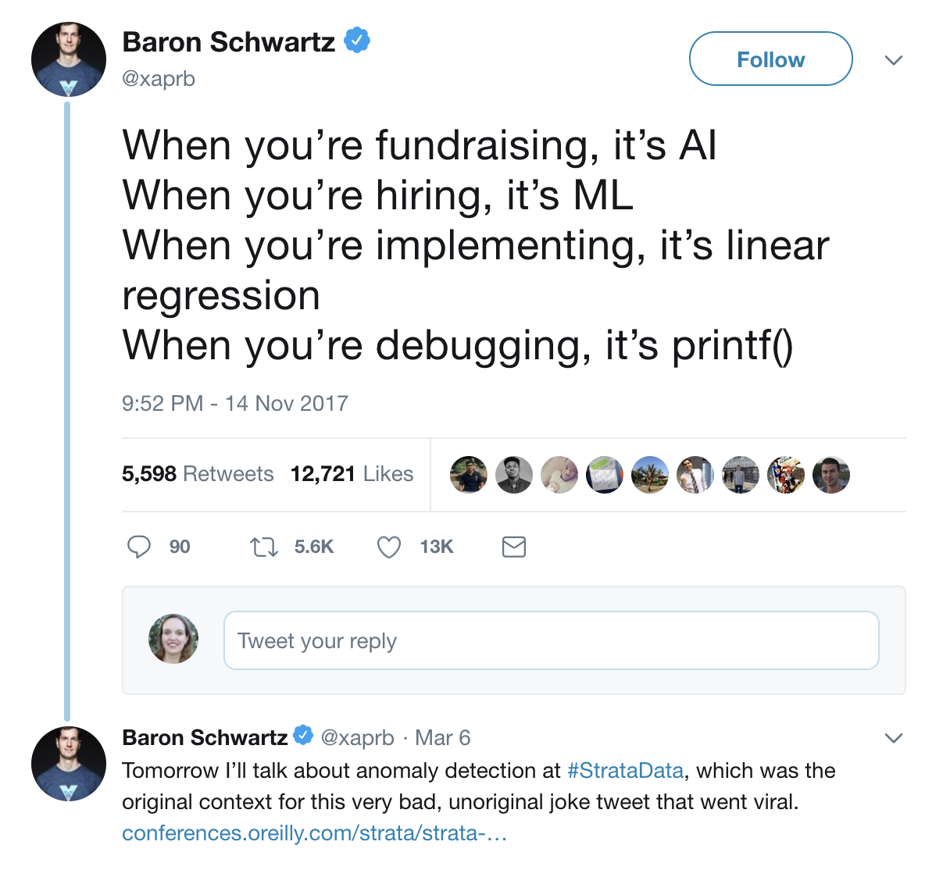
Why Now?
HAS THE HUMAN SPECIES SUDDENLY BECOME INTERESTING?
TEXT
Because of a surge in new data formats

Slide 13
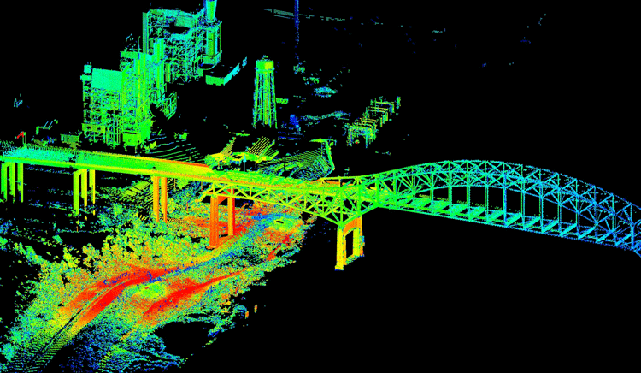
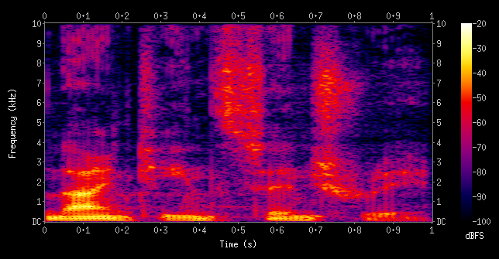
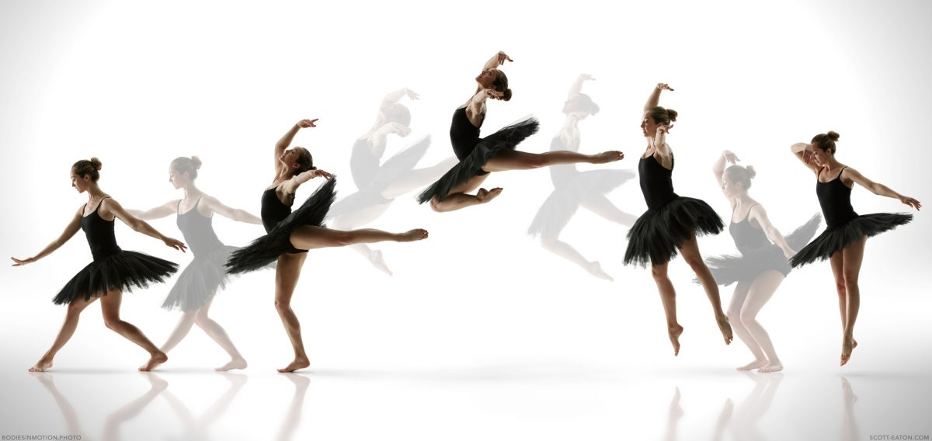

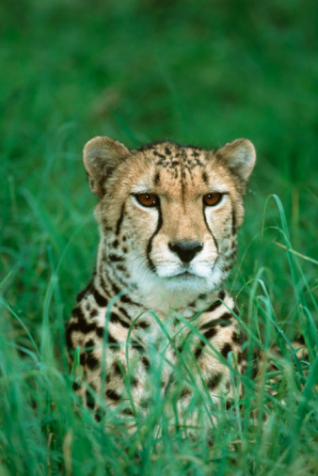



Why Now?
HAS THE HUMAN SPECIES SUDDENLY BECOME INTERESTING?
SENSOR
TEXT
AUDIO
Because of a surge in new data formats
SURVEYS
VIDEO
IMAGE

Slide 14
Why Now?
HAS THE HUMAN SPECIES SUDDENLY BECOME INTERESTING?
Because of a surge in new data formats
Because of new technologies

Slide 15

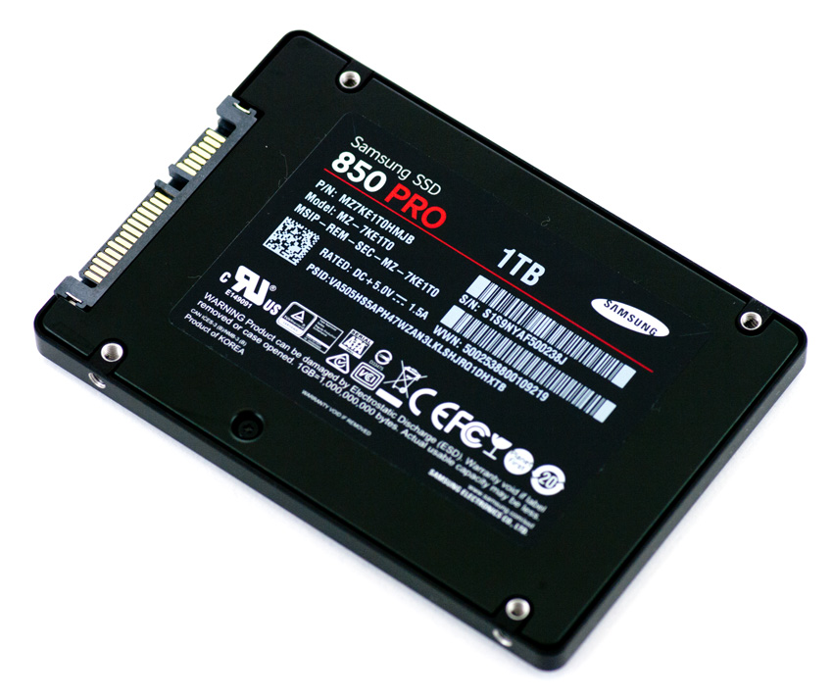


Why Now?
HAS THE HUMAN SPECIES SUDDENLY BECOME INTERESTING?
DATA STORAGE
IOT
Because of a surge in new data formats
Because of new technologies
DATA TRANSFER
SOCIAL MEDIA

Slide 16
Why Now?
HAS THE HUMAN SPECIES SUDDENLY BECOME INTERESTING?
Because of a surge in new data formats
Because of new technologies
Because of data duplication

Slide 17
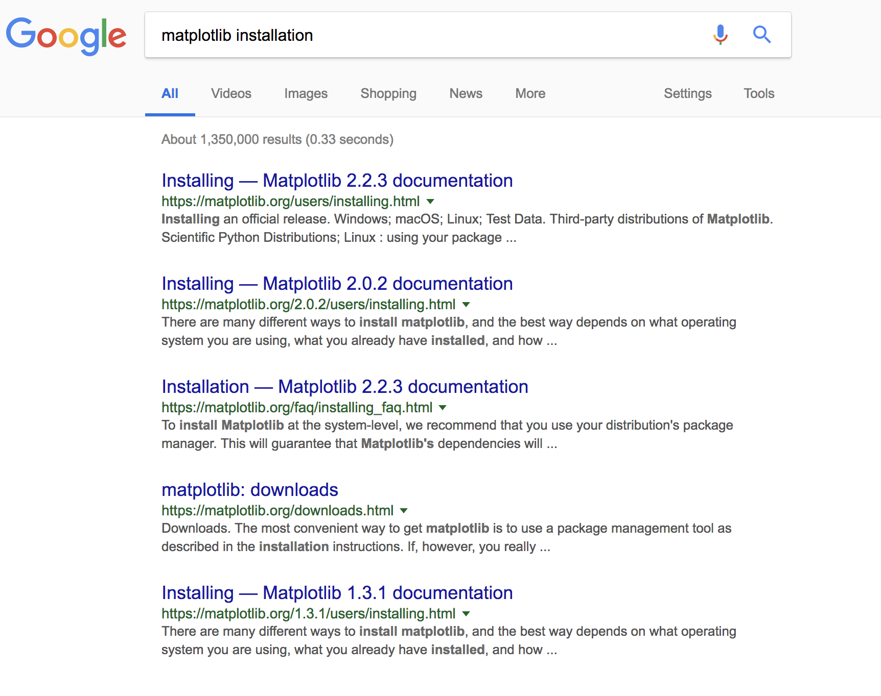
Why Now?
HAS THE HUMAN SPECIES SUDDENLY BECOME INTERESTING?
Because of a surge in new data formats
Because of new technologies
Because of data duplication

Slide 18
Why Now?
HAS THE HUMAN SPECIES SUDDENLY BECOME INTERESTING?
Because of a surge in new data formats
Because of new technologies
Because of data duplication
Version 2.2.3
Version 2.0.2
Version 1.3.1

Slide 19
ImageNet and the Rise of Computer Vision
HOW A NEW DATASET CHANGED THE GAME FOR COMPUTER VISION EXPERTS
1960
Computer vision
beginning

Slide 20
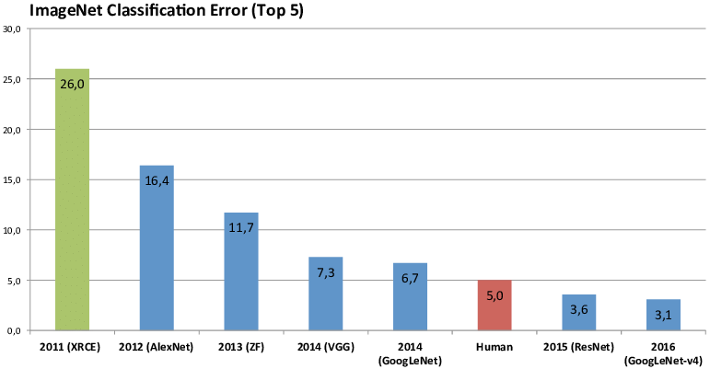
ImageNet and the Rise of Computer Vision
HOW A NEW DATASET CHANGED THE GAME FOR COMPUTER VISION EXPERTS
1960
2011
2012
2013
2014
2015
2016
Computer vision
beginning
ImageNet Classification Error (Top 5)

Slide 21

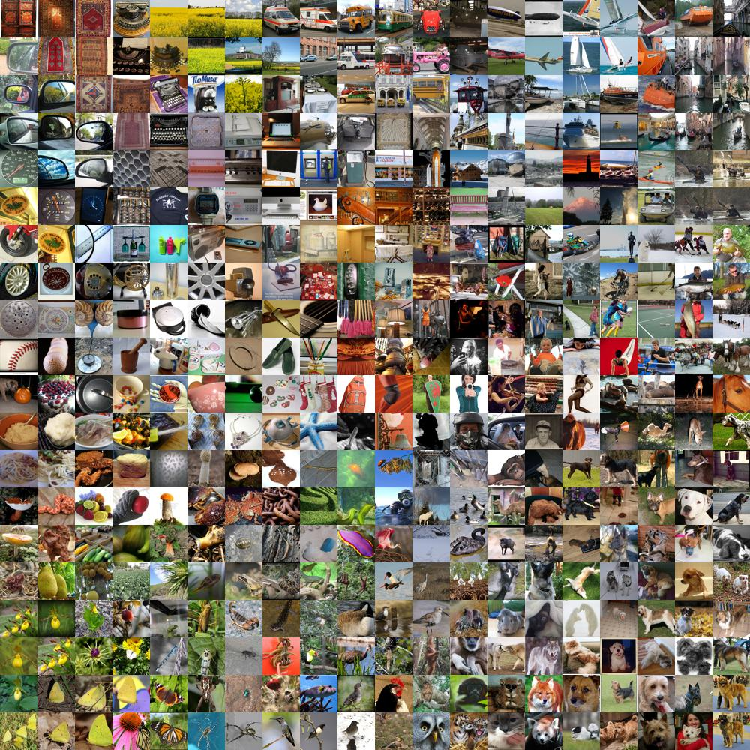
ImageNet and the Rise of Computer Vision
HOW A NEW DATASET CHANGED THE GAME FOR COMPUTER VISION EXPERTS
1960
2011
2012
2013
2014
2015
2016
Computer vision
beginning
  14,000,000 labeled images
  20,000 categories
ImageNet Classification Error (Top 5)

Slide 22
The Challenge of
Big Data Labeling
THE CRISIS OF THE POST BIG DATA ERA

Slide 23
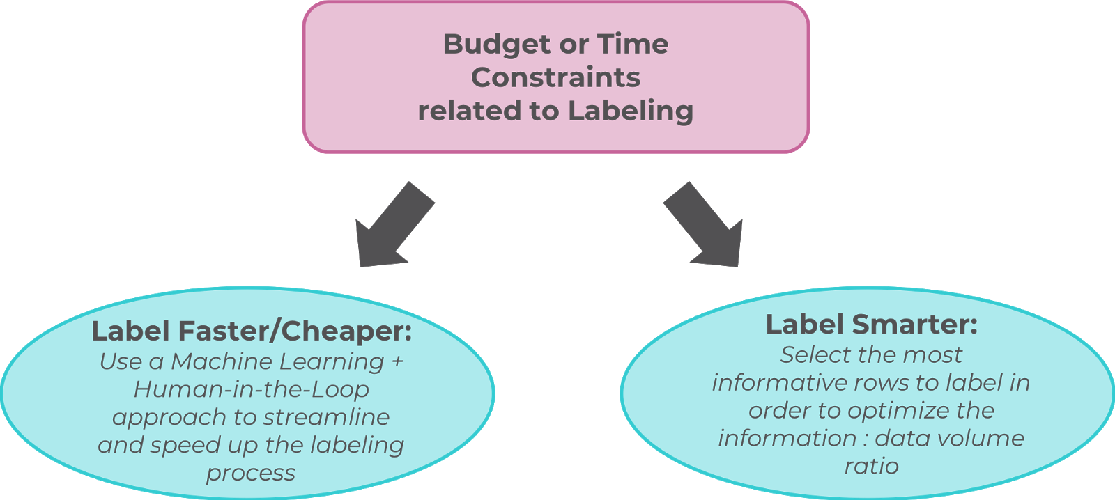
Labeling Superheroes
THERE IS JUST TOO MUCH TO LABEL!

Slide 24
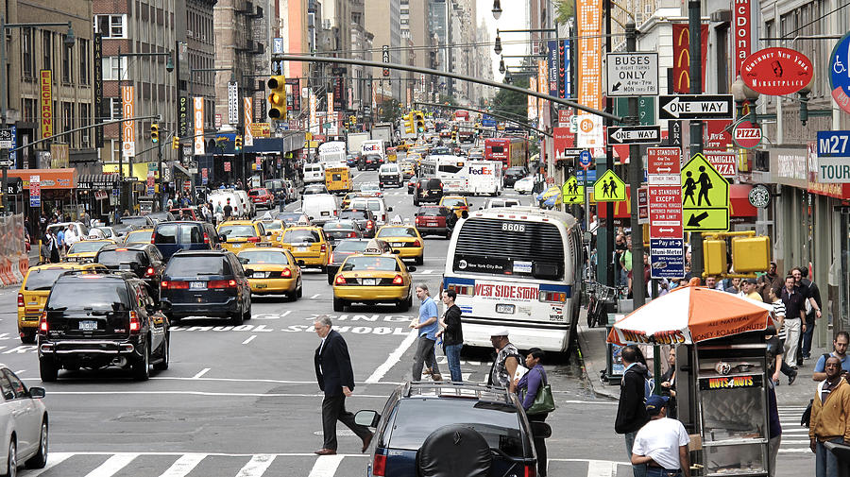
The Big Data Labeling Crisis
WHY WE’RE NOT OUT OF THE WOODS YET
30 frames / second

Slide 25
The Big Data Labeling Crisis
WHY WE’RE NOT OUT OF THE WOODS YET
~20 cars
x 10 seconds of video
x 30 frames per second
~ 1h40 for labeling of 10s video at 1 box/second
30 frames / second

Slide 26
The AI + Human-in-the-Loop Approach
THE BEST OF BOTH WORLD
Object detection:
YOLO
SSD
R-CNN

Slide 27
The AI + Human-in-the-Loop Approach
THE BEST OF BOTH WORLD
Object detection:
YOLO
SSD
R-CNN
Accuracy < 100%

Slide 28
The AI + Human-in-the-Loop Approach
THE BEST OF BOTH WORLD
Problematic bounding box

Slide 29
The AI + Human-in-the-Loop Approach
THE BEST OF BOTH WORLD
“Fixed” by human annotator

Slide 30
Beyond the Volume Problem
WHEN EVEN VALIDATING LABELS CHALLENGING
Even single annotations can be:

Slide 31

Beyond the Volume Problem
WHEN EVEN VALIDATING LABELS CHALLENGING
Even single annotations can be:
Hard to obtain

Slide 32

Beyond the Volume Problem
WHEN EVEN VALIDATING LABELS CHALLENGING
Even single annotations can be:
Hard to obtain
Expensive

Slide 33

Beyond the Volume Problem
WHEN EVEN VALIDATING LABELS CHALLENGING
Even single annotations can be:
Hard to obtain
Expensive
Time-Consuming

Slide 34

Beyond the Volume Problem
WHEN EVEN VALIDATING LABELS CHALLENGING
Even single annotations can be:
Hard to obtain
Expensive
Time-Consuming
Dangerous

Slide 35
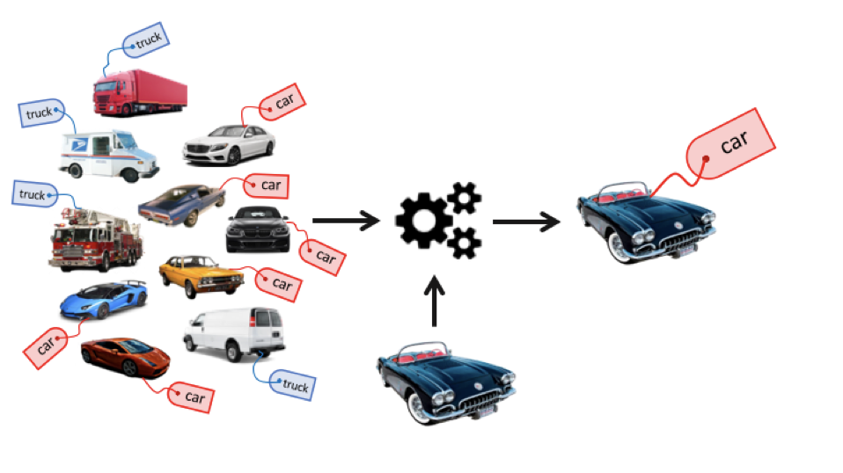
The Power of Semi-Supervised Learning
GETTING THE MOST OUT OF LABELS
Supervised Learning

Slide 36
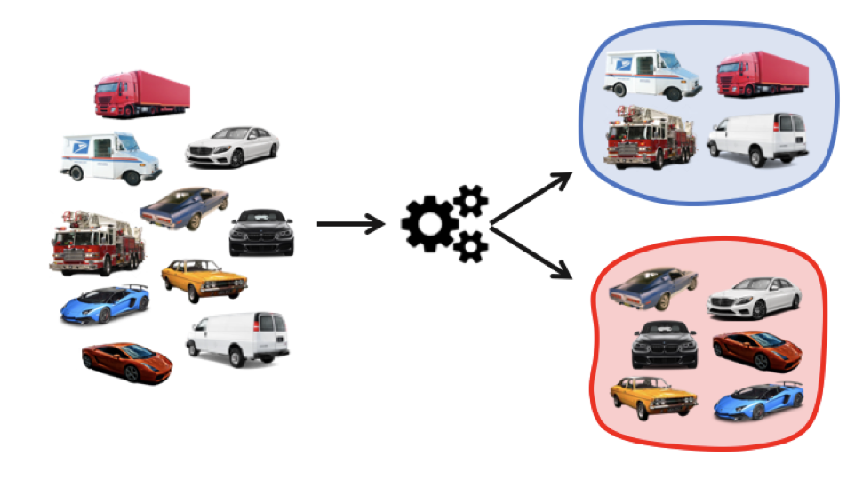
The Power of Semi-Supervised Learning
GETTING THE MOST OUT OF LABELS
Supervised Learning
Unsupervised Learning

Slide 37
The Power of Semi-Supervised Learning
GETTING THE MOST OUT OF LABELS
Supervised Learning
Unsupervised Learning
Semi-supervised Learning

Slide 38
Smart Data Labeling
… OR WHY ALL DATA IS NOT CREATED EQUAL
Once & for all
Entire Dataset Labeling
Supervised Learning

Slide 39
Smart Data Labeling
… OR WHY ALL DATA IS NOT CREATED EQUAL
Once & for all
Before Training
Entire Dataset Labeling
Prioritizer
Supervised Learning

Slide 40
Smart Data Labeling
… OR WHY ALL DATA IS NOT CREATED EQUAL
Once & for all
Before Training
During Training
Entire Dataset Labeling
Active Learning
Prioritizer
Supervised Learning
Semi-Supervised Learning

Slide 41
Smart Data Labeling
… OR WHY ALL DATA IS NOT CREATED EQUAL
Once & for all
Before Training
During Training
After Training
Entire Dataset Labeling
Active Learning
Manual Override
Prioritizer
Supervised Learning
Semi-Supervised Learning

Slide 42
Building Models, Building Training Sets…
WHY WE ARE CURRENTLY DOING MACHINE LEARNING THE “DUMB” WAY
The old way
The new, better way

Slide 43
Building Models, Building Training Sets…
WHY WE ARE CURRENTLY DOING MACHINE LEARNING THE “DUMB” WAY
The old way
The new, better way
Data
Model
Data

Slide 44
Building Models, Building Training Sets…
WHY WE ARE CURRENTLY DOING MACHINE LEARNING THE “DUMB” WAY
The old way
The new, better way
Data
Model
Data
Model

Slide 45
Active Learning Tutorial
UNDERSTANDING THE STEPS OF ACTIVE LEARNING

Slide 46
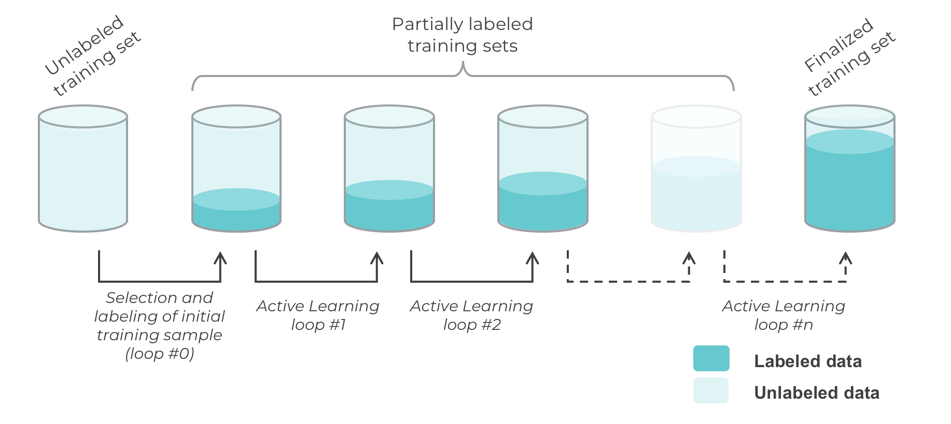
Active Learning in a Nutshell
… OR WHY ALL DATA IS NOT CREATED EQUAL

Slide 47
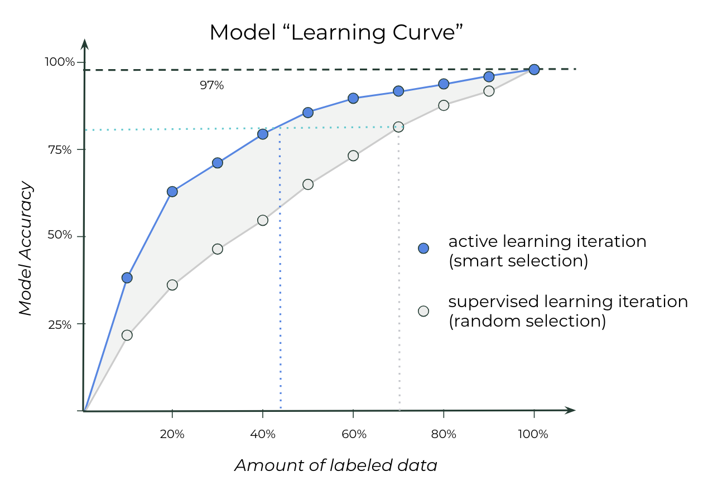
Active Learning & Learning Curves
MORE DATA FOR A BETTER ACCURACY
Active Learning:
  Getting “better” learning curves!
  Higher ”starting” slope
  Faster convergence

Slide 48
Step-By-Step Active Learning
… OR WHY ALL DATA IS NOT CREATED EQUAL
Unlabeled data

Slide 49

Step-By-Step Active Learning
… OR WHY ALL DATA IS NOT CREATED EQUAL
Human “oracle”
Initial sample

Slide 50

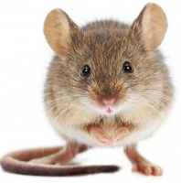

Step-By-Step Active Learning
… OR WHY ALL DATA IS NOT CREATED EQUAL
Initial sample, labeled

Slide 51

Step-By-Step Active Learning
… OR WHY ALL DATA IS NOT CREATED EQUAL
Model training
Learning agent

Slide 52
Step-By-Step Active Learning
… OR WHY ALL DATA IS NOT CREATED EQUAL
60% accuracy

Slide 53
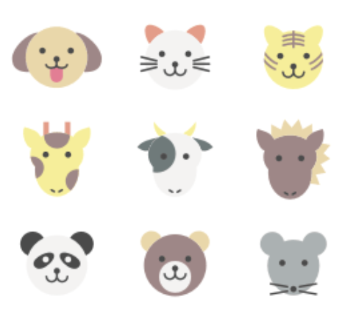


Step-By-Step Active Learning
… OR WHY ALL DATA IS NOT CREATED EQUAL
Inferred labels
on remaining data
60% accuracy

Slide 54
Step-By-Step Active Learning
… OR WHY ALL DATA IS NOT CREATED EQUAL
Sample selected using querying strategy
60% accuracy

Slide 55
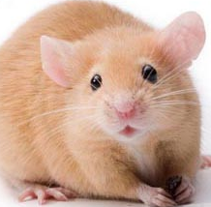


Step-By-Step Active Learning
… OR WHY ALL DATA IS NOT CREATED EQUAL
60% accuracy

Slide 56
Step-By-Step Active Learning
… OR WHY ALL DATA IS NOT CREATED EQUAL
Model training
60% accuracy

Slide 57
Step-By-Step Active Learning
… OR WHY ALL DATA IS NOT CREATED EQUAL
90% accuracy

Slide 58
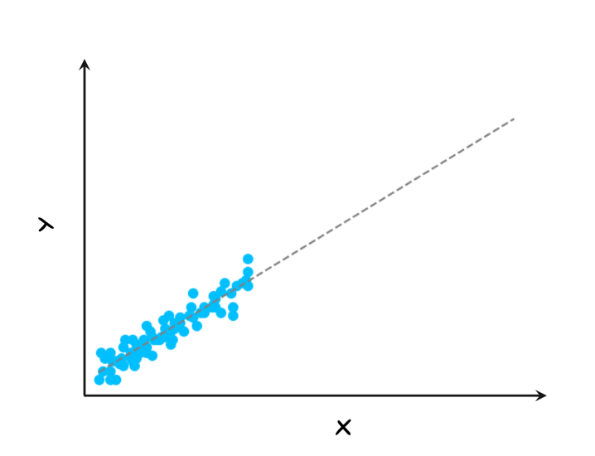
Intuition of Active Learning
WHY IT “WORKS”

Slide 59

Intuition of Active Learning
WHY IT “WORKS”

Slide 60
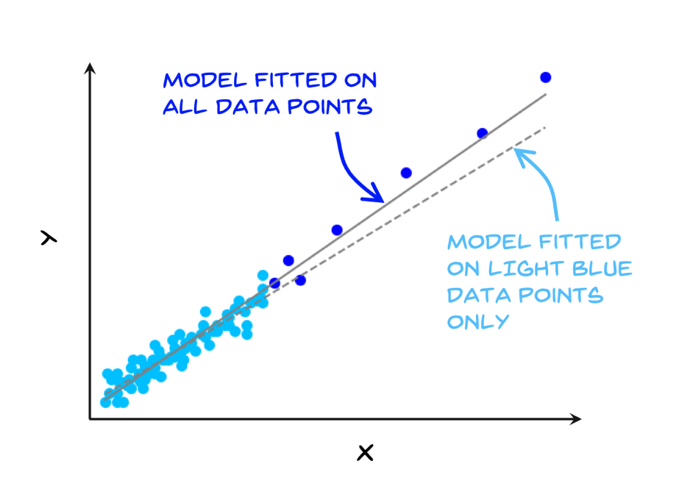
Intuition of Active Learning
WHY IT “WORKS”
Model fitted on
all data points
Model fitted on
randomly sampled data

Slide 61
Intuition of Active Learning
WHY IT “WORKS”
Model fitted on
all data points
Random sampling can fail
Model fitted on
randomly sampled data

Slide 62
Intuition of Active Learning
WHY IT “WORKS”
Model fitted on
all data points
Random sampling can fail
Not all rows are equally valuable
  Quality-wise
  Importance-wise
Model fitted on
randomly sampled data

Slide 63
Intuition of Active Learning
WHY IT “WORKS”
Model fitted on
all data points
Random sampling can fail
Not all rows are equally valuable
  Quality-wise
  Importance-wise
“Importance” depends on the task
Model fitted on
randomly sampled data

Slide 64
Active Learning:
Digging Deeper
WHY IT WORKS AND WHY IT’S HARD

Slide 65



Active Learning Approach #1: Streaming
Record r (unlabeled)
Unlabeled training set
Labeled
training set
Model
NO
V_{i}
YES
Record r
inferred value v
Record r
passed querying threshold?
Record r added to training set
Record r
label collected

Slide 66
Active Learning Approach #1: Streaming
PROS:
Lightweight
Works with ”online” algorithms
CONS:
Data points evaluated sequentially
No guarantee for a specific budget
Record r (unlabeled)
Unlabeled training set
Labeled
training set
Model
NO
V_{i}
YES
Record r
inferred value v
Record r
passed querying threshold?
Record r added to training set
Record r
label collected

Slide 67

Active Learning Approach #2: Pooling
All unlabeled records
Unlabeled training set
Labeled
training set
Model
V_{i}
All records
Inferred value
Sorted
results
Selected top N
results
Selected records added to training set
Selected records
labels collected

Slide 68
Active Learning Approach #2: Pooling
PROS:
Budget can be guaranteed
Real optimization
CONS:
All data has to be evaluated for
each loop
All unlabeled records
Unlabeled training set
Labeled
training set
Model
V_{i}
All records
Inferred value
Sorted
results
Selected top N
results
Selected records added to training set
Selected records
labels collected

Slide 69
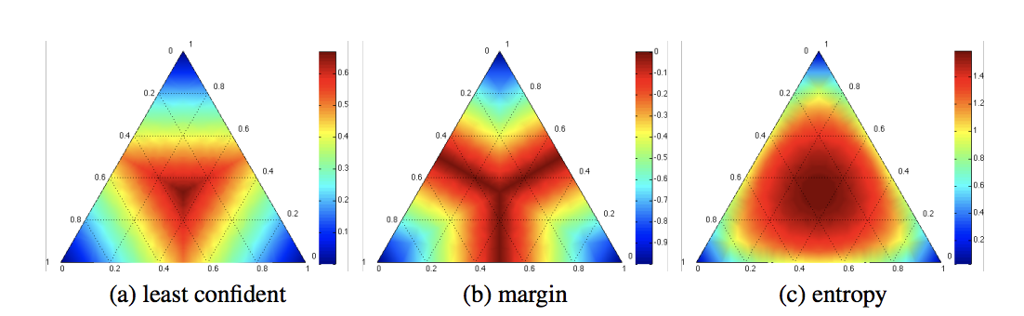



Active Learning Strategies
HOW TO PICK THE MOST INFORMATIVE ROWS
Uncertainty sampling
  Confidence
  Margin sampling
  Entropy

Slide 70
Active Learning Strategies
HOW TO PICK THE MOST INFORMATIVE ROWS
Uncertainty sampling
  Confidence
  Margin sampling
  Entropy
Query-by-Committee

Slide 71
Active Learning Strategies
HOW TO PICK THE MOST INFORMATIVE ROWS
Uncertainty sampling
  Confidence
  Margin sampling
  Entropy
Query-by-Committee
Expected model change

Slide 72
Hyperparameters for Active Learning
ACTIVE LEARNING IS EASY TO UNDERSTAND, NOT EASY TO EXECUTE ON
Pooling, streaming, synthetic query generation?
Querying strategy?
Pool size (pooling approach) or threshold (streaming approach)?
Number of loops or stopping criteria?

Slide 73
Hyperparameters for Active Learning
ACTIVE LEARNING IS EASY TO UNDERSTAND, NOT EASY TO EXECUTE ON
Pooling, streaming, synthetic query generation?
Querying strategy?
Pool size (pooling approach) or threshold (streaming approach)?
Number of loops or stopping criteria?
→ No framework available…

Slide 74
Misconception #1: Model or Strategy?
MYTH:
“Active Learning is a type of model”

Slide 75
Misconception #1: Model or Strategy?
MYTH:
FACT:
“Active Learning is a type of model”
“Active Learning is a strategy”
  A wrapper around a model
  That strategy is hard to generalize

Slide 76
Misconception #1: Model or Strategy?
MYTH:
FACT:
“Active Learning is a type of model”
“Active Learning is a strategy”
  A wrapper around a model
  That strategy is hard to generalize
Labeled data
Model
output
Unlabeled data
Model
output
Supervised
Active

Slide 77
Misconception #2: Querying Strategy
MYTH:
“A querying strategy is not a mathematical formula”

Slide 78
Misconception #2: Querying Strategy
MYTH:
FACT:
“A querying strategy is not a mathematical formula”
“A querying strategy is a dynamic sampling algorithm”
  Does not need to be deterministic
  Does not need to be based in confidence

Slide 79
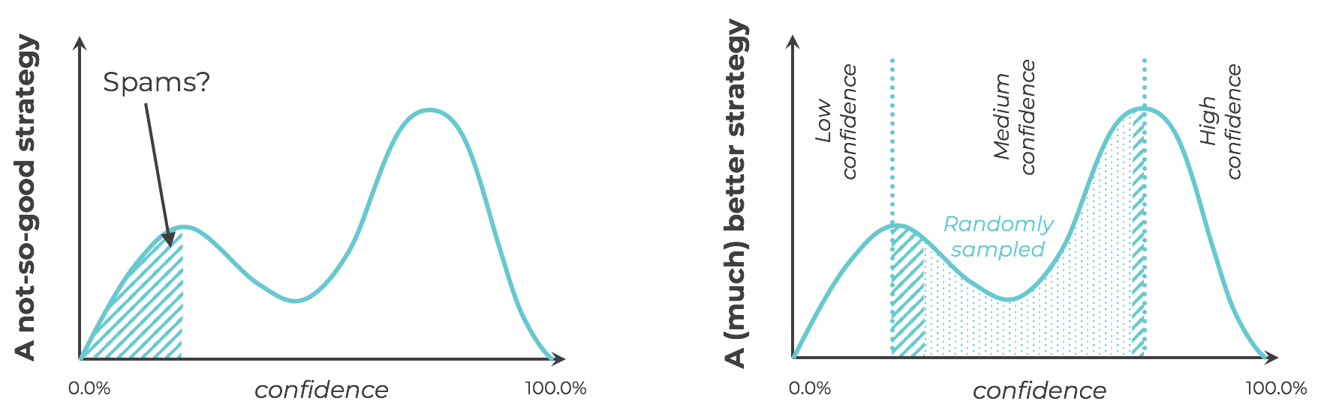
Misconception #2: Querying Strategy
MYTH:
FACT:
“A querying strategy is not a mathematical formula”
“A querying strategy is a dynamic sampling algorithm”
  Does not need to be deterministic
  Does not need to be based in confidence

Slide 80
Misconception #: Convergence to Supervised Learning
MYTH:
“Getting the highest accuracy still requires all the data”

Slide 81
Misconception #3: Convergence to Supervised Learning
MYTH:
FACT:
“Getting the highest accuracy still requires all the data”
“Learning curves are not always strictly monotonically increasing, and the AL curve can converge differently”

Slide 82
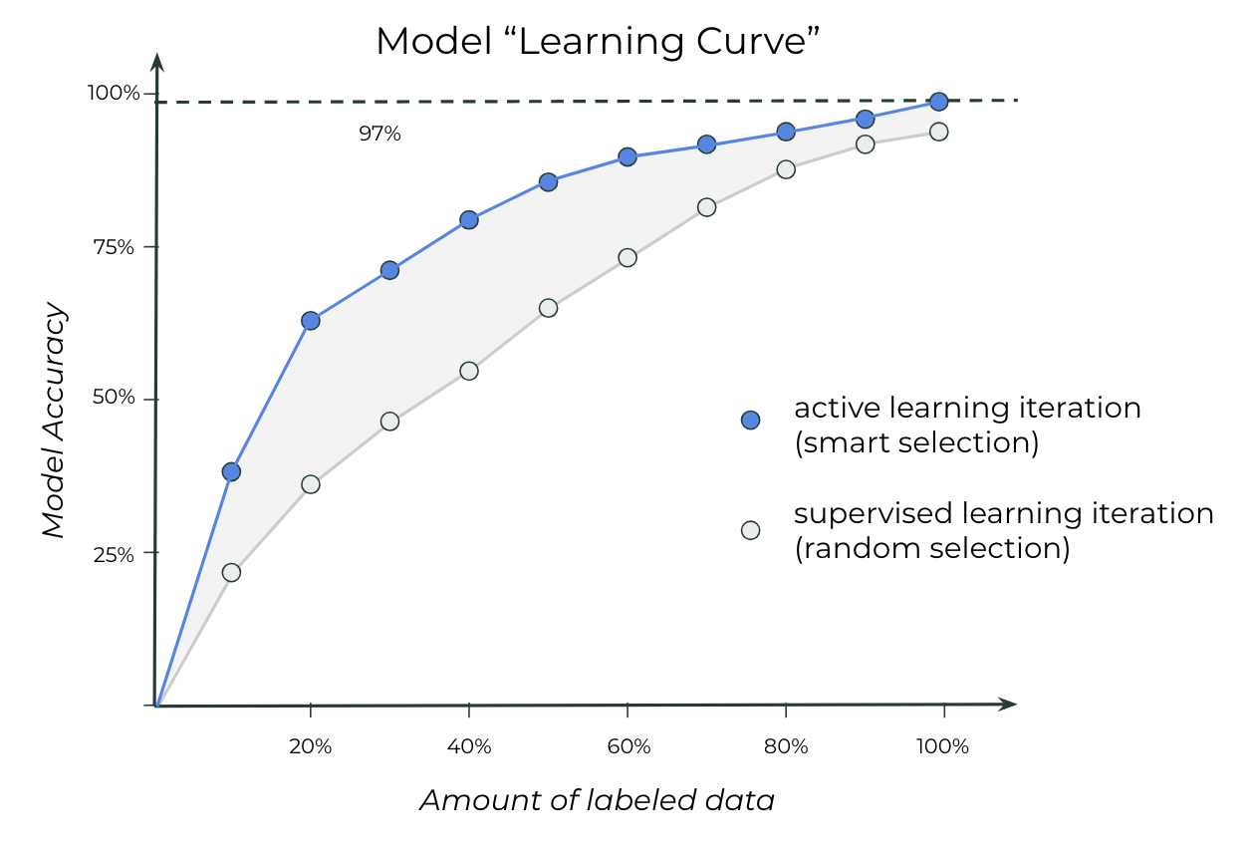
Misconception #3: Convergence to Supervised Learning
MYTH:
FACT:
“Getting the highest accuracy still requires all the data”
“Learning curves are not always strictly monotonically increasing, and the AL curve can converge differently”

Slide 83
Challenges
No theoretical framework for “AL hyperparameter tuning”
No guarantees regarding “compression rate”
Trade-off between cost and compute power
Sometimes it doesn’t work at all! (only 91% of papers report success)
Sparsity of use cases, especially in certain domains

Slide 84
Conclusions
BEFORE WE PART WAYS…

Slide 85
Conclusions
WHAT YOU SHOULD REMEMBER FROM THIS SESSION
(Good) data is instrumental for Machine Learning
Most data is unstructured and unlabeled
  You need labeled data for supervised learning!
We have a Big Data labeling crisis
  Label faster or smarter?
Active Learning
  Allows to reduce cost while improving accuracy
  Is an enhancement on top of your existing model
  Is a strategy/algorithm, not a model
  but can be hard

