Slide 1


Fast SQL-on-Anything
DataEngConf
2018 @ NYC
Kamil Bajda-Pawlikowski
Co-founder and CTO
www.starburstdata.com

Slide 2


Presto is SQL on anything
Query anything, anywhere

Slide 3


Presto Users
https://github.com/prestodb/presto/wiki/Presto-Users

Slide 4
Presto in production
Facebook: 1000s of nodes, HDFS (ORC, RCFile), sharded MySQL, 1000s of users
Uber: 800+ nodes (2 clusters on premises) with 200K+ queries daily over HDFS (Parquet/ORC)
Twitter: 800+ nodes (several clusters on premises) for HDFS (Parquet)
LinkedIn: 350+ nodes (2 clusters on premises), 40K+ queries daily over HDFS (ORC), 600+ users
Netflix: 250+ nodes in AWS, 40+ PB in S3 (Parquet)
Lyft: 200+ nodes in AWS, 20K+ queries daily, 20+ PBs in Parquet
Yahoo! Japan: 200+ nodes (4 clusters on premises) for HDFS (ORC), ObjectStore, and Cassandra
FINRA: 120+ nodes in AWS, 4PB in S3 (ORC), 200+ users

Slide 5

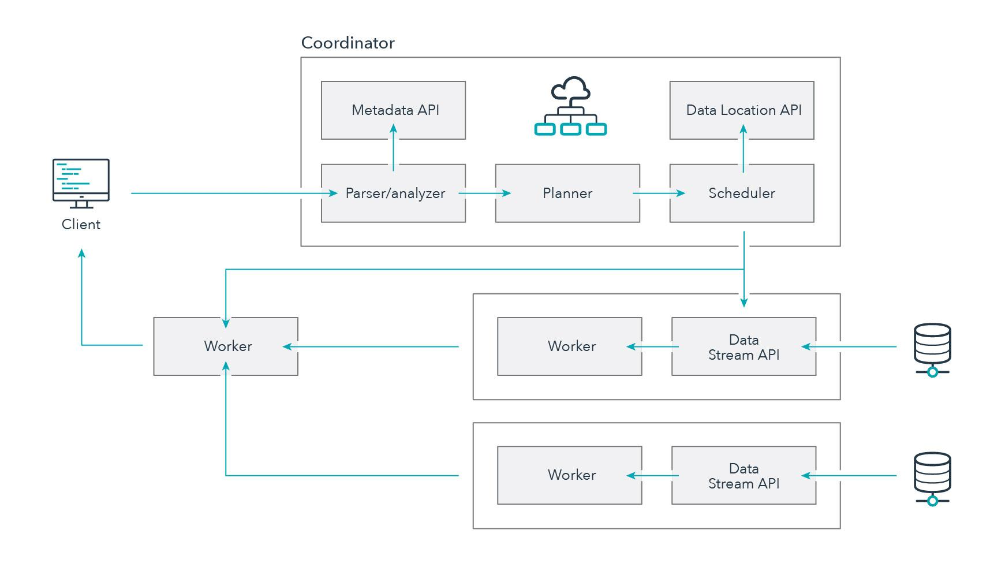


Slide 6
Why Presto?

Slide 7




Why Presto?
Community-driven open source project
High performance ANSI SQL engine
New Cost-Based Query Optimizer
Proven scalability
High concurrency
Separation of compute and storage
Scale storage and compute independently
No ETL or data integration necessary to get to insights
SQL-on-anything
No vendor lock-in
No Hadoop distro vendor lock-in
No storage engine vendor lock-in
No cloud vendor lock-in

Slide 8
Beyond ANSI SQL
Presto offers a wide variety of built-in functions including:
regular expression functions
lambda expressions and functions
geospatial functions
Complex data types:
JSON
ARRAY
MAP
ROW / STRUCT
SELECT regexp_extract_all('1a 2b 14m', '\d+'); -- [1, 2, 14]
SELECT filter(ARRAY [5, -6, NULL, 7], x -> x > 0); -- [5, 7]
SELECT transform(ARRAY [5, 6], x -> x + 1); -- [6, 7]
SELECT c.city_id, count(*) as trip_count
FROM trips_table as t
JOIN city_table as c
ON st_contains(c.geo_shape,
st_point(t.dest_lng, t.dest_lat))
WHERE t.trip_date = ‘2018-05-01’
GROUP BY 1;

Slide 9



Tools, bindings, extensibility
JDBC / ODBC drivers for BI/SQL tools
C/C++, Go, Java, Node.js, Python, PHP, R and Ruby on Rails
UDFs, UDAFs, Connector SPI

Slide 10


Presto on AWS
https://www.starburstdata.com/presto-aws-cloud/
https://www.starburstdata.com/technical-blog/presto-available-on-aws-marketplace/
Fully integrated with AWS:
Amazon S3
AWS Glue Catalog
Autoscaling
AWS Marketplace

Slide 11
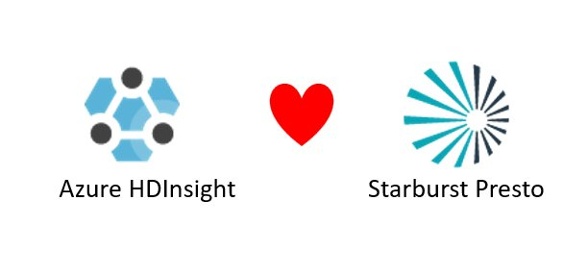
Presto on Azure
https://www.starburstdata.com/presto-azure/
https://azure.microsoft.com/en-us/blog/azure-hdinsight-and-starburst-brings-presto-to-microsoft-azure-customers/
Fully integrated with Azure HDInsight:
Azure Blob Storage
Azure Data Lake Storage
External Hive Metastore
Microsoft PowerBI

Slide 12
Presto Performance

Slide 13
Built for Performance
Query Execution Engine:
MPP-style pipelined in-memory execution
Columnar and vectorized data processing
Runtime query bytecode compilation
Memory efficient data structures
Multi-threaded multi-core execution
Optimized readers for columnar formats (ORC and Parquet)
Now also Cost-Based Optimizer

Slide 14
CBO in a nutshell
Cost-Based Optimizer v1 includes:
support for statistics stored in Hive Metastore
join reordering based on selectivity estimates and cost
automatic join type selection (repartitioned vs broadcast)
automatic left/right side selection for joined tables
https://www.starburstdata.com/technical-blog/

Slide 15
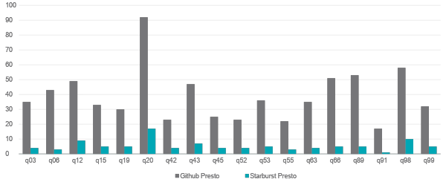
Presto CBO Speedup
Duration of TPC-DS queries (lower is better)
https://www.starburstdata.com/presto-benchmarks/

Slide 16
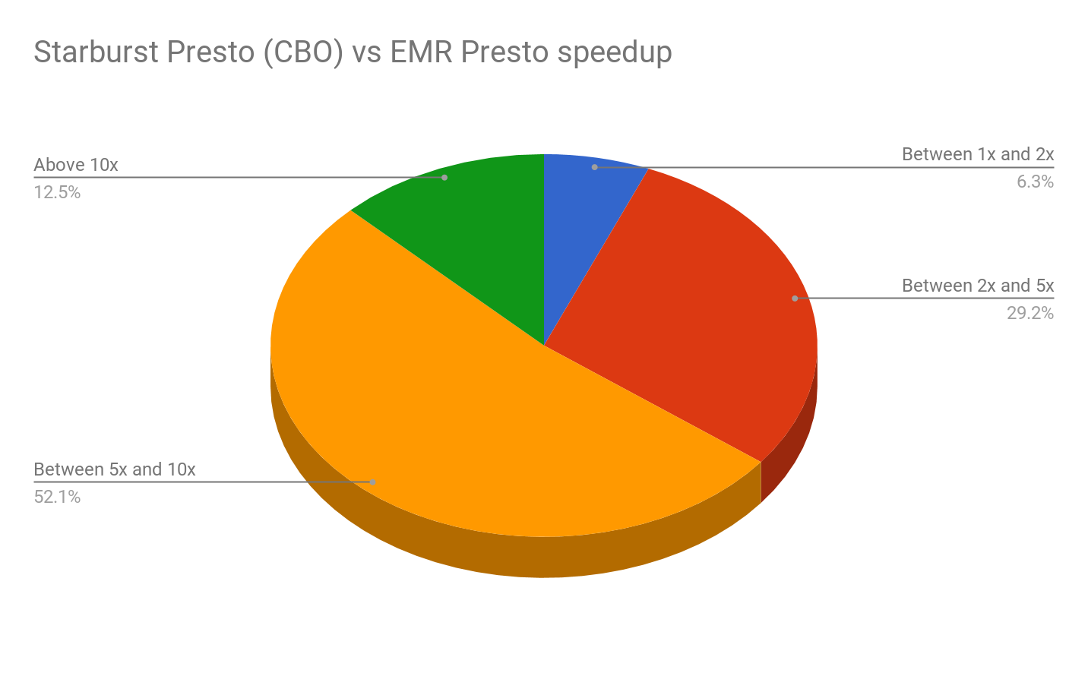
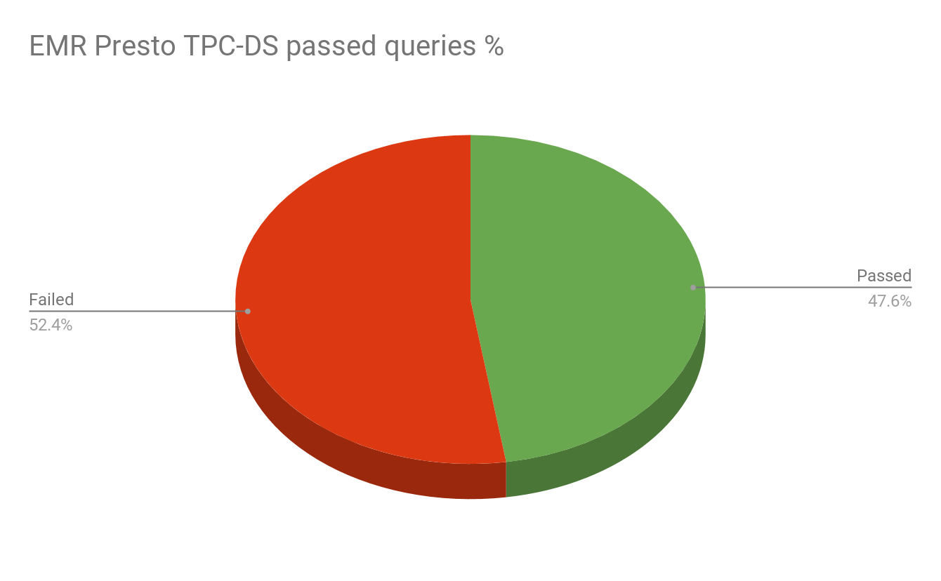
Cloud cost reduction
on average 7x improvement vs EMR Presto
EMR Presto cannot execute many TPC-DS queries
All TPC-DS queries pass on Starburst Presto
https://www.starburstdata.com/presto-aws/

Slide 17
Further reading
https://www.starburstdata.com/technical-blog/
https://fivetran.com/blog/warehouse-benchmark
https://www.concurrencylabs.com/blog/starburst-presto-vs-aws-emr-sql/
http://bytes.schibsted.com/bigdata-sql-query-engine-benchmark/
https://virtuslab.com/blog/benchmarking-spark-sql-presto-hive-bi-processing-googles-cloud-dataproc/

Slide 18
Why Starburst?

Slide 19

Starburst Data
Founded by Presto committers:
Over 3 years of contributions to Presto
Presto distro for on-prem and cloud env
Supporting customers in production
Enterprise subscription add-ons
Notable features contributed:
ANSI SQL syntax enhancements
Execution engine improvements
Security integrations
Spill to disk
Cost-Based Optimizer
https://www.starburstdata.com/presto-enterprise/

Slide 20
Thank You!
Twitter: @starburstdata @prestodb
Blog: www.starburstdata.com/technical-blog/
Newsletter: www.starburstdata.com/newsletter

