Slide 1
Oops I did it again
Adapting a pop music identifier to find syndicated content in talk radio
Allison King
DataEngConf
November 8th, 2018
Notes:
Hi
Title-- growing up in early 2000s, Britney
Cortico-- detecting duplicate content in talk radio

Slide 2
Introduction
Looking for a Solution
Existing Tools
Our Solution
Algorithm
Infrastructure
Results
Notes:
Going over our problem
What we were looking for in a solution
How we adapted a pop song identifying software and changed its algorithm, and how we scaled it for our volume of data
Results!

Slide 3
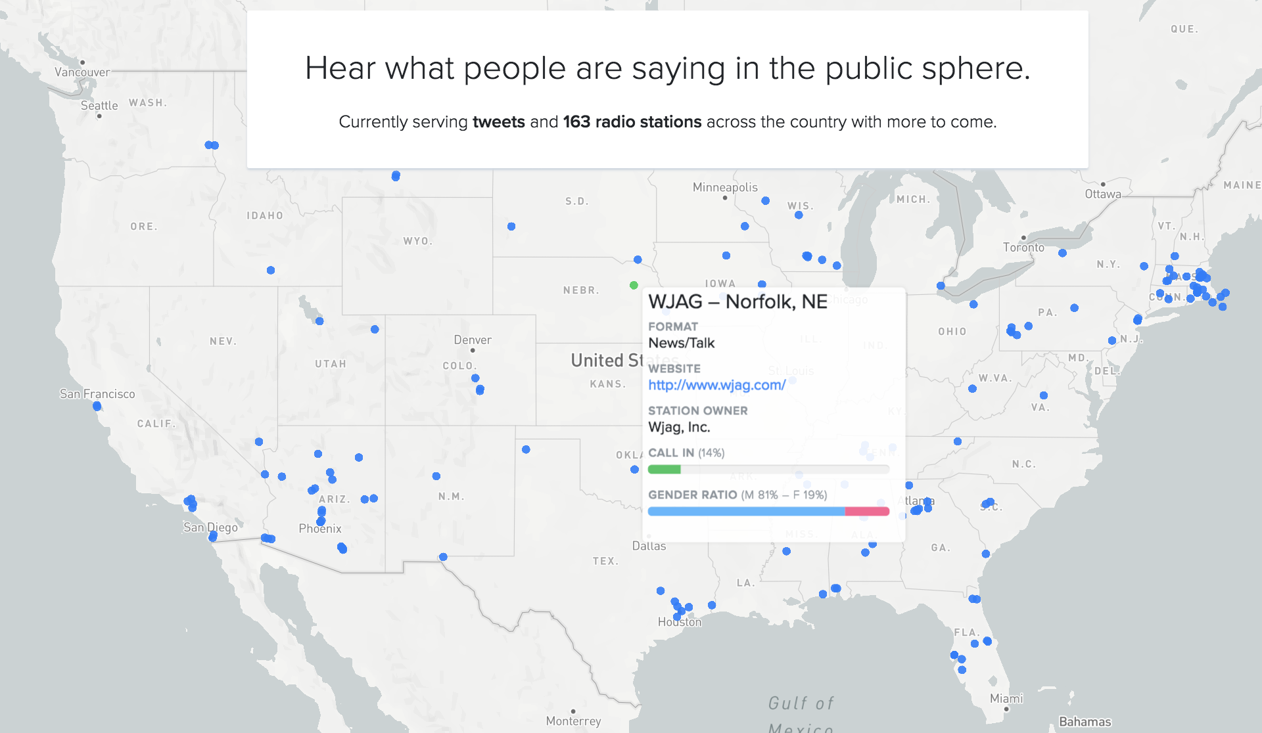
Earshot: Enabling public sphere search
Notes:
Wait, talk radio?!
163 radio stations across America to better understand what people around the country are concerned about
Earshot-- a product for journalists to surface local voices

Slide 4
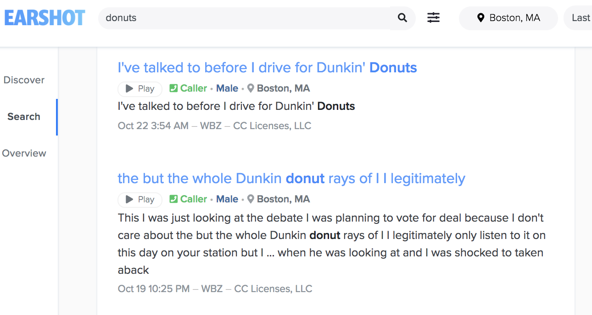
Earshot: Enabling public sphere search
Boston, Oct. 22
Notes:
Searching the public sphere in earshot.
Listen to what people are calling in to radio stations about regarding Dunkin Donuts

Slide 5
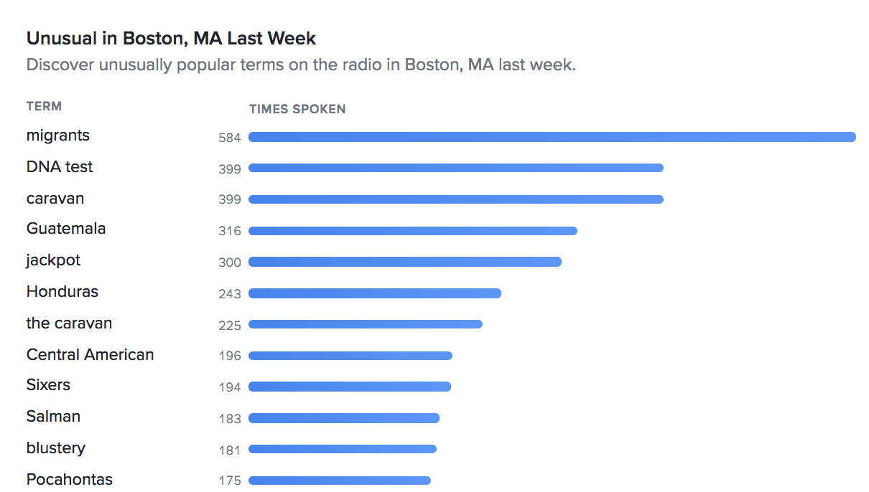
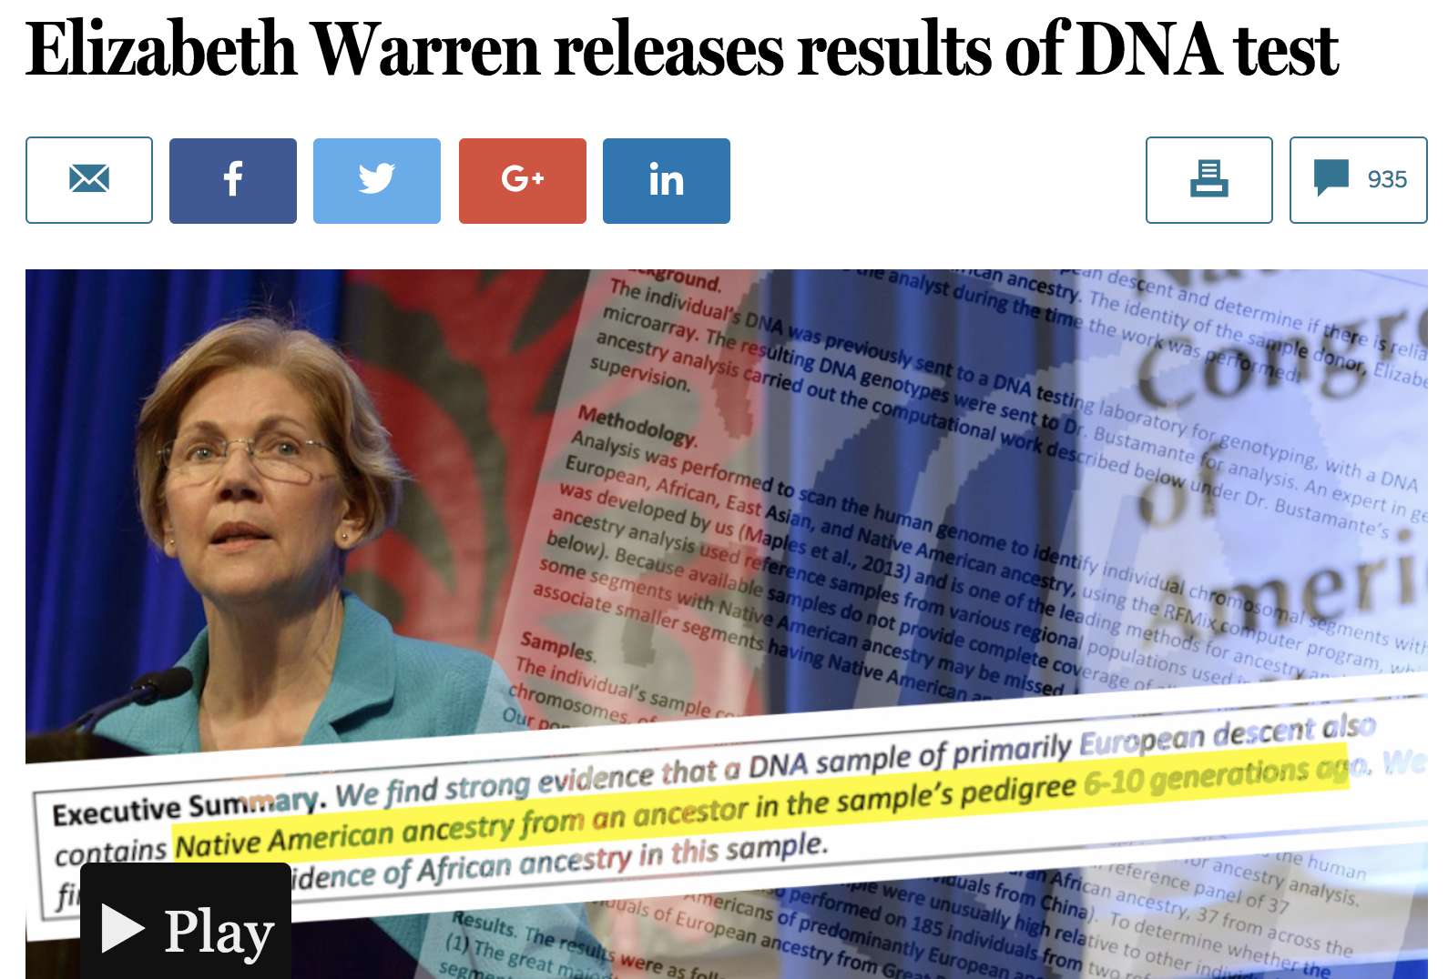
Earshot: Enabling public sphere search
Boston Globe, 10/15
Boston, Oct. 22
https://www.bostonglobe.com/news/politics/2018/10/15/warren-addresses-native-american-issue/YEUaGzsefB0gPBe2AbmSVO/story.html
Notes:
If you don’t know what to search, can see what is trending in different locations
Boston, migrant caravan, DNA test Pocahontas-- Elizabeth Warren, MA senator

Slide 6
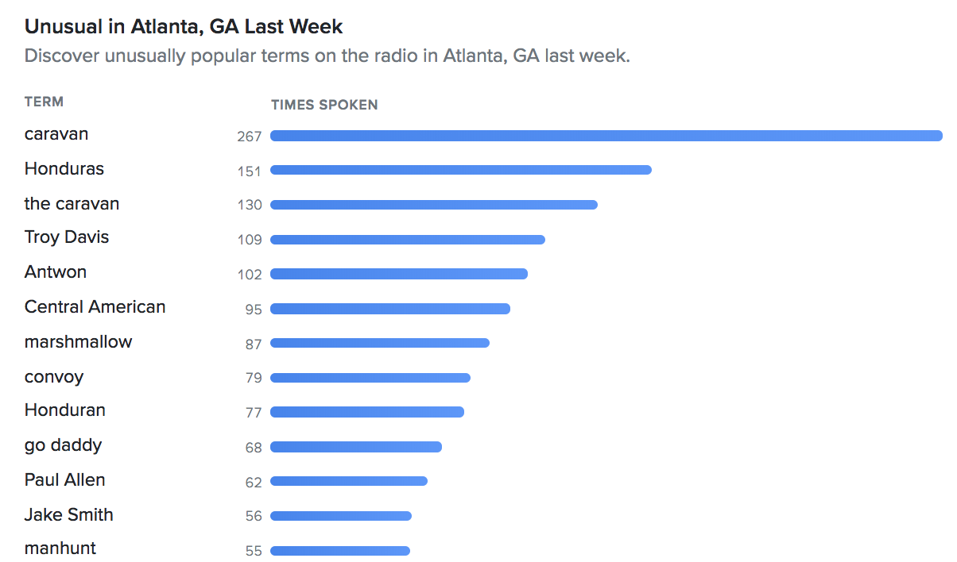
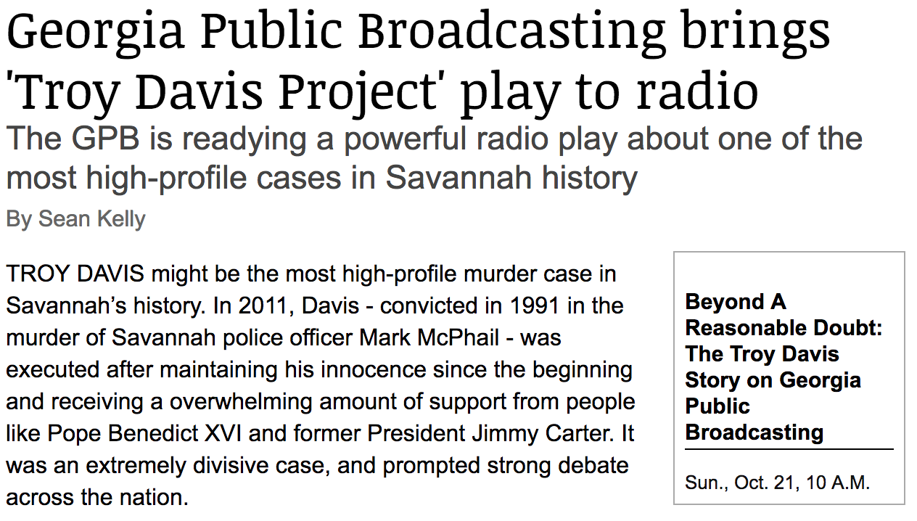
Earshot: Enabling public sphere search
Connect Savannah, 10/21
Atlanta, Oct. 22
https://www.connectsavannah.com/savannah/georgia-public-broadcasting-brings-troy-davis-project-play-to-radio/Content?oid=10541762
Notes:
Choose a random city-- Atlanta, GA
Also caravan, but also Troy Davis, which I looked up, and it turns out it’s the anniversary of a murder in Georgia and local radio stations aired a play related to it

Slide 7

Earshot: Enabling public sphere search
Atlanta, Oct. 22
Notes:
Look at other results-- strange things. Makes you want to make this face!
No news on go daddy-- likely just a commercial

Slide 8
Problems
Duplicates in public radio is no fun:
Don’t want user to have to listen to multiples of the same thing
Over accounted for in topic detection
Harder to hear local voices if too much syndicated content
Notes:
Having duplicates in our dataset isn’t great
Becomes harder to hear local voices

Slide 9
Introduction
Looking for a Solution
Existing Tools
Our Solution
Algorithm
Infrastructure
Results

Slide 10
Goals
Increase our duplicate detection accuracy
Visualize how much of talk radio is syndicated content
Understand clusters of radio stations that air the same content
Notes:
We wanted to increase our duplicate detection accuracy, but also understand the landscape of talk radio more

Slide 11
Audio Fingerprinting
Gives us a fingerprint for each portion of the file so we can compare each part to each part
Transcript based duplicate detection varies with transcription accuracy
  Transcription accuracy varies with background noise (e.g. music background in commercials)
  Limited to only English
    Difficulty with accents
Notes:
We were told of a technology known as audio fingerprinting
Wait! What about transcripts?
Try audio fingerprinting

Slide 12
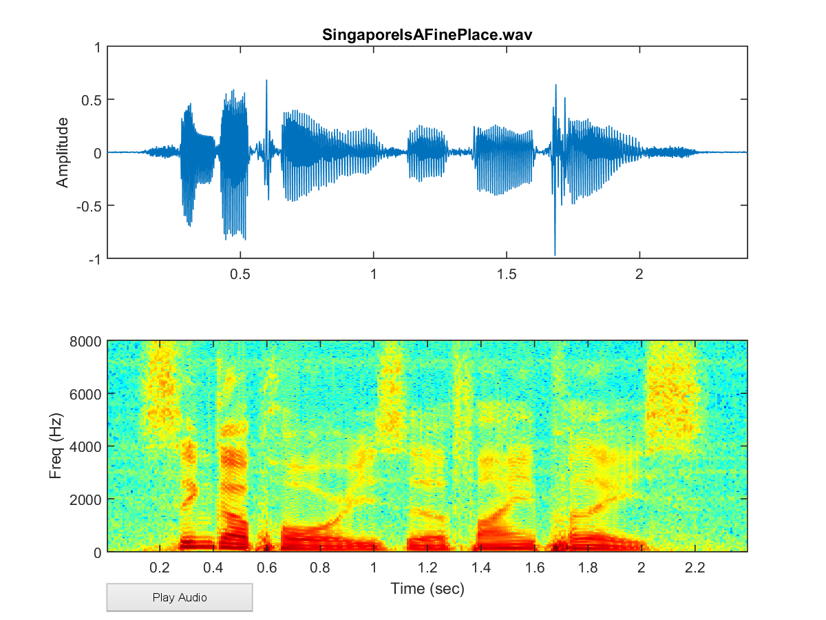
Audio fingerprinting overview
Fingerprinting extracts and matches unique time & frequency information in audio
Transform audio from time domain to frequency domain using FFT
Find peaks in resultant spectrogram, indexed by time and frequency
Compute a hash function on the relative peak positions, yields sequence of hash values – ie.
Matching an audio file reduces to identifying a sequence of common hashes
hash(frequencies of peaks, time diff between peaks)
This one WEIRD spectrogram trick has researchers baffled!: Windowlicker - Aphex Twin (5:24) (more examples here)
Notes:
Overview-- not going to go into it
Shazam white paper
FFTs, spectograms, etc.

Slide 13

Audio fingerprinting overview
Fingerprinting extracts and matches unique time & frequency information in audio
Transform audio from time domain to frequency domain using FFT
Find peaks in resultant spectrogram, indexed by time and frequency
Compute a hash function on the relative peak positions, yields sequence of hash values – ie.
Matching an audio file reduces to identifying a sequence of common hashes
hash | position
bcf93s | 1
p5ndk1 | 2
mnyt66 | 3
...
hash(frequencies of peaks, time diff between peaks)
This one WEIRD spectrogram trick has researchers baffled!: Windowlicker - Aphex Twin (5:24) (more examples here)
Notes:
Fingerprint each portion of an audio file
Come out with a table of hashes

Slide 14
Introduction
Looking for a Solution
Existing Tools
Our Solution
Algorithm
Infrastructure
Results

Slide 15
Existing song identifying software
Dejavu library: https://github.com/worldveil/dejavu
Store fingerprints of pop songs in a MySQL database
Toxic
...Baby One More Time
Oops… I Did It Again
Lucky
hash | position
bcf93s | 1
p5ndk1 | 2
mnyt66 | 3
hash | position
5nr9mr | 1
3l9w83 | 2
0w2cx1 | 3
hash | position
v36jtj | 1
n8ptj5 | 2
j9tc9v | 3
hash | position
8j36p3 | 1
57gzsb | 2
c57058 | 3
...
...
...
...
Notes:
Shazam description
Go into a bit about how Dejavu works so can explain how we adapted it
Starts with a MySQL database of pop songs and their fingerprint tables

Slide 16
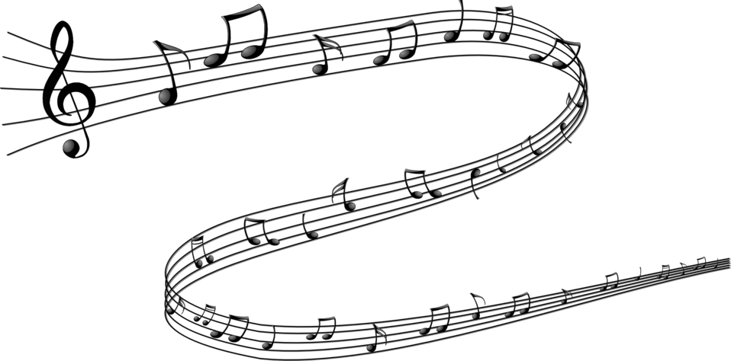

Existing song identifying software
Toxic
...Baby One More Time
Oops… I Did It Again
Lucky
hash | position
bcf93s | 1
p5ndk1 | 2
mnyt66 | 3
hash | position
5nr9mr | 1
3l9w83 | 2
0w2cx1 | 3
hash | position
v36jtj | 1
n8ptj5 | 2
j9tc9v | 3
hash | position
8j36p3 | 1
57gzsb | 2
c57058 | 3
...
...
...
...
Notes:
You hear a beautiful voice on the radio! Nostalgia!
‘I need to know what song this is!’

Slide 17
Existing song identifying software
Toxic
...Baby One More Time
Oops… I Did It Again
Lucky
hash | position
bcf93s | 1
p5ndk1 | 2
mnyt66 | 3
hash | position
5nr9mr | 1
3l9w83 | 2
0w2cx1 | 3
hash | position
v36jtj | 1
n8ptj5 | 2
j9tc9v | 3
hash | position
8j36p3 | 1
57gzsb | 2
c57058 | 3
...
...
...
...
hash | position
bcf93s | 1
p5ndk1 | 2
mnyt66 | 3
Notes:
Phone fingerprints the song as it comes in

Slide 18
Existing song identifying software
Toxic
...Baby One More Time
Oops… I Did It Again
Lucky
hash | position
bcf93s | 1
p5ndk1 | 2
mnyt66 | 3
hash | position
5nr9mr | 1
3l9w83 | 2
0w2cx1 | 3
hash | position
v36jtj | 1
n8ptj5 | 2
j9tc9v | 3
hash | position
8j36p3 | 1
57gzsb | 2
c57058 | 3
...
...
...
...
hash | position
bcf93s | 1
p5ndk1 | 2
mnyt66 | 3
Notes:
Compares to every song in database
Not an easy comparison-- might have started recording in the middle of the song
Compare each song to every single segment of every other song in the database

Slide 19


Existing song identifying software
Toxic
...Baby One More Time
Oops… I Did It Again
Lucky
hash | position
bcf93s | 1
p5ndk1 | 2
mnyt66 | 3
hash | position
5nr9mr | 1
3l9w83 | 2
0w2cx1 | 3
hash | position
v36jtj | 1
n8ptj5 | 2
j9tc9v | 3
hash | position
8j36p3 | 1
57gzsb | 2
c57058 | 3
...
...
...
...
hash | position
bcf93s | 1
p5ndk1 | 2
mnyt66 | 3
Notes:
Successfully does that and-- why, the beautiful voice you’re hearing is Britney Spears and her hit song, Toxic!
And you continue on with your day, happier for having remembered one of your favorite songs

Slide 20
Our Problem
hash | position
bcf93s | 1
p5ndk1 | 2
mnyt66 | 3
Notes:
Let’s look at the pipeline from the Dejavu library

Slide 21




Our Problem
hash | position
bcf93s | 1
p5ndk1 | 2
mnyt66 | 3
Talk radio is more like a string of possible duplicate content than just one match
Notes:
Instead of matching just one song, we really want to match many songs, or clips. A snippet from talk radio is really a string of possible duplicate content. So you can imagine it's more like 4 Britney songs played in a row, possibly with interruptions in the middle, and we want to return each of the songs that matched-- not just the one that matched the most. Talk radio has strings of commercials, and it also has clips played from other stations, or jingles for their own shows played throughout the day.

Slide 22
Our Problem
1:14 - 2:30
3:00 - 5:30
hash | position
bcf93s | 1
p5ndk1 | 2
mnyt66 | 3
6:00 - 7:45
And we need the time of each match
8:00 - 9:15
Notes:
Want to know when the matches occurred relative to the stream
“From 1 minute to 2 minutes in clip A, we have the same content from 3 minutes to 4 minutes in clip B, so don’t double count those words”

Slide 23
Radio ingest stats
Speech pipeline stats:
163 radio stations in 37 states
970 million words per month
3.5 TB of audio ingested per month
Fingerprinting:
50,000 files per day
~10,000 fingerprints per file
How to scale?
Notes:
But there is another problem-- a really big one!
Stats
Aren’t just finding duplicates between an incoming song and every other audio clip, but are looking to compare every song to every other song
N2 problem, where n is every possible sequence in a given audio file TIMES 50,000

Slide 24
Introduction
Looking for a Solution
Existing Tools
Our Solution
Algorithm
Infrastructure
Results

Slide 25
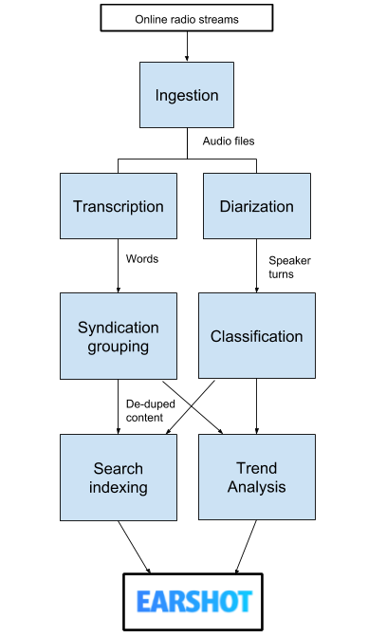
Scaling fingerprinting
Notes:
Two parts-- fingerprinting, and matching
Scaling up fingerprints is easy if we have resources
Overall pipeline

Slide 26
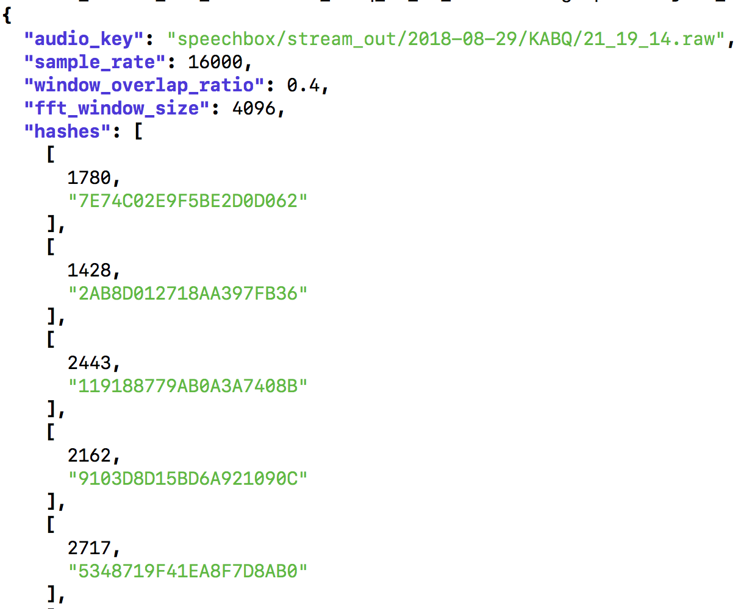

Scaling fingerprinting
Fingerprint!
Notes:
Just add this line
Upload to S3, explain json

Slide 27
Scaling duplicate detection
Query Song
Match in Database
Match in Database
...
Can’t avoid comparing everybody with everybody!
Notes:
Scaling matching is harder-- need to know about everybody’s hashes

Slide 28


Scaling duplicate detection
Query Song
Match in Database
Match in Database
...
Notes:
Ditch MySQL database
Hold values in memory with Spark
Original code not written in a functional way-- rethought process using only map and reduce functions

Slide 29
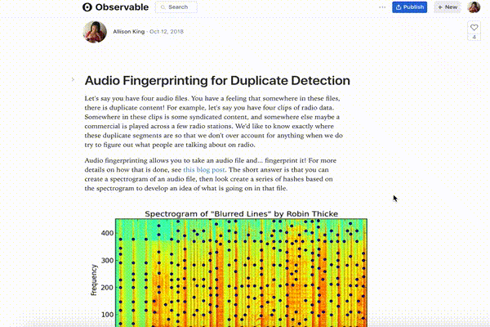
Duplicate detection algorithm
In depth walkthrough: http://bit.ly/dup-detect
Notes:
High level overview-- more in depth one available with this observable notebook
See code and example input file
Some animations, parameters to play with
JavaScript, so not actual code, but good for explaining/visualizing

Slide 30
Spark Pipeline
List of S3 Fingerprint Files
[
“bucket/prefix/clip1”, “bucket/prefix/clip2”, “bucket/prefix/clip3”,...
]
Notes:
General overview of spark pipeline
List of files in S3 which fingerprinting process dropped into a bucket

Slide 31
Spark Pipeline
List of S3 Fingerprint Files
Map → Download
Notes:
Download

Slide 32
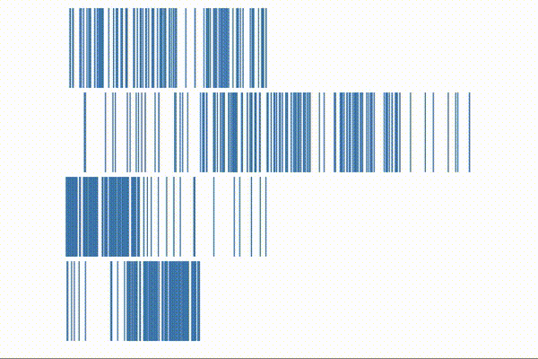
Spark Pipeline
List of S3 Fingerprint Files
Map → Download
Reduce → Group by hash value
Notes:
Group by hashes with the same value

Slide 33
Spark Pipeline
List of S3 Fingerprint Files
Map → Download
Reduce → Group by hash value
Map → Calculate offsets
Query Song
A B C D E F G H I J K L M N O P Q R
Database Song
Z G H I J K L Y K J M N P Q W E R F
Calculate offsets:
G - G = 10
H - H = 10
I - I = 10
M - M = 12
Notes:
Within grouped hashes, calculate how far apart they are. In this picture, G - G will always be equal to H - H, which is equal to I - I...

Slide 34
Spark Pipeline
List of S3 Fingerprint Files
Map → Download
Reduce → Group by hash value
Map → Calculate offsets
Reduce → Align offsets
Query Song
A B C D E F G H I J K L M N O P Q R
Database Song
Z G H I J K L Y K J M N P Q W E R F
Align hashes by same offset
(G - G = H - H = I - I….)
Notes:
Group by the same offsets (everything that is G - G apart)
Can begin to see where a duplicate piece of audio might exist

Slide 35
Spark Pipeline
List of S3 Fingerprint Files
Map → Download
Reduce → Group by hash value
Map → Calculate offsets
Reduce → Align offsets
Map → Get time range matches
Query Song
Query Song
Find time range matches by smoothing out hashes and only taking chunks above a threshold (low pass filter)
Notes:
Low pass filter to get the time range matches

Slide 36
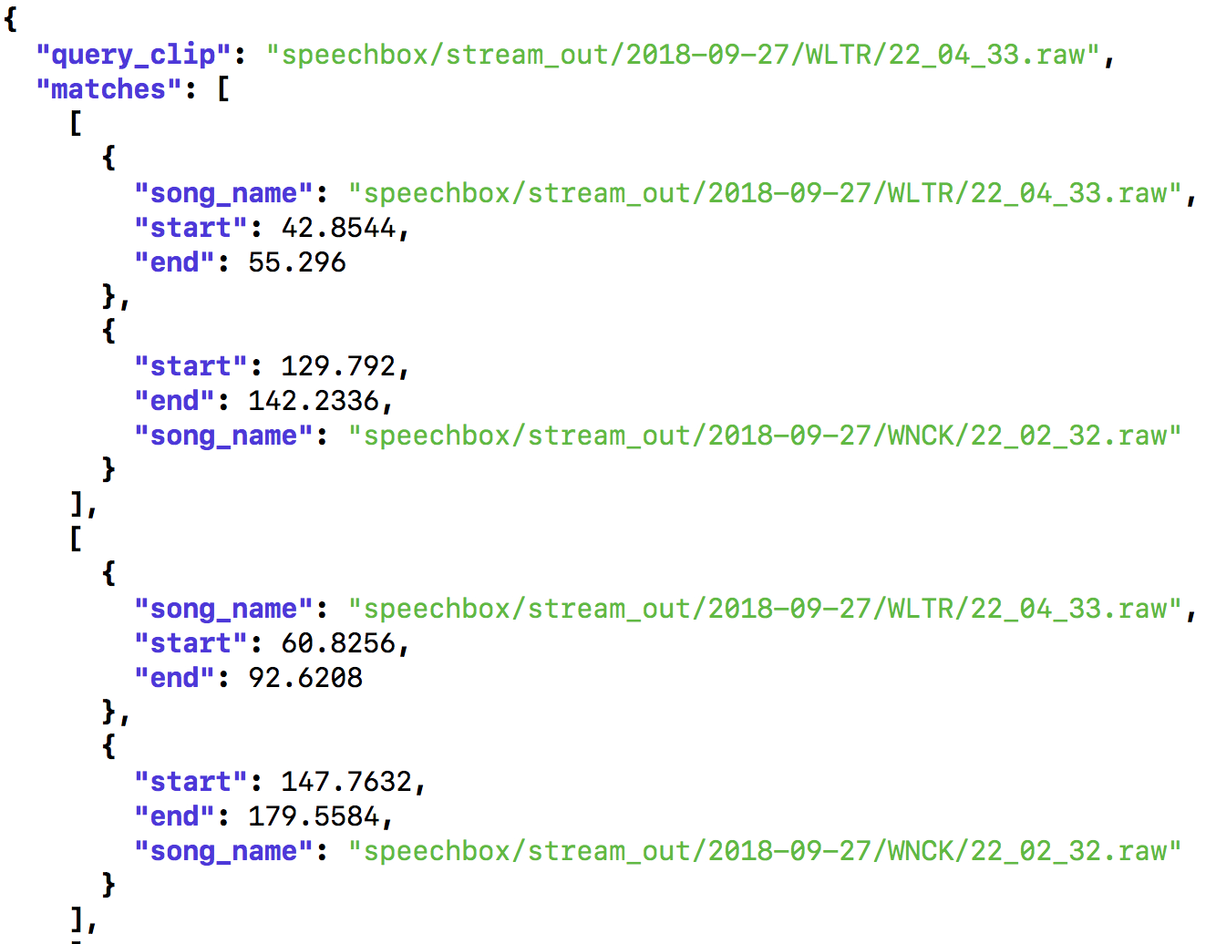
Spark Pipeline
List of S3 Fingerprint Files
Map → Download
Reduce → Group by hash value
Map → Calculate offsets
Reduce → Align offsets
Map → Get time range matches
Reduce → Group by clip name
Map → Save to S3
http://bit.ly/dup-detect
Notes:
Group by the clip name and save to S3!
Explain JSON

Slide 37
Introduction
Looking for a Solution
Existing Tools
Our Solution
Algorithm
Infrastructure
Results

Slide 38

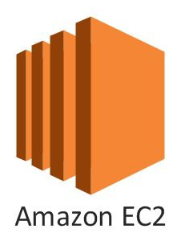
Spark cluster
Kubernetes
Notes:
Three technologies

Slide 39
Spark cluster
Notes:
So here’s me, and I want a spark cluster to run my stuff on.

Slide 40
Spark cluster
Notes:
Hey

Slide 41
Spark cluster
Notes:
Kubernetes!

Slide 42
Spark cluster
50 CPUs!
Notes:
I have this spark job that needs 50 CPUs. Can you help me out?

Slide 43
Spark cluster
K8s autoscaler
Notes:
Kubernetes asks the autoscaler-- do we have 50 CPU’s lying around?

Slide 44
Spark cluster
K8s autoscaler
Notes:
Autoscaler says no, we are a nonprofit! But I know who to ask for more!
We ask for spot instances to reduce our cost. Spark is pretty good about being interrupted, so we can afford to have spot instances taken away for the money we save.

Slide 45

Spark cluster
7 machines with 8 cores please!
K8s autoscaler
Notes:
Amazon provisions machines

Slide 46
Spark cluster
K8s autoscaler
Notes:
Spark job goes and runs on this new cluster

Slide 47
Spark cluster
!
K8s autoscaler
Notes:
Spark job is done-- Kubernetes autoscaler notices that we have a lot of underutilized nodes lying around, so asks Amazon EC2 to relinquish them

Slide 48
Spark cluster
:)
K8s autoscaler
Notes:
Autoscaler is happy-- no new K8s jobs require more nodes, and all existing nodes are being used.

Slide 49
Spark cluster
K8s autoscaler
Notes:
Now there is one really slow part of this picture.

Slide 50

Spark cluster
K8s autoscaler
Notes:
And that’s me! So replace me a Kubernetes Cron Job

Slide 51
Spark cluster
K8s autoscaler
Notes:
So I can hang out here with all of you instead!

Slide 52
Introduction
Looking for a Solution
Existing Tools
Our Solution
Algorithm
Infrastructure
Results

Slide 53
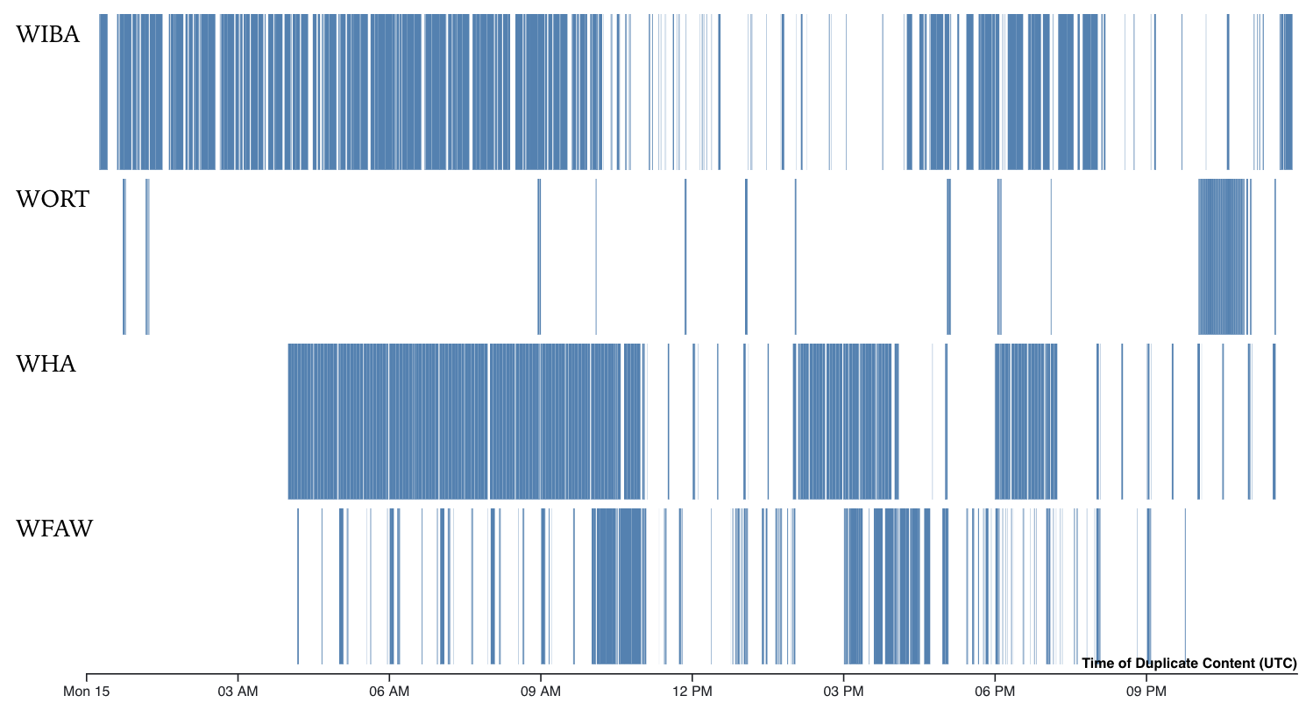
Initial Results
http://bit.ly/madison-radio
Notes:
This is a visualization of radio stations in Madison, Wisconsin. There are 4 radio stations that we are ingesting that you can hear if you are driving through Madison. This shows Monday, October 15th.
Can see which stations air unique content
Differences with weekend vs weekday

Slide 54

Initial Results
http://bit.ly/radio-graph
Notes:
Force directed graph
Nodes are radio stations
Linked if they have a certain threshold of duplicate content between them
Otherwise repelled
Colored independently
NPR
Conservative talk
Outskirts-- college radio stations

Slide 55
Future work
Commercial detection (i.e. frequently repeating 30 second clips)
Remove syndicated content to train/test on accents from different parts of the country
Notes:
Running for 38 days!
Excited to dive into commercials-- who is funding which stations? Are there patterns?
Train on different accents by removing syndicated content

Slide 56
Relevant Links
Making Radio Searchable: https://medium.com/cortico/making-radio-searchable-f337de9fa325
Dejavu (Python library): https://github.com/worldveil/dejavu
Running Kubernetes jobs on EC2 Spot Instances: https://aws.amazon.com/blogs/compute/run-your-kubernetes-workloads-on-amazon-ec2-spot-instances-with-amazon-eks/
Seminal pop song of the early 2000’s, “Oops!... I Did it Again”: https://www.youtube.com/watch?v=CduA0TULnow

Slide 57
allison@cortico.ai
@allisonjking
Notes:
Thank you so much!
First step in work to bridge communities and facilitate conversation
Stick around to bridge the gap and have a great conversation
Thank you

Slide 58
Backup

Slide 59
Abstract
At Cortico, we are making talk radio searchable in order to surface local voices and the range of issues and opinions being discussed across the country. With that comes a host of problems, including lots of duplicate content ranging from syndicated shows to repeated commercials. This talk will go through how we adapted the technology used in identifying popular songs to automatically detect duplicate content within roughly 4000 hours of audio collected per day from nearly 200 radio stations. By utilizing audio fingerprinting, we encode and compare subsequences of audio to identify near duplicates. To do this at scale, we set up an ephemeral Spark cluster within Kubernetes to find duplicates once a day. From this data, we can begin to map out the space of American talk radio.

Slide 60
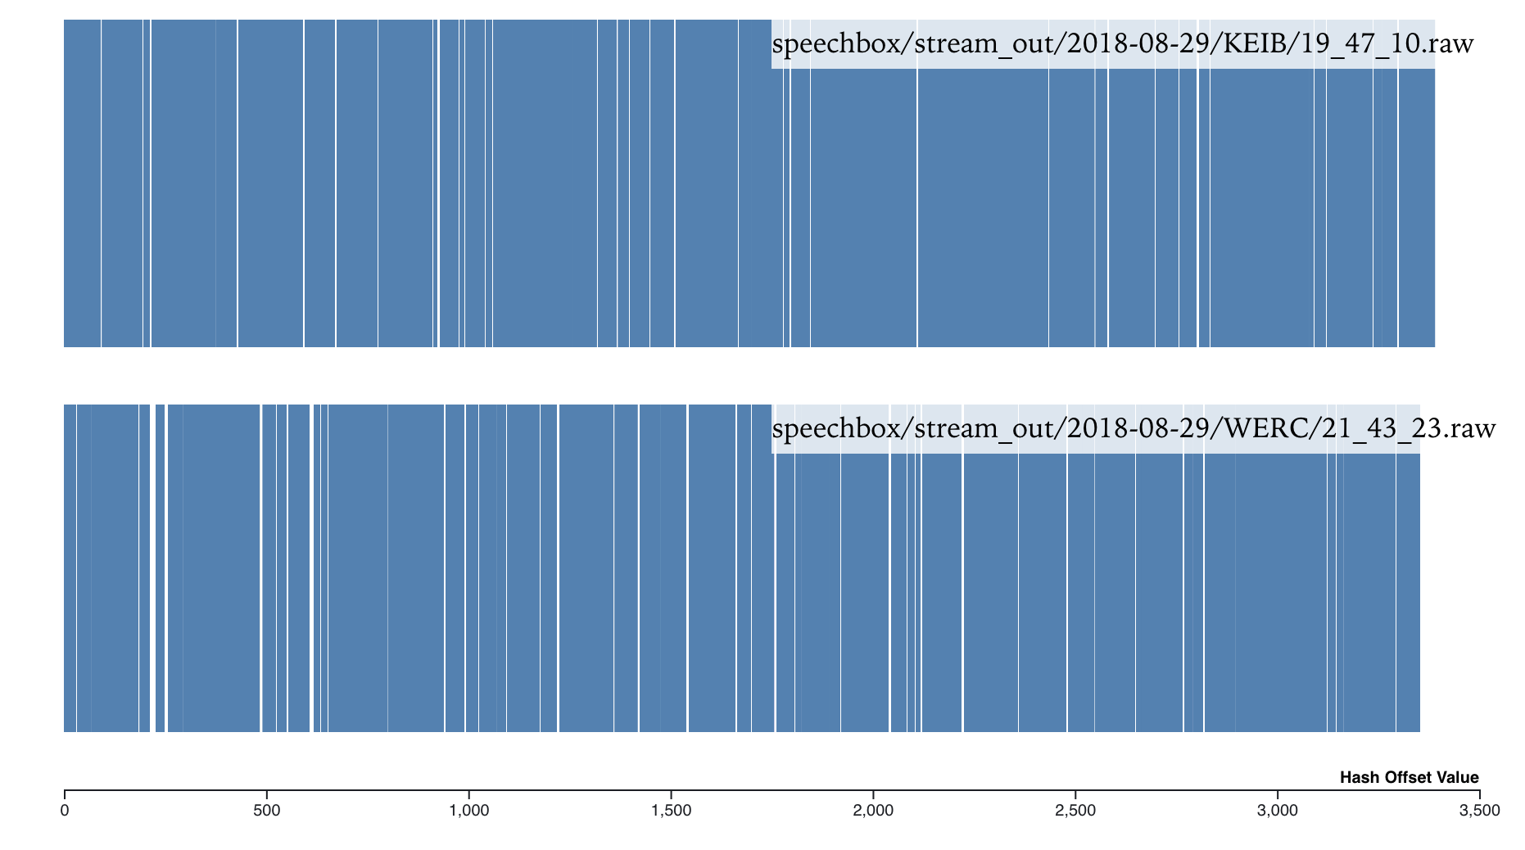
Hashes

Slide 61
Our Problem
Query Song
Query Song
Match in Database
Match in Database
Match in Database
...
Song matching use case
Our use case
Not an entire match-- parts of a clip match parts of another clip
Multiple matches-- duplicate portions in multiple clips
Time boxing-- need to know which time ranges matched, not just that it matched

Slide 62
Our Problem
Query Song
A B C D E F G H I J K L M N O P Q R
Query Song
Query Song
Database Song
Z G H I J K L Y K J M N P Q W E R F
Align hashes by
same offset
(G - G = H - H = I - I….)
Find time range matches by smoothing out hashes and only taking chunks above a threshold (low pass filter)
Not an entire match-- parts of a clip match parts of another clip
Multiple matches-- duplicate portions in multiple clips
Time boxing-- need to know which time ranges matched, not just that it matched

Slide 63
Our Problem
Query Song
A B C D E F G H I J K L M N O P Q R
Query Song
Query Song
Database Song
Z G H I J K L Y K J M N P Q W E R F
Align hashes by
same offset
(G - G = H - H = I - I….)
Find time range matches by smoothing out hashes and only taking chunks above a threshold (low pass filter)
Not an entire match-- parts of a clip match parts of another clip
Multiple matches-- duplicate portions in multiple clips
Time boxing-- need to know which time ranges matched, not just that it matched

