Slide 1

Fast Data apps with Alpakka Kafka connector and Akka Streams
Sean Glover, Lightbend
@seg1o
Notes:
Calibration speaker notes
Calibration speaker notes
Calibration speaker notes
Calibration speaker notes
Calibration speaker notes
Calibration speaker notes

Slide 2



Who am I?
I’m Sean Glover
Principal Engineer at Lightbend
Member of the Fast Data Platform team
Organizer of Scala Toronto (scalator)
Contributor to various projects in the Kafka ecosystem including Kafka, Alpakka Kafka (reactive-kafka), Strimzi, DC/OS Commons SDK
/ seg1o

Slide 3
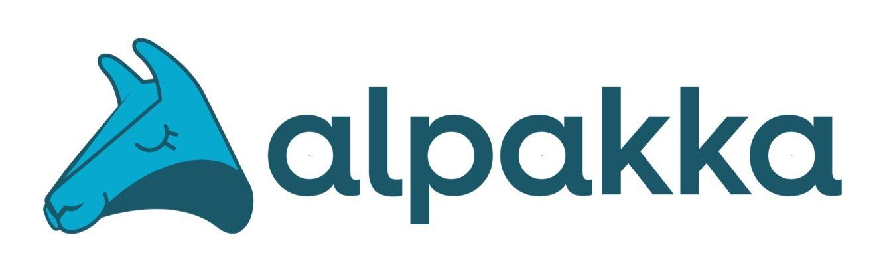
“
The Alpakka project is an initiative to implement a library of integration modules to build stream-aware, reactive, pipelines for Java and Scala.
“
Notes:
Alpakka project is an open source initiative to integrate disparate systems together
It’s a container project that contains Akka Streams integration abstractions for various technologies
It’s similar to projects like Apache Camel and Kafka connect
Help users implement stream-aware and reactive integration pipelines for Java and Scala
Based on Reactive Streams specification and fully compliant with java.util.concurrent.Flow types in JDK 9+ releases

Slide 4
















JMS
Cloud Services
Data Stores
Messaging
Notes:
Alpakka started out as a community initiative, but now has a dedicated team at Lightbend
Evolving into production-ready Enterprise Integration Library.
There are modules for
Cloud Services: AWS S3, AWS SQS, AWS DynamoDB, GCloud Pub/Sub, Azure Storage Queue
Data Stores: Cassandra, MongoDB, HDFS, Solr
Messaging Systems: IronMQ, AMQP impl.’s like RabbitMQ, JMS, and of course Kafka

Slide 5
kafka connector
“
This Alpakka Kafka connector lets you connect Apache Kafka to Akka Streams. It was formerly known as Akka Streams Kafka and even Reactive Kafka.
“
Notes:
Connect Apache Kafka to Akka Streams
Formerly known as Akka Streams Kafka and reactive-kafka
predates Alpakka community initiative
Originally created by SoftwareMill team and eventually included as an official Akka project
Used by many Lightbend clients and products in production
Used for I/O of Streamlets in Fast Data Pipelines
Bundled as an option for messaging passing for Lagom microservices
Can be used as a single JVM library dep without lots of infra

Slide 6
Top Alpakka Modules
Alpakka Module | Downloads in August 2018
Kafka | 61177
Cassandra | 15946
AWS S3 | 15075
MQTT | 11403
File | 10636
Simple Codecs | 8285
CSV | 7428
AWS SQS | 5385
AMQP | 4036

Slide 7

streams
“
Akka Streams is a library toolkit to provide low latency complex event processing streaming semantics using the Reactive Streams specification implemented internally with an Akka actor system.
“
Notes:
There are lots of Stream Processors today which do massive scalability and aggregation well, but don’t support back-pressure
Originally created to simplify streaming semantics in Actor Systems
Lots of boilerplate is required for same semantics on basic Akka actor systems, requires experience
Akka Streams itself is based on Akka Actors and takes care of streaming boilerplate for you, as well as back-pressure

Slide 8
streams
User Messages (flow downstream)
Outlet
Source
Flow
Sink
Inlet
Internal Back-pressure Messages (flow upstream)
Notes:
Require at least a Source and Sink, and optionally Flows
Source have no input, Sink have no outlet, Flow have at least one inlet and outlet
Support cyclic graphs, i.e. can model feedback loops
User messages flow Source to Sink (downstream)
Back-pressure messages flow Sink to Source (upstream)

Slide 9
Reactive Streams Specification
“
Reactive Streams is an initiative to provide a standard for asynchronous stream processing with non-blocking back pressure.
“
http://www.reactive-streams.org/
Notes:
The Reactive Streams spec defines a protocol to provide async stream processing with non-blocking back-pressure
Borrows same principles from Reactive Manifesto: helps build flexible, loosely-coupled, scalable systems, that communicate with asynchronous messaging
Reactive Streams spec coordinated effort by many experts in streaming space incl. Lightbend, Red Hat, Netflix, Pivotal, and more.

Slide 10


Reactive Streams Libraries
streams
migrating to
Spec now part of JDK 9 java.util.concurrent.Flow
Notes:
Spec implemented into a number of libraries in different runtimes
JVM impl.’s include Akka Streams, RxJava, and Vert.x
More recently Reactive Streams was introduce to JDK itself. JDK 9
java.util.concurrent.Flow 1:1 semantically equivalent
After migrationary period (to JDK 9+), libraries will move to use these types
Will make interoperation between libs easier

Slide 11

Back-pressure
Destination Kafka Topic
I need some messages.
I need to load some messages for downstream
Demand request is sent upstream
Demand satisfied downstream
...
Key: EN, Value: {“message”: “Bye Akka!” }
Key: FR, Value: {“message”: “Au revoir Akka!” }
Key: ES, Value: {“message”: “Adiós Akka!” }
...
Source
Flow
Sink
...
Key: EN, Value: {“message”: “Hi Akka!” }
Key: FR, Value: {“message”: “Salut Akka!” }
Key: ES, Value: {“message”: “Hola Akka!” }
...
openclipart
Source Kafka Topic
Notes:
Each Source, Flow, or Sink is represented as actor in Akka. Therefore standard Akka rules apply to each component:
The component has a bounded mailbox that can contain some number of messages
Each component only processes 1 message at a time (“the single threaded illusion”)
State can be encapsulated within the component.
Sink begins with no messages and propagates a demand request upstream.
Demand requests will only be sent once the Flow or Sink have room available in their mailbox.
Source will receive demand satisfy it by loading messages from somewhere (i.e. a Kafka topic).
Source will only send number of messages request so it doesn’t overflow upstream
The Source sends messages downstream to satisfy the demand request from the Flow.
Now that the Flow has messages it can satisfy demand from the Sink.

Slide 12
Dynamic Push Pull
Source sends (push) a batch of 5 messages downstream
I can’t send more messages downstream because I no more demand to fulfill.
Flow sends demand request (pull) of 5 messages max
I can handle 5 more messages
Source
x
Flow
Slow Consumer
Fast Producer
Bounded Mailbox
Flow’s mailbox is full!
openclipart
Notes:
Akka Streams may look like a “pull” model, but it’s actually a hybrid
Pull models don’t scale well with high volume workloads.
Compromise is to request a variable number of messages in demand upstream
Calculated by checking the amount of space left in its bounded mailbox.
The bounded mailbox is like a buffer for each processing stage.
Constraining the size of the mailbox allows stream to run without running out of memory.
Ex)
Flow sends a demand requests up to 5 messages. Calculated based on room in its mailbox. “pull”
Source receives demand request and then loads and sends 5 messages downstream.
We can send as batch instead of waiting for demand requests for each message. batch send is like “push”
This is the “Dynamic push pull” model.
Just demonstrated common scenario fast producer and slow consumer.
Each graph stage will take a different amount of time to process messages in its mailbox
Back-pressure allows us to only request what we need.
Back-pressure can be propagated across systems if Sources use a compatible technology, such as a TCP socket.

Slide 13

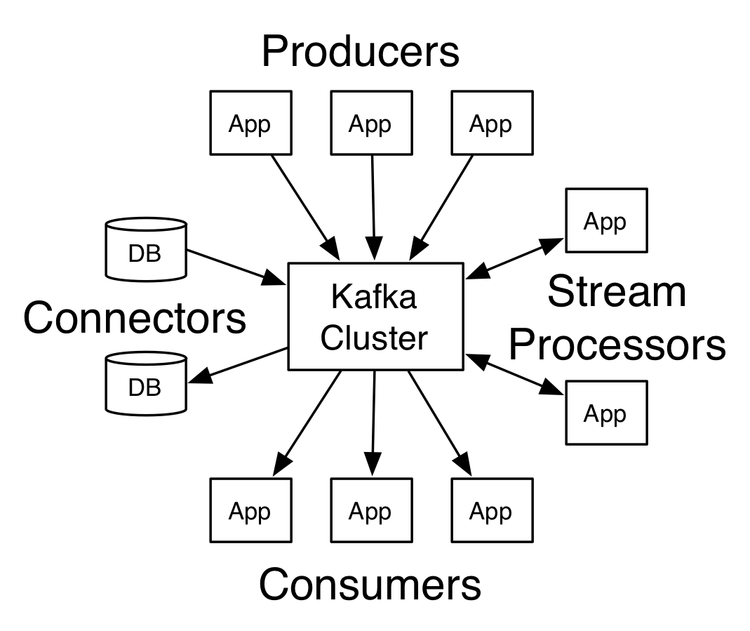
Kafka
“
Kafka is a distributed streaming system. It’s best suited to support fast, high volume, and fault tolerant, data streaming platforms.
“
Kafka Documentation
Notes:
Distributed streaming platform
Simple architecture, smart clients and libraries like Kafka Streams and Alpakka Kafka
Kafka is best suited as a durable high volume message store at the periphery of your infrastructure.
Allows you to absorb spikes of high volume without having to scale your internal infra.
In these kinds of scenarios back-pressure may not be possible, or desirable.
A Topic is comprised of 1 or more Partitions
A Partition can have 0 or more Replicas
High Volume - Partitions spread across cluster
Fault Tolerant - Partition replicas, consistency guarantees, disk persistence
Fast - Zero-copy, PageCache, Append-only

Slide 14
When to use Alpakka Kafka over Kafka Streams?
To build back-pressure aware integrations
Complex Event Processing
A need to model the most complex of graphs
Notes:
Kafka streams has some great features WRT
stateful operations
or using latest Kafka’s transactional support
But there are some reasons to use Alpakka Kafka and Akka Streams instead. These include:
Integrating with other systems where back-pressure would be useful
Doing complex event processing by integrating Akka actor systems, or Akka cluster.
Model complex stateful domains in Akka
Build any kind of complex graphs.
Cyclical sub graphs, such as feedback loops,
Unique feature to Akka Streams

Slide 15
Alpakka Kafka Setup
val consumerClientConfig = system.settings.config.getConfig("akka.kafka.consumer")
val consumerSettings =
ConsumerSettings(consumerClientConfig, new StringDeserializer, new ByteArrayDeserializer)
.withBootstrapServers("localhost:9092")
.withGroupId("group1")
.withProperty(ConsumerConfig.AUTO_OFFSET_RESET_CONFIG, "earliest")
val producerClientConfig = system.settings.config.getConfig("akka.kafka.producer")
val producerSettings = ProducerSettings(system, new StringSerializer, new ByteArraySerializer)
.withBootstrapServers("localhost:9092")
Alpakka Kafka config & Kafka Client config can go here
Set ad-hoc Kafka client config
Notes:
Can use Lightbend Config objects to pre-configure the source and sink, as well as Kafka client config.

Slide 16
Simple Consume, Transform, Produce Workflow
Committable Source provides Kafka offset storage committing semantics
val control =
Consumer
.committableSource(consumerSettings, Subscriptions.topics("topic1", "topic2"))
.map { msg =>
ProducerMessage.Message[String, Array[Byte], ConsumerMessage.CommittableOffset](
new ProducerRecord("targetTopic", msg.record.value),
msg.committableOffset
)
}
.toMat(Producer.commitableSink(producerSettings))(Keep.both)
.mapMaterializedValue(DrainingControl.apply)
.run()
// Add shutdown hook to respond to SIGTERM and gracefully shutdown stream
sys.ShutdownHookThread {
Await.result(control.shutdown(), 10.seconds)
}
Kafka Consumer Subscription
Transform and produce a new message with reference to offset of consumed message
Create ProducerMessage with reference to consumer offset it was processed from
Produce ProducerMessage and automatically commit the consumed message once it’s been acknowledged
Graceful shutdown on SIGTERM
Notes:
Controlled Shutdown notes
Consumer.Control.stop() to stop producing messages from the Source. Doesn’t stop consumer
Wait for the stream to complete, so that a commit request has been made for all offsets of all processed messages (via commitScaladsl() or commitJavadsl()).
Consumer.Control.shutdown() to wait for all outstanding commit requests to finish and stop the Kafka Consumer
Wait for producer acks

Slide 17
Consumer Groups

Slide 18
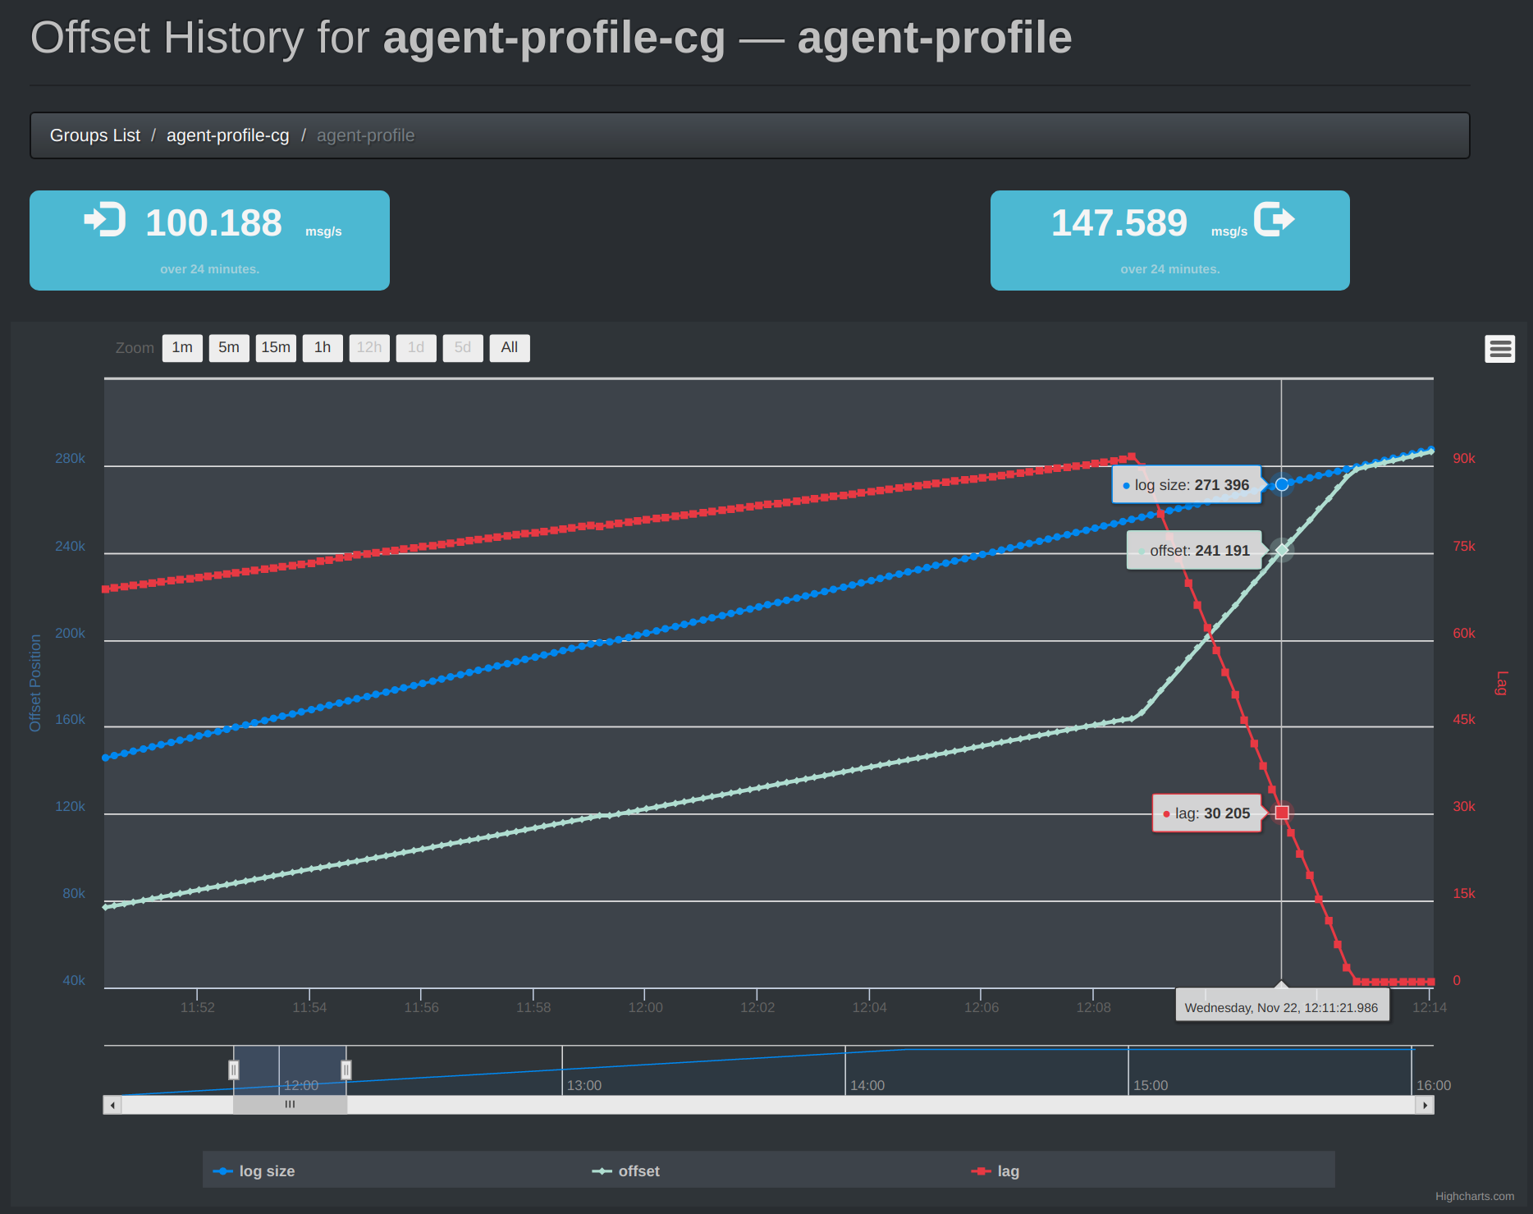
Why use Consumer Groups?
Easy, robust, and performant scaling of consumers to reduce consumer lag

Slide 19

Latency and Offset Lag
Producer 1
Consumer Group
Cluster
Consumer Throughput ~3 MB/s each
~9 MB/s
Total offset lag and latency is growing.
Consumer 1
Producer 2
...
Topic
Consumer 2
Producer n
Consumer 3
Throughput: 10 MB/s
Back
Pressure
openclipart
Notes:
Kafka doesn’t support back-pressure. Can’t tell producers to slow down.
Reminder: Kafka at periphery of infra. Best used to absorb spikey load. Back-pressure may not be possible or desriable.
Example)
Various producers have a combined throughput of 10 MB/s
Each consumers processes 3 MB/s on average
Offset lag increases indefinitely, unless the throughput drops

Slide 20
Latency and Offset Lag
Producer 1
Consumer Group
Cluster
Consumer 1
Producer 2
...
Topic
Consumer 2
Consumers now can support a throughput of ~12 MB/s
Offset lag and latency decreases until consumers are caught up
Producer n
Consumer 3
Consumer 4
Data Throughput: 10 MB/s
Add new consumer and rebalance
Notes:
Example cont)
We add a new consumer and have it join the consumer group
A rebalance occurs so topic data is distributed evenly
New combined throughput is greater than average throughput of topic
Lag decreases
Tools to help monitor consumer lag
Through metrics in the Kafka consumer client and Alpakka Kafka
kafka-exporter for Kubernetes
Kafka Offset Monitor

Slide 21
Anatomy of a Consumer Group
Consumer Group
Cluster
Client A
Important Consumer Group Client Config
Topic Subscription:
Subscription.topics(“Topic1”, “Topic2”, “Topic3”)
Kafka Consumer Properties:
group.id: [“my-group”]
session.timeout.ms: [30000 ms]
partition.assignment.strategy: [RangeAssignor]
heartbeat.interval.ms: [3000 ms]
Consumer Group Leader
Consumer Group Coordinator
Partitions: 0,1,2
Client B
Partitions: 3,4,5
T1
T2
Partitions: 6,7,8
Consumer Group Topic Subscription
T3
Client C
Consumer Group Offsets topic
Ex)
P0: 100489
P1: 128048
P2: 184082
P3: 596837
P4: 110847
P5: 99472
P6: 148270
P7: 3582785
P8: 182483
Consumer Offset Log
Notes:
Clients
A consumer group has 1 or more Kafka Consumer clients (i.e. Alpakka Kafka clients)
Scaling clients out gains performance because each client instance can be run on a separate machine with its own resources (network)
Scale your number of clients to as many partitions as you have defined in your topic
Consumer Group Leader
Background process that runs in the oldest member of the consumer group.
Coordinates with the consumer group coordinator execute the partition assignment strategy (i.e. the RangeAssignor) to assign sets of partitions to clients.
Lives on the client so easy for user to provide strategy
Consumer Group Coordinator
Coordinator for group runs as background process on a broker
Will be loaded on one of the broker’s when there’s at least one active client in the group.
Job is to coordinate with all client group members and decide when to rebalance
Consumer Offset Log
The Consumer Offset Log (a topic), when using Kafka to manage offsets.
Compacted topic which contains last committed offset for each partition in the consumer group.

Slide 22
Consumer Group Rebalance (1/7)
Consumer Group
Cluster
Client A
Consumer Group Leader
Consumer Group Coordinator
Partitions: 0,1,2
Client B
Partitions: 3,4,5
T1
T2
Partitions: 6,7,8
T3
Client C
Consumer Offset Log
Notes:
Rebalances occur because of
A Consumer leaves the Consumer group (either by failing heartbeat or by leaving)
A new Consumer joins the Consumer Group
A Consumer changes its Topic subscription
Topic changes (e.g. an increase in the number of Partitions)

Slide 23
Consumer Group Rebalance (2/7)
Consumer Group
Cluster
Client A
Consumer Group Leader
Consumer Group Coordinator
Partitions: 0,1,2
Client B
Partitions: 3,4,5
T1
T2
Partitions: 6,7,8
T3
Client C
Consumer Offset Log
Client D
Client D requests to join the consumer group
New Client D with same group.id sends a request to join the group to Coordinator
Notes:
New client with same group.id sends a request to join the group to Coordinator

Slide 24
Consumer Group Rebalance (3/7)
Consumer group coordinator requests group leader to calculate new Client:partition assignments.
Consumer Group
Cluster
Client A
Consumer Group Leader
Consumer Group Coordinator
Partitions: 0,1,2
Client B
Partitions: 3,4,5
T1
T2
Partitions: 6,7,8
T3
Client C
Consumer Offset Log
Client D
Notes:
Consumer group coordinator requests group leader to calculate new Client:partition assignments.

Slide 25
Consumer Group Rebalance (4/7)
Consumer group leader sends new Client:Partition assignment to group coordinator.
Consumer Group
Cluster
Client A
Consumer Group Leader
Consumer Group Coordinator
Partitions: 0,1,2
Client B
Partitions: 3,4,5
T1
T2
Partitions: 6,7,8
T3
Client C
Consumer Offset Log
Client D
Notes:
Consumer group leader calculates Client:Partition assignment and sends to group coordinator.

Slide 26
Consumer Group Rebalance (5/7)
Consumer Group
Cluster
Client A
Consumer Group Leader
Assign Partitions: 0,1
Consumer Group Coordinator
Assign Partitions: 2,3
Client B
Assign Partitions: 4,5
T1
T2
Assign Partitions: 6,7,8
T3
Client C
Consumer Offset Log
Client D
Consumer group coordinator informs all clients of their new Client:Partition assignments.
Notes:
Coordinator informs all clients of their new Client:Partition assignments.
NOTE:
This is a simplified assignment of partitions.
Provided assignment strategies attempt to keep reassignments to a minimum.
Re-assignments can be expensive.

Slide 27
Consumer Group Rebalance (6/7)
Consumer Group
Cluster
Client A
Consumer Group Leader
Consumer Group Coordinator
Client B
Partitions to Commit: 2
T1
T2
Partitions to Commit: 3,5
T3
Client C
Partitions to Commit: 6,7,8
Consumer Offset Log
Client D
Clients that had partitions revoked are given the chance to commit their latest processed offsets.
Notes:
Clients that had partitions revoked are given the chance to commit their latest processed offsets.

Slide 28
Consumer Group Rebalance (7/7)
Consumer Group
Cluster
Client A
Consumer Group Leader
Consumer Group Coordinator
Partitions: 0,1
Client B
Partitions: 2,3
T1
T2
Partitions: 4,5
Partitions: 6,7,8
T3
Client C
Consumer Offset Log
Client D
Rebalance complete. Clients begin consuming partitions from their last committed offsets.
Notes:
Rebalance complete. Clients consume partitions from their last committed offset

Slide 29
Commit on Consumer Group Rebalance
val consumerClientConfig = system.settings.config.getConfig("akka.kafka.consumer")
val consumerSettings = ConsumerSettings(consumerClientConfig, new StringDeserializer, new ByteArrayDeserializer)
.withGroupId("group1")
class RebalanceListener extends Actor with ActorLogging {
def receive: Receive = {
case TopicPartitionsAssigned(sub, assigned) =>
case TopicPartitionsRevoked(sub, revoked) =>
commitProcessedMessages(revoked)
}
}
val subscription = Subscriptions.topics("topic1", "topic2")
.withRebalanceListener(system.actorOf(Props[RebalanceListener]))
val control = Consumer.committableSource(consumerSettings, subscription)
...
Declare a RebalanceListener Actor to handle assigned and revoked partitions
Commit offsets for messages processed from revoked partitions
Assign RebalanceListener to topic subscription.
Notes:
Define a RebalanceListener actor that can respond to assigned and revoked partitions.
The RebalanceListener is any Akka Actor that handles these messages:
TopicsPartitionsAssigned, TopicPartitionsRevoked

Slide 30
Transactional “Exactly-Once”

Slide 31
Kafka Transactions
“
Transactions enable atomic writes to multiple Kafka topics and partitions. All of the messages included in the transaction will be successfully written or none of them will be.
“
Notes:
Kafka transactions allow for exactly once processing of messages.
Released in version 0.11.0.0 on June 28th, 2017.
Not possible before 0.11.0.0 because producer could send a duplicate message in retres and fail before it received an ack
Messages are consumed, transformed, and produced to another Kafka topic in one atomic operation.
All messages included in a transaction will be successfully written or none of them will be.
Kafka calls this form of processing “exactly once”

Slide 32

Message Delivery Semantics
At most once
At least once
“Exactly once”
openclipart
Notes:
Background
Exactly once delivery is considered by many as a holy grail in terms of message delivery semantics in distributed systems.
To the uninitiated, exactly once sounds reasonable, but the implications in achieving these guarantees are glossed over
Message Delivery Semantics
At Most Once:
Messages are only ever sent once.
They are either received successfully or they are not, resulting in gaps downstream.
Can be advantageous because of the performance benefits involved.
Processes such as acknowledgement of receipt, write consistency guarantees, retries, are add additional overhead and latency.
If the stream can tolerate some failure and requires very low latency to process at a high volume, then this may be acceptable.
At Least Once
Messages sent after being processed, with possible retries, resulting in possible duplicates.
Wait for acks before message considered received In the event of failure the source can retry to send the message.
Sink systems may be tolerant of this by ensuring they persist messages in an idempotent way.
Most common compromise between at most once and exactly once semantics.
Exactly Once:
Messages only be sent to destination once
Destination should only have one copy of message.
Messages arrive in the order they're sent.
How can we guarantee this?

Slide 33
Exactly Once Delivery vs Exactly Once Processing
“
Exactly-once message delivery is impossible between two parties where failures of communication are possible.
“
Two Generals/Byzantine Generals problem
Notes:
Summarized as “Exactly-once message delivery is impossible between two parties where failures of communication are possible.”
Often introduced in introductory networking classes WRT TCP protocol, which can’t guarantee consistency between endpoints, but applicable to any possibly faulty communication.
See Tyler Treat’s blog post "You Cannot Have Exactly Once Delivery"
After the Kafka 0.11.0.0 caused some debate in the community, Tyler has clarified his position in a new post: “You Cannot Have Exactly-Once Delivery Redux.”
Exactly Once Delivery vs Processing
Exactly Once delivery may be impossible, but we can fake it at processing layer
Faking Exactly Once Processing in its most basic form is “At least once message delivery with effective idempotency guarantees on the sink.”
Retry until acknowledgement from sink.
Idempotent data sources on the receiving side. Db/App de-dupe
Enforce that source messages are not processed more than once.

Slide 34
Why use Transactions?
Zero tolerance for duplicate messages
Less boilerplate (deduping, client offset management)

Slide 35
Anatomy of Kafka Transactions
Important Client Config
Topic Subscription:
Subscription.topics(“Topic1”, “Topic2”, “Topic3”)
Destination topic partitions get included in the transaction based on messages that are produced.
Kafka Consumer Properties:
group.id: “my-group”
isolation.level: “read_committed”
plus other relevant consumer group configuration
Kafka Producer Properties:
transactional.id: “my-transaction”
enable.idempotence: “true” (implicit)
max.in.flight.requests.per.connection: “1” (implicit)
“Consume, Transform, Produce”
Client
Transformation
Consumer Group Coordinator
Transaction Coordinator
Control Messages
Topic Sub
Topic Dest
CM
UM
UM
UM
CM
UM
Consumer Offset Log
Transaction Log
Cluster
Notes:
Only possible in consume->transform->produce flow in same cluster
1) Transaction Coordinator. Each producer is assigned a transaction coordinator. All the logic of assigning PIDs and managing transactions is done by the transaction coordinator.
2) Internal log Transaction Log. The transaction log is a persistent and replicated record of every transaction.
3) Control Messages. Special messages written to user topics, processed by clients, but never exposed to users. Used for instance, to let consumers know transactions committed
4) TransactionalId. Uniquely identify transactional sessions.
5) Producer epoch (tx id + epoch), which enables us to ensure that there is only one legitimate active instance of a producer with a given TransactionalId, and hence enables us to maintain transaction guarantees in the event of failures.

Slide 36
Kafka Features That Enable Transactions
Idempotent producer
Multiple partition atomic writes
Consumer read isolation level
Notes:
Kafka achieves Exactly Once Processing through a coordination of features in the Kafka broker and client

Slide 37
Idempotent Producer (1/5)
Client
KafkaProducer.send(k,v)
sequence num = 0
producer id = 123
Broker
Cluster
Leader Partition
Log
Notes:
Idempotent producers solve several problems
Prevent producing messages out of order to a single partition.
Prevent duplicates in the log.
Example begins

Slide 38
Idempotent Producer (2/5)
Client
Broker
Cluster
Append (k,v) to partition
sequence num = 0
producer id = 123
Leader Partition
(k,v)
seq = 0
pid = 123
Log

Slide 39
Idempotent Producer (3/5)
Client
Broker acknowledgement fails
x
KafkaProducer.send(k,v)
sequence num = 0
producer id = 123
Broker
Cluster
Leader Partition
(k,v)
seq = 0
pid = 123
Log

Slide 40
Idempotent Producer (4/5)
Client
(Client Retry)
KafkaProducer.send(k,v)
sequence num = 0
producer id = 123
Broker
Cluster
Leader Partition
(k,v)
seq = 0
pid = 123
Log

Slide 41
Idempotent Producer (5/5)
Client
Broker acknowledgement succeeds
ack(duplicate)
KafkaProducer.send(k,v)
sequence num = 0
producer id = 123
Broker
Cluster
Leader Partition
(k,v)
seq = 0
pid = 123
Log

Slide 42
Multiple Partition Atomic Writes
Ex) Second phase of two phase commit
Client
KafkaProducer.commitTransaction()
Transaction and Consumer Group Coordinators
Cluster
Consumer
Offset Log
Transactions
Log
User Defined Partition 1
User Defined Partition 2
User Defined Partition 3
CM
CM
CM
CM
CM
CM
CM
UM
UM
UM
CM
CM
UM
UM
UM
Last Offset Processed for
Consumer Subscription
Transaction Committed
(internal)
Transaction Committed control messages (user topics)
Multiple Partitions Committed Atomically, “All or nothing”
Notes:
Multiple Partition Atomic Writes are used in the second phase of a two-phase commit.
The two-phase commit protocol is used in order to achieve transactions in Kafka.
First phase the transaction coordinator will update its state to “prepare commit” in transaction log
Second phase the client will commit transaction. Triggers atomic write by the transaction and consumer group coordinator to their logs, as well as control messages to all the partitions produced to

Slide 43
Consumer Read Isolation Level
User Defined Partition 1
User Defined Partition 2
User Defined Partition 3
CM
CM
CM
Cluster
UM
UM
UM
UM
UM
UM
Client
Kafka Consumer Properties:
isolation.level: “read_committed”
Notes:
The Kafka consumer isolation level “read_committed” is used to configure consumers to only read messages that have been committed.
Client only consumes from partitions with transaction committed Control Message
Isolation level “read_uncommitted” enables the default Kafka consumer behaviour to read messages as soon as they’re written to the log.

Slide 44
Transactional Pipeline Latency
Client
Client
Client
Transaction Batches every 100ms
End-to-end Latency
~300ms
Notes:
This is the biggest cost of latency when building transactional pipelines that span more than one application.
If each app needs to wait for committed transactions, aggregate lag piles up.
Therefore keep interval between transactions short

Slide 45

Alpakka Kafka Transactions
Destination Kafka Partitions
Cluster
Messages waiting for ack
before commit
...
Key: EN, Value: {“message”: “Bye Akka!” }
Key: FR, Value: {“message”: “Au revoir Akka!” }
Key: ES, Value: {“message”: “Adiós Akka!” }
...
Transactional
Source
Transform
Transactional Sink
...
Key: EN, Value: {“message”: “Hi Akka!” }
Key: FR, Value: {“message”: “Salut Akka!” }
Key: ES, Value: {“message”: “Hola Akka!” }
...
Cluster
openclipart
Source Kafka Partition(s)
akka.kafka.producer.eos-commit-interval = 100ms
Notes:
Alpakka Kafka makes transactional workflows easy
All you have to provide is a transactional id and use the transactional source and sinks!
Similar to how Kafka Streams works
Transactional Source - Emits a ConsumerMessage.TransactionalMessage which has metadata needed at commit time
Transaction Sink/Flow - Automatically commits transaction as part of interval. Must be used with Transactional.Source
Transactional Sink/Flow manages transactions. All required consumer/producer config handled automatically
Transactions are committed on an using config akka.kafka.producer.eos-commit-interval,
Larger commit intervals increase latency of overall pipeline
Every commit interval we check if messages need to be committed
If yes then we suspend demand from upstream (back-pressure) while we wait for acks of all outstanding messages

Slide 46
Transactional GraphStage (1/7)
Transactional GraphStage
Transaction Status
Begin Transaction
Transaction
Flow
Back Pressure Status
Resume Demand
Waiting for ACK
Commit Loop
Waiting
Mailbox
Notes:
Transaction begun
Demand for more messages
Commit loop in “waiting” status

Slide 47
Transactional GraphStage (2/7)
Transactional GraphStage
Transaction Status
Transaction is Open
Transaction
Flow
Back Pressure Status
Resume Demand
Waiting for ACK
Commit Loop
Commit Interval Elapses
Messages flowing
Mailbox
Notes:
Transaction is open and new messages are being added

Slide 48

Transactional GraphStage (3/7)
Transactional GraphStage
Transaction Status
Transaction is Open
Transaction
Flow
Back Pressure Status
Resume Demand
Waiting for ACK
Commit Loop
Commit Interval Elapses
Messages flowing
100ms
Mailbox
Commit loop “tick”
message
Notes:
Timer for commit loop is triggered, begin commit lifecycle
When commit loop “tick” message processed it will begin transaction process

Slide 49
Transactional GraphStage (4/7)
Transactional GraphStage
Transaction Status
Transaction is Open
Transaction
Flow
x
Back Pressure Status
Suspend Demand
Waiting for ACK
Commit Loop
Commit Interval Elapses
Messages stopped
Mailbox
Notes:
Stop sending demand requests “back-pressure”
Drain outstanding any messages that are waiting for ACK

Slide 50
Transactional GraphStage (5/7)
Transactional GraphStage
Transaction Status
Send Consumed Offsets
Transaction
Flow
x
Back Pressure Status
Suspend Demand
Waiting for ACK
Commit Loop
Commit Interval Elapses
Messages stopped
Mailbox
Notes:
Drain complete. All ACK’s received
Send consumed offset transactions to consumer group coordinator
Included in transaction like any other produced message

Slide 51
Transactional GraphStage (6/7)
Transactional GraphStage
Transaction Status
Commit Transaction
Transaction
Flow
x
Back Pressure Status
Suspend Demand
Waiting for ACK
Commit Loop
Commit Interval Elapses
Messages stopped
Mailbox
Notes:
Commit transaction
Begins two-phase commit
Writes “prepare transaction” to transaction log
Writes “transaction commit” control messages to produced partitions
Writes “transaction complete” to transaction log

Slide 52
Transactional GraphStage (7/7)
Transactional GraphStage
Transaction Status
Begin New Transaction
Transaction
Flow
Back Pressure Status
Resume Demand
Waiting for ACK
Commit Loop
Waiting
Messages flowing again
Mailbox
Notes:
Repeat: Begin a new transaction

Slide 53
Alpakka Kafka Transactions
val producerSettings = ProducerSettings(system, new StringSerializer, new ByteArraySerializer)
.withBootstrapServers("localhost:9092")
.withEosCommitInterval(100.millis)
val control =
Transactional
.source(consumerSettings, Subscriptions.topics("source-topic"))
.via(transform)
.map { msg =>
ProducerMessage.Message(new ProducerRecord[String, Array[Byte]]("sink-topic", msg.record.value),
msg.partitionOffset)
}
.to(Transactional.sink(producerSettings, "transactional-id"))
.run()
Optionally provide a Transaction commit interval (default is 100ms)
Use Transactional.source to propagate necessary info to Transactional.sink (CG ID, Offsets)
Call Transactional.sink or .flow to produce and commit messages.

Slide 54
Complex Event Processing

Slide 55
What is Complex Event Processing (CEP)?
“
Complex Event Processing (CEP) has emerged as the unifying field for technologies that require processing and correlating distributed data sources in real-time.
“
Foundations of Complex Event Processing, Cornell
Notes:
Complex event processing, or CEP, is event processing that combines data from multiple sources to infer events or patterns that suggest more complicated circumstances and respond to them as fast as possible.

Slide 56
Options for implementing Stateful Streams
Built-in Akka Streams stages for simple stateful operations: fold, scan, etc.
Custom GraphStage
Call into an Akka Actor System
Notes:
There are several options for state management in Akka Streams
Using provided stateful Akka Streams stages for simple stateful operators: fold, scan, count, etc.
Create a Custom GraphStage with and model your own state within a single type
Call out into an Akka Actor System using the Ask pattern.

Slide 57
Calling into an Akka Actor System
Entity
Entity
Entity
Entity
Event Store
Service
Actor System
Service
Event Store
Entity
Router
Pass message to Actor System asynchronously and send the response downstream
Actors
Source
Ask
?
Sink
Cluster
Cluster
openclipart
Notes:
Actor Systems well suited for modeling complex domains and their state
Akka allows you to build rich Actor Systems on single machine or cluster
Akka Streams can easily integrate with already running Akka actor systems while maintaining back-pressure

Slide 58
Actor System Integration
Transform your stream by processing messages in an Actor System. All you need is an ActorRef.
class ProblemSolverRouter extends Actor {
def receive = {
case problem: Problem =>
val solution = businessLogic(problem)
sender() ! solution // reply to the ask
}
}
...
val control = Consumer
.committableSource(consumerSettings, Subscriptions.topics("topic1", "topic2"))
.map(parseProblem)
.mapAsync(parallelism = 5)(problem => (problemSolverRouter ? problem).mapTo[Solution])
.map { solution => ProducerMessage.Message[String, Array[Byte], ConsumerMessage.CommittableOffset](
new ProducerRecord("targetTopic", solution.toBytes), solution.committableOffset)
}
.toMat(Producer.commitableSink(producerSettings))(Keep.both)
.mapMaterializedValue(DrainingControl.apply)
.run()
Use Ask pattern (? function) to call provided ActorRef to get an async response
Parallelism used to limit how many messages in flight so we don’t overwhelm mailbox of destination Actor and maintain stream back-pressure.
Notes:
Only need an ActorRef. Could be local or remote actor.
Ask pattern creates an asynchronous request and response, represented as Future
You can use map or mapAsync when using the ask pattern.
mayAsync is better because then destination actor will have pending messages in its mailbox that can be quickly dequeued to be processed.
Have small value for the parallelism factor so we don’t overwhelm the possibly unbounded mailbox of the destination actor.
By constraining the parallelism we can maintain the back-pressure feature of Akka Streams
You can also use an actor as a Sink

Slide 59
Persistent Stateful Stages

Slide 60
Persistent Stateful Stages using Event Sourcing
Recover state after failure
Create an event log
Share state
Notes:
The most natural way to maintain state in a stream is to use Event Sourcing.
Event Sourcing is a commonly used pattern in Akka Actor Systems because it’s so well suited for distributed systems.

Slide 61




Persistent GraphStage using Event Sourcing
Stateful
Stage
Source
Sink
Cluster
Cluster
State
Request (Command/Query)
Request Handler
Event Handler
Response (Event)
Triggers State Change
Akka Persistence Plugins
akka.persistence.Journal
Writes
Reads (Replays)
Event Log
openclipart
Notes:
An event sourcing system will receive a command or query which mutates state
Instead of simply mutating the state, we process our request with a request handler.
The request handler will emit an event which captures the state change
Persist to an immutable append-only event log and to event handler to update state
In failures we will lose all the runtime state
State is rebuilt by replaying the event log through the Event handler
If you’re familiar with Kafka Streams and KTable’s then you will recognize this model.
This is an area where Kafka Streams makes life a lot easier.

Slide 62


krasserm / akka-stream-eventsourcing
“
This project brings to Akka Streams what Akka Persistence brings to Akka Actors: persistence via event sourcing.
“
Experimental
Public Domain Vectors
Notes:
akka-stream-eventsourcing by Martin Krasser is a prototype to add event sourced graph stages
Martin is a gifted distributed systems and ML engineer who active in Event Sourcing, Akka, and Kafka spaces.
Promising but experimental and doesn’t have a lot activity.
Submitted last year as a proposal to be added to Akka Streams, but hasn’t seen further development
It would be great if someone could pick up this project and run develop it further *hint* *hint*

Slide 63
New in Alpakka Kafka 1.0-M1

Slide 64
Alpakka Kafka 1.0M1 Release Notes
Released Nov 6, 2018
Highlights in this release
Upgraded the Kafka client to version 2.0.0 #544 by @fr3akX
  Support new API’s from KIP-299: Fix Consumer indefinite blocking behaviour in #614 by @zaharidichev
New Committer.sink for standardised committing #622 by @rtimush
Commit with metadata #563 and #579 by @johnclara
Factored out akka.kafka.testkit for internal and external use: see Testing
Support for merging commit batches #584 by @rtimush
Reduced risk of message loss for partitioned sources #589
Expose Kafka errors to stream #617
Java APIs for all settings classes #616
Much more comprehensive tests
Notes:
Updated to support Kafka 2.0 client
KIP-299 - All Consumer calls block indefinitely (except for .poll())
This KIP introduces adds timeouts default.api.timeout.ms, soon to be used by Alpakka Kafka too
Easier semantics for committing offsets put into sink (commit by interval and batch size)
Support for committing metadata with Kafka offset commit
New testkit for testing Alpakka Kafka connector
Merge commit batches

Slide 65
Conclusion

Slide 66
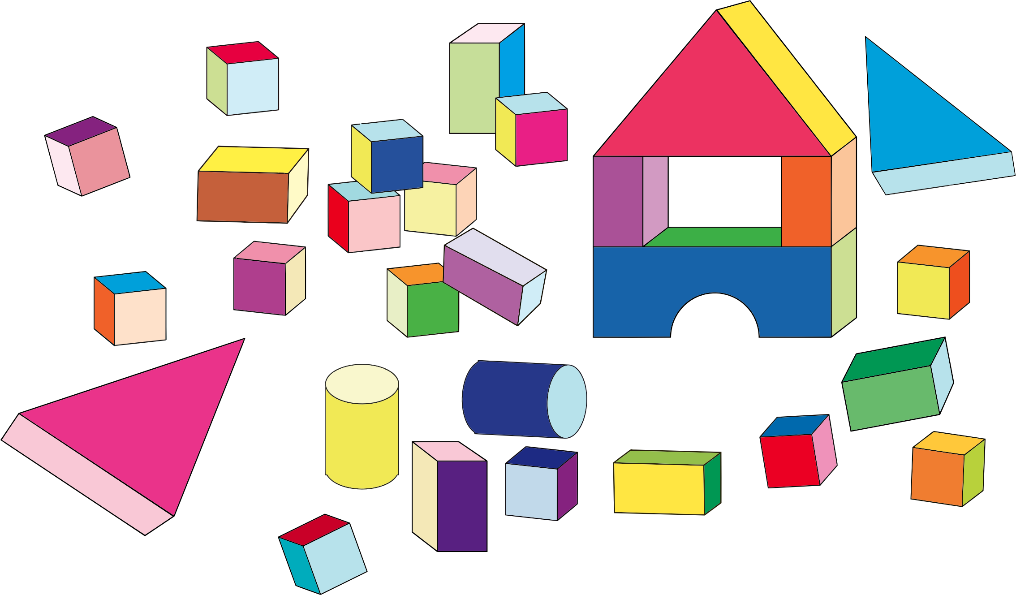
kafka connector
openclipart
Notes:
Alpakka Kafka connector is just one tool in large toolbox of tools in Akka Streams, Akka Cluster, Akka core, and a whole ecosystem of community projects.
Akka Streams is ubiquitous within Akka, Play, and Lagom
Makes integration between all tools easy
With these tools you can build any kind of Fast Data platform you want, but they’re lying on the floor and you need to pick them up.
I hope this presentation has got you thinking about the possibilities. Good luck!

Slide 67
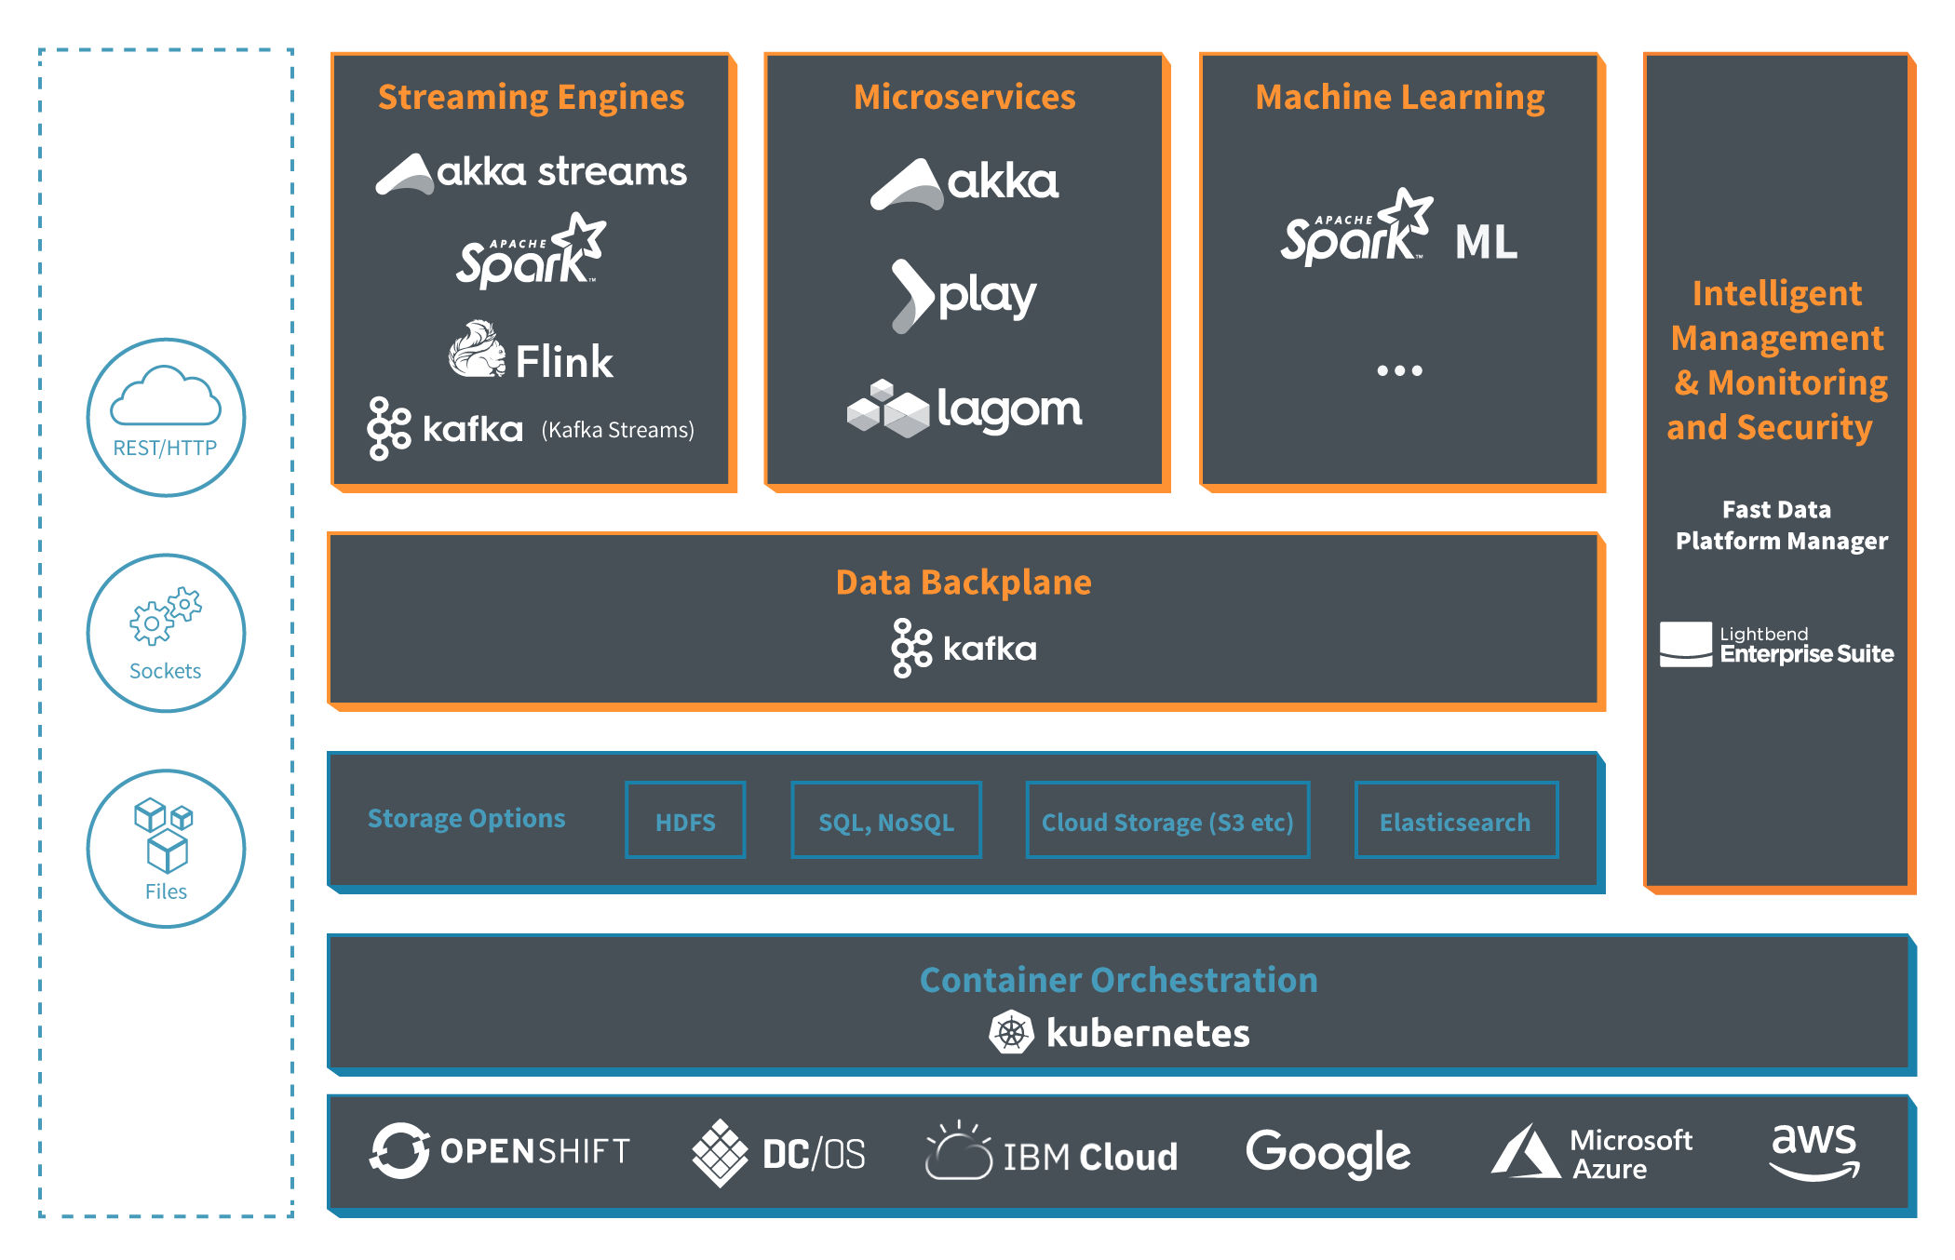
Lightbend Fast Data Platform
http://lightbend.com/fast-data-platform

Slide 68

Thank You!
Free eBook!
https://bit.ly/2J9xmZm
Sean Glover
@seg1o
in/seanaglover
sean.glover@lightbend.com

