Slide 1



Evolving Stitch Fix’s Data Platform for Data Lineage
Neelesh Srinivas Salian
DataEngConf, New York
November 9, 2018

Slide 2

Stitch Fix
Personalized styling service serving Men, Women, and Kids
Founded in 2011, Led by CEO & Founder, Katrina Lake
Employ more than 5,800 nationwide (USA)
Algorithms + Humans

Slide 3





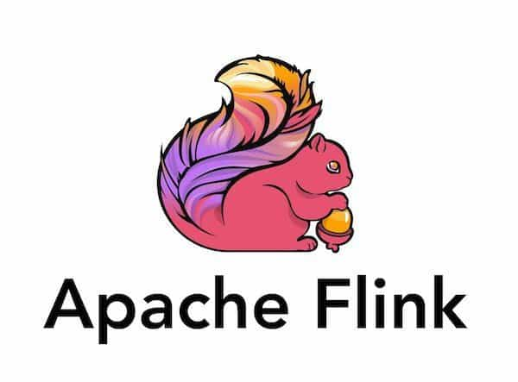
About Me

Slide 4
This talk
Data Ecosystem
Data Lineage
Our Need and Challenges
Evolution
Architecture
Questions

Slide 5
Data Ecosystem

Slide 6
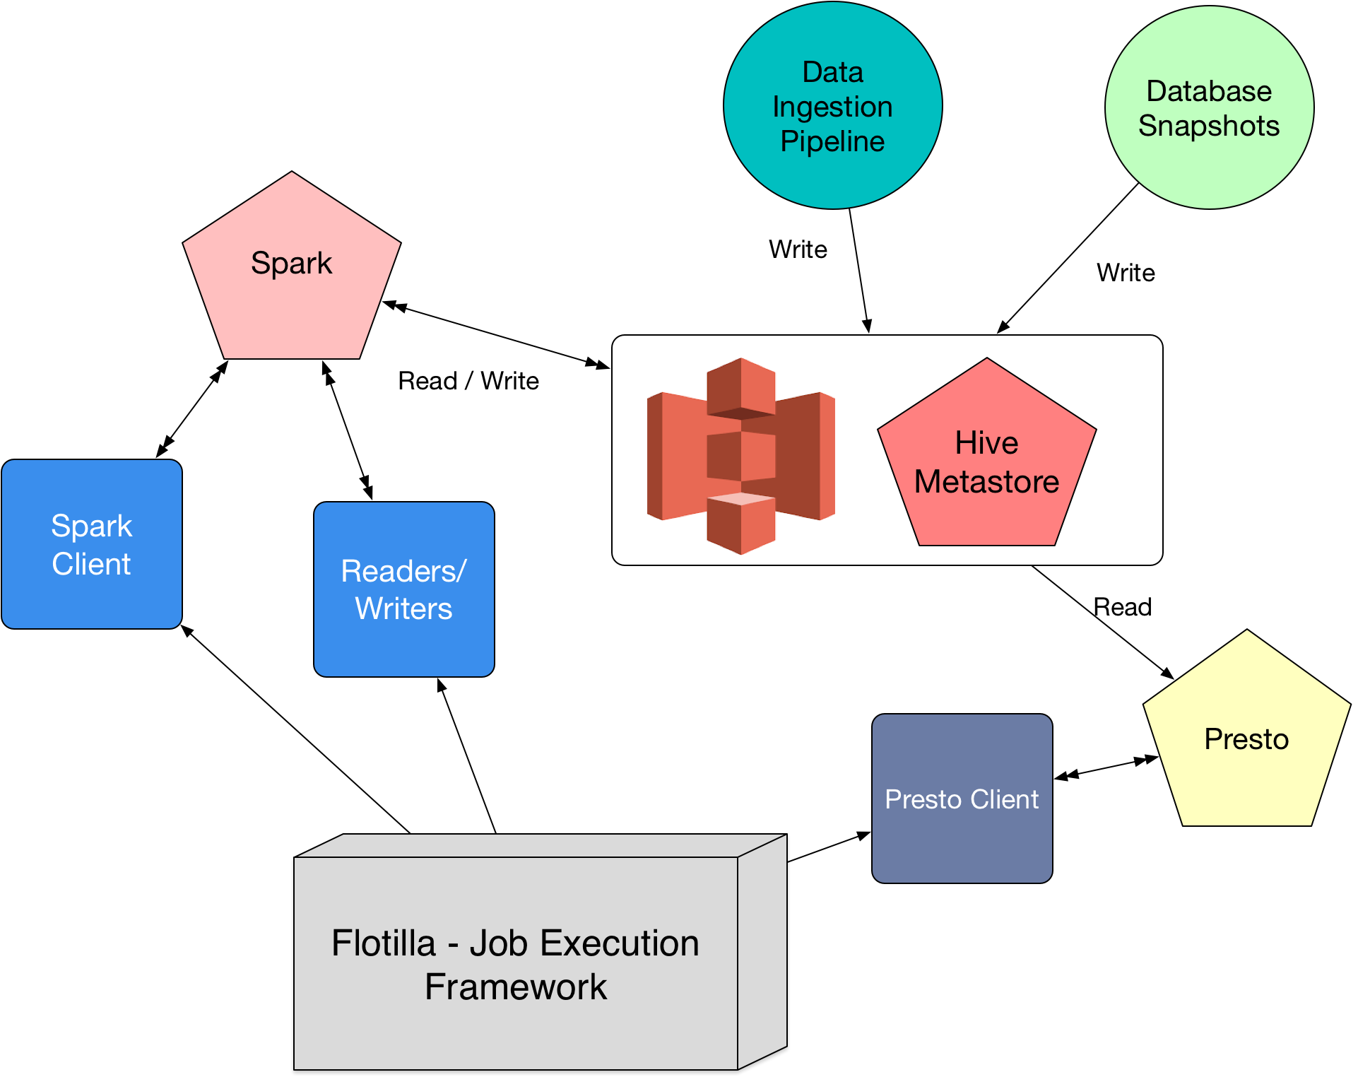

Slide 7
Data Lineage

Slide 8
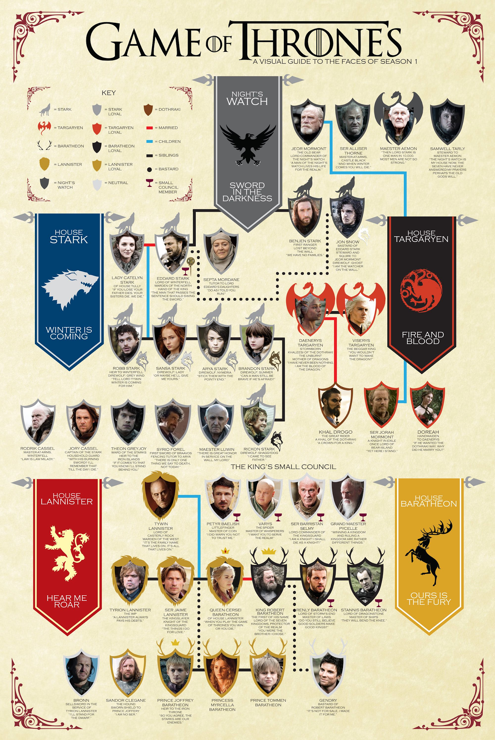
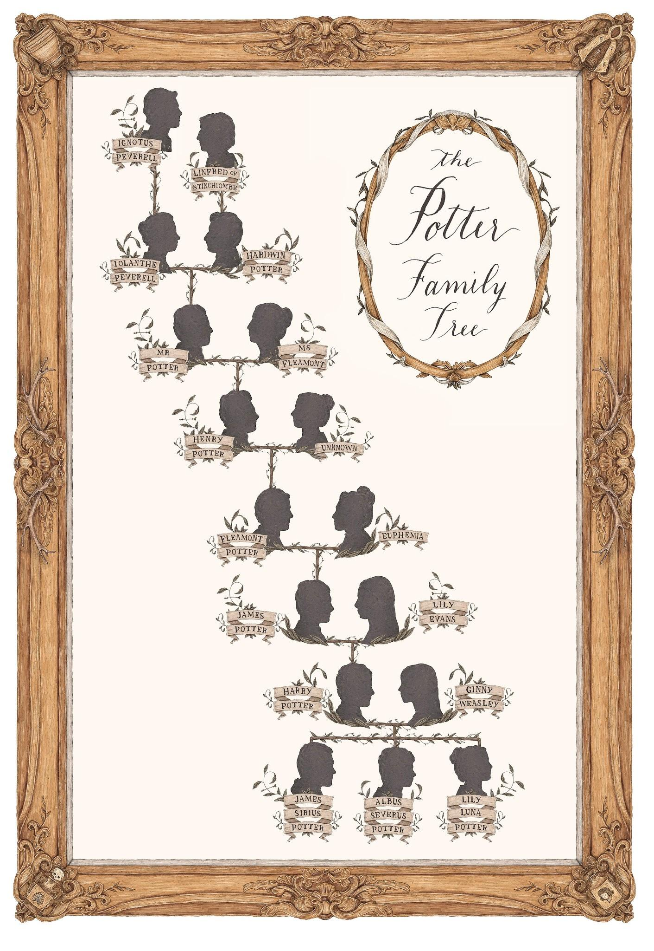

Slide 9
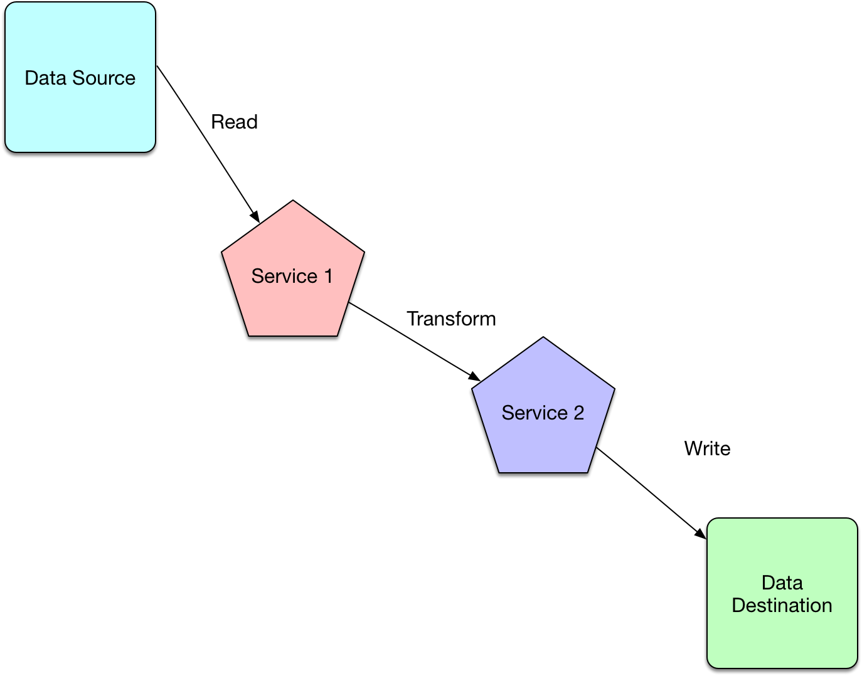

Slide 10
Our Need and Challenges

Slide 11
Key Terminology
Resource
  Structured Data - Hive Table
  Postgres Database
ID - Unique identifier
  Service generated
  Synthesised
Job
  Service defined batch jobs
  Performs read/write on resources
Event
  Read Resource
  Write Resource

Slide 12
Managing a Resource
Visibility - Data Scientists need to know what could break.
  Upstream and Downstream to a Resource
Effects of Change - If a resource is modified what does it affect?
  Schema change
  Data type modification
Tracing - How did we get to this resource - source to destination?
  Journey of a resource
Debugging - How can you reliably debug a large pipeline?
History - What has been writing to this resource?
  Historical view of a resource

Slide 13
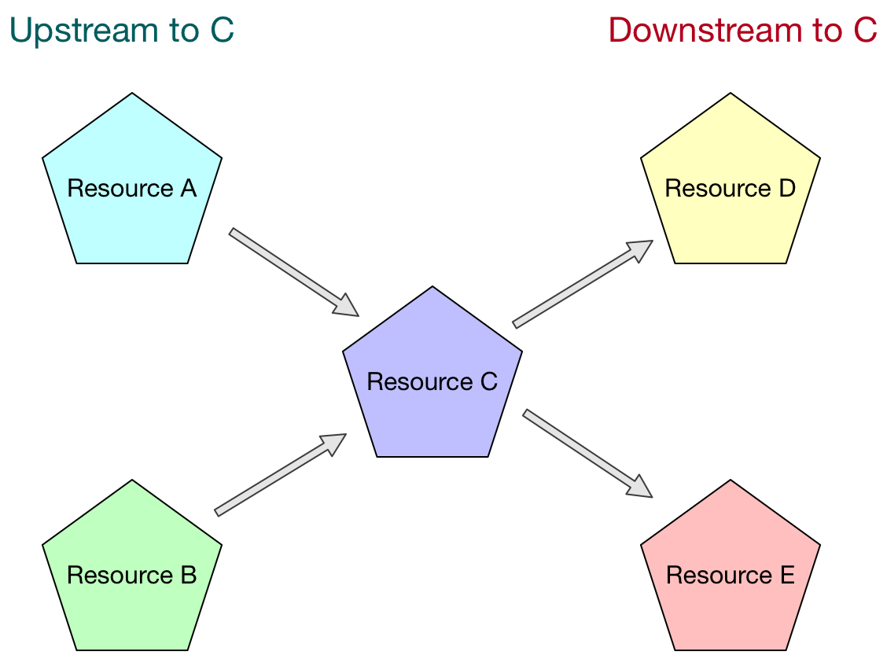
Upstream and Downstream

Slide 14
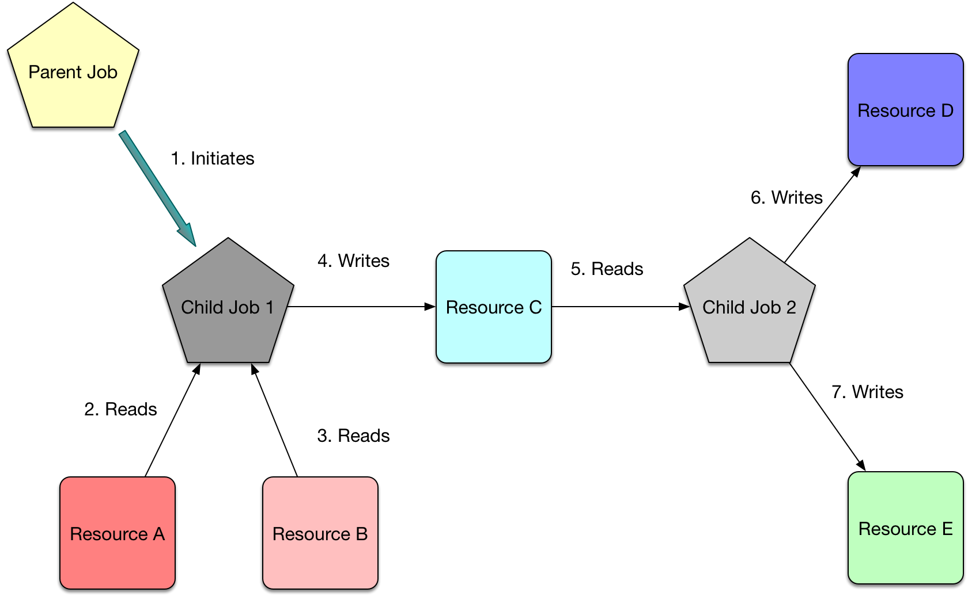
Traceability

Slide 15
Challenges - Consistency
Multiple services
Different Job Representations
Different points of concern
Extractable information needs to be identified

Slide 16
Evolution

Slide 17
Simplifying the Data Model
Owner (User/ Team)
Job
Parent Job
Read Resource / Write Resource

Slide 18
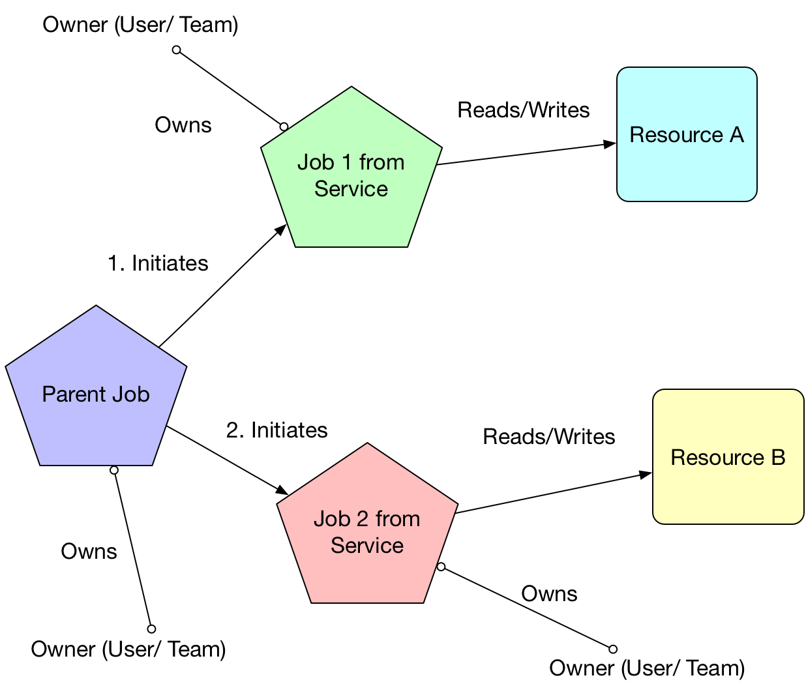

Slide 19
Augmenting Code
Avoid breaking API Changes
  If any, there needs to be better communication
Augment with necessary information to pass to Data Ingestion pipeline
Most of the changes are backend libraries
Idempotency in workflows
  Behavior
  Function

Slide 20
Architecture

Slide 21


Slide 22
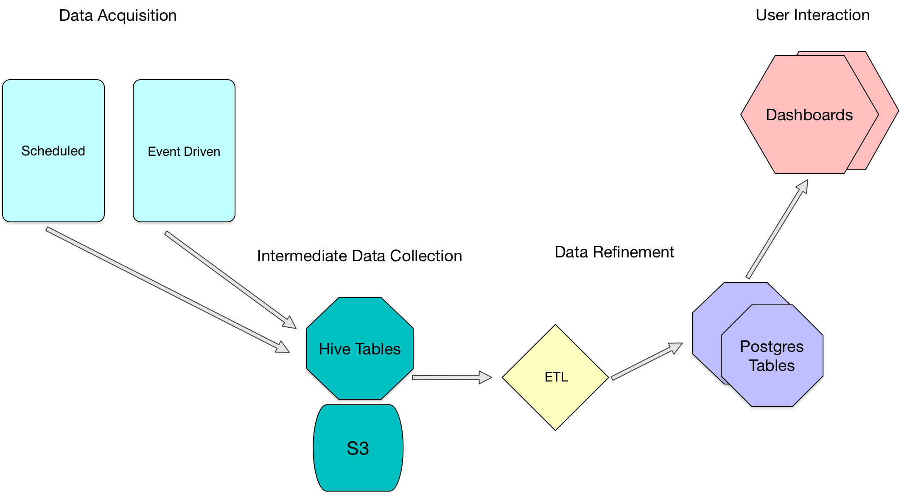

Slide 23
Data Acquisition
Event Driven
  Using the Data Ingestion pipeline
  A Custom S3 Sink to write to Hive table
  Clients can send lineage information
Scheduled
  Ad-hoc usage
  Use only if additional information is needed
  Harder to maintain

Slide 24
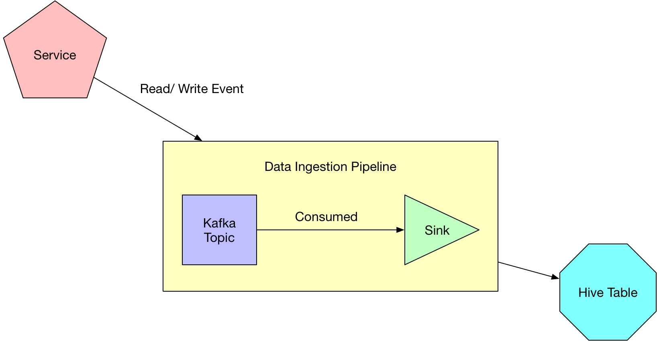
Event Driven

Slide 25
Intermediate Data Collection
Resource Attributes
  database
  table
  batchId
Service Data Attributes
  owner
  jobId
  serviceName
  parentId
Hive Tables

Slide 26

Presto Data Lineage
Extract information from Queries
Currently implemented
Missing pieces
  Parent- Child relationship
  Augmenting various clients

Slide 27


Spark Data Lineage
Changing the execution and deployment of Spark jobs
Adding ability to log reads and writes as the happen
Move over to Parquet as the default FileFormat
Augmenting library + clients to pass parentage information

Slide 28
Data Refinement
ETL
Regular cadence of ETLs extracting Lineage information
Output into clean Postgres Tables
ETLs for
  Aggregated Metric Extraction
  Resource Relationships
Postgres DB

Slide 29
User Interaction
Dashboards for Resource Views
  Showing Upstream and Downstream dependencies
Static Views
  Metrics from the Warehouse
Dynamic Views
  In-flux changes to Resources
Custom dashboards can be built

Slide 30

Thank you!
https://multithreaded.stitchfix.com/

