Slide 1
Data Pipeline Frameworks
The Dream and the Reality
DataEngConf, NYC
Nov. 9, 2018
Mark Weiss
Senior Software Engineer, Beeswax
mark@beeswax.com
LinkedIn: @marksweiss
Notes:
Hello. My name is Mark Weiss and I'm a senior engineer at Beeswax, an online advertising company here in New York. I've been focused on our data pipeline platform for about the last year and a half, and have a background in ETL and data-focused applications for the last 12 years or so.
(Quick show of hands …)

Slide 2

Topics
About Beeswax and Our Pipelines
Building an Example Pipeline
Reality Checks
What Do Data Pipeline Frameworks Give You?
The Dream
Notes:
So here is a more detailed overview of the talk.
I'm going to start with a quick overview of Beeswax' business and our current data pipelines.
Then we'll introduce our example pipeline, and dig into issues we face implementing it with two different pipeline frameworks, AWS Data Pipeline and Airflow.
I'll talk about a couple of Reality Checks. These are issues you are going to face whatever pipeline framework you choose because they are just part of the solution you need that no framework is going to fully address.
Then we'll talk about why it's still worth picking a framework and building out a pipeline solution and what you get from having one. What you get is, of course, that you are living the Dream.

Slide 3
About Beeswax and Our Pipelines
Notes:
First, let's set the stage by describing what Beeswax does and some data pipelines we have operating in production now to set the context for our example.

Slide 4











The Beeswax Programmatic Platform
Ad Exchanges
Millions of requests per second
Bid Request
Bidder
Bid
Response
99th percentile response time < 30 ms
Notes:
Our core business is programmatic advertising
Publishers want to sell the right to put an advertisement into an ad slot on a web page or in an app
They publish an description of the ad slot to exchanges
Exchanges forward these messages to bidders, such as Beeswax
Exchanges arrange to deliver the ad for the bidder that wins the auction
From the data point of view, key things to understand is that our platform is:
ingesting this firehose of millions of incoming bid requests per second
making bidding decisions very quickly with very low latency against this volume of bid request
Of course all of this activity generates a lot of data ...

Slide 5






Beeswax Data Pipelines: Processing at Scale
Bid Request
Kinesis
Data Warehouse
Bid Response
ETL
Impression
Redshift
S3
AWS Data Pipeline
Event Processing
Click/
Conversion
Data Lake
EMR/Hive
Airflow
Notes:
… which we see here.
Bidding transactions generate several asynchronous event streams:
bid requests
bid responses
impressions -- which are wins in the auction
some users click on the ad
some users visit landing pages or take other actions that can be related back to the ad they were shown, called a conversion
ETL implemented in AWS Data Pipeline over Redshift.
It has to:
handle this scale
join all of these event streams
merge attributes
build aggregates
enforce business logic
solve hard problems such as figuring out which impression from 30 days ago should get credit for a user visiting a landing page today

Slide 6
Beeswax Data Pipelines: Processing at Scale
Bid Request
Kinesis
Data Warehouse
Bid Response
ETL
Impression
Redshift
S3
AWS Data Pipeline
Event Processing
Click/
Conversion
Data Lake
EMR/Hive
Airflow
Notes:
Data in Redshift is persisted for 30 days
We want to make use of it for longer for internal analytics and machine learning modeling
So we have built a datalake in S3
Airflow pipelines extract the newly arrived data each day from the main fact table in Redshift, copy it to S3, transform its format to parquet, and update a fact table in Hive

Slide 7
Beeswax Data Pipelines: Processing at Scale
Bid Request
Kinesis
Data Warehouse
Bid Response
ETL
Impression
Redshift
S3
AWS Data Pipeline
Event Processing
Click/
Conversion
Data Lake
1% Sampled Auctions | Billions / Day
Bid Requests | 10's of Billion / Day
Impressions | 100's of Million / Day
EMR/Hive
Airflow
Notes:
These events generate a lot of data!

Slide 8
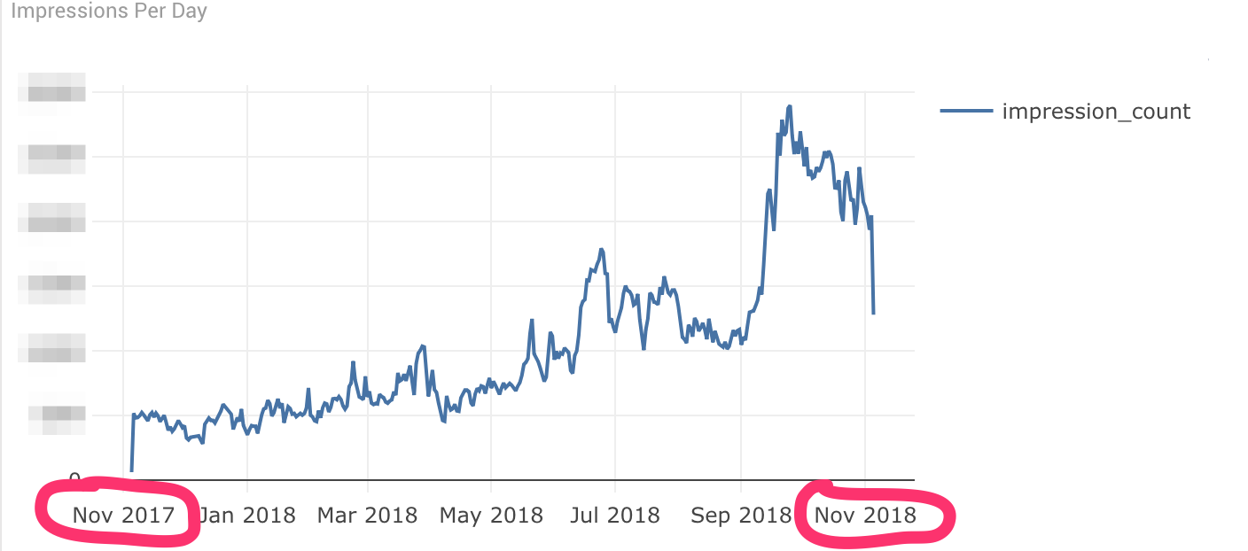
Beeswax Data Pipelines: The Scale is Growing
Notes:
We have been investing in and improving our data pipelines for the last two years or so
This chart shows you an idea why -- data volume has tripled in the past year!
So improving our data pipelines is essential for continuing to scale our business
But we are also thinking strategically about a complete solution for defining and running data pipelines that will help us:
build pipelines quickly and with low engineering effort
support new use cases easily
accelerate growth while decreasing data engineering effort

Slide 9
Building an Example Pipeline
Notes:
So, with that in mind let's dive into an example ...
We'll look at what we found out when we considered implementing this pipeline with two very different frameworks, AWS Data Pipeline and Airflow.

Slide 10
The Example Pipeline: Building a Datalake
S3
Data Warehouse
Data Lake
AWS Data Pipeline
Redshift
Hive/
EMR
Airflow
Notes:
We must build a pipeline to periodically extract new data from the Redshift data warehouse to a Datalake created in Hive over S3
The diagram shows two paths to achieving the same goal, using two different pipeline frameworks, Airflow and AWS Data Pipeline
Hopefully this is a typical enough use case hat you can relate it to your situation

Slide 11
The Frameworks: Data Pipeline vs. Airflow
vs.
Notes:
Example is drawn from our actual experience
We compared the approaches and features sets of various data pipeline frameworks
Decision narrowed down to AWS Data Pipeline, which we know now to operate but we were not particularly happy with, and Airflow
Data Pipeline is a typical first-generation AWS service:
utilitarian
integrated with other AWS services
painful APIs
terrible UI
Data Pipeline is a managed service, taking care of a range of operational responsibilities for us.
Airflow:
shiny new object
the de facto winner of the current generation of open source pipeline frameworks, adopted as an Apache Incubator project
a code framework only not a service
it provides many more operators than Data Pipeline and is more agnostic
very nice UI

Slide 12

The Frameworks: Data Pipeline vs. Airflow
Notes:
The decision feels a little bit like this …
We already know how to type with Data Pipeline, and we can just start typing. But no matter what we do, AWS Data Pipeline can only do so much, and we've been working with it for a while, so we are familiar with its limitations.
On the other hand Airflow looks like it could be much more powerful and nicer to work with … if we climb the learning curve we need to actually have it running in production. But if we do the hope is that we'll have a powerful general-purpose platform for running our pipelines.

Slide 13
The Example Pipeline: We Need Operators
S3
Data Warehouse
Data Lake
AWS Data Pipeline
Redshift
Hive/
EMR
Airflow
Notes:
So we start evaluating both frameworks as tools to build our pipeline.
We need to unload data from Redshift to S3
We need to load that data into a table in Hive over S3
We need operators to perform these steps
So the first question we want to answer is:
Do the frameworks deliver on their promise of providing pre-built operators we can use?

Slide 14
The Example Pipeline: We Need Operators
S3
Data Warehouse
Data Lake
AWS Data Pipeline
Redshift
Hive/
EMR
Airflow
Notes:
Let's look at Airflow first

Slide 15
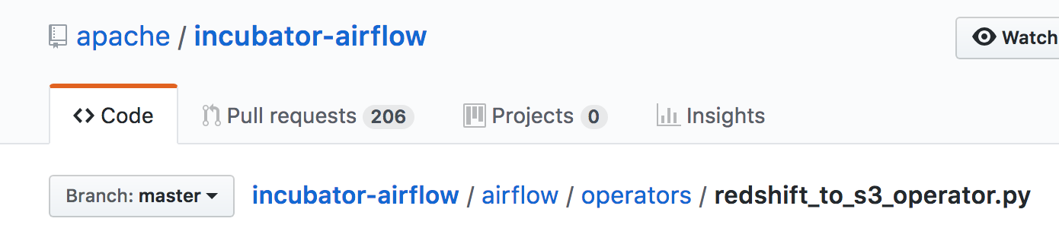
The Example Pipeline: We Need Operators
S3
Data Warehouse
Data Lake
AWS Data Pipeline
Redshift
Hive/
EMR
Airflow
Notes:
Let's look at Airflow first.
They appear to have the exact operator we are looking for, "RedshiftToS3Operator."
And the code is open source so we can look at exactly how it works and what arguments we can pass to control its behavior. Great!
But when we read the code we see that:
It doesn't support retrieving credentials through SSM, our required method
We can't use this Operator code without forking, modifying and maintaining our own version
Furthermore, although this has been fixed since, at the time of our evaluation the operator didn't support configuring extracting data to CSV with or without headers. This is a small but obvious example of how brittle it is to rely on pre-built operators.

Slide 16
The Example Pipeline: We Need Operators
S3
Data Warehouse
Data Lake
AWS Data Pipeline
Redshift
Hive/
EMR
Airflow
Notes:
Now we look at the Data Pipeline SQL Operator.

Slide 17
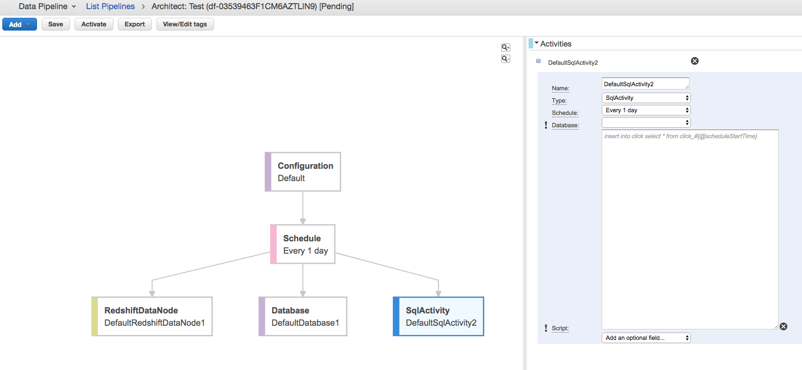
The Example Pipeline: We Need Operators
Paste your code here
Notes:
Using the UI to build pipelines is painful. We can paste SQL in directly, which is only suitable for prototyping, if that
We can point to a SQL script file on S3, so if we want to deploy versioned code we would have to build tooling to pull versioned coded from our repo to S3 location
So for anything non-trivial we need to write custom shell activities that implement the Data Pipeline API

Slide 18
The Example Pipeline: We Still Need Operators
S3
Data Warehouse
Data Lake
?
?
AWS Data Pipeline
?
?
Redshift
Hive/
EMR
Airflow
Notes:
So the first thing we realize is that we are not going to be able to use the pre-implemented operators "off the shelf."
The more we dig into our requirements, the more we see that this is true.

Slide 19
Summary: Why We Still Need Operators
Airflow
  Code does not support authentication the way we do it
  Code does not have features we need and can't be parameterized to support them
AWS
  Need custom tooling to support proper versioning
  Need to write the Operator code ourselves

Slide 20
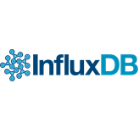

The Example Pipeline: Can't Extend Operators
AWS Data Pipeline
Airflow
Notes:
The more we dig into our requirements, the more we see blocking issues with using the pre-implemented operators
For example at Beeswax we are very focused on collecting metrics from our applications
We want to emit metrics on every step in a job:
how long the step took to run
success or failure count
Send metrics to a time series database, in our case InfluxDB
Neither framework provides the hooks for us to record metrics or plugins to integrate a metrics library of our choosing
Similarly, we want to raise alerts to PagerDuty from exception handling blocks if a task raises an exception, but we aren't able to
Could possibly get close to our goals in Airflow using Hooks, which wrap events in custom code. But Hooks aren't available for all the events we want to add behavior to.
For Data Pipeline we definitely need to design and implement our own solution
The fundamental issue is that you want a Data Pipeline Platform that works like the rest of your stack
You already have made many opinionated decisions about many things, and done the work to make those choices work
It is very unlikely that pre-built operators will have made all the same choices or be implemented flexibly enough to support all your requirements

Slide 21

Example Pipeline: Can't Integrate Existing Code
https://xkcd.com/353/
Notes:
Same issue if we want to integrate any existing code
In our case, we didn't need to "import antigravity" like in XKCD here, but we did have three years of production Python code that we wanted very to leverage by being able to import it into our pipelines just like any other application
Not possible in Data Pipeline without writing custom activities from scratch
In Airflow, we could use their Plugin API, but plugins have to implement a wrapper interface. And linting and testing code with plugins is complicated because import paths for plugins resolve dynamically and only in processes launched by Airflow

Slide 22
(First) Reality Check
Notes:
This brings us to our first pipeline reality check ...

Slide 23

Reality Check: Expect to Implement Your Own Operators
The more you look at existing operator code, the more issues you'll find
Notes:
The more you look at existing operator code, the more issues you'll find, because ...
There is not clean separation of concerns between implementation and many other aspects of pipelines running in production, such as:
Metrics
Monitoring
Alerting
Logging
Authentication
Integrating third-party libraries
Integrating existing code
Security
and so on and so on, ...

Slide 24
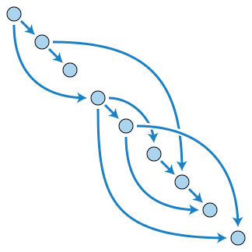
Reality Check: Operators Require Flexible Config
The strength of Data Pipelines is generic reusable code driven by config ...
… but this means every behavior you want to control has to expose arguments that you can set values for in config
db_con = {host: "abc", port: "123"}
Config
redshift_op = RedshiftOp(db_conn)
DAG
class RedshiftOp(object)
def __init__(self, db_conn):
self.db_conn = db_conn
Code

Slide 25
Reality Check: How to Implement Your Own Operators
BeeswaxRedshiftToS3Operator
BeeswaxBaseOperator
AirflowOperator
Notes:
We decided to solve this problem by committing to implementing our own operators and building that into our design
Airflow Operators must inherit from AirflowOperator, which wraps all the plumbing required for Airflow to use them in pipelines
So we derived a base class from that class and then implement all of our operators as derived from our base class

Slide 26
Reality Check: How to Implement Your Own Operators
BeeswaxRedshiftToS3Operator
BeeswaxBaseOperator
AirflowOperator
Notes:
This lets us add standard behaviors for all of our Operators to the base class and add custom behavior as needed to any specific operato
For example all operators report custom metrics from the base class:
duration of task execution
success or failure count
But if we want custom error handling logic particular one operator, we can implement that in that operator

Slide 27
Deploying an Example Pipeline

Slide 28
Deploying Example Pipeline
S3
Data Warehouse
Data Lake
AWS Data Pipeline
Redshift
Hive/
EMR
Airflow
Notes:
Let's return to our example pipeline

Slide 29

Deploying an Example Pipeline
Config
DAG
Code
Notes:
We now turn to operational questions
how will we package our DAG, Config and Code?
how will we deploy
where will our pipeline run?

Slide 30
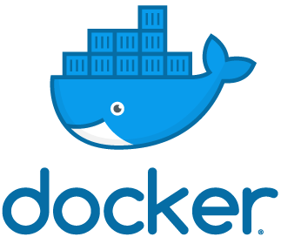
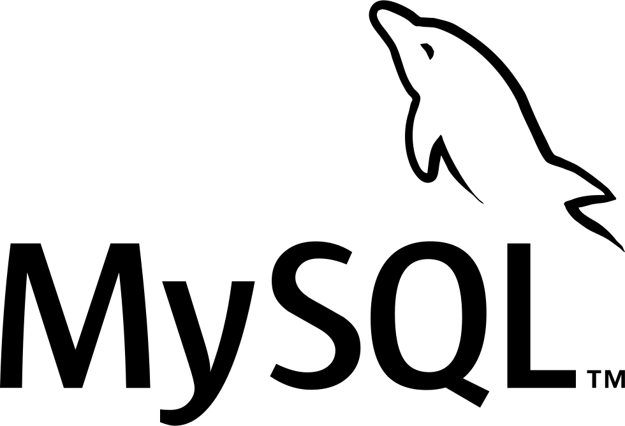

Deploying an Example Pipeline: Airflow
Config
DAG
Code
Notes:
Airflow deployments require you to:
package and deploy your DAG, config and code to some runtime
deploy an Airflow Scheduler and Workers to some runtime
deploy MySql and Redis and configure Airflow to know where they are

Slide 31
Deploying an Example Pipeline: AWS Data Pipeline
Config
DAG
Code
AWS Data Pipeline
Taskrunner
Notes:
If you are running code for your own custom shell activities, AWS deployments require you to:
package and deploy your DAG, config and code to some runtime
deploy the AWS TaskRunner application to a host and run it yourself

Slide 32
(Second) Reality Check
Notes:
This brings us to our second pipeline reality check ...

Slide 33
Reality Check: You Don't Have "No Ops"
Config
DAG
Code
Notes:
There isn't a "point and click" Data Pipeline solution
Both and Airflow and AWS Data Pipeline require you to solve packing, deployment and running your pipelines in production

Slide 34
What Do Data Pipelines Give You?
Notes:
OK, so at this point you may be wondering, what exactly are these frameworks giving me? Great question.

Slide 35
Why Use a Data Pipeline Framework?
Problems are general and easy to get wrong
You need more than just DAGs
Notes:
Despite their limitations there are good reasons to pick a data pipeline framework and stick with it
First, the problems frameworks address are generic but easy to get wrong, which means there is low value in solving them yourself

Slide 36

Why Use a Data Pipeline Framework?
Notes:
Furthermore, a big part of the value proposition of picking a framework is just picking one
Focus development on a shared platform code base that provides the entire organization a powerful set of primitives
Build on your existing code base by integrating it with pipelines as needed
Follow your standard approaches to aspects such as metrics, monitoring, alerting, logging, security, etc.

Slide 37
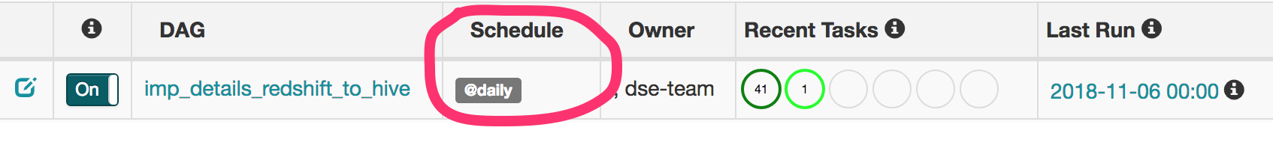
What Do Data Pipeline Frameworks Give You?
Scheduling
DAG Definition APIs
Start
End

Slide 38
What Do Data Pipeline Frameworks Give You?
Design and APIs to configure pipelines and define a runtime environment
Config
DAG
Code

Slide 39
What Do Data Pipeline Frameworks Give You?
Handling Task Failures
Retries
Backfill

Slide 40
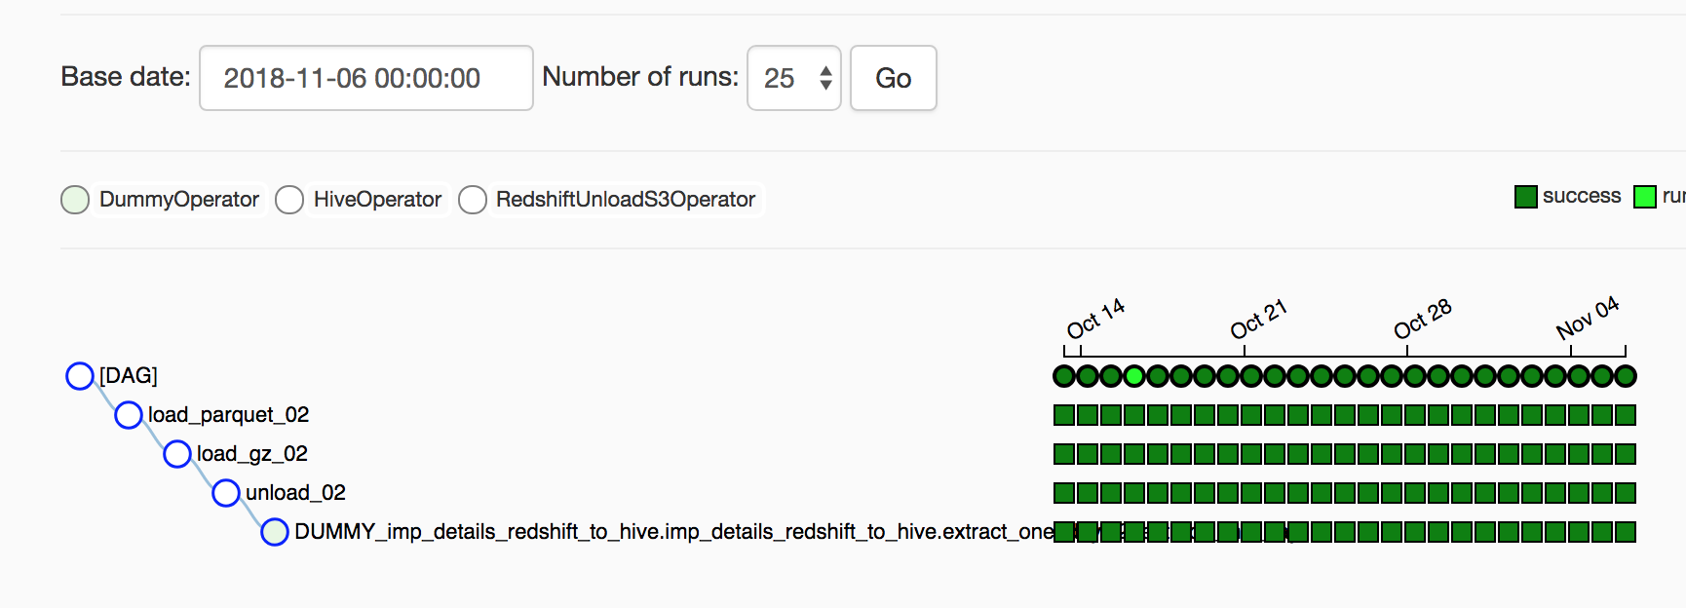
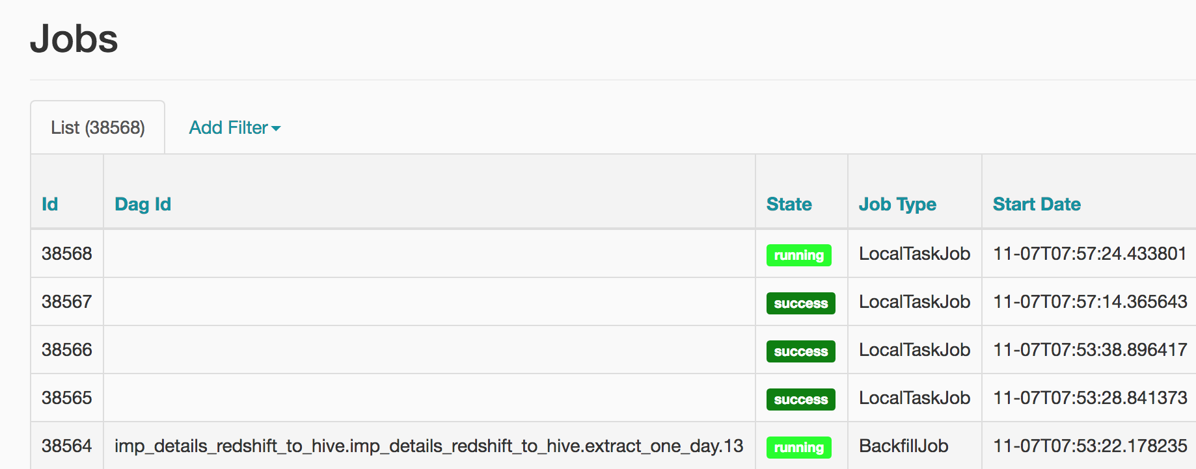
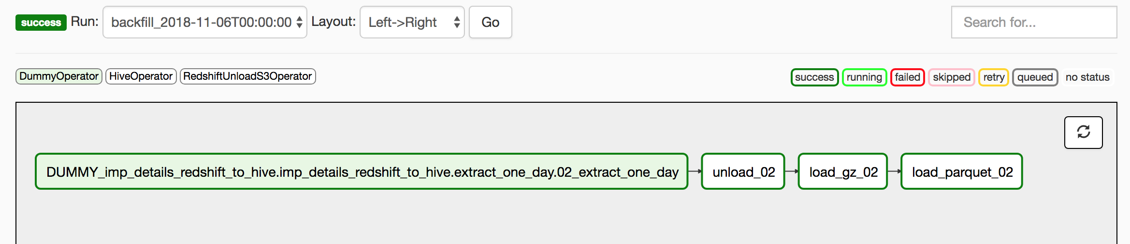
What Do Data Pipeline Frameworks Give You?
UI for Status and Management

Slide 41
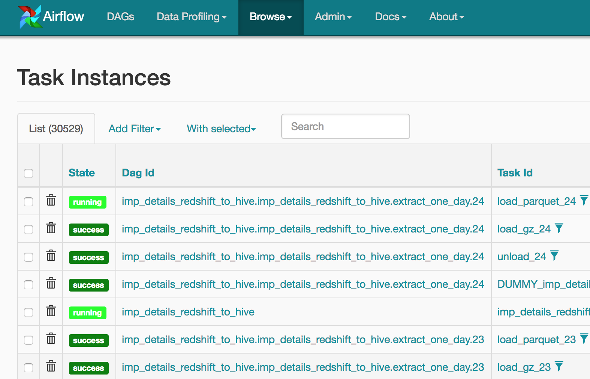

The Data Pipeline Platform
Start
{
'database': MY_DB
'table': 'impressions'
}
End
Notes:
So, you do get value from a pipeline framework
And if you do the work to solve packaging, deployment and implementing operators that you can operate in production, then you have a Data Pipeline platform that provides a complete model for ...
defining
configuring
packaging
deploying
scheduling
running
operating
… arbitrary sequences of computation

Slide 42

The Data Pipeline Dream
Notes:
And that, my friends, is living the Dream

Slide 43
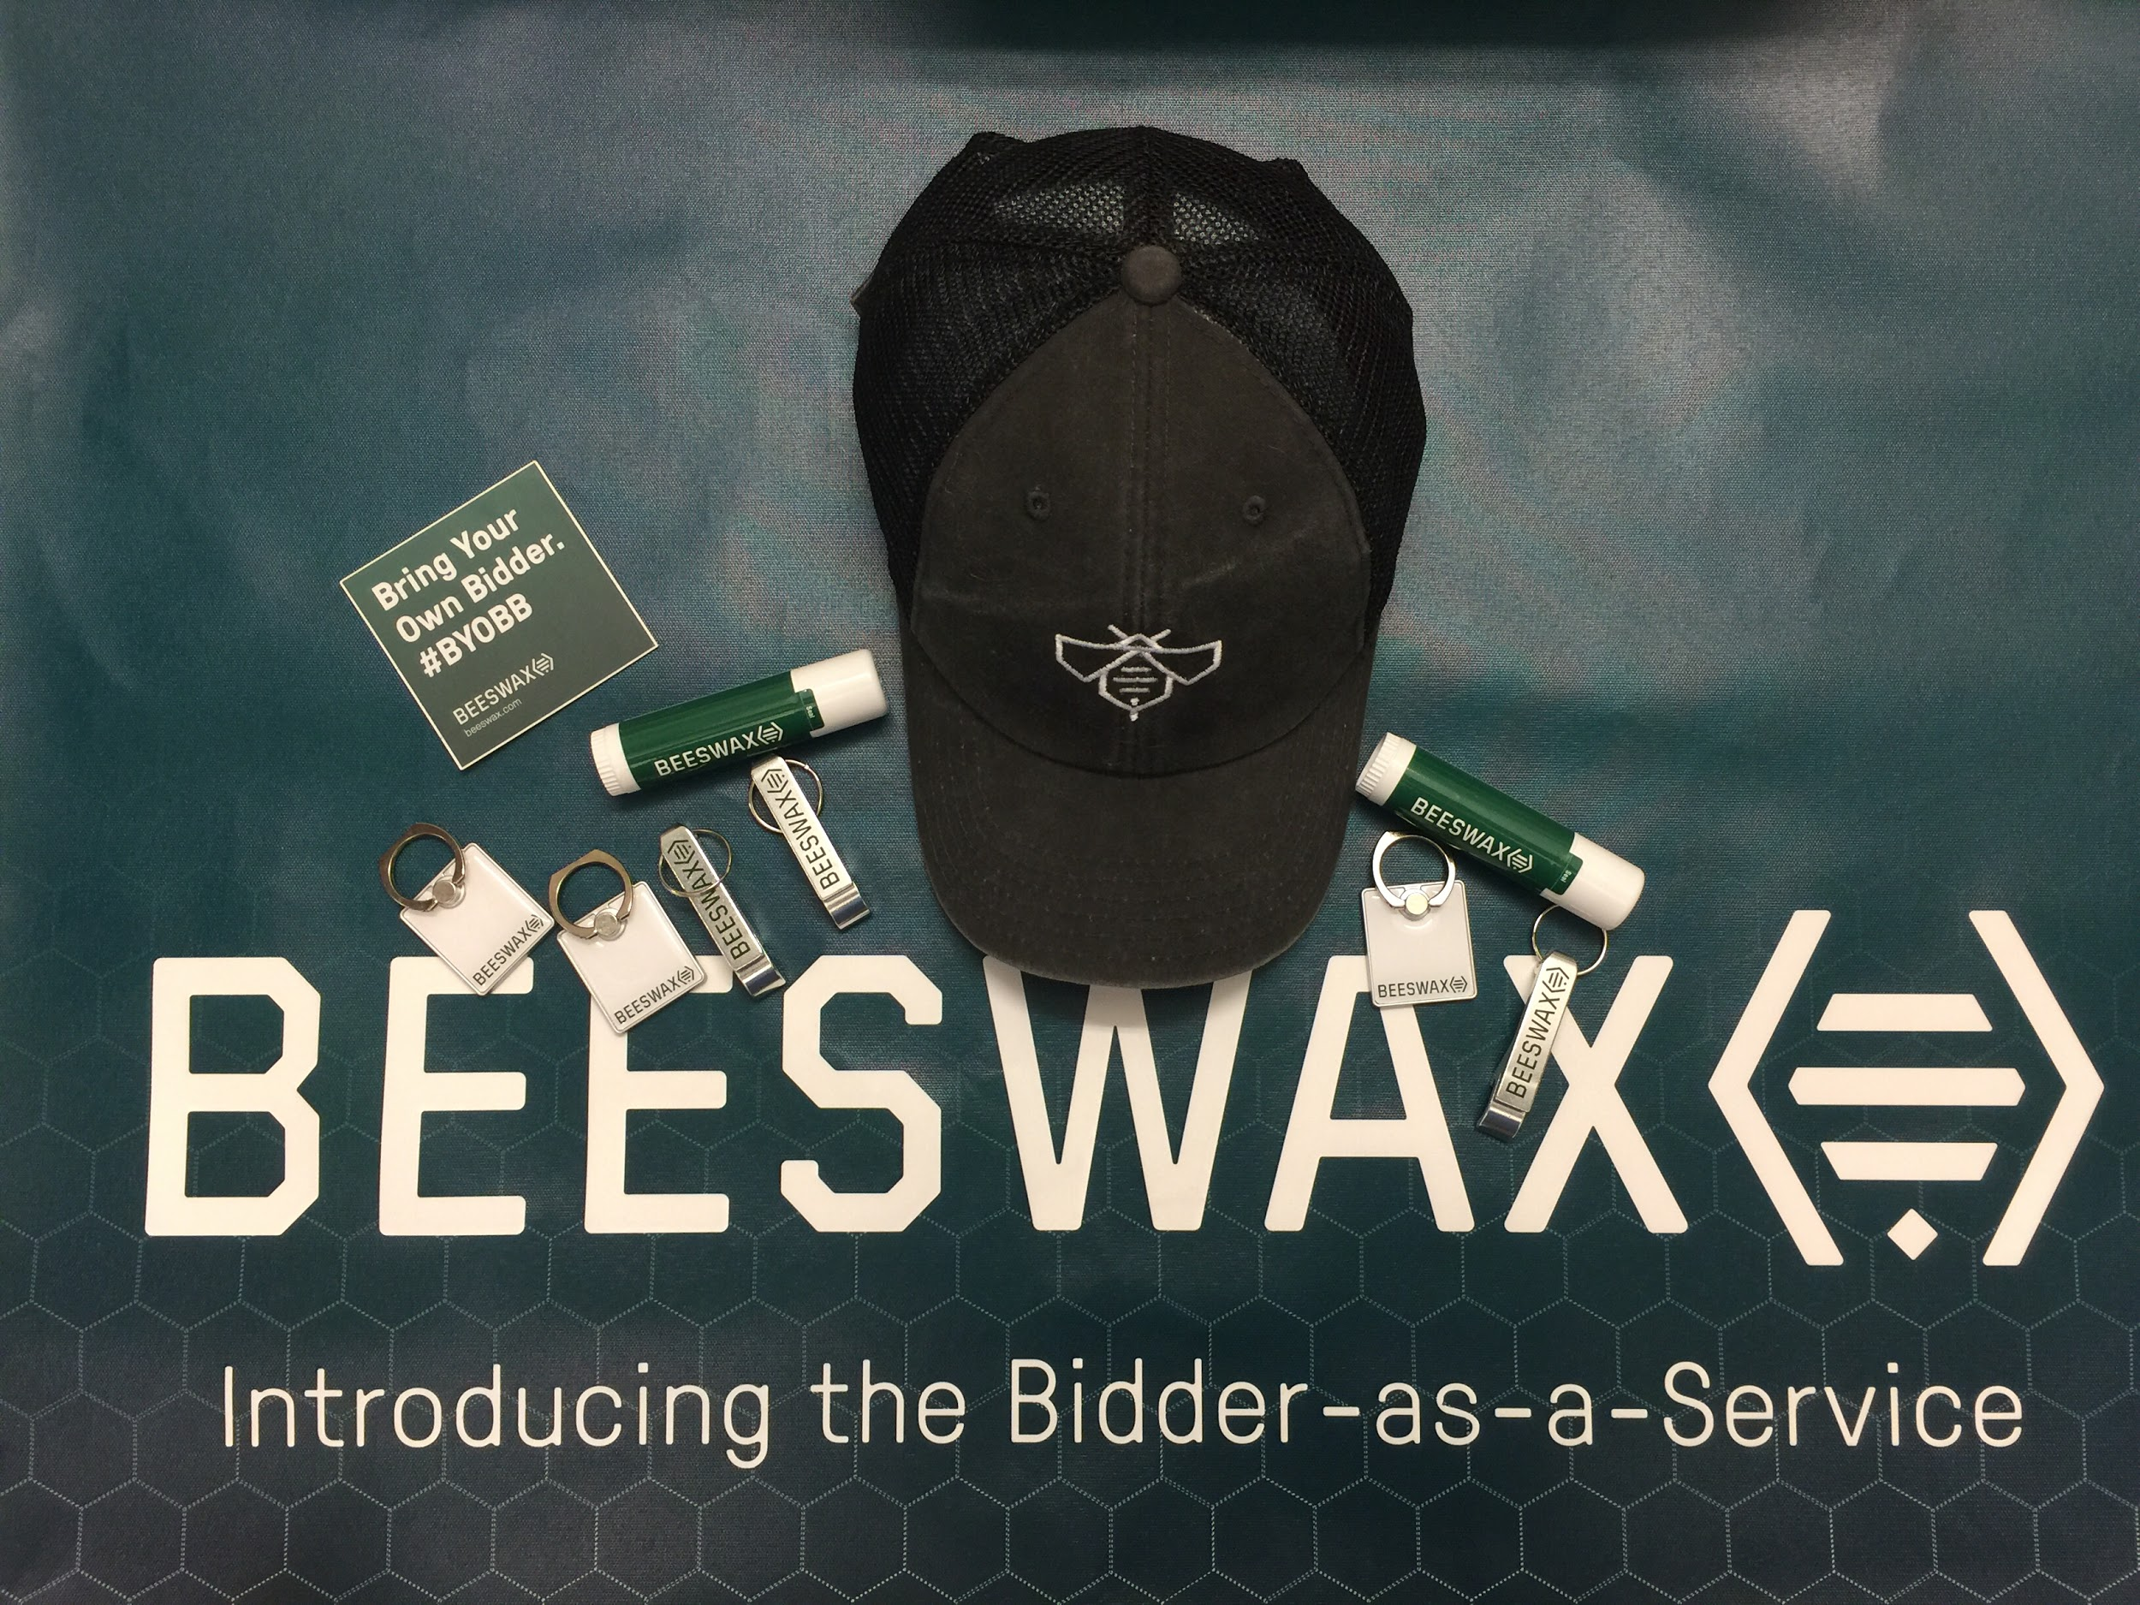
Questions?
We are growing fast
and hiring!
Visit our table, find out more and score cool Bee-swag ⇪⇪ 🐝
Talk to me at office hours following the talk
Contact me: mark@beeswax.com, LinkdedIn: @marksweiss

