Slide 1
Automating Modeling Pipelines
Deploying thousands of models per day

Slide 2
Agenda
Intent
DoubleSpeak: Feature extraction and model serving
Model proliferation
Automated modeling pipeline
Questions

Slide 3

DoubleSpeak team
Yoojong Bang
  Principal data scientist
Yoaquim Cintron
  Senior software engineer
William Nelson
  Principal data scientist
Gabriel Peredo
  Senior software engineer
Sebastian Vivanco
  Lead software engineer

Slide 4
Introduction to Intent

Slide 5

Introduction to Intent
Web experiences are designed for average users, but different populations exist within every site
Intent Media turns averages back into individual users, allowing sites to give each user the right experience
Notes:
Intent Media believes that the web is designed around catering to the average user.
But, average users don’t really exist. They’re mythical.
The question we pose to a lot of our partners is: if you could understand your individual users and get away from having to make decisions based on averages, how much value could you unlock by giving individuals the experience they really need?

Slide 6
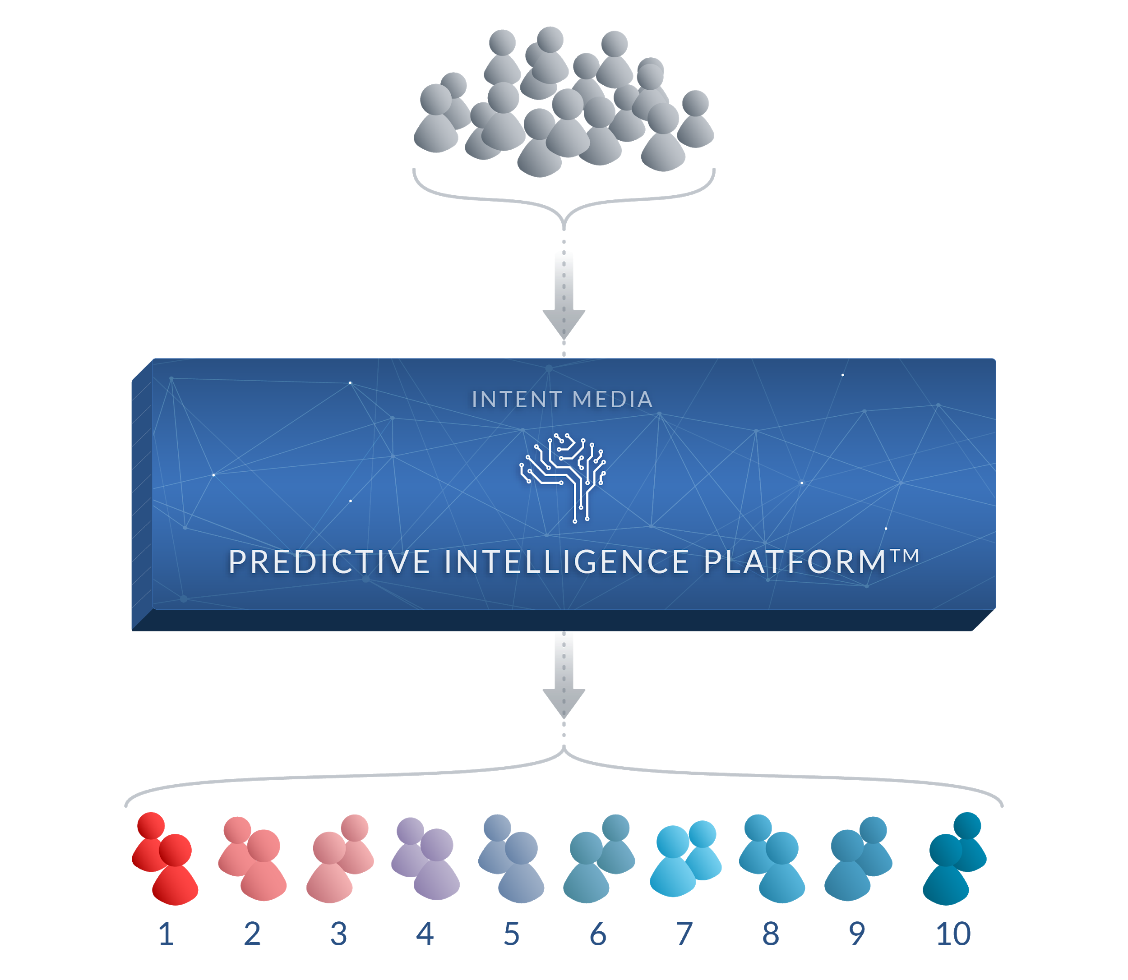
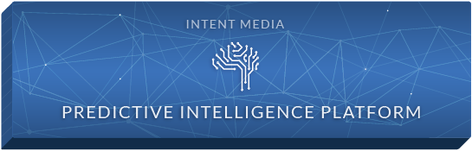
Introduction to Intent
site visitors
INTENT SCORE
Notes:
Well, that’s what we do. We turn your averages back into individual users.
Our Predictive Intelligence Platform uses machine learning to take hundreds of signals to make real time predictions about how likely a given user is to convert at any given time.
Based on these predictions, we assign users an Intent Score.
Essentially, we’re disaggregating your users - identifying subpopulations for whom you can do unique things. With a better, more nuanced view of your users and what they are looking to do at every page view, you can make better decisions about how to serve them.

Slide 7
Introduction to Intent
site visitors
e.g. real time prediction of likelihood to convert
INTENT SCORE
Notes:
Well, that’s what we do. We turn your averages back into individual users.
Our Predictive Intelligence Platform uses machine learning to take hundreds of signals to make real time predictions about how likely a given user is to convert at any given time.
Based on these predictions, we assign users an Intent Score.
Essentially, we’re disaggregating your users - identifying subpopulations for whom you can do unique things. With a better, more nuanced view of your users and what they are looking to do at every page view, you can make better decisions about how to serve them.

Slide 8
Introduction to Intent
  Media experience
  Commerce experience
Example use case
Media
Bookings
Notes:
Here’s our vision of what that looks like
We’re here to help you use Intent Scores to hyper-target users with the experience that’s right for them
Give a media-led experience to users with low intent scores, a conversion led experience to users with high intent scores - and then in the middle, find the right balance between media and conversion led experiences and find other ways to optimize the experiences based on our predictions and the scores we give to each user

Slide 9







































































Introduction to Intent
40
COUNTRIES
21
LANGUAGES
200+
ADVERTISERS
1.3BN+
SEARCHES / MONTH
Notes:
And, so you don’t have to just believe me - Here’s a snapshot of our partner base. We cover 40 countries, more than 20 languages, and process more than 1 billion searches every month
We have long-standing relationships with the likes of Expedia, PCLN group and lastminute
I would encourage you to talk to any of our partners and get a reference from them - we take pride in our longevity and relationships

Slide 10
Introduction to Intent
Data Science at Intent Media
Data collected from tags / pixels on partner sites
Models trained on this data
  For example: to predict likelihood to convert
Models used for real time predictions (<10 ms), at high throughput (> 160k/ minute)
Predictions used to decide:
  Whether to show media, conversion boosting experience, nothing
  Which type of experience a user sees (e.g. which type of ad)
Core to the business

Slide 11
DoubleSpeak: Feature extraction and model serving

Slide 12
Feature extraction
Feature extraction needs to:
Deal with incomplete data
  Integration issues
  Incomplete or corrupt values
  Nulls
Be production level code
  Robust
  Maintainable
  Efficient
  Well structured
  Complete test coverage
  Continuous integration
Feature extraction needs to:
Allow for rapid experimentation
  New features
  New definitions of existing features
  A lot of throw away code
Be flexible
  Consume different event types
  User friendly
Be feature rich
  Interpolation
  Feature encoding
  Feature analysis
Notes:
Nice talk from Joseph Gonzales from Rise labs

Slide 13
DoubleSpeak: What it is
A Scala library for…
Defining feature extractors
Extracting features
  From Spark RDDs during training batch jobs
  From individual records in real-time
Outputting summary statistics and metadata
  For encoding features in batch jobs
  For encoding features in real-time

Slide 14
DoubleSpeak: What it is
Concise, easy to use API for feature creation
Feature extractors with transformers, imputers
  Feature extractor logic is static scala code
  Transformers and imputers have defaults
  You can choose them appropriately for the ML algorithm you will apply

Slide 15
DoubleSpeak: What it is
Concise, easy to use API for feature creation
Feature extractors with transformers, imputers
  Feature extractor logic is static scala code
  Transformers and imputers have defaults
  You can choose them appropriately for the ML algorithm you will apply
val fs = FeatureSet.of[Impression](validators=List(SingleValue))
.cat(‘device_family, _.request.deviceFamily, transformer = OneHotEncoder)
.num(‘past_visits, _.user.visits.size)
.bin('logged_in, _.user.isLoggedIn)
Notes:
It being code provides a further barrier against inconsistency in feature extraction in real-time vs training

Slide 16
DoubleSpeak: What it is
Robust to schema changes
  Being strongly typed, any schema change that would result in an error fails at compile time
  New categories → OTHER
Can limit the number of categories in a categorical
  Helpful for very large cardinality categorical features
  OTHER category for long tail
Default encoding, interpolation & normalization
  Supports numeric, categorical, binary and map features
Automatically calculate feature summaries
  At training time, over the entire dataset
  Scaling, order of encoded categories, long tail categories.
  Will be used for encoding at both training and prediction time

Slide 17
DoubleSpeak: Feature Extraction
DoubleSpeak
val fs = FeatureSet.of[Impression](validators=List(SingleValue))
.cat(‘device_family, _.request.deviceFamily)
.num(‘past_visits, _.user.visits.size)
.bin('logged_in, _.user.isLoggedIn)
RDD[Impressions]
imp₁
imp₂
⋮
imp_{n}
val trainingImpressions =
val ext = trainingImpressions.rddExtractor(fs)
val featuresAndLabels = ext.referenceFeatures
.join(conversions, …)
.withColumn("labels", …)
val model = new Model.fit(featuresAndLabels)
⋮
cf: Featran from Spotify

Slide 18
DoubleSpeak: Feature Extraction
referenceFeatures
val ext = impressions.rddExtractor(fs, applyScaling = false)
device_family | past_visits | logged_in | features
PHONE | 2 | 1 | [1, 0, 2, 1]
TABLET | 6 | 1 | [0, 0, 6, 1]
COMPUTER | 10 | 1 | [0, 1, 10, 1]
⋮ | ⋮ |  | ⋮
PHONE | 4 | 0 | [1, 0, 4, 0]
rawFeatures
device_family | past_visits | logged_in
PHONE | 2 | 1
TABLET | 6 | 1
DESKTOP | 10 | 1
⋮ | ⋮
PHONE | 4 | 0
Statistical summaries, categories found, etc.
Features that should be removed
Necessary for feature extraction in real time
extractionMetadata

Slide 19
DoubleSpeak: Testing the Model
val testData = ...
Extracted using the same feature summaries
val testFeatures = ext.extract(testData)
model.test(testFeatures)
⋮

Slide 20
DoubleSpeak: Real-time Feature Extraction
val extractionMetadata = … // Load extractionMetadata from training
val extractor = fs.recordExtractor(extractionMetadata)
val features: Array[Double] = extractor(impression)
// Predict based on extracted features

Slide 21
DoubleSpeak: the challenge of success
Lines of feature extraction code:
  more than 10k → less than 1k
Lines of tests:
  more than 45K → less than 3k
Number of tests:
  more than 1k → less than 150
Effort required to include a new feature in production model:
  days → minutes
Have to deal with hundreds of new features → rapidly changing models

Slide 22
Features & models - deployment

Slide 23
Features and models - deployment
Training pipeline
Load data
Extract features
Train model
Test model
Publish model
Prediction service
Feature extractors need to:
Be versioned with the model
Be consistent online and offline
Be associated with feature encoders
Allow for new categories
Find model
Extract features
Make prediction
c.f. sklearn pipeline & joblib

Slide 24
Features and models - deployment
Training pipeline
Load data
Extract features
Train model
Test model
Publish model
New pipeline
(1,2,3,0,0)
(w₁,w₂,w₃,w₄,w₅)
Prediction service
Feature extractors first, then model
New features & model trained
Old features & model currently in production
Find model
(w₁,w₂,w₃,w₄,w₅,w₆)
Extract features
{
(1,2,3,0,0,1)
Old prediction
Make prediction

Slide 25
Features and models - deployment
Training pipeline
Load data
Extract features
Train model
Test model
Publish model
New pipeline
(1,2,3,0,0)
(w₁,w₂,w₃,w₄,w₅)
Prediction service
Feature extractors first, then model
New features & model trained
Old features & model currently in production
Find model
?
(w₁,w₂,w₃,w₄,w₅)
Extract features
{
(1,2,3,0,0,1)
Nonsense
Make prediction
?

Slide 26
Features and models - deployment
Training pipeline
Load data
Extract features
Train model
Test model
Publish model
New pipeline
(1,2,3,0,0)
(w₁,w₂,w₃,w₄,w₅)
Prediction service
Feature extractors first, then model
New features & model trained
Old features & model currently in production
Find model
(w₁,w₂,w₃,w₄,w₅)
Extract features
{
(1,2,3,0,0)
New prediction
Make prediction

Slide 27
Features and models
Training pipeline
Load data
Extract features
Train model
Test model
Publish model
Prediction service
How do you deploy new pipeline
Feature extractors first, then model
Model first, then feature extractors
Ensure model & feature extractors are always in sync
Find model
Extract features
Make prediction

Slide 28
Model proliferation

Slide 29
Model proliferation: Offline training
Challenges:
  Using the right data:
    Each partner that we create a model for must be trained using the right amount of data
  Explosion of configurations: each partner, conversion product, path and model type:
    Different features
    Different length of training data
    Different definitions of objective
    Different algorithms
  Each model is re-trained (at least) daily
Notes:
Business model --> custom model for every partner:
- 100s of models that need to be trained
- We run them as Spark jobs
- Wildly varying length of processing
- Different configurations, that need to be managed
Prepare for questions:
Why do you retrain daily? Why not more frequently? We can, and sometimes do. But we have found that the primary seasonality in our traffic is 24 hours, and this turns out to be sufficiently frequent. It is something we regularly test.

Slide 30

Model proliferation: Offline training
Partner, product, path & model type 1
Load data
Extract features
Train model
Test model
Publish model
Partner, product, path & model type 2
Load data
Extract features
Train model
Test model
Publish model
…....
x100s
Raw data
Partner, product, path & model type N
Load data
Extract features
Train model
Test model
Publish model

Slide 31

Model proliferation: Online predictions
Response time < 10ms
Peak rate: 160k/ min
Latest version for this partner, product & path
Prediction service
Find model
Correct feature version for this model
Extract features
Using the correct algorithm for this model
Make prediction
Prediction request

Slide 32
Model proliferation
We have to deal with a lot of data
  10s TB / day for training
We have to deal with a lot of models
  1000s of models live
We have to make predictions very fast
  <10ms for prediction response
We have to deploy a lot of models
  1000s per day
We have to be very robust
  Failure to make an accurate prediction costs $$$
Notes:
-- 450+ features
-- 1.8k/second,
Prepare for questions:
How often do things go wrong? In the early days, quite often. But now our platform is really very robust.
Have you ever had any times when the predictions failed, and it cost a lot of money? Yes, fortunately not often, but once we ended up in an inconsistent state for some time, and had to use fail safes (essentially, don’t do anything) for several hours. It wasn’t pleasant!

Slide 33
Automated modeling pipeline

Slide 34
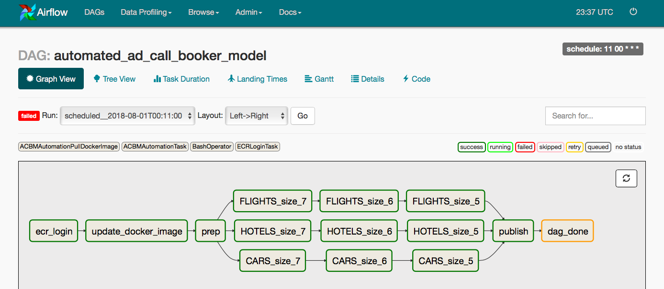
Automate modeling pipeline
Use Airflow to schedule pipelines
Train cohorts of models
Train all models supported by the data
Use the data to decide on model parameters (e.g. number of training days)
Uploads the jar and decides which cohort should be trained for each partner & product
Notes:
Questions to prepare for:
Why Airflow

Slide 35
Automate modeling pipeline
User Airflow to schedule pipelines
Train cohorts of models
Train all models supported by the data
Use the data to decide on model parameters (e.g. number of training days)
Inspect the available data and determine which models can actually be supported. Launch these training jobs, monitor and log reports

Slide 36
Automate modeling pipeline
User Airflow to schedule pipelines
Train cohorts of models
Train all models supported by the data
Use the data to decide on model parameters (e.g. number of training days)
Decide which models should be used for each site & product
(e.g. Expedia_JP hotels → Expedia_JP flights or Expedia_US hotels)

Slide 37
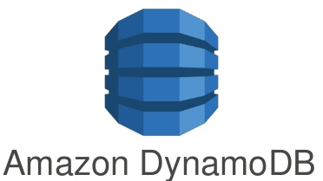




Automate modeling pipeline
Airflow logs feature-models to DynamoBD for publishing and monitoring
Airflow publishes feature-models directly to AWS Lambda or ECS for immediate predictions
Everything can also be triggered from a dev machine, so a test model can be deployed with a single command
Request
Prediction
Amazon ECS
Request
Amazon s3
Prediction
Amazon lambda
Notes:
Questions to prepare for:
Why Airflow
Why Snowflake etc

Slide 38
Automate modeling pipeline
Each part of the pipeline can be launched from dev environments
  Staging is per-user
Can publish to a Lambda for quick testing against production traffic
Automatically infer the correct model configurations
Train every model supported by the data
  New requests can be served immediately
Defined fallback logic if a model is unavailable
  Every request gets a response
Training jobs grouped into cohorts
  Defines a hierarchy of model importance
  Provides similar sized EMR clusters → avoids throttling
  Improved maintainability
Persistent and consistent record of every model, with feature extractors & transformations
  Traceability & monitoring
Deployment is atomic and consistent

Slide 39
Questions?
Notes:
Questions to prepare for:
How many people worked on this? 3-5
How many people are there on the DS team? 20-25 depending on how you define the ‘data’ team
Are you going to open source this? We have started to discuss doing so, but it might be some time before it’s ready
How long have you been using this? Went live quite recently, but have been testing/ using various parts of it for a while
What did you do before you had this platform? Managing the models manually used to be a major time sink for the team. As we onboarded more and more partners, it became clear that we would eventually not be able to keep up, which is what prompted this effort.
What other types of predictions do you make? We make various predictions for partners, which we typically past back to them for things like retargeting. We also do a lot of click based predictions for the advertiser side of the business, as well as various other internal predictions used during the ‘which experience to show’ decisions.
What has your up-time been? So far (touch wood) excellent.
General notes:
Remember that the old system wasn’t ‘bad’, this is just ‘better’
Remember that although the new system has been built for robustness, this doesn’t mean that the old system failed often

