Slide 1

PYTORCH - THE PLATFORM FOR ACCELERATING
AI RESEARCH TO PRODUCTION
JEFF
SMITH
ENG MANAGER
FACEBOOK AI RESEARCH

Slide 2
AGENDA
01
AI AT FACEBOOK
02
RESEARCH TO PRODUCTION
03
PYTORCH 1.0
04
HYBRID FRONTEND

Slide 3


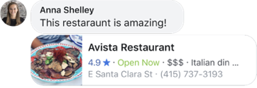

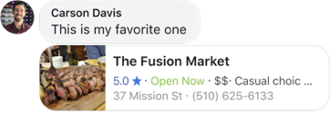
ENHANCING EXISTING PRODUCTS
SOCIAL
RECOMMENDATIONS
Notes:
AI makes existing products better – e.g.:
Social recommendations: use NLP to make suggestions from friends more useful
Machine translations
Accessibility: use CV to provide descriptions of photos for the visually impaired

Slide 4
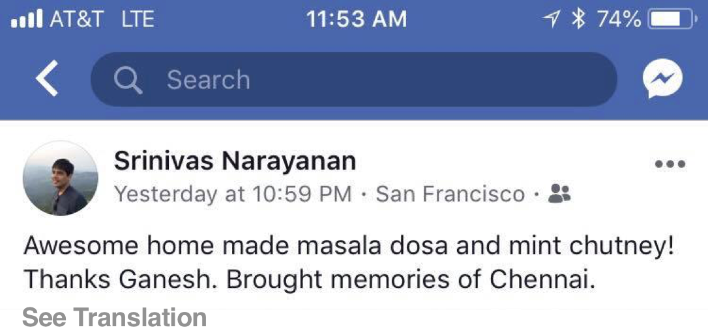
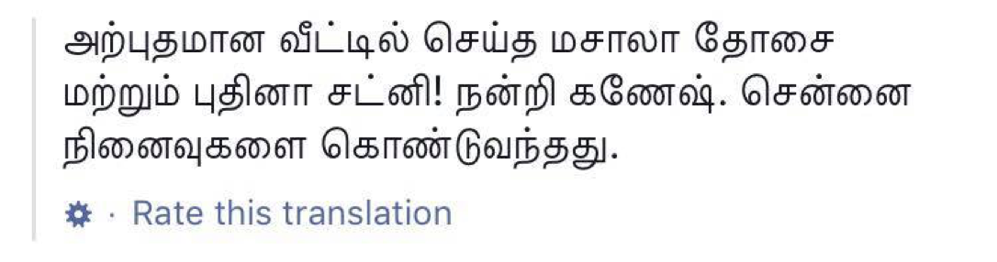
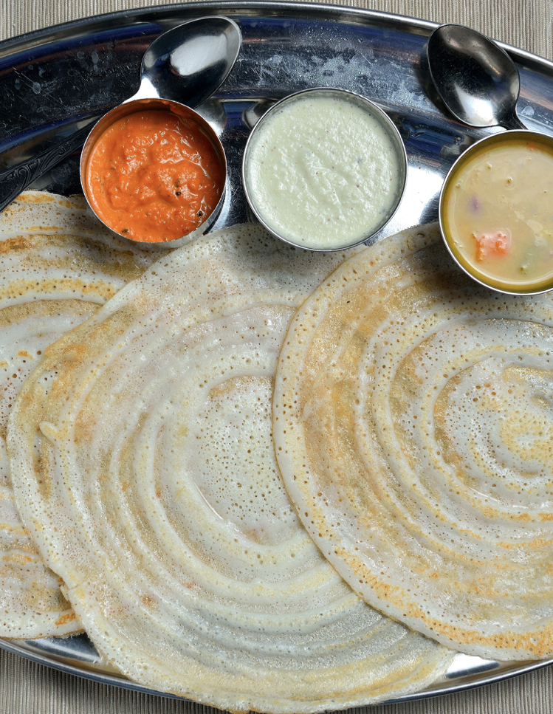
ENHANCING EXISTING PRODUCTS
SOCIAL
RECOMMENDATIONS
MACHINE
TRANSLATIONS
Notes:
AI makes existing products better – e.g.:
Social recommendations: use NLP to make suggestions from friends more useful
Machine translations
Accessibility: use CV to provide descriptions of photos for the visually impaired

Slide 5


ENHANCING EXISTING PRODUCTS
SOCIAL
RECOMMENDATIONS
MACHINE
TRANSLATIONS
ACCESSIBILITY
IMAGE CONTAINS
Diana and Hanna
on green bicycles
Riding bikes
in Santo Domingo
Biking near
a red building
Notes:
AI makes existing products better – e.g.:
Social recommendations: use NLP to make suggestions from friends more useful
Machine translations
Accessibility: use CV to provide descriptions of photos for the visually impaired

Slide 6

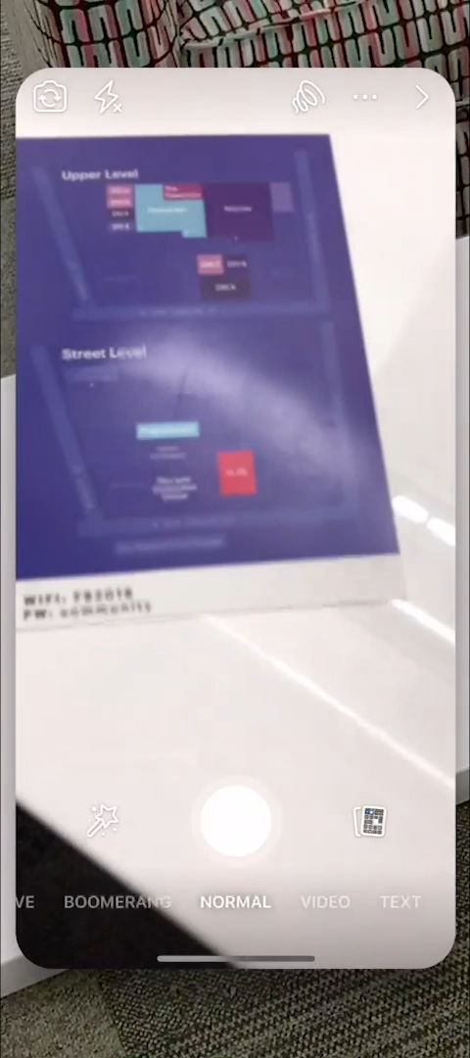
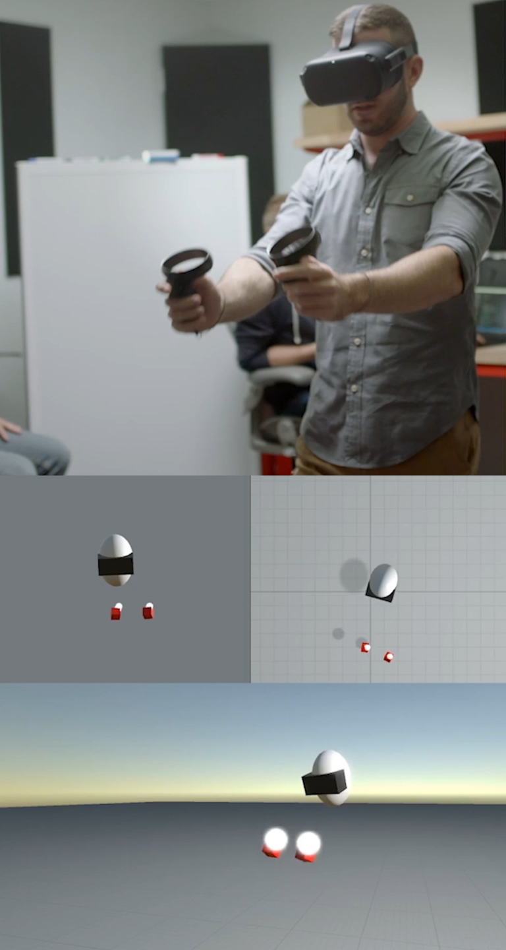
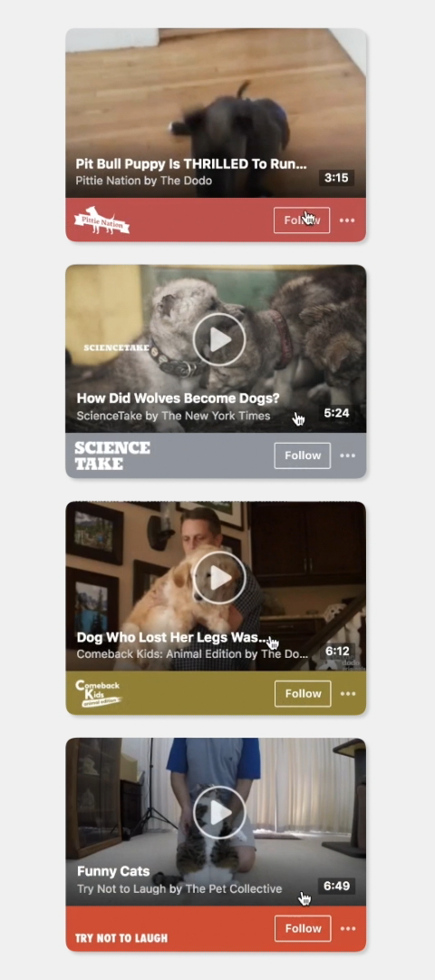
POWERING NEW EXPERIENCES
BOTS &
ASSISTANTS
GENERATED
CONTENT
AR
EFFECTS
VR
HARDWARE
Notes:
AI drives new experiences, e.g.:
Bots & assistants
Generated content – automatic thumbnails for videos on Watch tab
AR & VR

Slide 7






HELPING PROTECT COMMUNITY
SHARE
BAITING
SUICIDE
PREVENTION
Notes:
AI also helps us keep our communities safe, at global scale, e.g.:
Helps proactively fight spam, engagement bait, and other inappropriate content
Systems also proactively identify when individuals may be expressing thoughts of self-harm and suicide, and escalate the

Slide 8

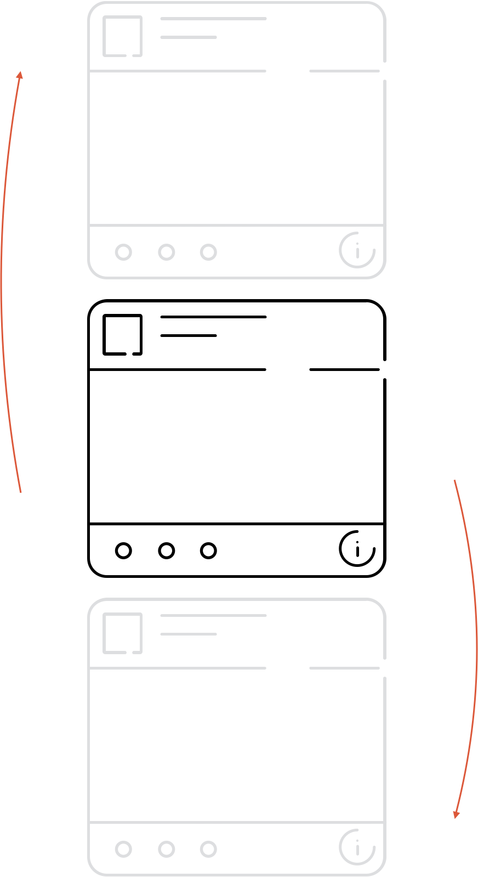













NEWS FEED & ADS CUSTOMIZATION
Notes:
AI can be of even greater value in the future – e.g.:
- Customizing feed by optimizing for value it gives you, rather than time spent

Slide 9



AI IS ADVANCING QUICKLY
REINFORCEMENT
LEARNING
COMPUTER
VISION
NATURAL LANGUAGE
PROCESSING
Notes:
Field of AI advancing quickly - just years ago, I wouldn't have predicted what's possible today
Not yet at AGI, but we are seeing extraordinary value from RL, CV, NLP, etc.
AI is fundamental to FB – central to our business (e.g. used in News Feed ranking & ads), but also makes existing products better, drives new experiences, helps keep our community safe - all at global scale.
From customizing the News Feed for billions of individuals, to providing detailed descriptions of photos for the visually impaired, to identifying and escalating cases where people may be expressing thoughts of self-harm - tools driven by AI are having a positive impact on the lives of the billions of people who use FB today

Slide 10
GOING FROM
RESEARCH TO
PRODUCTION

Slide 11
PREPARE
DATA
PREPARE
DATA
TRANSFER TO
PRODUCTION
DEPLOY &
SCALE
1
2
1
2
3
3
4
4
5
DETERMINE
APPROACH
BUILD &
TRAIN MODEL
DETERMINE
APPROACH
BUILD &
TRAIN MODEL
DEPLOY &
SCALE
Notes:
Historically, there's a lag between research to production - the tech transfer to take groundbreaking research into production at scale takes time. Often involves…
Step 1: Determine approach
Step 2: Prepare data
Step 3: Build & Train model
Step 4: Transfer proven model to production environment
Step 5: Deploy and scale
Good news is, this gap is shrinking. Taking a newly trained model and run it in a production environment at scale used to take years, and now can be done in months or even weeks in some instance.
e.g. Unsupervised translation work from FAIR, will be used in production at FB this year.
While progress has been made, there's more to be done. Closing the gap is an opportunity to significantly accelerate / increase AI's positive impact on the world
This is essential as we depend more and more on AI, and quickly deploying fresher models becomes business-critical - for example to address challenges like content moderation, accessibility, digital security, medical imaging / healthcare generally, productivity, etc
We believe that by minimizing/eliminating the difficulty of tech transfer, we can encourage more experimentation and progress the field faster, allowing a system created in research and can be brought to production in weeks/days

Slide 12

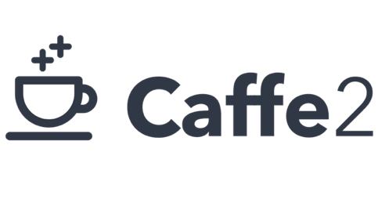

PROCESS
Research to Production at Facebook
Notes:
To get there, we need a better path to quickly bring innovations from research to production. As FAIR and other researchers push the state of the art, we want to ensure everyone can benefit from the latest advancements:
When joined FB, had different systems for research and production:

Slide 13
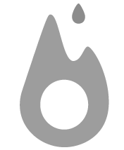
PROCESS
PyTorch
For Research
Flexibility & ease-of-use
Python-first design
Imperative front-end
Notes:
PyTorch for research - flexibility and ease-of-use made this popular with the research community early on - thousands of repos using PyTorch. It's well suited for experimentation because of its Python-first design and imperative front-end that makes building and debugging easier.

Slide 14

PROCESS
ONNX
For Interoperability
Open standard for deep learning models
Enabled porting PyTorch-trained models to other frameworks and platforms
Notes:
ONNX - we partnered with technology leaders to create an open standard for representing deep learning models. ONNX allowed us to port models trained in PyTorch to other frameworks and platforms for production deployment, and generally makes AI development tools more interoperable.

Slide 15
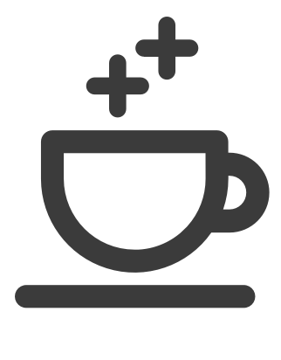
PROCESS
Caffe2
For Production
Robust & optimized for scale
From datacenters to mobile devices
Powering 300T predictions a day
Notes:
Caffe2 for production - another open source framework that is highly optimized for large scale production across data centers and mobile devices - this was the framework that powered many experiences on Facebook from automatic translations to camera effects. This tech is powering 300T predictions a day.

Slide 16
PROCESS
Research to Production at Facebook
PROTOTYPING
TRANSFERRING
DEPLOYING
Notes:
Each of these tools were optimized for different constraints/needs for each stage of development, with the side effect being that, bringing research to production tended to be long and difficult.
Anecdote / example of challenges bringing research to production in the past? e.g. time it takes to port a model from PT to Caffe2, or not having a C++ environment for PT for production needs, Caffe2's declarative graph not being great for experimentation, etc.
A unified, modular framework that can be leveraged across platforms and seamlessly transition between exploration and deployment is essential to further compressing the time needed to go from research to production

Slide 17

PROCESS
Research to Production at Facebook
PROTOTYPING
DEPLOYING
Notes:
With PyTorch 1.0, we're taking the first major step towards providing a unified, end-to-end framework that is designed to shrink/minimize the lag from research to production.
PyTorch 1.0 unifies the tools I just spoke about [PyTorch, ONNX, Caffe2] to provide a seamless workflow from research and flexible experimentation to robust production deployments at scale

Slide 18
PYTORCH
1.0

Slide 19
PYTORCH 1.0
A seamless path from AI
research to production
Notes:
It is an open and accessible platform that enables developers to push the state of the art in research, but also quickly scale to solve business needs

Slide 20

VISION
Build tools for transitioning from research to production
in the same environment
VALUES
Fully loaded: expose building blocks for performance and scaling
Opt-in: trade-off flexibility only when beneficial
Same environment: continuously refactor your model
Notes:
PyTorch established itself as a flexible modeling environment which is great for research and prototyping
However, when the idea is working, scaling it up to a larger dataset or tricky deployment environment is often a hassle.
With PyTorch 1 we want to expose all high-performance building blocks necessary for optimizing the model within the same familiar programming environment.
The functionality is opt-in – you’re free to use regular PyTorch for experimentation and then follow necessary tweaking and refactoring step to leverage perf improvements if you need them. Our goal is to make this process as smooth as possible.

Slide 21
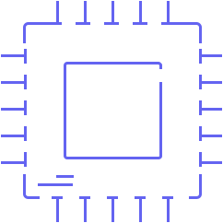


WHAT DOES PRODUCTIONIZATION MEAN?
HARDWARE
EFFICIENCY
Optimal performance
on CPU/GPU/custom
devices
SCALABILITY
Distributed training
Multithreading
Multitenancy
CROSS-
PLATFORM
In-service deployment
Mobile devices
C++ only environments
Notes:
What does bringing to production actually mean? Production systems often bring several constraints:
Hardware efficiency – many environment have very tight latency constraints, also at large scale underutilizing the hardware can significantly increase the cost
Scalability – running bigger datasets in training or millions of inferences per second with multiple models in inference
Platform constraints – NN models often need to be deployed within the target process with a lot of interdependence with the surrounding application or service. These constraints are particularly acute when deploying to the mobile devices.

Slide 22
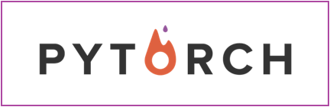
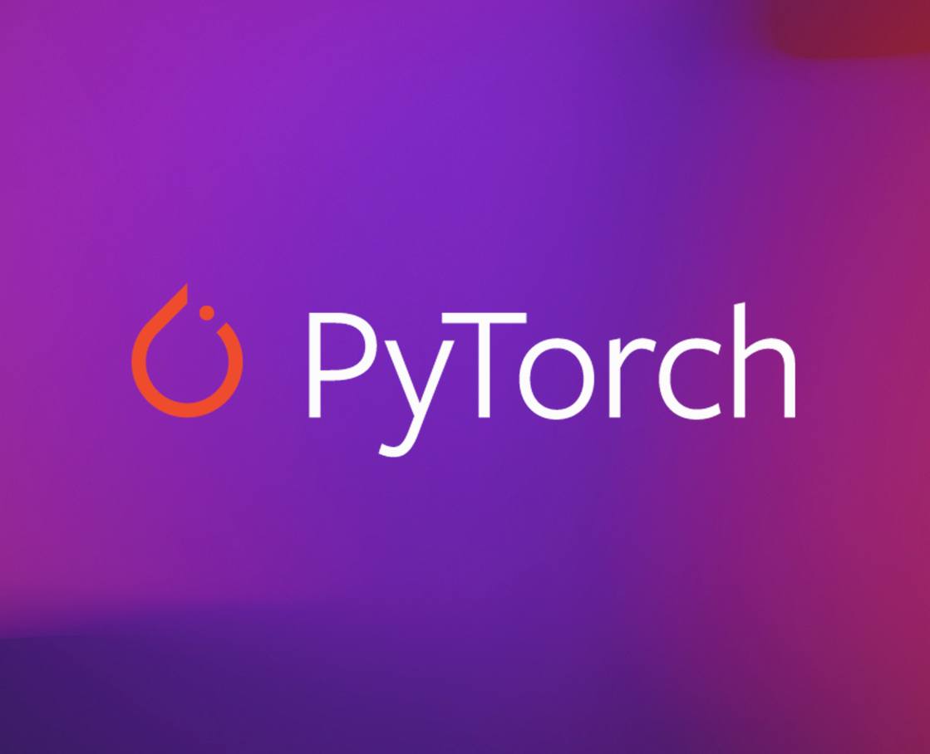
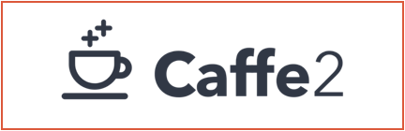
Exposing the best
of Caffe2 perf via PyTorch frontend
PyTorch 1.0 is the start of a journey, more is coming…
Notes:
Luckily, we’re not starting from scratch. As you know over the past several years Facebook developed Caffe2 deep learning framework with uncompromising focus on performance. For several years Caffe2 backend powered FB production use cases from the datacenter to more than a billion of mobile devices.
We’re viewing PyTorch 1.0 evolution as an ability to bring high-performance components and best practices we learnt to the broader community and expose them through the familiar PyTorch frontend.
Let’s take a look at some of the features that are part of PyTorch 1, but also stay tuned for integration of more high-perf components in future releases

Slide 23
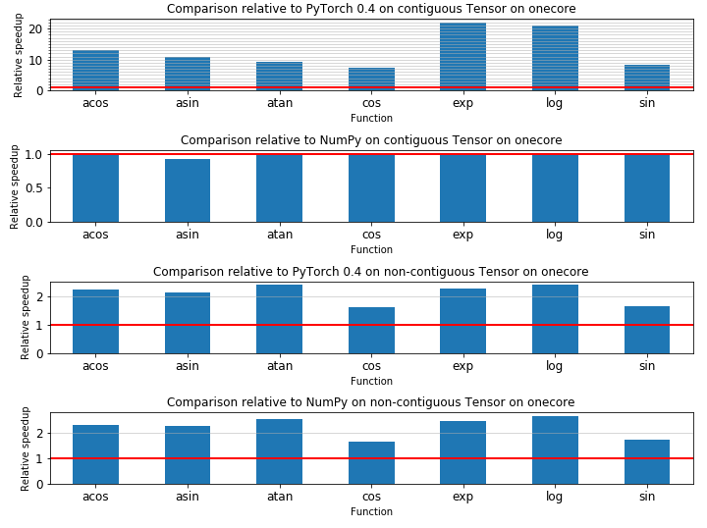
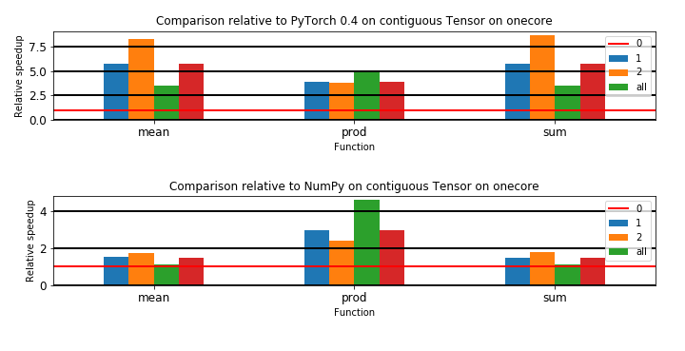
HARDWARE EFFICIENCY
Faster operator performance
In PyTorch 1.0:
Leveraging specialized libraries: MKL-DNN, CuDNN, etc
Faster implementations for dozens of basic tensor operations
What’s next:
Exposing all of the best operator implementations from Caffe2
Notes:
When running at scale of thousands of servers one doesn’t want to leave performance on the table.
PyTorch 1 leverages best vendor libraries like Cudnn and MKL-DNN. We also invested a lot of effort into optimizing core tensor operations – so expect stuff to run faster.
Going forward we will continue to expose best of Caffe2 kernels in PyTorch operator library.

Slide 24

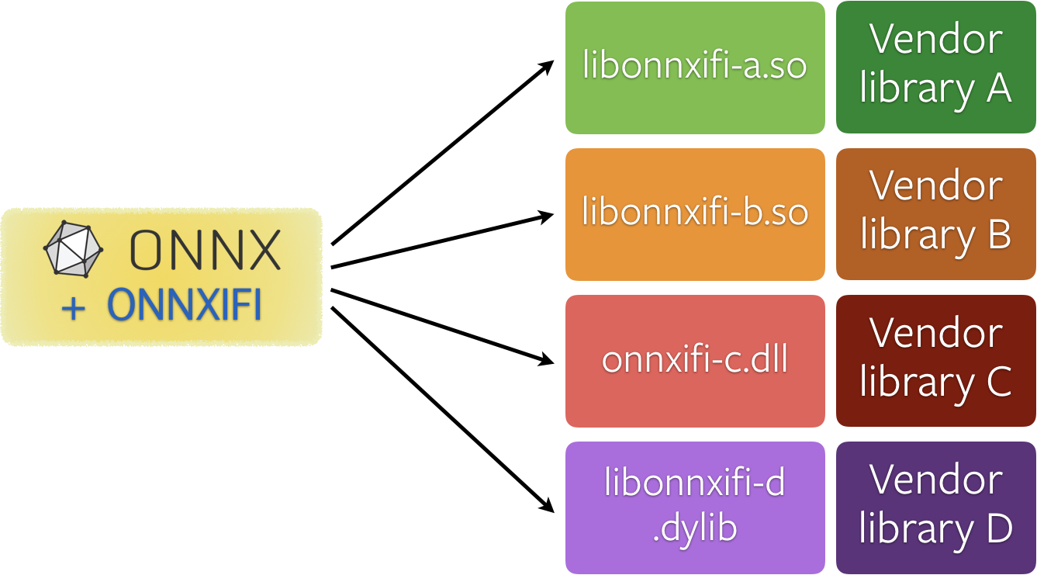
HARDWARE EFFICIENCY
Connecting to
ONNX Ecosystem
Vendor runtimes are best for running things fast.
In PyTorch 1.0:
Export entire model to ONNX for inference
What’s coming:
ONNXIFI runtimes as part of bigger model through JIT
Notes:
Getting the best performance out of hardware often requires performing graph-level optimization for mult-operator chunks of the program – for example, fusion or changing tensor layouts. Nobody can optimize for the target platforms better than the vendors themselves. Thus last year we co-created ONNX initiative to provide a standard interface to hardware accelerated runtimes – such as Nvidia TensorRT or Glow.
PyTorch supports ONNX export natively and we’re working on making it easy to accelerate only a part of the larger model through ONNXIFI runtime interface.

Slide 25
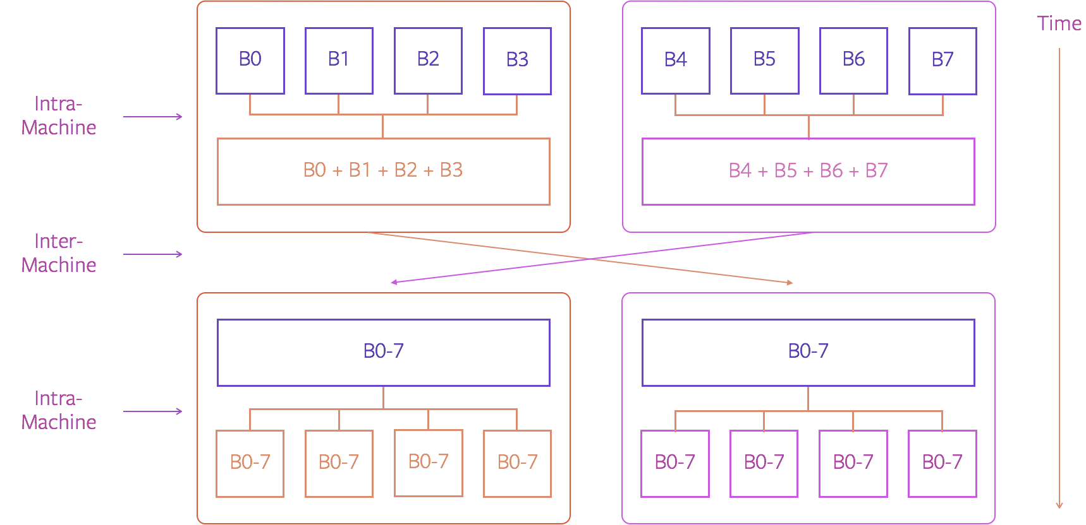
SCALABILITY
Distributed training
Challenges:
Scaling to hundreds of GPUs
Heterogeneous clusters, Ethernet/InfiniBand
Potentially unreliable nodes
In PyTorch 1.0:
Fully revamped distributed backend - c10d
Notes:
Scaling to production level datasets with billions of images or hundreds of billions of rows often brings challenges. Scaling to hundrerds of GPUs is not easy and requires high reliability. Also, production clusters often have heterogeneous nodes or have different mix of networking technologies.
That’s why in PyTorch 1.0 we’re releasing fully revamped distributed backend.

Slide 26
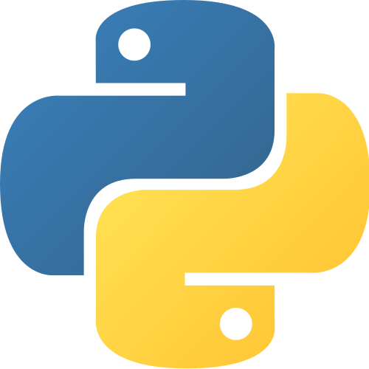
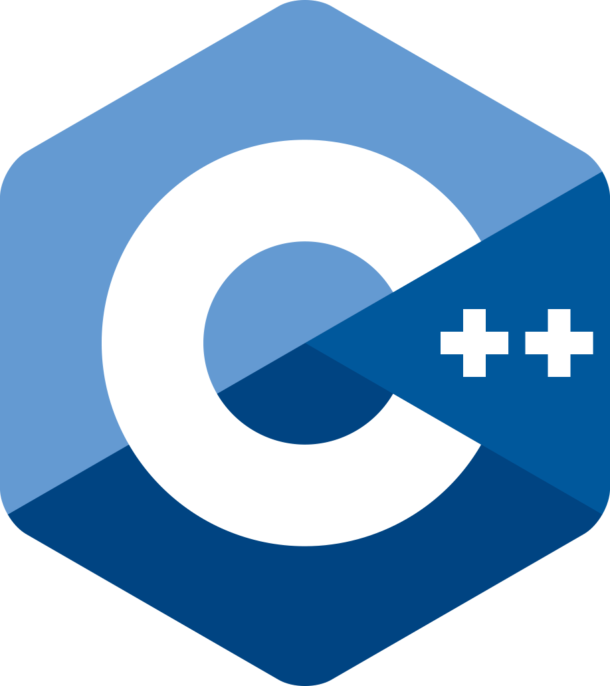
SCALABILITY & CROSS-PLATFORM
Deployment in C++
Often Python is not an option:
High overhead on small models
Multithreading services bottleneck on GIL
Deployment service might be C++ only
In PyTorch 1.0:
Convert inference part of the model to Torch Script
Link with libtorch.so in your C++ application
Torch Script
+ state_dict
Notes:
Python is a great environment for prototyping and often works just fine for large scale training when the individual operations are beefy enough. But the overhead of the interpreter and in particularly GIL becomes a bottleneck on small models or when the target service needs to run multiple models on different threads creating contention. Even more, many environment, like robotics or many prod clusters, just don’t permit running python interpreter all together.
Thus with PyTorch 1.0 and JIT we’re building tools to extract the inference part of the model out of the python script and run it on a small embeddable runtime of Pytorch within the target application. Just link your binary with libtorch.so and utilize simple C++ api to load and execute the model.

Slide 27
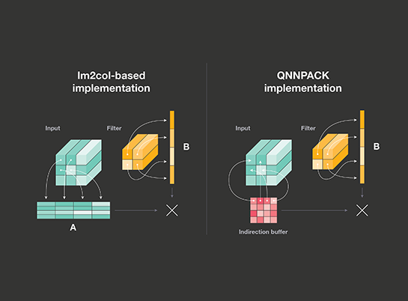
HARDWARE EFFICIENCY
Quantization
Why reduced precision:
2-4x speed improvements in various Facebook applications
Just released
High performance kernels for int8 compute – FBGEMM and QNNPACK
Coming in future release:
Quantized tensors in PyTorch runtime
TorchScript model rewrites for inference
Quantization-aware training support utils
Notes:
Let’s now talk about some of the features that will be coming in future releases of PyTorch.
Running efficiently on modern hardware often requires converting the models to lower precision. 16 or even 8 bit arithmetic takes much less chip space and energy than 32 bit compute. With the right tricks switching to lower precision doesn’t affect model accuracy substantially - we saw speed ups up to 2-4x in various Facebook improvements.
We’re going to open-source some of the libraries for efficient int8 compute for both server and mobile later this fall. Going forward – we’re working on smoothly integrating quantized compute in PyTorch abstractions as well as recipes for quantizing existing models – this functionality will be available in future releases.

Slide 28
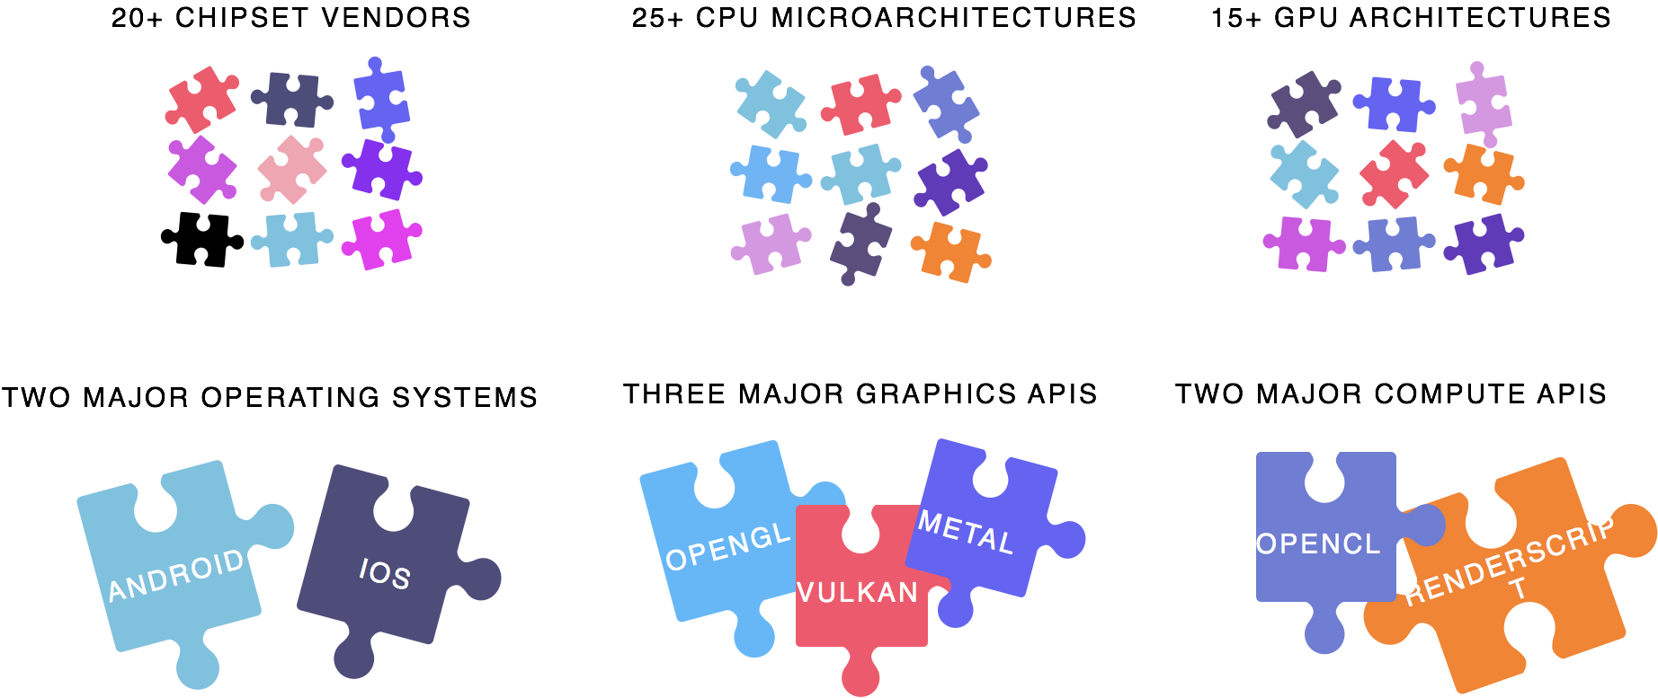

CROSS-PLATFORM
Mobile deployment
Fragmentation
Constraints
Code and model
size limits
Restricted compute
and battery
Notes:
Running neural networks on mobile devices is challenging. First, there’s no single platform – one has to deal with two OSs, more than 20 different chipsets and CPU architectures and several compute APIs.
Also, mobile devices usually have hard constraints on model and code size as well as at compute and power consumption of the model.

Slide 29
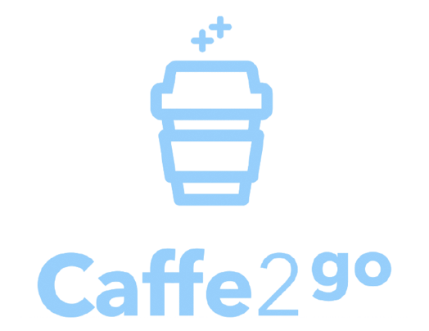
CROSS-PLATFORM
Mobile deployment
Today:
Caffe2go is available through
ONNX export for simple models
Coming in future releases:
Mobile deployment pipeline as part of PyTorch ecosystem
Notes:
At Facebook we’ve developed lightweight Caffe2go mobile engine that ships and runs on more than a billion mobile phones.
You can use this engine right now through the ONNX export. We’re going to expose it together with revamped mobiles pipeline in upcoming releases.

Slide 30
TIMELINE
Quantization
Mobile
ONNXIFI
…
C++ deployment
Revamped distributed
Faster operator library
ONNX export
1.0.0
Future releases
Notes:
PyTorch 1.0 ships with core features to address your deployment needs. But it’s only beginning of the journey – we’re committed to provide the smoothest experience of bridging research and production gap and expose all the performance goodies through the familiar pytorch interface

Slide 31

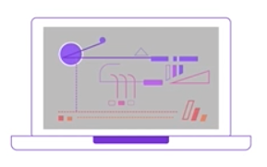

Torch.JIT to capture and optimize PyTorch code
EXPERIMENT
Full flexibility of PyTorch
EXTRACT TorchScript
Torch.JIT to extract parts of compute
OPTIMIZE & DEPLOY
Whole program optimizations
Deploy without Python
Notes:
Applying many of the techniques described requires optimization for bigger chunks of model structure or applying automatic recipes.
Our approach is to capture structure of your PyTorch model with minimal changes to the source code. That’s the goal of JIT it to make this process seamless.

Slide 32
HYBRID
FRONTEND

Slide 33
Matrix a = ...;
Matrix b = ...;
Matrix c = ...;
scalar s = 7;
d = s * a + b;
e = matmul(c, d);
if s > 0 {
x = d;
} else {
x = e;
}
while s > 0 {
x = input();
c = matmul(c, x);
}
result = c;
Matrix<6, 9> a = ...;
Matrix<6, 9> b = ...;
Matrix<16, 6> c = ...;
scalar s = 7;
d = s * a + b;
e = matmul(c, d);
x = if_clause(s > 0, d, e);
while_loop(s > 0, [x, c], lambda x,c {
x = input();
c = matmul(c, x);
});
result = evaluate(x);
EAGER
STATIC

Slide 34
PROGRAM
PROGRAM
GRAPH
RESULT
GRAPH
RESULT
EAGER
STATIC

Slide 35
PRO
— No boundaries on flexibility
— Happier debugging
— No expensive compilation
CONTRA
— Harder to optimize
— Harder to deploy
EAGER

Slide 36
PRO
PRO
— No boundaries on flexibility
— Happier debugging
— No expensive compilation
— Easier to optimize
— Easier to deploy
— Easier to post-process
CONTRA
CONTRA
— Harder to optimize
— Harder to deploy
— Harder to understand
— Harder to debug
— Less flexible
EAGER
STATIC

Slide 37
PyTorch
Models are Python program,
autograd for derivatives
+ Simple
+ Debuggable — print and pdb
+ Hackable — use any Python library
Notes:
People really like PyTorch's eager execution model.
Your model is just native python code.
Autograd allows you to take a derivative of whatever code runs.
Because everything is just native python, all your favorite tools for debugging, including printing and gdb just work.
If you want to use an obscure Python library in the middle of your model, there is absolutely no friction to doing so.
In practice, many of the fundamental new models start this way, with hacky prototype code that glues different python libraries together.
This workflow has been great for prototyping, but for the small amount of models that you do want to widely deploy, this workflow has some issues.

Slide 38
PyTorch
Eager Mode
PyTorch
Script Mode
Models are Python program,
autograd for derivatives
+ Simple
+ Debuggable — print and pdb
+ Hackable — use any Python library
– Needs Python to run
– Difficult to optimize and parallelize
Models are programs written in
an optimizable subset of Python
+ Production deployment
+ No Python dependency
+ Optimizable
Notes:
The models are closely coupled with Python.
The Python interpreter needs to be present to run the model.
This isn't always convenient or possible, especially on mobile.
It can hamper the ability to get multi-threaded performance.
Furthermore, all the dynamic features of the Python language make it difficult to optimize the program,
for instance performing operator fusion or algebraic simplification.
To address these uses of PyTorch, we built another way to express PyTorch programs that allows them to be run independently from Python.
<> PyTorch as you use it today will exist unchanged, and we refer to this mode as eager mode.
<> In addition to eager mode, we have added a "script" mode.
In this mode models are expressed in an optimizable subset of the Python that we can run without the python interpreter.
This subset contains all the building blocks necessary to build models:
Tensors and fundamental ops like matrix multiply and convolution
traditional language features like if statements and loops.
But it restricts the dynamic behaviors in Python that make it difficult to optimize.

Slide 39
PYTORCH JIT
Tools to transition eager code into script mode
EAGER
MODE
@torch.jit.script
SCRIPT
MODE
torch.jit.trace
For prototyping, training,
and experiments
For use at scale
in production
Notes:
Because we believe in the flexibility of eager mode for prototyping, we expect most users will first write programs in that form.
For the small subset of successful models that you actual want to put into production, the PyTorch JIT provides tools for taking code originally written in eager mode,
and annotating it so it is possible to run it in script mode.
The tools we provide allow this transition to happen gradually function-by-function and module-by-module. This 'hybrid' use of the frontends allows you to incrementally make changes and check that nothing has broken before continuing.
The JIT offers two techniques for doing this annotation: tracing and scripting.

Slide 40
CONVERTING TO TORCH SCRIPT VIA TRACING
import torch
import torchvision
# An instance of your model.
model = torchvision.models.resnet18()
# An example input you would normally provide to your model's forward() method.
example = torch.rand(1, 3, 224, 224)
# Use torch.jit.trace to generate a torch.jit.ScriptModule via tracing.
traced_script_module = torch.jit.trace(model, example)

Slide 41
EVALUATING A TRACED MODEL
In[1]: output = traced_script_module(torch.ones(1, 3, 224, 224))
In[2]: output[0, :5]
Out[2]: tensor([-0.2698, -0.0381, 0.4023, -0.3010, -0.0448], grad_fn=<SliceBackward>)

Slide 42
CONVERTING TO TORCH SCRIPT VIA ANNOTATION
import torch
class MyModule(torch.nn.Module):
def __init__(self, N, M):
super(MyModule, self).__init__()
self.weight = torch.nn.Parameter(torch.rand(N, M))
def forward(self, input):
if input.sum() > 0:
output = self.weight.mv(input)
else:
output = self.weight + input
return output
@torch.jit.script_method

Slide 43
SERIALIZING YOUR SCRIPT MODULE TO A FILE
traced_script_module.save("model.pt")

Slide 44
A MINIMAL C++ APPLICATION
#include <torch/script.h> // One-stop header.
#include <iostream>
#include <memory>
int main(int argc, const char* argv[]) {
if (argc != 2) {
std::cerr << "usage: example-app <path-to-exported-script-module>\n";
return -1;
}
// Deserialize the ScriptModule from a file using torch::jit::load().
std::shared_ptr<torch::jit::script::Module> module = torch::jit::load(argv[1]);
assert(module != nullptr);
std::cout << "ok\n";
}

Slide 45
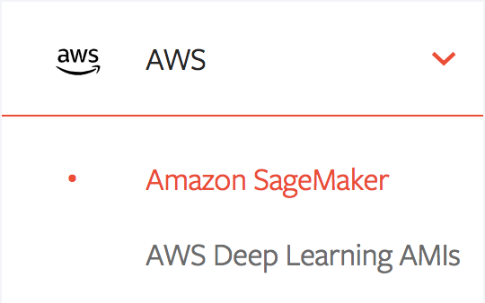
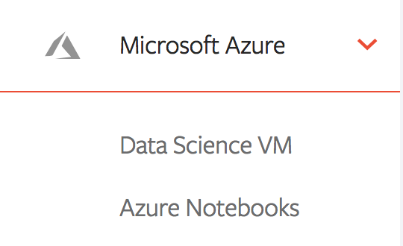
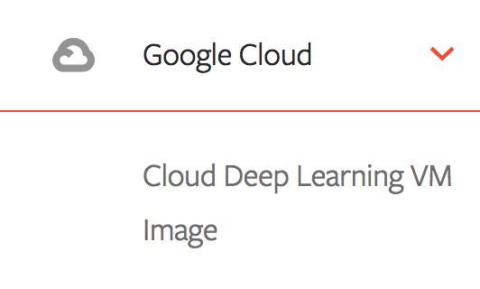
Deploy to the cloud
AWS
Using SageMaker
MICROSOFT AZURE
Using Azure Machine Learning
GOOGLE CLOUD
Using PyTorch Deep Learning VM
and, soon, TPUs
Notes:
PyTorch builds with a preview of this functionality are available today, and our website contains tutorials and documentation to get you started.

Slide 46
C++ dependency and build setup elided for brevity
For more details https://pytorch.org/tutorials/advanced/cpp_export.html

Slide 47
EXAMPLE EXECUTION
// Create a vector of inputs.
std::vector<torch::jit::IValue> inputs;
inputs.push_back(torch::ones({1, 3, 224, 224}));
// Execute the model and turn its output into a tensor.
auto output = module->forward(inputs).toTensor();
std::cout << output.slice(/*dim=*/1, /*start=*/0, /*end=*/5) << '\n';

Slide 48
BUILDING THE MINIMAL APPLICATION
root@4b5a67132e81:/example-app/build# make
Scanning dependencies of target example-app
[ 50%] Building CXX object CMakeFiles/example-app.dir/example-app.cpp.o
[100%] Linking CXX executable example-app
[100%] Built target example-app

Slide 49
EXECUTING THE SCRIPT MODULE FROM THE C++ APPLICATION
root@4b5a67132e81:/example-app/build# ./example-app model.pt
-0.2698 -0.0381 0.4023 -0.3010 -0.0448
[ Variable[CPUFloatType]{1,5} ]

Slide 50
EVALUATING A TRACED MODEL FROM PYTHON
In[1]: output = traced_script_module(torch.ones(1, 3, 224, 224))
In[2]: output[0, :5]
Out[2]: tensor([-0.2698, -0.0381, 0.4023, -0.3010, -0.0448], grad_fn=<SliceBackward>)

Slide 51
What subset of PyTorch is valid Torch Script?
✓ Tensors and numeric primitives
✓ If statements
✓ Simple loops
✓ Code organization using nn.Module
✓ Tuples, Lists
✓ print and strings
✓ Gradients propagation through script functions
✗ In-place updates to tensors or lists
✗ Direct use of standard nn.Modules like
nn.Conv (trace them instead!)
✗ Calling grad() or backwards()
within @script
Coming in 1.0 stable
For more details https://pytorch.org/docs/master/jit.html#torch-script-language-reference
Notes:
In our current preview release, Torch Script supports a small but usable set of Python….
A few important features are not yet implemented but will added for the stable release.
This includes doing in place updates to tensors or lists, and using existing nn.Modules like Conv2D directly from script.
In latter case, we suggest you trace the modules like Conv2D instead.
We also don’t allowing calling gradient functions from inside script – it is perfectly fine to return the loss from script and call backward there though.
We expect to have these features implemented for the coming 1.0 stable release, and a more detailed guide for what is possible is available in our documentation.

Slide 52
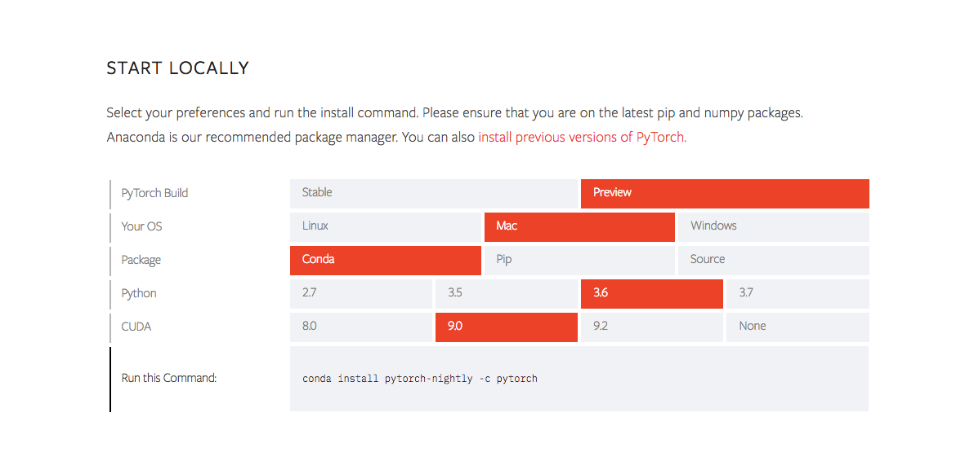
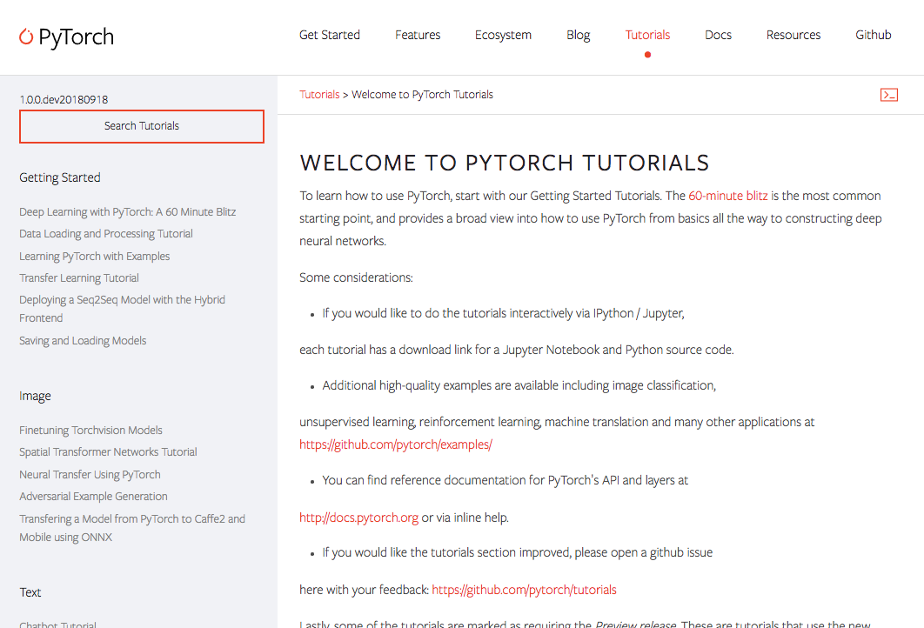
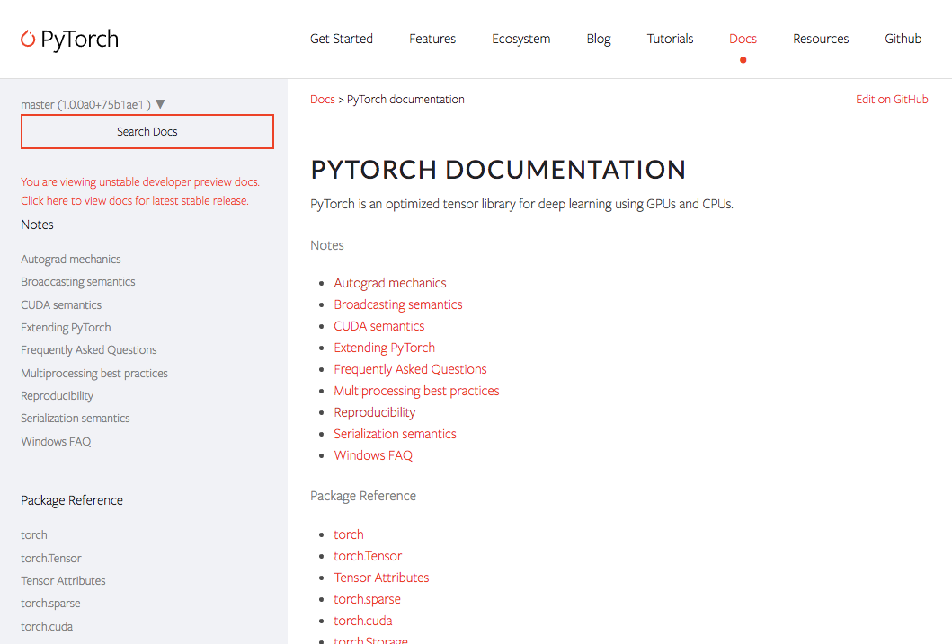
PREVIEW RELEASE
Try the hybrid frontend today
INSTALL
Using the nightly preview builds of PyTorch
TUTORIALS
How to use tracing and script to export a sequence to sequence model.
DOCS
API and language reference for Torch Script
Notes:
PyTorch builds with a preview of this functionality are available today, and our website contains tutorials and documentation to get you started.

Slide 53
THANK YOU

